Slide 1
GraphQL

Slide 2
Helpful resources
Language Basics: https://medium.com/volosoft/building-graphql-apis-with-asp-net-core-419b32a5305b
GraphQLHub: https://www.graphqlhub.com/playground
Dotnet quick start: https://dev.to/dotnet/learn-how-you-can-use-graphql-in-net-core-and-c-4h96

Slide 3
Use Case
Netflix
https://medium.com/netflix-techblog/our-learnings-from-adopting-graphql-f099de39ae5f

Slide 4
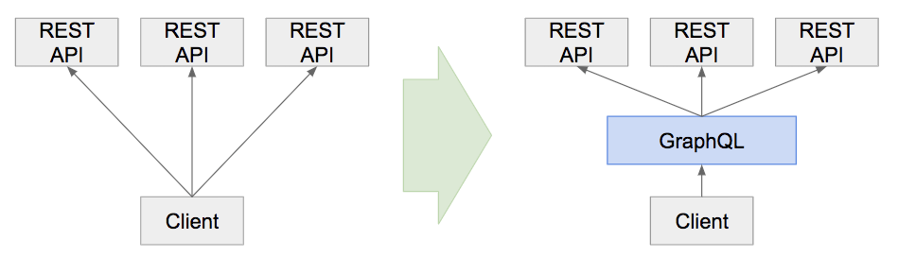
Benefits
Redistributing load and payload optimization
Reusable abstractions
Chaining type systems
DI/DX — Simplifying development

Slide 5
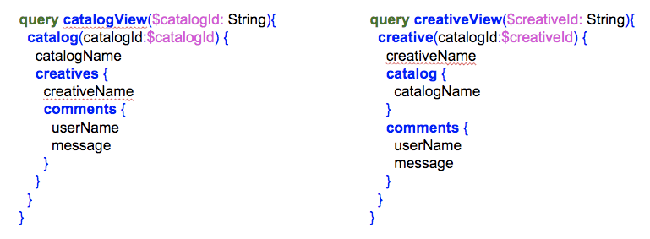
Reusable abstractions

Slide 6
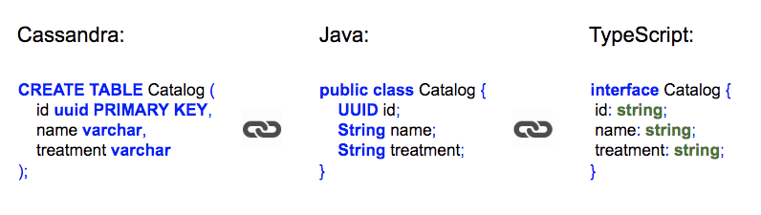
Chaining type systems
Once we defined the entities in our GraphQL server, we use auto codegen tools to generate TypeScript types for the client application.

