Slide 1
Gender identification using fingerprint
Batch no : G-23
Nithish kumar .B
Malleshvaran .R

Slide 2
abstRacT
Information on the gender of a person plays a vital role in crime investigation, authentication and statistical report on the visitors.
As a novel method, the optimal score assignment (OSA) method is proposed to classify gender. An optimal score is calculated for male and female from the internally collected fingerprint database.
Fingerprints are collected under four age groups and all the fingers are scanned. For the fingerprint image ‘I’ for which gender is to be identified, scores are assigned for ridge count and fingertip assuming that the given image is male.

Slide 3
introdution
Ridge patterns exhibit many properties that reflect the biology of individuals. Ridge parameters such as fingerprint ridge count, ridge density, ridge thickness to valley thickness ratio, ridge width and fingerprint pattern types are used for gender determination.
In this manuscript, automatic gender identification from the fingerprint ridge count (RC) and fingertip size (FTS) using the OSA method is proposed.
Initially, core and delta (singular points) are identified. With respect to core and delta, RCs are determined (traditional method) and in addition, ridge counts measured diagonally (at 45° and 135°) with respect to the core points are averaged. Fingertip size is measured as another parameter to find gender.

Slide 4
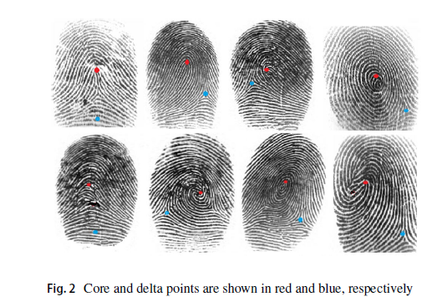
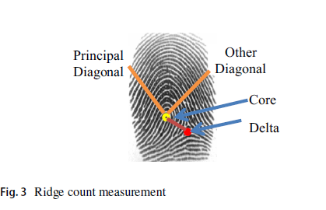
Ridge COUNT MEASUREMENT

Slide 5
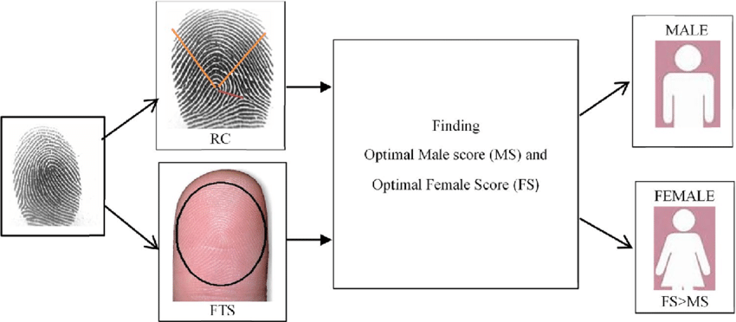
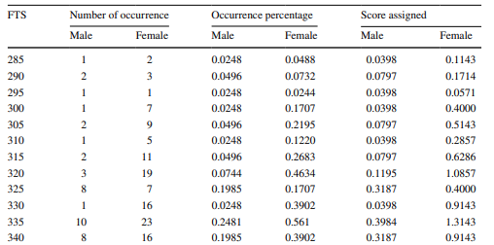
FINGERTIP SIZE VARIATION

Slide 6
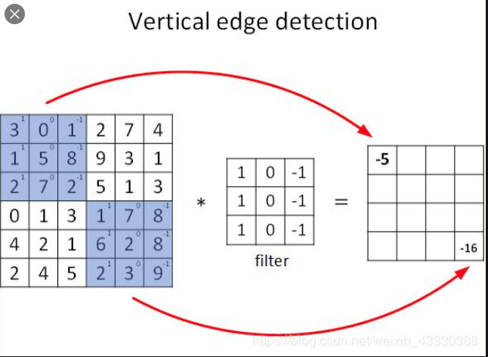
CONVOLUTIONAL NEURAL NETWORKS(CNN)
Convolutional Neural Networks (CNNs) process data by mimicking the visual processing of the human brain, starting with an input layer that represents data, such as images, as grids of pixel values. They apply a series of convolutional layers using filters to detect features in the data, producing feature maps that highlight patterns like edges or textures.

Slide 7
REFERENCE
TOPIC : Gender Classification from Fingerprint Using Hybrid CNN-SVM
Year : 2023
https://doi.org/10.37965/jait.2023.0192

