Slide 1
COMPLETE
BUSINESS
STATISTICS
by
AMIR D. ACZEL
&
JAYAVEL SOUNDERPANDIAN
6th edition (SIE)

Slide 2
Chapter 1
Introduction and Descriptive Statistics

Slide 3
Introduction and Descriptive Statistics
1
Using Statistics
Percentiles and Quartiles
Measures of Central Tendency
Measures of Variability
Grouped Data and the Histogram
Skewness and Kurtosis
Relations between the Mean and Standard Deviation
Methods of Displaying Data
Exploratory Data Analysis
Using the Computer

Slide 4
LEARNING OBJECTIVES
1
After studying this chapter, you should be able to:
Distinguish between qualitative data and quantitative data.
Describe nominal, ordinal, interval, and ratio scales of measurements.
Describe the difference between population and sample.
Calculate and interpret percentiles and quartiles.
Explain measures of central tendency and how to compute them.
Create different types of charts that describe data sets.
Use Excel templates to compute various measures and create charts.

Slide 5
WHAT IS STATISTICS?
Statistics is a science that helps us make better decisions in business and economics as well as in other fields.
Statistics teaches us how to summarize, analyze, and draw meaningful inferences from data that then lead to improve decisions.
These decisions that we make help us improve the running, for example, a department, a company, the entire economy, etc.

Slide 6
1-1. Using Statistics (Two Categories)
Descriptive Statistics
  Collect
  Organize
  Summarize
  Display
  Analyze
Inferential Statistics
  Predict and forecast values of population parameters
  Test hypotheses about values of population parameters
  Make decisions

Slide 7
Types of Data - Two Types
Qualitative - Categorical or Nominal:
Examples are-
  Color
  Gender
  Nationality
Quantitative - Measurable or Countable:
Examples are-
  Temperatures
  Salaries
  Number of points scored on a 100
  point exam

Slide 8
Scales of Measurement
  Nominal Scale - groups or classes
    Gender
  Ordinal Scale - order matters
    Ranks (top ten videos)
  Interval Scale - difference or distance matters – has arbitrary zero value.
    Temperatures (⁰F, ⁰C)
  Ratio Scale - Ratio matters – has a natural zero value.
    Salaries

Slide 9
Samples and Populations
A population consists of the set of all measurements for which the investigator is interested.
A sample is a subset of the measurements selected from the population.
A census is a complete enumeration of every item in a population.

Slide 10
Simple Random Sample
Sampling from the population is often done randomly, such that every possible sample of equal size (n) will have an equal chance of being selected.
A sample selected in this way is called a simple random sample or just a random sample.
A random sample allows chance to determine its elements.

Slide 11
Samples and Populations
Population (N)
Sample (n)

Slide 12
Why Sample?
Census of a population may be:
  Impossible
  Impractical
  Too costly

Slide 13
1-2 Percentiles and Quartiles
Given any set of numerical observations, order them according to magnitude.
The P^{th} percentile in the ordered set is that value below which lie P% (P percent) of the observations in the set.
The position of the P^{th} percentile is given by (n + 1)P/100, where n is the number of observations in the set.

Slide 14
Example 1-2
A large department store collects data on sales made by each of its salespeople. The number of sales made on a given day by each of
20 salespeople is shown on the next slide. Also, the data has been sorted in magnitude.

Slide 15
Example 1-2 (Continued) - Sales and Sorted Sales
Sales Sorted Sales
9 6
6 9
12 10
10 12
13 13
15 14
16 14
14 15
14 16
16 16
17 16
16 17
24 17
21 18
22 18
18 19
19 20
18 21
20 22
17 24

Slide 16
Example 1-2 (Continued) Percentiles
Find the 50th, 80th, and the 90th percentiles of this data set.
To find the 50th percentile, determine the data point in position (n + 1)P/100 = (20 + 1)(50/100)
= 10.5.
Thus, the percentile is located at the 10.5th position.
The 10th observation is 16, and the 11th observation is also 16.
The 50th percentile will lie halfway between the 10th and 11th values (which are both 16 in this case) and is thus 16.

Slide 17
Example 1-2 (Continued) Percentiles
To find the 80th percentile, determine the data point in position (n + 1)P/100 = (20 + 1)(80/100) = 16.8.
Thus, the percentile is located at the 16.8th position.
The 16th observation is 19, and the 17th observation is also 20.
The 80th percentile is a point lying 0.8 of the way from 19 to 20 and is thus 19.8.

Slide 18
Example 1-2 (Continued) Percentiles
To find the 90th percentile, determine the data point in position (n + 1)P/100 = (20 + 1)(90/100) = 18.9.
Thus, the percentile is located at the 18.9th position.
The 18th observation is 21, and the 19th observation is also 22.
The 90th percentile is a point lying 0.9 of the
way from 21 to 22 and is thus 21.9.

Slide 19
Quartiles – Special Percentiles
Quartiles are the percentage points that break down the ordered data set into quarters.
The first quartile is the 25th percentile. It is the point below which lie 1/4 of the data.
The second quartile is the 50th percentile. It is the point below which lie 1/2 of the data. This is also called the median.
The third quartile is the 75th percentile. It is the point below which lie 3/4 of the data.

Slide 20
Quartiles and Interquartile Range
The first quartile, Q₁, (25th percentile) is
often called the lower quartile.
The second quartile, Q₂, (50th
percentile) is often called the median
or the middle quartile.
The third quartile, Q₃, (75th percentile)
is often called the upper quartile.
The interquartile range is the difference
between the first and the third quartiles.

Slide 21
Example 1-3: Finding Quartiles
Sorted
Sales Sales
9 6
6 9
12 10
10 12
13 13
15 14
16 14
14 15
14 16
16 16
17 16
16 17
24 17
21 18
22 18
18 19
19 20
18 21
20 22
17 24
(n+1)P/100
Quartiles
Position
First Quartile
(20+1)25/100=5.25
13 + (.25)(1) = 13.25
Median
(20+1)50/100=10.5
16 + (.5)(0) = 16
Third Quartile
(20+1)75/100=15.75
18+ (.75)(1) = 18.75

Slide 22
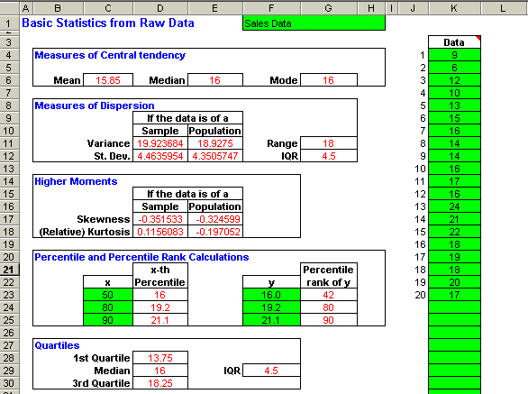
Example 1-3: Using the Template
(n+1)P/100
Quartiles

Slide 23
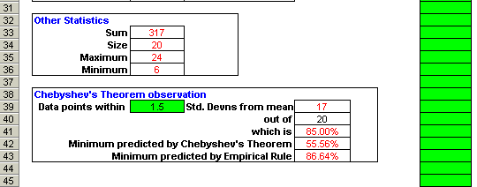
Example 1-3 (Continued): Using the Template
(n+1)P/100
Quartiles
This is the lower part of the same template from the previous slide.

Slide 24
Summary Measures: Population Parameters Sample Statistics
Measures of Central Tendency
  Median
  Mode
  Mean
Measures of Variability
  Range
  Interquartile range
  Variance
  Standard Deviation
Other summary measures:
  Skewness
  Kurtosis

Slide 25
1-3 Measures of Central Tendency or Location
•
Median
Middle value when
sorted in order of
magnitude
50th percentile
•
Mode
Most frequently-
occurring value
•
Mean
Average

Slide 26
Example – Median (Data is used from Example 1-2)
Sales Sorted Sales
9 6
6 9
12 10
10 12
13 13
15 14
16 14
14 15
14 16
16 16
17 16
16 17
24 17
21 18
22 18
18 19
19 20
18 21
20 22
17 24
See slide # 21 for the template output
Median
50th Percentile
(20+1)50/100=10.5
16 + (.5)(0) = 16
Median
The median is the middle value of data sorted in order of magnitude. It is the 50th percentile.

Slide 27
Example - Mode (Data is used from Example 1-2)
See slide # 21 for the template output
.
. . . . . : . : : : . . . . .
---------------------------------------------------------------
6 9 10 12 13 14 15 16 17 18 19 20 21 22 24
Mode = 16
The mode is the most frequently occurring value. It is the value with the highest frequency.

Slide 28
Arithmetic Mean or Average
The mean of a set of observations is their average - the sum of the observed values divided by the number of observations.
Population Mean
Sample Mean
N
n
∑
x
∑
x
μ
=
i
=
1
x
=
i
=
1
N
n

Slide 29
Example – Mean (Data is used from Example 1-2)
Sales
9
6
12
10
13
15
16
14
14
16
17
16
24
21
22
18
19
18
20
17
n
∑
x
317
x
=
i
=
1
=
=
15
.
85
n
20
See slide # 21 for the template output
317

Slide 30
Example - Mode (Data is used from Example 1-2)
.
. . . . . : . : : : . . . . .
---------------------------------------------------------------
6 9 10 12 13 14 15 16 17 18 19 20 21 22 24
Mean = 15.85
Median and Mode = 16
See slide # 21 for the template output

Slide 31
1-4 Measures of Variability or Dispersion
Range
  Difference between maximum and minimum values
Interquartile Range
  Difference between third and first quartile (Q₃ - Q₁)
Variance
  Average*of the squared deviations from the mean
Standard Deviation
  Square root of the variance
∗ Definitions of population variance and sample variance differ slightly.

Slide 32
Example - Range and Interquartile Range (Data is used from Example 1-2)
Sorted
Sales Sales Rank
9 6 1
6 9 2
12 10 3
10 12 4
13 13 5
15 14 6
16 14 7
14 15 8
14 16 9
16 16 10
17 16 11
16 17 12
24 17 13
21 18 14
22 18 15
18 19 16
19 20 17
18 21 18
20 22 19
17 24 20
Range:
Maximum - Minimum =
24 - 6 = 18
Minimum
Q₁ = 13 + (.25)(1) = 13.25
First Quartile
See slide # 21 for the template output
Q₃ = 18+ (.75)(1) = 18.75
Third Quartile
Interquartile Range:
Q3 - Q1 =
18.75 - 13.25 = 5.5
Maximum

Slide 33
Variance and Standard Deviation
Population Variance
Sample Variance
n
−
N
∑
(
x
x
)
2
∑
(
x
−
μ
)
2
s
2
=
i
=
1
σ
2
=
i
=
1
(
n
−
1
)
N
(
)
(
)
N
2
n
2
∑
x
∑
x
N
=
n
−
i
=
1
∑
x
2
−
i
1
∑
x
2
N
=
=
n
=
i
=
1
i
1
N
(
n
−
1
)
σ
=
σ
2
s
=
s
2

Slide 34


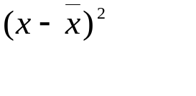
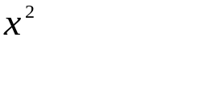
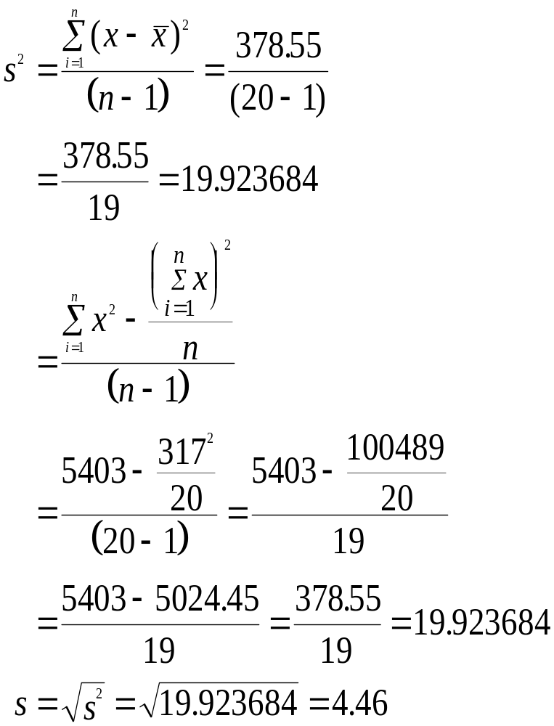
Calculation of Sample Variance
6 -9.85 97.0225 36
9 -6.85 46.9225 81
10 -5.85 34.2225 100
12 -3.85 14.8225 144
13 -2.85 8.1225 169
14 -1.85 3.4225 196
14 -1.85 3.4225 196
15 -0.85 0.7225 225
16 0.15 0.0225 256
16 0.15 0.0225 256
16 0.15 0.0225 256
17 1.15 1.3225 289
17 1.15 1.3225 289
18 2.15 4.6225 324
18 2.15 4.6225 324
19 3.15 9.9225 361
20 4.15 17.2225 400
21 5.15 26.5225 441
22 6.15 37.8225 484
24 8.15 66.4225 576
317 0 378.5500 5403

Slide 35
Example: Sample Variance Using the Template
(n+1)P/100
Quartiles
Note: This is just a replication of slide #21.

Slide 36
1-5 Group Data and the Histogram
Dividing data into groups or classes or intervals
Groups should be:
  Mutually exclusive
    Not overlapping - every observation is assigned to only one group
  Exhaustive
    Every observation is assigned to a group
  Equal-width (if possible)
    First or last group may be open-ended

Slide 37
Frequency Distribution
Table with two columns listing:
  Each and every group or class or interval of values
  Associated frequency of each group
    Number of observations assigned to each group
    Sum of frequencies is number of observations
      N for population
      n for sample
Class midpoint is the middle value of a group or class or interval
Relative frequency is the percentage of total observations in each class
  Sum of relative frequencies = 1

Slide 38
Example 1-7: Frequency Distribution
x f(x) f(x)/n
Spending Class ($) Frequency (number of customers) Relative Frequency
0 to less than 100 30 0.163
100 to less than 200 38 0.207
200 to less than 300 50 0.272
300 to less than 400 31 0.168
400 to less than 500 22 0.120
500 to less than 600 13 0.070
184 1.000
Example of relative frequency: 30/184 = 0.163
Sum of relative frequencies = 1

Slide 39
Cumulative Frequency Distribution
x F(x) F(x)/n
Spending Class ($) Cumulative Frequency Cumulative Relative Frequency
0 to less than 100 30 0.163
100 to less than 200 68 0.370
200 to less than 300 118 0.641
300 to less than 400 149 0.810
400 to less than 500 171 0.929
500 to less than 600 184 1.000
The cumulative frequency of each group is the sum of the
frequencies of that and all preceding groups.

Slide 40
Histogram
A histogram is a chart made of bars of different heights.
  Widths and locations of bars correspond to widths and locations of data groupings
  Heights of bars correspond to frequencies or relative frequencies of data groupings

Slide 41
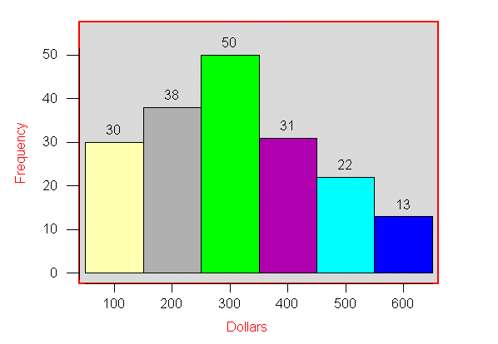
Histogram Example
Frequency Histogram

Slide 42
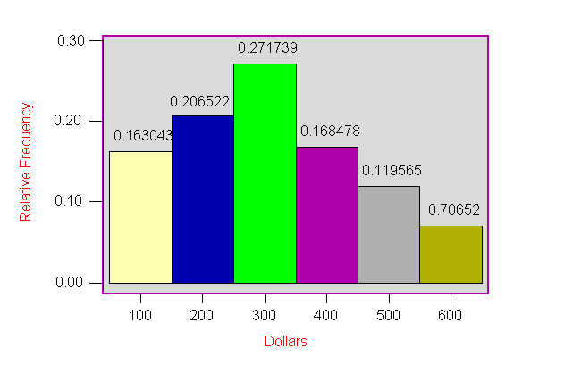
Histogram Example
Relative Frequency Histogram

Slide 43
1-6 Skewness and Kurtosis
Skewness
  Measure of asymmetry of a frequency distribution
    Skewed to left
    Symmetric or unskewed
    Skewed to right
Kurtosis
  Measure of flatness or peakedness of a frequency distribution
    Platykurtic (relatively flat)
    Mesokurtic (normal)
    Leptokurtic (relatively peaked)

Slide 44
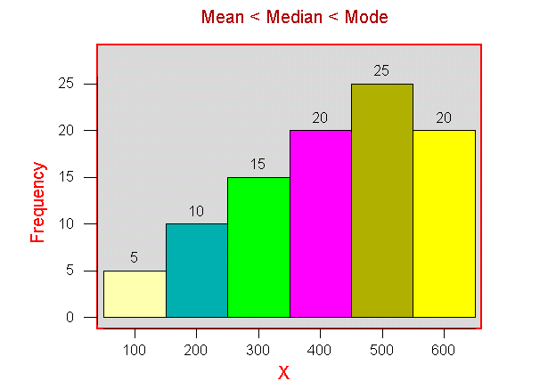
Skewness
Skewed to left

Slide 45
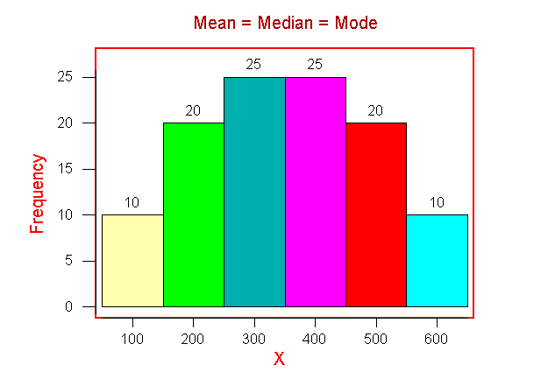
Skewness
Symmetric

Slide 46
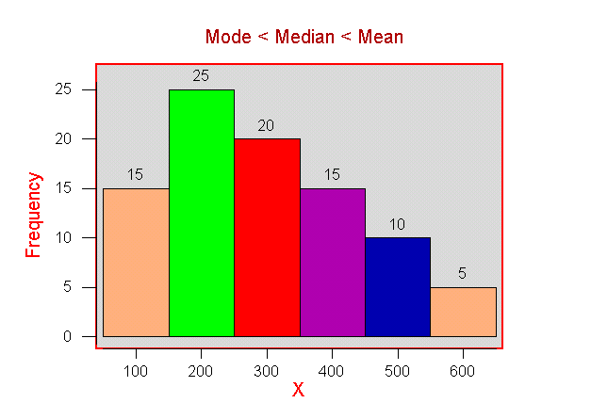
Skewness
Skewed to right

Slide 47
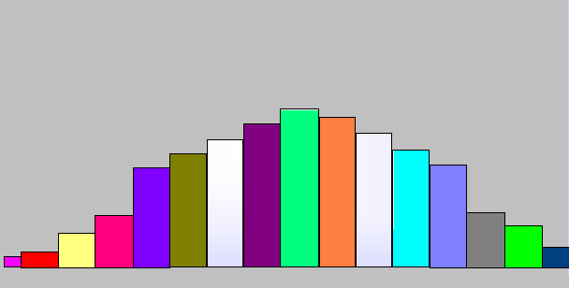
Kurtosis
Platykurtic - flat distribution

Slide 48
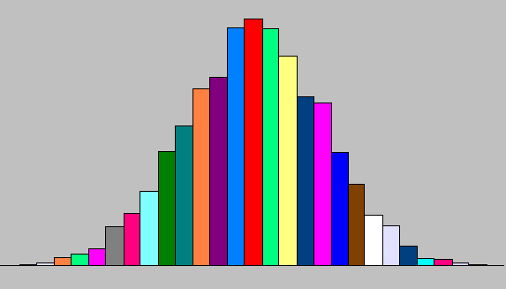
Kurtosis
Mesokurtic - not too flat and not too peaked

Slide 49
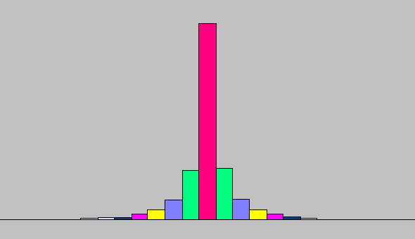
Kurtosis
Leptokurtic - peaked distribution

Slide 50
1-7 Relations between the Mean and Standard Deviation
Chebyshev’s Theorem
  Applies to any distribution, regardless of shape
  Places lower limits on the percentages of observations within a given number of standard deviations from the mean
Empirical Rule
  Applies only to roughly mound-shaped and symmetric distributions
  Specifies approximate percentages of observations within a given number of standard deviations from the mean

Slide 51
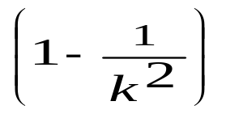
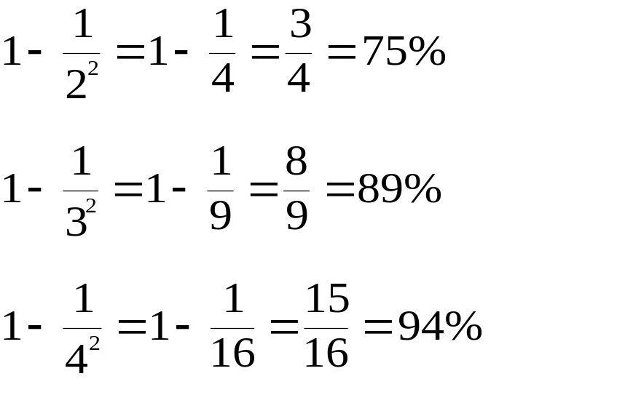
Chebyshev’s Theorem
At least of the elements of any distribution lie within k standard deviations of the mean
2
3
4
Standard
deviations
of the mean
At
least
Lie
within

Slide 52
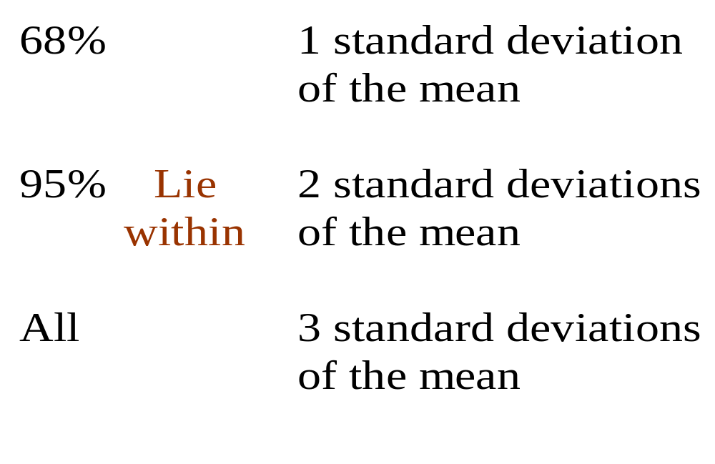
Empirical Rule
For roughly mound-shaped and symmetric distributions, approximately:

Slide 53
1-8 Methods of Displaying Data
Pie Charts
  Categories represented as percentages of total
Bar Graphs
  Heights of rectangles represent group frequencies
Frequency Polygons
  Height of line represents frequency
Ogives
  Height of line represents cumulative frequency
Time Plots
  Represents values over time

Slide 54
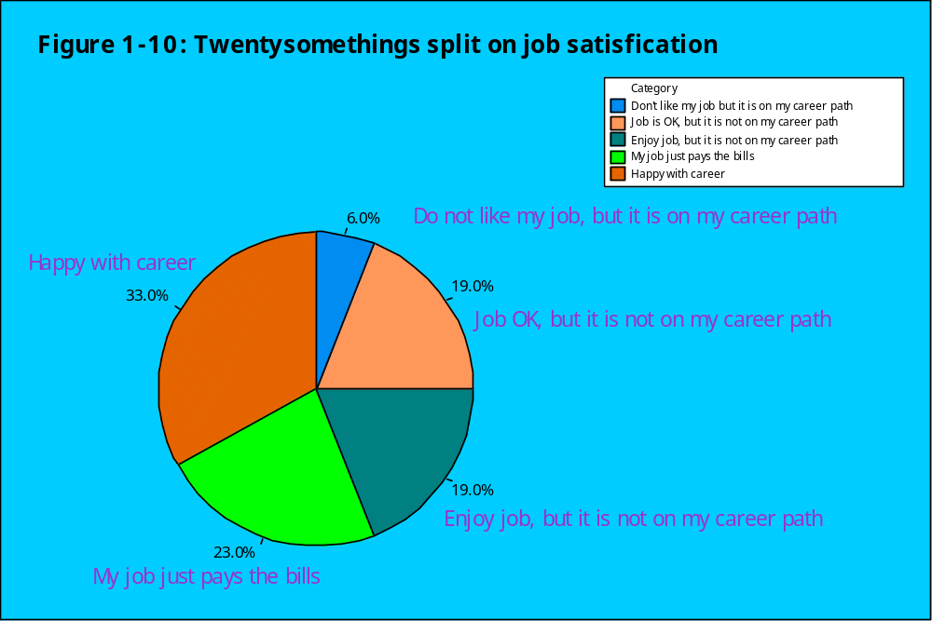
Pie Chart

Slide 55
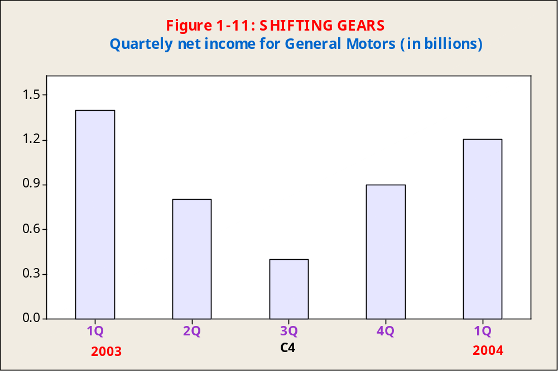
Bar Chart

Slide 56
Frequency Polygon and Ogive
Relative Frequency Polygon
Ogive
0
.
3
1
.
0
0
.
2
0
.
5
Relative Frequency
Cumulative Relative Frequency
0
.
1
0
.
0
0
.
0
0
1
0
2
0
3
0
4
0
5
0
0
1
0
2
0
3
0
4
0
5
0
Sales
Sales
(Cumulative frequency or
relative frequency graph)

Slide 57
Time Plot
M
o
n
t
h
l
y
S
t
e
e
l
P
r
o
d
u
c
t
i
o
n
8
.
5
s
7
.
5
n
o
T
f
o
s
n
o
i
l
l
i
6
.
5
M
5
.
5
M
o
n
t
h
J
F
M
A
M
J
J
A
S
O
N
D
J
F
M
A
M
J
J
A
S
O
N
D
J
F
M
A
M
J
J
A
S
O

Slide 58
1-9 Exploratory Data Analysis - EDA
Techniques to determine relationships and trends, identify outliers and influential observations, and quickly describe or summarize data sets.
Stem-and-Leaf Displays
  Quick-and-dirty listing of all observations
  Conveys some of the same information as a histogram
Box Plots
  Median
  Lower and upper quartiles
  Maximum and minimum

Slide 59
Example 1-8: Stem-and-Leaf Display
1 122355567
2 0111222346777899
3 012457
4 11257
5 0236
6 02
Figure 1-17: Task Performance Times

Slide 60
Box Plot
Elements of a Box Plot
Smallest data point not below inner fence
Largest data point not exceeding inner fence
Suspected outlier
Outlier
o
*
X
X
Inner
Fence
Q₁
Median
Q₃
Outer
Fence
Inner
Fence
Outer
Fence
Q₁-1.5(IQR)
Interquartile Range
Q₃+1.5(IQR)
Q₁-3(IQR)
Q₃+3(IQR)

Slide 61
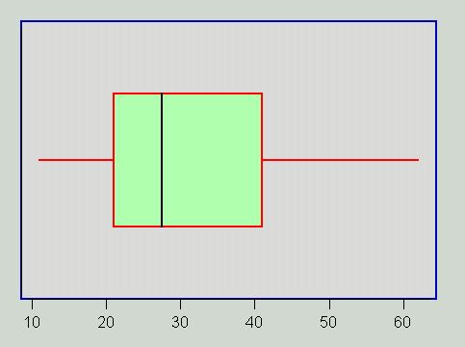
Example: Box Plot

Slide 62
1-10 Using the Computer – The Template Output with Basic Statistics

Slide 63
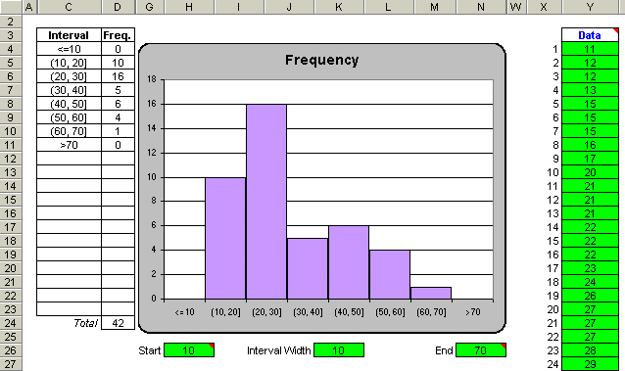
Using the Computer – Template Output for the Histogram
Figure 1-24

Slide 64
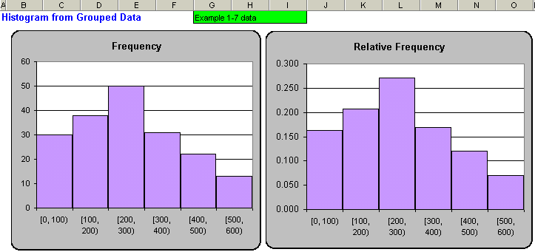
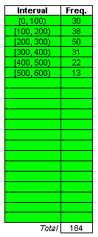
Using the Computer – Template Output for Histograms for Grouped Data
Figure 1-25

Slide 65
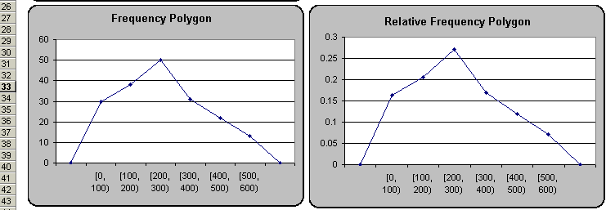
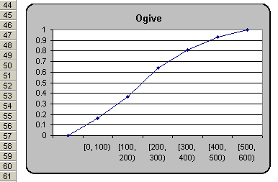
Using the Computer – Template Output for Frequency Polygons & the Ogive for Grouped Data
Figure 1-25

Slide 66
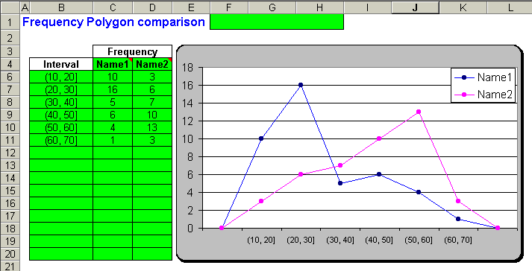
Using the Computer – Template Output for Two Frequency Polygons for Grouped Data
Figure 1-26

Slide 67
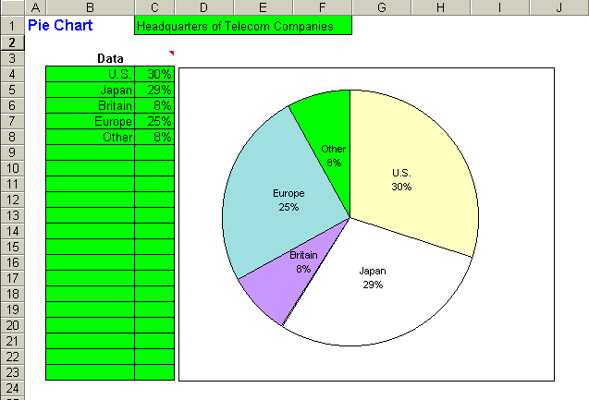
Using the Computer – Pie Chart Template Output
Figure 1-27

Slide 68
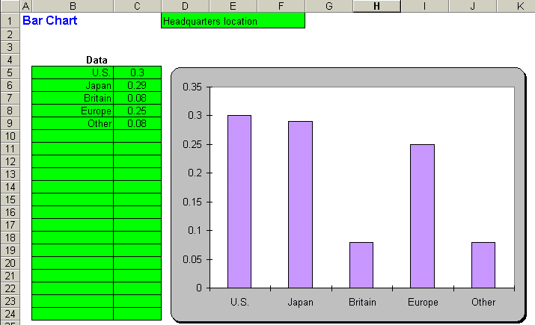
Using the Computer – Bar Chart Template Output
Figure 1-28

Slide 69
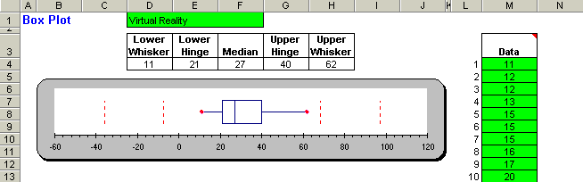
Using the Computer – Box Plot Template Output
Figure 1-29

Slide 70
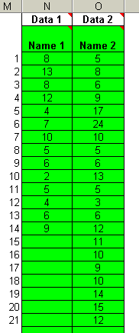
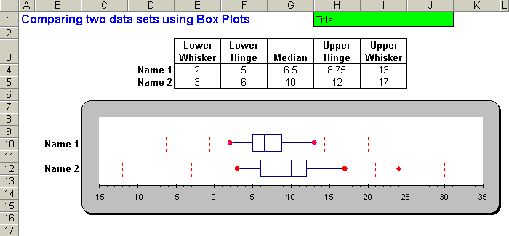
Using the Computer – Box Plot Template to Compare Two Data Sets
Figure 1-30

Slide 71
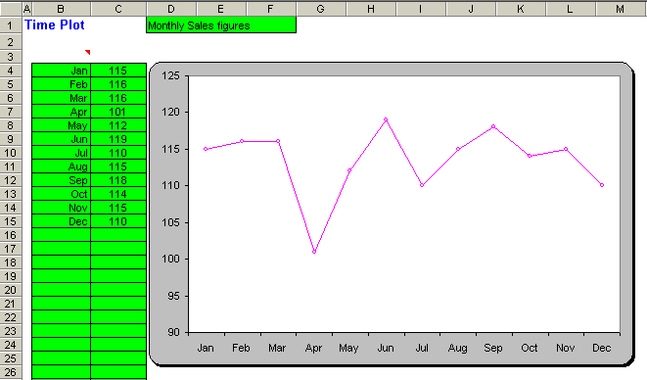
Using the Computer – Time Plot Template
Figure 1-31

Slide 72
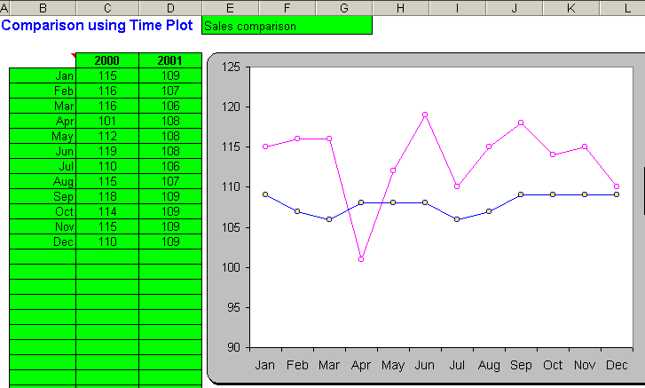

Using the Computer – Time Plot Comparison Template
Figure 1-32

Slide 73
Scatter Plots
Scatter Plots are used to identify and report any underlying relationships among pairs of data sets.
The plot consists of a scatter of points, each point representing an observation.

Slide 74
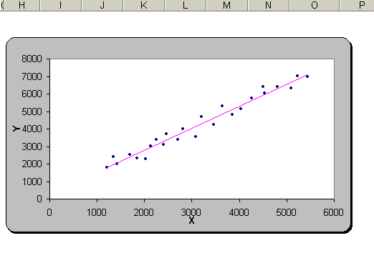
Scatter Plots
Scatter plot with
trend line.
This type of
relationship is
known
as a positive
correlation.
Correlation will be
discussed in later
chapters.

