Slide 1
COMPLETE
BUSINESS
STATISTICS
by
AMIR D. ACZEL
&
JAYAVEL SOUNDERPANDIAN
6th edition (SIE)

Slide 2
Chapter 3
Random Variables

Slide 3
3
Random Variables
Using Statistics
Expected Values of Discrete Random Variables
Sum and Linear Composite of Random Variables
Bernoulli Random Variable
The Binomial Random Variable
The Geometric Distribution
The Hypergeometric Distribution
The Poisson Distribution
Continuous Random Variables
Uniform Distribution
The Exponential Distribution

Slide 4
LEARNING OBJECTIVES
3
After studying this chapter you should be able to:
Distinguish between discrete and continuous random variables
Explain how a random variable is characterized by its probability distribution
Compute statistics about a random variable
Compute statistics about a function of a random variable
Compute statistics about the sum or a linear composite of a random variable
Identify which type of distribution a given random variable is most likely to follow
Solve problems involving standard distributions manually using formulas
Solve business problems involving standard distributions using spreadsheet templates.

Slide 5
3-1 Using Statistics
Consider the different possible orderings of boy (B) and girl (G) in four sequential births. There are 2*2*2*2=2⁴ = 16 possibilities, so the sample space is:
BBBB BGBB GBBB GGBB
BBBG BGBG GBBG GGBG
BBGB BGGB GBGB GGGB
BBGG BGGG GBGG GGGG
If girl and boy are each equally likely [P(G) = P(B) = 1/2], and the gender of each child is independent of that of the previous child, then the probability of each of these 16 possibilities is:
(1/2)(1/2)(1/2)(1/2) = 1/16.

Slide 6
Random Variables
Now count the number of girls in each set of four sequential births:
BBBB (0) BGBB (1) GBBB (1) GGBB (2)
BBBG (1) BGBG (2) GBBG (2) GGBG (3)
BBGB (1) BGGB (2) GBGB (2) GGGB (3)
BBGG (2) BGGG (3) GBGG (3) GGGG (4)
Notice that:
each possible outcome is assigned a single numeric value,
all outcomes are assigned a numeric value, and
the value assigned varies over the outcomes.
The count of the number of girls is a random variable:
A random variable, X, is a function that assigns a single, but variable, value to each element of a sample space.

Slide 7
Random Variables (Continued)
BBBB
BGBB
GBBB
BBBG
BBGB
GGBB
GBBG
BGBG
BGGB
GBGB
BBGG
BGGG
GBGG
GGGB
GGBG
GGGG
0
1
X
2
3
4
Points on the Real Line
Sample Space

Slide 8
Random Variables (Continued)
Since the random variable X = 3 when any of the four outcomes BGGG, GBGG, GGBG, or GGGB occurs,
P(X = 3) = P(BGGG) + P(GBGG) + P(GGBG) + P(GGGB) = 4/16
The probability distribution of a random variable is a table that lists the possible values of the random variables and their associated probabilities.
x P(x)
0 1/16
1 4/16
2 6/16
3 4/16
4 1/16
16/16=1
The Graphical Display for this
Probability Distribution
is shown on the next Slide.

Slide 9
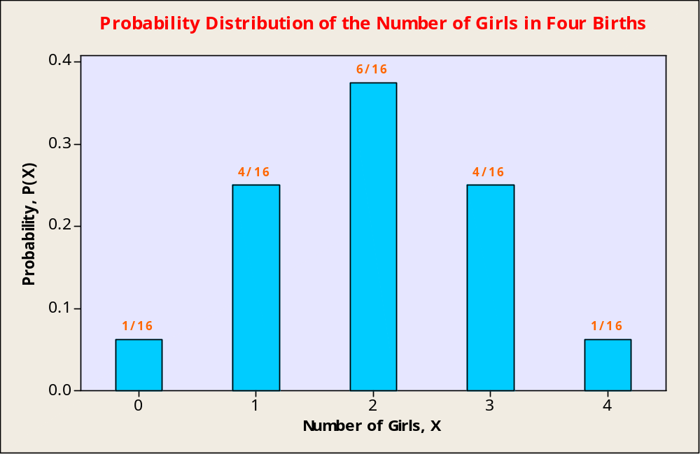
Random Variables (Continued)

Slide 10


Example 3-1
Consider the experiment of tossing two six-sided dice. There are 36 possible outcomes. Let the random variable X represent the sum of the numbers on the two dice:
x P(x)*
2 1/36
3 2/36
4 3/36
5 4/36
6 5/36
7 6/36
8 5/36
9 4/36
10 3/36
11 2/36
12 1/36
1
P
r
o
b
a
b
i
l
i
t
y
D
i
s
t
r
i
b
u
t
i
o
n
o
f
S
u
m
o
f
T
w
o
D
i
c
e
0
.
1
7
2
3
4
5
6
7
1,1
1,2
1,3
1,4
1,5
1,6
8
0
.
1
2
)
x
2,1
2,2
2,3
2,4
2,5
2,6
9
(
p
3,1
3,2
3,3
3,4
3,5
3,6
10
0
.
0
7
4,1
4,2
4,3
4,4
4,5
4,6
11
5,1
5,2
5,3
5,4
5,5
5,6
12
0
.
0
2
2
3
4
5
6
7
8
9
1
0
1
1
1
2
6,1
6,2
6,3
6,4
6,5
6,6
x

Slide 11
Example 3-2
Probability Distribution of the Number of Switches
x P(x)
0 0.1
1 0.2
2 0.3
3 0.2
4 0.1
5 0.1
1
T
h
e
P
r
o
b
a
b
i
l
i
t
y
D
i
s
t
r
i
b
u
t
i
o
n
o
f
t
h
e
N
u
m
b
e
r
o
f
S
w
i
t
c
h
e
s
0
.
4
0
.
3
)
x
(
0
.
2
P
0
.
1
0
.
0
0
1
2
3
4
5
x
Probability of more than 2 switches:
P(X > 2) = P(3) + P(4) + P(5) = 0.2 + 0.1 + 0.1 = 0.4
Probability of at least 1 switch:
P(X ≥ 1) = 1 - P(0) = 1 - 0.1 = .9

Slide 12
Discrete and Continuous Random Variables
A discrete random variable:
  has a countable number of possible values
  has discrete jumps (or gaps) between successive values
  has measurable probability associated with individual values
  counts
A continuous random variable:
  has an uncountably infinite number of possible values
  moves continuously from value to value
  has no measurable probability associated with each value
  measures (e.g.: height, weight, speed, value, duration, length)

Slide 13
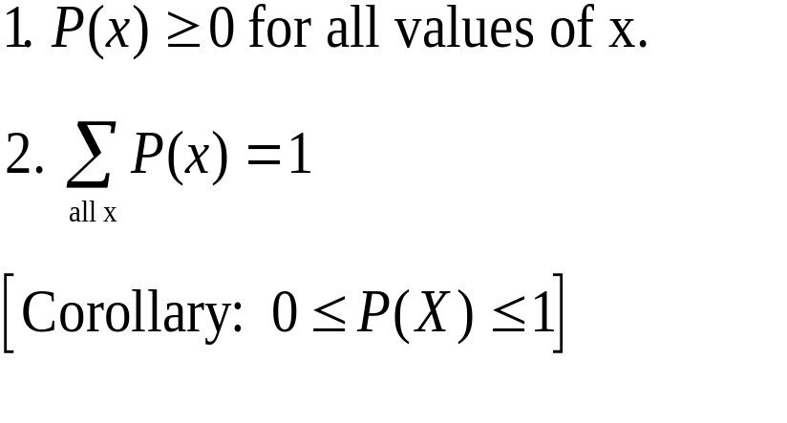
Rules of Discrete Probability Distributions
The probability distribution of a discrete random variable X must satisfy the following two conditions.

Slide 14
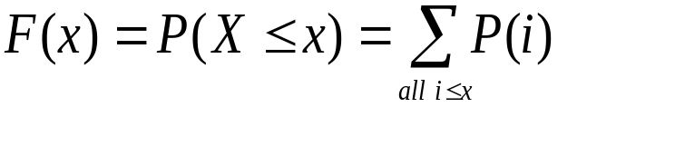
Cumulative Distribution Function
The cumulative distribution function, F(x), of a discrete random variable X is:
x P(x) F(x)
0 0.1 0.1
1 0.2 0.3
2 0.3 0.6
3 0.2 0.8
4 0.1 0.9
5 0.1 1.0
1.00
C
u
m
u
l
a
t
i
v
e
P
r
o
b
a
b
i
l
i
t
y
D
i
s
t
r
i
b
u
t
i
o
n
o
f
t
h
e
N
u
m
b
e
r
o
f
S
w
i
t
c
h
e
s
1
.
0
0
.
9
0
.
8
0
.
7
)
0
.
6
x
(
0
.
5
F
0
.
4
0
.
3
0
.
2
0
.
1
0
.
0
0
1
2
3
4
5
x

Slide 15
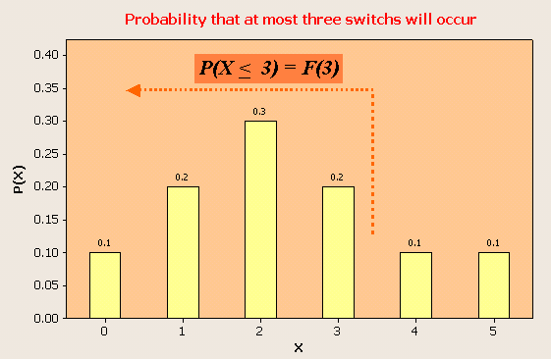
Cumulative Distribution Function
The probability that at most three switches will occur:
x P(x) F(x)
0 0.1 0.1
1 0.2 0.3
2 0.3 0.6
3 0.2 0.8
4 0.1 0.9
5 0.1 1.0
1
Note: P(X < 3) = F(3) = 0.8 = P(0) + P(1) + P(2) + P(3)

Slide 16
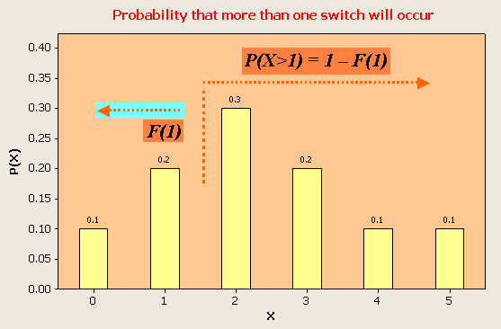
Using Cumulative Probability Distributions (Figure 3-8)
The probability that more than one switch will occur:
x P(x) F(x)
0 0.1 0.1
1 0.2 0.3
2 0.3 0.6
3 0.2 0.8
4 0.1 0.9
5 0.1 1.0
1
Note: P(X > 1) = P(X > 2) = 1 – P(X < 1) = 1 – F(1) = 1 – 0.3 = 0.7

Slide 17
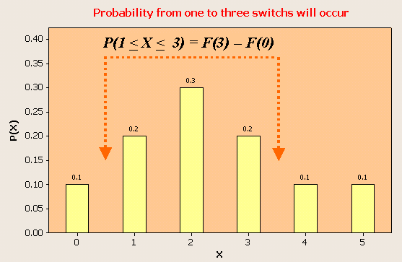
Using Cumulative Probability Distributions (Figure 3-9)
The probability that anywhere from one to three switches will occur:
x P(x) F(x)
0 0.1 0.1
1 0.2 0.3
2 0.3 0.6
3 0.2 0.8
4 0.1 0.9
5 0.1 1.0
1
Note: P(1 < X < 3) = P(X < 3) – P(X < 0) = F(3) – F(0) = 0.8 – 0.1 = 0.7

Slide 18
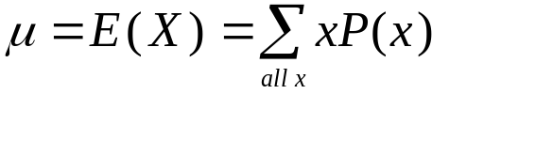
3-2 Expected Values of Discrete Random Variables
The mean of a probability distribution is a measure of its centrality or location, as is the mean or average of a frequency distribution. It is a weighted average, with the values of the random variable weighted by their probabilities.
0
1
2
3
4
5
2.3
The mean is also known as the expected value (or expectation) of a random variable, because it is the value that is expected to occur, on average.
x P(x) xP(x)
0 0.1 0.0
1 0.2 0.2
2 0.3 0.6
3 0.2 0.6
4 0.1 0.4
5 0.1 0.5
1.0 2.3 = E(X) = μ
The expected value of a discrete random variable X is equal to the sum of each value of the random variable multiplied by its probability.

Slide 19
A Fair Game
Suppose you are playing a coin toss game in which you are paid $1 if the coin turns up heads and you lose $1 when the coin turns up tails. The expected value of this game is E(X) = 0. A game of chance with an expected payoff of 0 is called a fair game.
x P(x) xP(x)
-1 0.5 -0.50
1 0.5 0.50
1.0 0.00 = E(X)=μ
-1
0
1

Slide 20
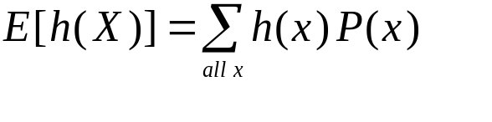
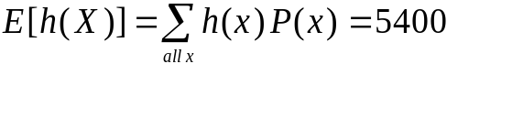
Expected Value of a Function of a Discrete Random Variables
The expected value of a function of a discrete random variable X is:
Example 3-3: Monthly sales of a certain product are believed to follow the given probability distribution. Suppose the company has a fixed monthly production cost of $8000 and that each item brings $2. Find the expected monthly profit h(X), from product sales.
Number
of items, x P(x) xP(x) h(x) h(x)P(x)
5000 0.2 1000 2000 400
6000 0.3 1800 4000 1200
7000 0.2 1400 6000 1200
8000 0.2 1600 8000 1600
9000 0.1 900 10000 1000
1.0 6700 5400
Note: h (X) = 2X – 8000 where X = # of items sold
The expected value of a linear function of a random variable is:
E(aX+b)=aE(X)+b
In this case: E(2X-8000)=2E(X)-8000=(2)(6700)-8000=5400

Slide 21
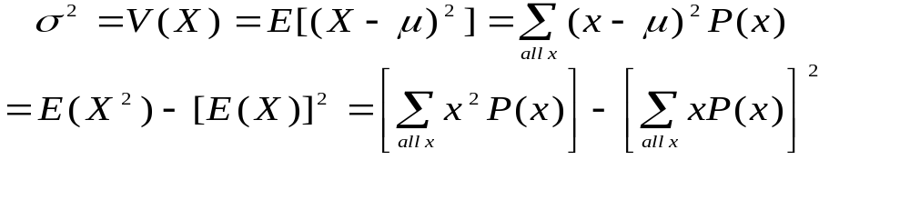
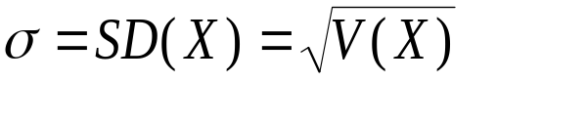
Variance and Standard Deviation of a Random Variable
The variance of a random variable is the expected squared deviation from the mean:
The standard deviation of a random variable is the square root of its variance:

Slide 22

Variance and Standard Deviation of a Random Variable – using Example 3-2
σ
2
=
V
(
X
)
=
E
[(
X
−
μ
)
2
]
Table 3-8
=
∑
(
x
−
μ
)
2
P
(
x
)
=
2
.
01
Number of
Switches, x P(x) xP(x) (x-μ) (x-μ)² P(x-μ)² x²P(x)
0 0.1 0.0 -2.3 5.29 0.529 0.0
1 0.2 0.2 -1.3 1.69 0.338 0.2
2 0.3 0.6 -0.3 0.09 0.027 1.2
3 0.2 0.6 0.7 0.49 0.098 1.8
4 0.1 0.4 1.7 2.89 0.289 1.6
5 0.1 0.5 2.7 7.29 0.729 2.5
2.3 2.010 7.3
all
x
=
E
(
X
2
)
−
[
E
(
X
)]
2
2
⎡
2
⎤
⎡
⎤
=
⎢
∑
x
P
(
x
)
⎥
−
⎢
∑
xP
(
x
)
⎥
Recall: = 2.3.
⎣
all
x
⎦
⎣
all
x
⎦
=
7
.
3
−
2
.
3
2
=
2
.
01

Slide 23
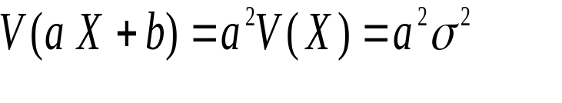
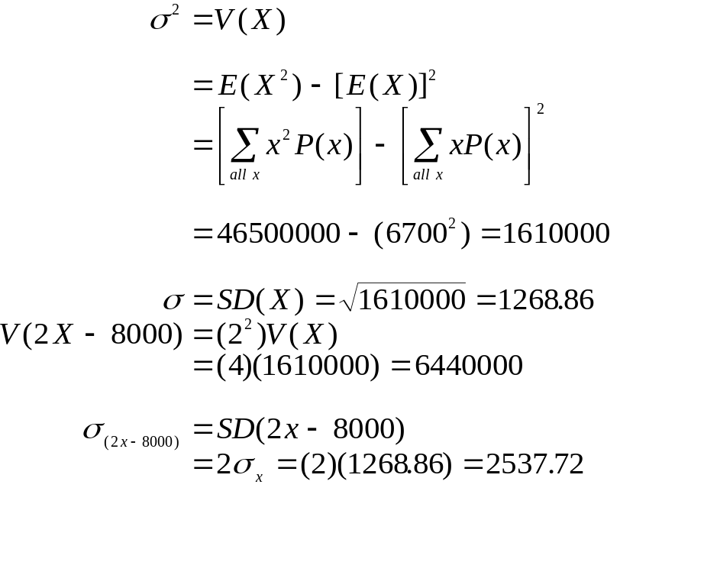
Variance of a Linear Function of a Random Variable
The variance of a linear function of a random variable is:
Example 3-3:
Number
of items, x P(x) xP(x) x² P(x)
5000 0.2 1000 5000000
6000 0.3 1800 10800000
7000 0.2 1400 9800000
8000 0.2 1600 12800000
9000 0.1 900 8100000
1.0 6700 46500000

Slide 24
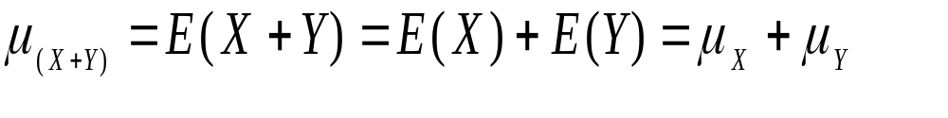
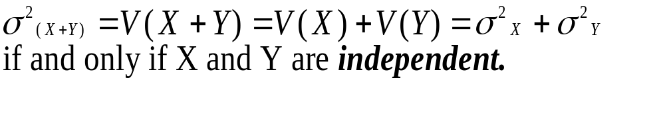
Some Properties of Means and Variances of Random Variables
The mean or expected value of the sum of random variables is the sum of their means or expected values:
For example: E(X) = $350 and E(Y) = $200
E(X+Y) = $350 + $200 = $550
The variance of the sum of mutually independent random variables is the sum of their variances:
For example: V(X) = 84 and V(Y) = 60
V(X+Y) = 144

Slide 25
Some Properties of Means and Variances of Random Variables
NOTE:
The variance of the sum of k mutually independent random variables is the sum of their variances:
and

Slide 26
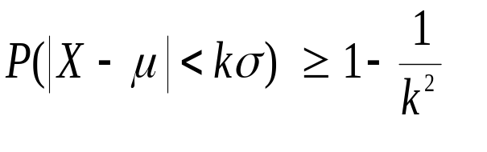
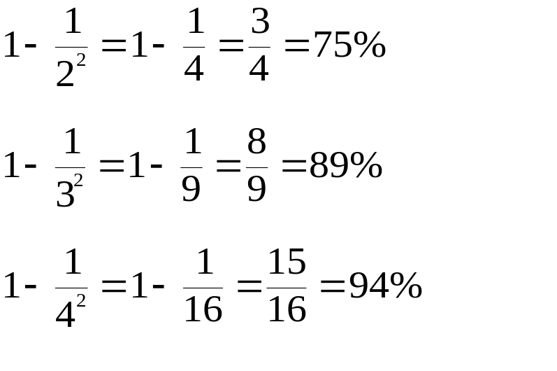
Chebyshev’s Theorem Applied to Probability Distributions
Chebyshev’s Theorem applies to probability distributions just as it applies to frequency distributions.
For a random variable X with mean μ, standard deviation σ, and for any number k > 1:
2
3
4
Lie
within
Standard
deviations
of the mean
At
least

Slide 27
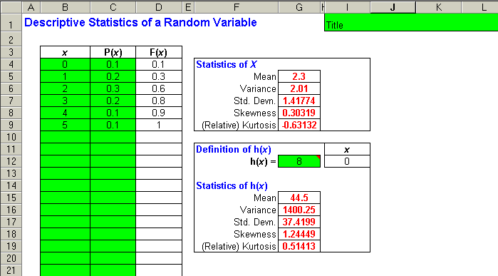
Using the Template to Calculate statistics of h(x)

Slide 28
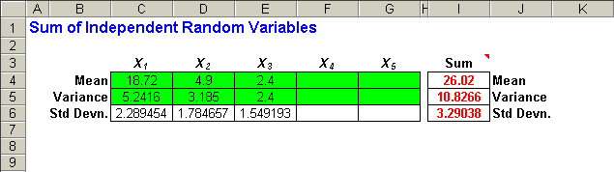
Using the Template to Calculate Mean and Variance for the Sum of Independent Random Variables
Output for Example 3-4

Slide 29
3-3 Bernoulli Random Variable
If an experiment consists of a single trial and the outcome of the trial can only be either a success* or a failure, then the trial is called a Bernoulli trial.
The number of success X in one Bernoulli trial, which can be 1 or 0, is a Bernoulli random variable.
Note: If p is the probability of success in a Bernoulli experiment, the E(X) = p and V(X) = p(1 – p).
* The terms success and failure are simply statistical terms, and do not have positive or negative implications. In a production setting, finding a defective product may be termed a “success,” although it is not a positive result.

Slide 30
3-4 The Binomial Random Variable
Consider a Bernoulli Process in which we have a sequence of n identical trials satisfying the following conditions:
1. Each trial has two possible outcomes, called success *and failure. The two outcomes are mutually exclusive and exhaustive.
2. The probability of success, denoted by p, remains constant from trial to trial. The probability of failure is denoted by q, where q = 1-p.
3. The n trials are independent. That is, the outcome of any trial does not affect the outcomes of the other trials.
A random variable, X, that counts the number of successes in n Bernoulli trials, where p is the probability of success* in any given trial, is said to follow the binomial probability distribution with parameters n (number of trials) and p (probability of success). We call X the binomial random variable.
* The terms success and failure are simply statistical terms, and do not have positive or negative implications. In a production setting, finding a defective product may be termed a “success,” although it is not a positive result.

Slide 31
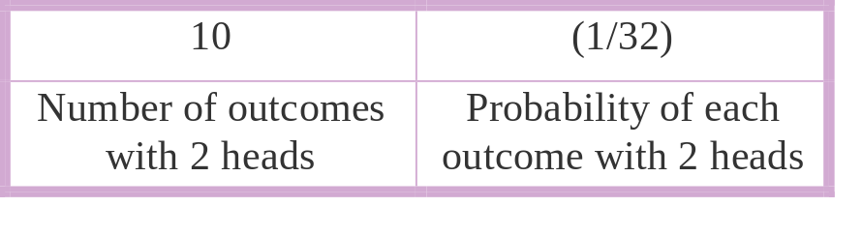
Binomial Probabilities (Introduction)
Suppose we toss a single fair and balanced coin five times in succession,
and let X represent the number of heads.
There are 2⁵ = 32 possible sequences of H and T (S and F) in the sample space for this experiment. Of these, there are 10 in which there are exactly 2 heads (X=2):
HHTTT HTHTH HTTHT HTTTH THHTT THTHT THTTH TTHHT TTHTH TTTHH
The probability of each of these 10 outcomes is p³q³ = (1/2)³(1/2)²=(1/32), so the probability of 2 heads in 5 tosses of a fair and balanced coin is:
P(X = 2) = 10 * (1/32) = (10/32) = 0.3125

Slide 32
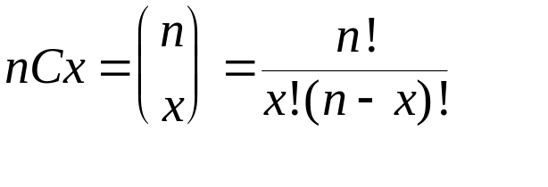
Binomial Probabilities (continued)
P(X=2) = 10 * (1/32) = (10/32) = .3125
Notice that this probability has two parts:
In general:
1. The probability of a given sequence of x successes out of n trials with probability of success p and probability of failure q is equal to:
p^{x}q^{(n-x)}
2. The number of different sequences of n trials that result in exactly x successes is equal to the number of choices of x elements out of a total of n elements. This number is denoted:

Slide 33
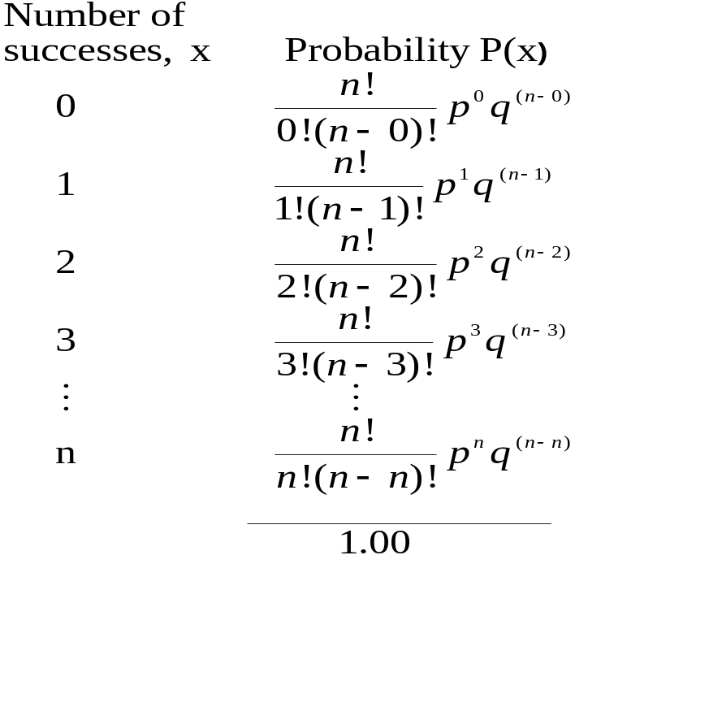
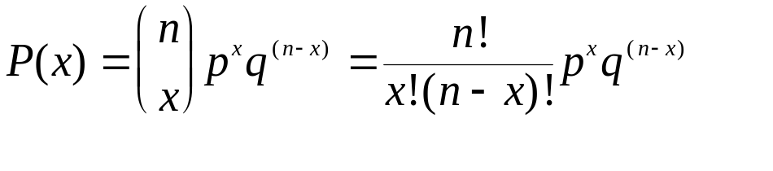
The Binomial Probability Distribution
The binomial probability distribution:
where :
p is the probability of success in a single trial,
q = 1-p,
n is the number of trials, and
x is the number of successes.

Slide 34
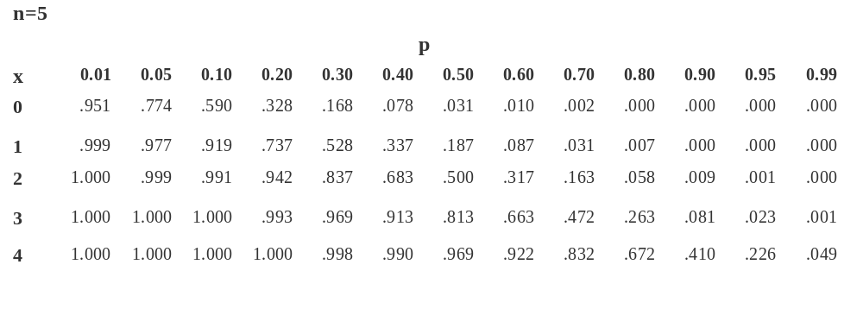
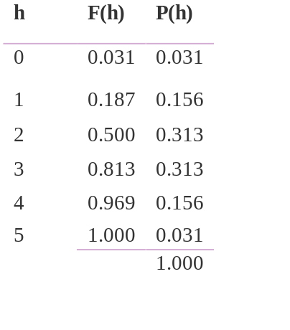
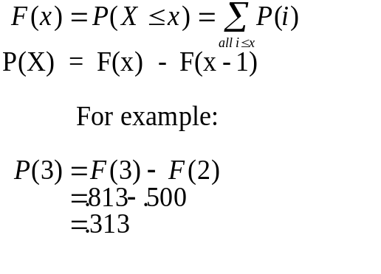
The Cumulative Binomial Probability Table (Table 1, Appendix C)
Cumulative Binomial Probability Distribution and Binomial Probability Distribution of H,the Number of Heads Appearing in Five Tosses of a Fair Coin
Deriving Individual Probabilities from Cumulative Probabilities

Slide 35
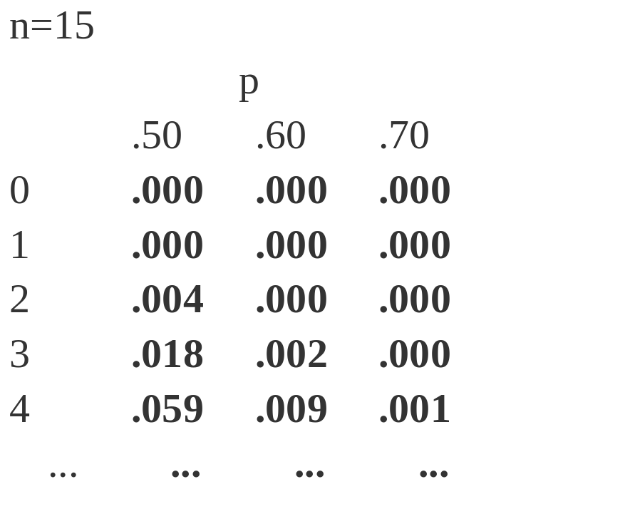
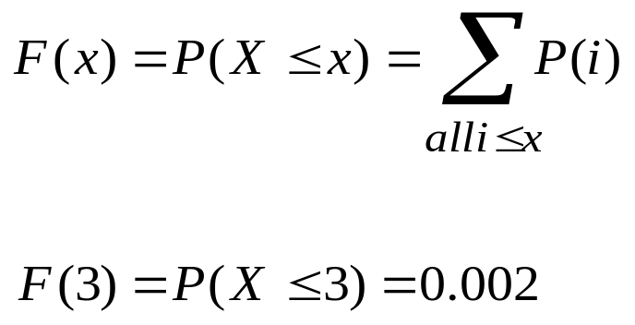
Calculating Binomial Probabilities -
Example
60% of Brooke shares are owned by LeBow. A random sample of 15 shares is chosen. What is the probability that at most three of them will be found to be owned by LeBow?

Slide 36
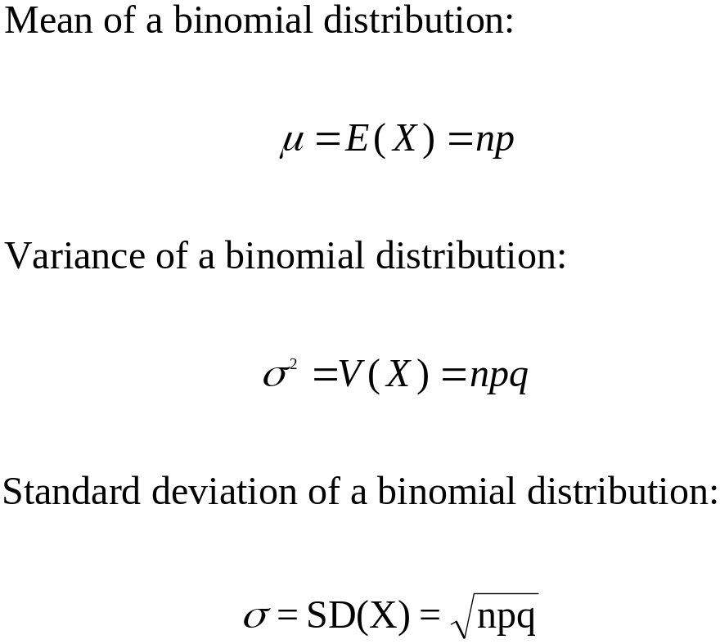
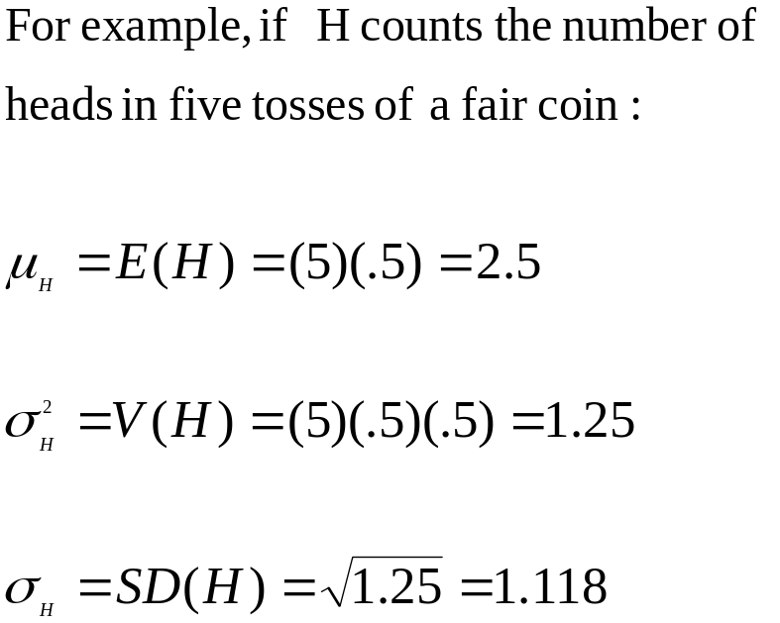
Mean, Variance, and Standard Deviation of the Binomial Distribution

Slide 37
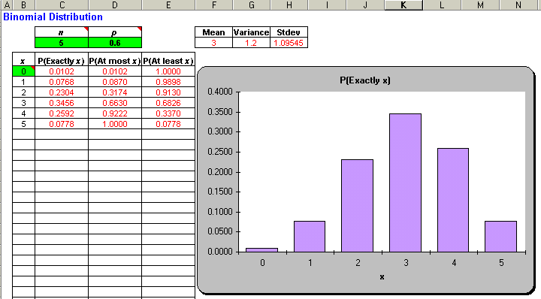
Calculating Binomial Probabilities using the Template

Slide 38
Shape of the Binomial Distribution
p = 0.1
p = 0.3
p = 0.5
B
i
n
o
m
i
a
l
P
r
o
b
a
b
i
l
i
t
y
:
n
=
4
p
=
0
.
1
B
i
n
o
m
i
a
l
P
r
o
b
a
b
i
l
i
t
y
:
n
=
4
p
=
0
.
3
B
i
n
o
m
i
a
l
P
r
o
b
a
b
i
l
i
t
y
:
n
=
4
p
=
0
.
5
0
.
7
0
.
7
0
.
7
0
.
6
0
.
6
0
.
6
n = 4
)
0
.
5
)
0
.
5
)
0
.
5
x
0
.
4
x
0
.
4
x
0
.
4
(
(
(
P
0
.
3
P
0
.
3
P
0
.
3
0
.
2
0
.
2
0
.
2
0
.
1
0
.
1
0
.
1
0
.
0
0
1
2
3
4
0
.
0
0
1
2
3
4
0
.
0
0
1
2
3
4
x
x
x
B
i
n
o
m
i
a
l
P
r
o
b
a
b
i
l
i
t
y
:
n
=
1
0
p
=
0
.
1
B
i
n
o
m
i
a
l
P
r
o
b
a
b
i
l
i
t
y
:
n
=
1
0
p
=
0
.
3
B
i
n
o
m
i
a
l
P
r
o
b
a
b
i
l
i
t
y
:
n
=
1
0
p
=
0
.
5
0
.
5
0
.
5
0
.
5
n = 10
0
.
4
0
.
4
0
.
4
)
0
.
3
)
0
.
3
)
0
.
3
x
x
x
(
(
(
P
0
.
2
P
0
.
2
P
0
.
2
0
.
1
0
.
1
0
.
1
0
.
0
0
1
2
3
4
5
6
7
8
9
1
0
0
.
0
0
1
2
3
4
5
6
7
8
9
1
0
0
.
0
0
1
2
3
4
5
6
7
8
9
1
0
x
x
x
B
i
n
o
m
i
a
l
P
r
o
b
a
b
i
l
i
t
y
:
n
=
2
0
p
=
0
.
1
B
i
n
o
m
i
a
l
P
r
o
b
a
b
i
l
i
t
y
:
n
=
2
0
p
=
0
.
3
B
i
n
o
m
i
a
l
P
r
o
b
a
b
i
l
i
t
y
:
n
=
2
0
p
=
0
.
5
n = 20
)
0
.
2
)
0
.
2
)
0
.
2
x
x
x
(
(
(
P
0
.
1
P
0
.
1
P
0
.
1
0
.
0
0
1
2
3
4
5
6
7
8
9
1
0
1
1
1
2
1
3
1
4
1
5
1
6
1
7
1
8
1
9
2
0
0
.
0
0
1
2
3
4
5
6
7
8
9
1
0
1
1
1
2
1
3
1
4
1
5
1
6
1
7
1
8
1
9
2
0
0
.
0
0
1
2
3
4
5
6
7
8
9
1
0
1
1
1
2
1
3
1
4
1
5
1
6
1
7
1
8
1
9
2
0
x
x
x
Binomial distributions become more symmetric as n increases and as p 0.5.

Slide 39
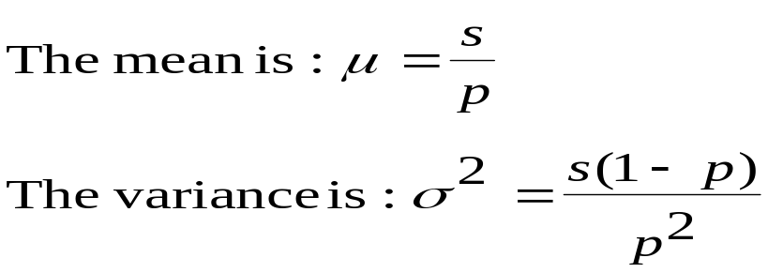
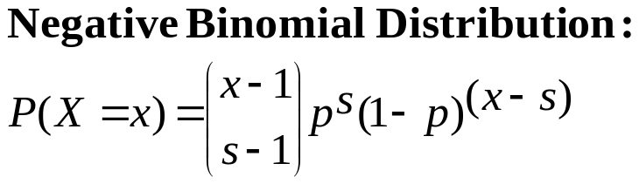
3-5 Negative Binomial Distribution
The negative binomial distribution is useful for determining the probability of the number of trials made until the desired number of successes are achieved in a sequence of Bernoulli trials. It counts the number of trials X to achieve the number of successes s with p being the probability of success on each trial.

Slide 40
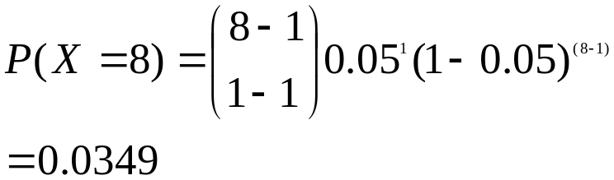
Negative Binomial Distribution - Example
Example:
Suppose that the probability of a manufacturing process producing a defective item is 0.05. Suppose further that the quality of any one item is independent of the quality of any other item produced. If a quality control officer selects items at random from the production line, what is the probability that the first defective item is the eight item selected.
Here s = 1, x = 8, and p = 0.05. Thus,

Slide 41
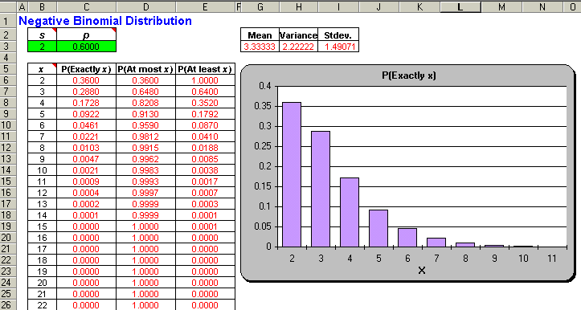
Calculating Negative Binomial Probabilities using the Template

Slide 42
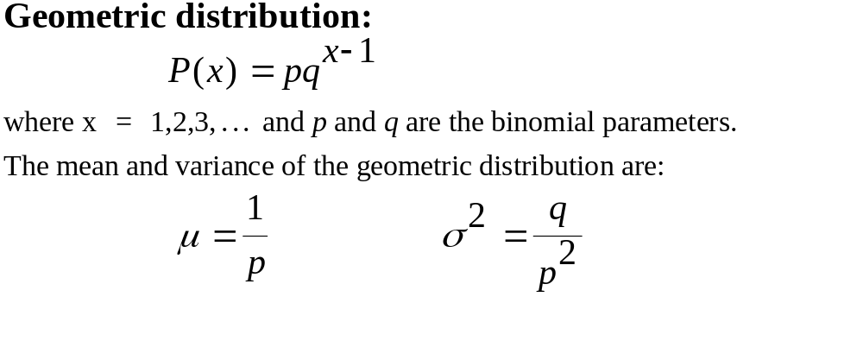
3-6 The Geometric Distribution
Within the context of a binomial experiment, in which the outcome of each of n independent trials can be classified as a success (S) or a failure (F), the geometric random variable counts the number of trials until the first success..

Slide 43
The Geometric Distribution - Example
Example:
A recent study indicates that Pepsi-Cola has a market share of 33.2% (versus 40.9% for Coca-Cola). A marketing research firm wants to conduct a new taste test for which it needs Pepsi drinkers. Potential participants for the test are selected by random screening of soft drink users to find Pepsi drinkers. What is the probability that the first randomly selected drinker qualifies? What’s the probability that two soft drink users will have to be interviewed to find the first Pepsi drinker? Three? Four?
P
(
1
)
=
(.
332
)(.
668
)
(
1
−
1
)
=
0
.
332
P
(
2
)
=
(.
332
)(.
)
−
=
668
(
2
1
)
0
.
222
P
(
3
)
=
(.
332
)(.
)
−
=
668
(
3
1
)
0
.
148
P
(
4
)
=
(.
332
)(.
)
(
4
−
1
)
=
668
0
.
099

Slide 44
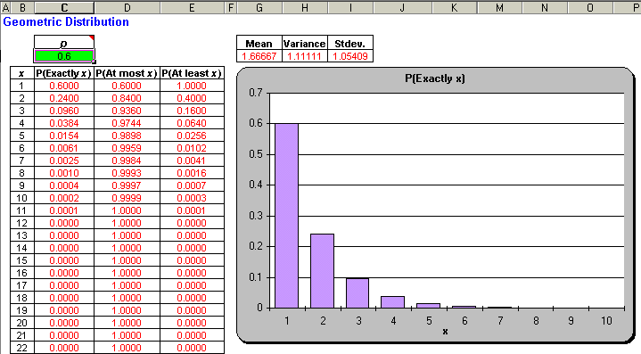
Calculating Geometric Distribution Probabilities using the Template

Slide 45
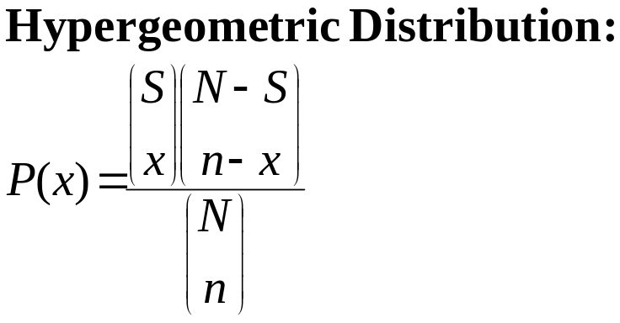
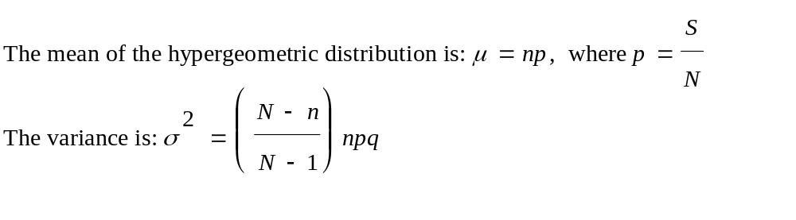
3-7 The Hypergeometric Distribution
The hypergeometric probability distribution is useful for determining the probability of a number of occurrences when sampling without replacement. It counts the number of successes (x) in n selections, without replacement, from a population of N elements, S of which are successes and (N-S) of which are failures.

Slide 46
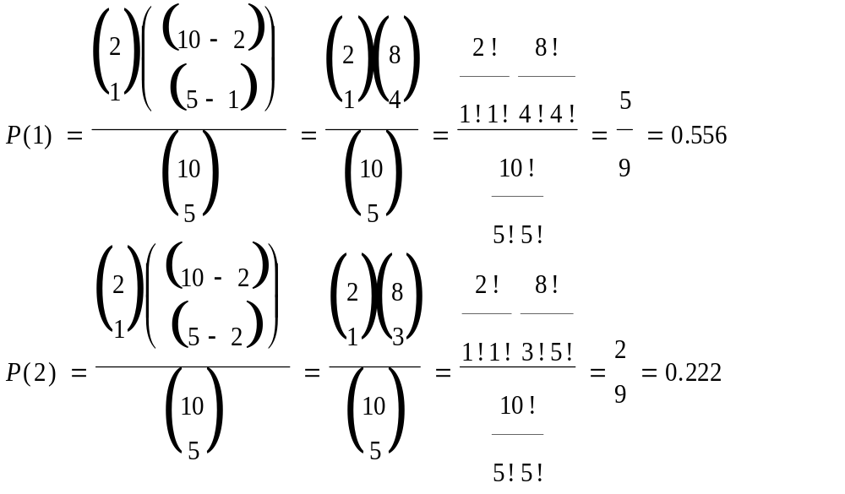
The Hypergeometric Distribution - Example
Example:
Suppose that automobiles arrive at a dealership in lots of 10 and that for time and resource considerations, only 5 out of each 10 are inspected for safety. The 5 cars are randomly chosen from the 10 on the lot. If 2 out of the 10 cars on the lot are below standards for safety, what is the probability that at least 1 out of the 5 cars to be inspected will be found not meeting safety standards?
Thus, P(1) + P(2) =
0.556 + 0.222 = 0.778.

Slide 47
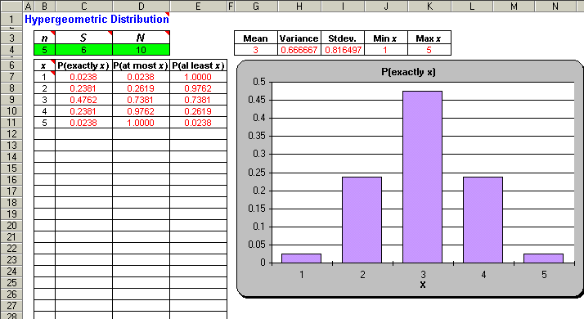
Calculating Hypergeometric Distribution Probabilities using the Template

Slide 48
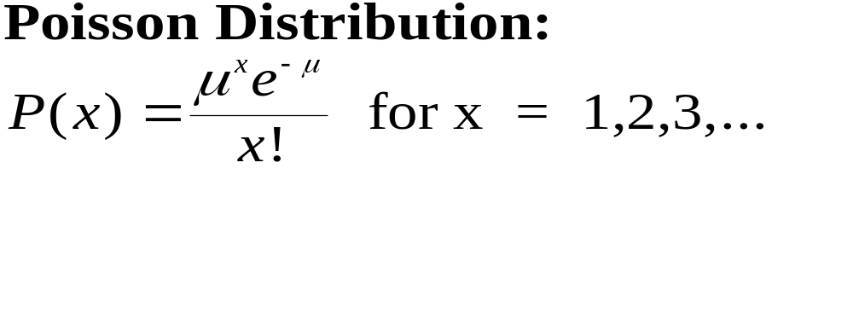
3-8 The Poisson Distribution
The Poisson probability distribution is useful for determining the probability of a number of occurrences over a given period of time or within a given area or volume. That is, the Poisson random variable counts occurrences over a continuous interval of time or space. It can also be used to calculate approximate binomial probabilities when the probability of success is small (p ≤0.05) and the number of trials is large (n ≥20).
where μ is the mean of the distribution (which also happens to be the variance) and
e is the base of natural logarithms (e=2.71828...).

Slide 49
The Poisson Distribution - Example
Example 3-5:
Telephone manufacturers now offer 1000 different choices for a telephone (as combinations of color, type, options, portability, etc.). A company is opening a large regional office, and each of its 200 managers is allowed to order his or her own choice of a telephone. Assuming independence of choices and that each of the 1000 choices is equally likely, what is the probability that a particular choice will be made by none, one, two, or three of the managers?
n = 200 μ = np = (200)(0.001) = 0.2
p = 1/1000 = 0.001
.
2
0
e
−
.
2
P
(
0
)
=
=
0.8187
0
!
.
2
1
e
−
.
2
P
(
1
)
=
=
0.1637
1
!
.
2
2
e
−
.
2
P
(
2
)
=
=
0.0164
2
!
.
2
3
e
−
.
2
P
(
3
)
=
=
0.0011
3
!

Slide 50
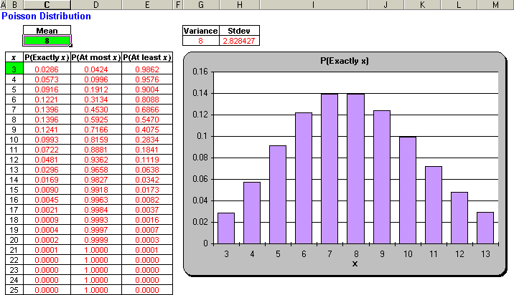
Calculating Poisson Distribution Probabilities using the Template

Slide 51
The Poisson Distribution (continued)
Poisson assumptions:
  The probability that an event will occur in a short interval of time or space is proportional to the size of the interval.
  In a very small interval, the probability that two events will occur is close to zero.
  The probability that any number of events will occur in a given interval is independent of where the interval begins.
  The probability of any number of events occurring over a given interval is independent of the number of events that occurred prior to the interval.

Slide 52
The Poisson Distribution (continued)
μ
=
1
.
μ
5
=
1
.
0
0
.
0
4
.
4
0
.
3
0
.
3
)
)
x
x
0
.
(
2
0
.
P
(
2
P
0
.
1
0
.
1
0
.
0
0
.
0
1
2
3
4
0
X
0
1
2
3
4
5
6
7
X
μ
=
4
μ
=
1
0
0
.
2
0
.
1
5
0
.
1
0
)
)
x
x
0
.
(
1
(
P
P
0
.
0
5
0
.
0
0
.
0
0
0
1
2
3
4
5
6
7
8
9
1
0
0
1
2
3
4
5
6
7
8
9
1
0
1
1
1
2
1
3
1
4
1
5
1
6
1
7
1
8
1
9
2
0
X
X

Slide 53
Discrete and Continuous Random Variables - Revisited
A discrete random variable:
  counts occurrences
  has a countable number of possible values
  has discrete jumps between successive values
  has measurable probability associated with individual values
  probability is height
A continuous random variable:
  measures (e.g.: height, weight, speed, value, duration, length)
  has an uncountably infinite number of possible values
  moves continuously from value to value
  has no measurable probability associated with individual values
  probability is area
For example:
Binomial
n=3 p=.5
x P(x)
0 0.125
1 0.375
2 0.375
3 0.125
1.000
B
i
n
o
m
i
a
l
:
n
=
3
p
=
.
5
For example:
In this case, the shaded area epresents the probability that the task takes between 2 and 3 minutes.
M
i
n
u
t
e
s
t
o
C
o
m
p
l
e
t
e
T
a
s
0
.
4
k
0
.
0
.
3
3
)
x
(
0
.
P
0
.
2
)
2
x
(
P
0
.
1
0
.
1
0
.
0
0
.
0
1
C
1
2
3
0
1
2
3
4
5
6
M
i
n
u
t
e
s

Slide 54
From a Discrete to a Continuous Distribution
The time it takes to complete a task can be subdivided into:
Half-Minute Intervals
Quarter-Minute Intervals
Eighth-Minute Intervals
M
i
n
u
t
e
s
t
o
C
o
m
p
l
e
t
e
T
a
s
k
:
F
o
u
r
t
h
s
o
f
a
M
i
n
u
t
e
M
i
n
u
t
e
s
t
o
C
o
m
p
l
e
t
e
T
a
s
k
:
E
i
g
h
t
h
s
o
f
a
M
i
n
u
t
M
e
i
n
u
t
e
s
t
o
C
o
m
p
l
e
t
e
T
a
s
k
:
B
y
H
a
l
f
-
M
i
n
u
t
e
s
0
.
1
5
0
.
1
)
0
)
)
x
x
x
(
(
(
P
P
P
0
.
0
5
0
.
0
0
0.0
.
1
.
0
1
.
5
2
.
0
2
.
5
3
.
0
3
.
5
4
.
0
4
.
5
5
.
0
5
.
5
6
.
0
6
.
M
5
0 1 2 3 4 5 6 7
0 1 2 3 4 5 6 7
i
n
u
t
e
s
M
i
n
u
t
e
s
M
i
n
u
t
e
s
Or even infinitesimally small intervals:
Minutes to Complete Task: Probability Density Function
When a continuous random variable has been subdivided into infinitesimally small intervals, a measurable probability can only be associated with an interval of values, and the probability is given by the area beneath the probability density function corresponding to that interval. In this example, the shaded area represents P(2 ≤ X ≤ 3).
)
z
(
f
0
1
2
3
4
5
6
7
Minutes

Slide 55
3-9 Continuous Random Variables
A continuous random variable is a random variable that can take on any value in an interval of numbers.
The probabilities associated with a continuous random variable X are determined by the probability density function of the random variable. The function, denoted f(x), has the following properties.
1. f(x) ≥ 0 for all x.
2. The probability that X will be between two numbers a and b is equal to the area under f(x) between a and b.
3. The total area under the curve of f(x) is equal to 1.00.
The cumulative distribution function of a continuous random variable:
F(x) = P(X ≤ x) =Area under f(x) between the smallest possible value of X (often -∞) and the point x.

Slide 56
Probability Density Function and Cumulative Distribution Function
F(x)
1
F(b)
}
P(a ≤ X ≤ b)=F(b) - F(a)
F(a)
0
a
b
x
f(x)
P(a ≤ X ≤ b) = Area under f(x) between a and b
= F(b) - F(a)
0
a
b
x

Slide 57
3-10 Uniform Distribution
The uniform [a,b] density:
1/(a – b) for a ≤ X ≤ b
f(x)=
0 otherwise
E(X) = (a + b)/2; V(X) = (b – a)²/12
{
Uniform [a, b] Distribution
The entire area under f(x) = 1/(b – a) * (b – a) = 1.00
)
x
(
f
The area under f(x) from a1 to b1 = P(a1≤X≤ b1)
= (b1 – a1)/(b – a)
a
a1
b1
b
x

Slide 58
Uniform Distribution (continued)
The uniform [0,5] density:
1/5 for 0 ≤ X ≤ 5
f(x)=
0 otherwise
E(X) = 2.5
{
U
n
i
f
o
r
m
[
0
,
5
]
D
i
s
t
r
i
b
u
t
i
o
n
0
.
5
0
The entire area under f(x) = 1/5 * 5 = 1.00
.
4
0
.
)
3
x
(
f
0
The area under f(x) from 1 to 3 = P(1≤X≤3)
= (1/5)2 = 2/5
.
2
0
.
1
.
0.0
-
1
2
1
0
3
4
5
6
x

Slide 59
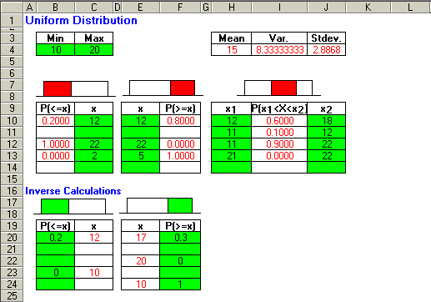
Calculating Uniform Distribution Probabilities using the Template

Slide 60
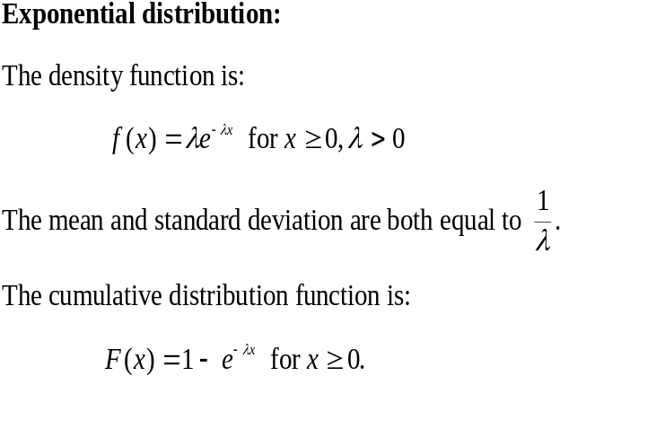
3-11 Exponential Distribution
E
x
p
o
n
e
n
t
i
a
l
D
i
s
t
r
i
b
u
t
i
o
n
:
λ
The exponential random variable measures the time between two occurrences that have a Poisson distribution.
=
2
2
)
x
(
f
1
0
0
1
2
3
Time

Slide 61
Exponential Distribution - Example
Example
The time a particular machine operates before breaking down (time between breakdowns) is known to have an exponential distribution with parameter λ = 2. Time is measured in hours. What is the probability that the machine will work continuously for at least one hour? What is the average time between breakdowns?
F
(
x
)
=
1
−
e
−
λ
x
⇒
P
(
X
≥
x
)
=
e
−
λ
x
1
1
≥
=
E
(
X
)
=
=
=
.
5
P
(
X
1
)
e
(
−
2
)(
1
)
λ
2
=
.
1353

Slide 62
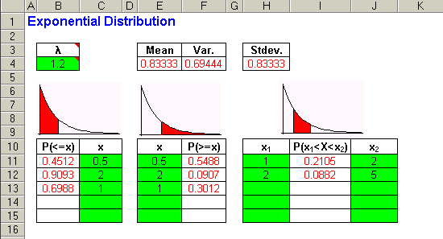
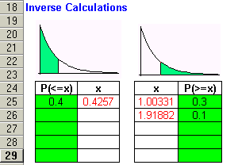
Calculating Exponential Distribution Probabilities using the Template

