Slide 1
COMPLETE
BUSINESS
STATISTICS
by
AMIR D. ACZEL
&
JAYAVEL SOUNDERPANDIAN
6th edition (SIE)

Slide 2
Chapter 8
The Comparison of Two Populations

Slide 3
8
The Comparison of Two Populations
Using Statistics
Paired-Observation Comparisons
A Test for the Difference between Two Population Means Using Independent Random Samples
A Large-Sample Test for the Difference between Two Population Proportions
The F Distribution and a Test for the Equality of Two Population Variances

Slide 4
8
LEARNING OBJECTIVES
After studying this chapter you should be able to:
Explain the need to compare two population parameters
Conduct a paired difference test for the difference in population means
Conduct an independent samples test for the difference in population means
Describe why a paired difference test is better than independent samples test
Conduct a test for difference in population proportions
Test whether two population variances are equal
Use templates to carry out all tests

Slide 5
8-1 Using Statistics
Inferences about differences between parameters of two populations
  Paired-Observations
  Observe the same group of persons or things
      At two different times: “before” and “after”
      Under two different sets of circumstances or “treatments”
  Independent Samples
    Observe different groups of persons or things
      At different times or under different sets of circumstances

Slide 6
8-2 Paired-Observation Comparisons
Population parameters may differ at two different times or under two different sets of circumstances or treatments because:
  The circumstances differ between times or treatments
  The people or things in the different groups are themselves different
By looking at paired-observations, we are able to minimize the “between group” , extraneous variation.

Slide 7
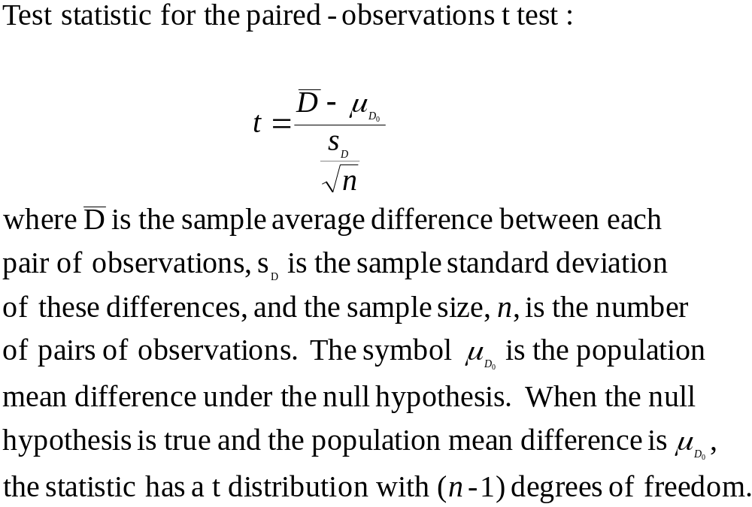
Paired-Observation Comparisons of Means

Slide 8
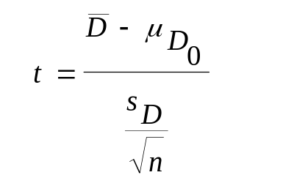
Example 8-1
A random sample of 16 viewers of Home Shopping Network was selected for an experiment. All viewers in the sample had recorded the amount of money they spent shopping during the holiday season of the previous year. The next year, these people were given access to the cable network and were asked to keep a record of their total purchases during the holiday season. Home Shopping Network managers want to test the null hypothesis that their service does not increase shopping volume, versus the alternative hypothesis that it does.
Shopper Previous Current Diff
1 334 405 71
2 150 125 -25
3 520 540 20
4 95 100 5
5 212 200 -12
6 30 30 0
7 1055 1200 145
8 300 265 -35
9 85 90 5
10 129 206 77
11 40 18 -22
12 440 489 49
13 610 590 -20
14 208 310 102
15 880 995 115
16 25 75 50
H₀: μ_{D} ≤ 0
H₁: μ_{D} > 0
df = (n-1) = (16-1) = 15
Test Statistic:
Critical Value: t_{0.05} = 1.753
Do not reject H₀ if : t ≤ 1.753
Reject H₀ if: t > 1.753

Slide 9
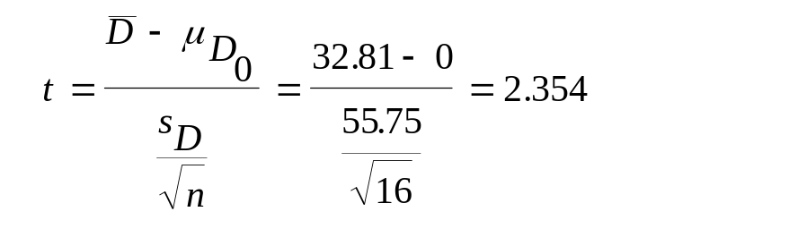
Example 8-1: Solution
t = 2.354 > 1.753, so H₀ is rejected and we conclude that there is evidence that shopping volume by network viewers has increased, with a p-value between 0.01 an 0.025. The Template output gives a more exact p-value of 0.0163. See the next slide for the output.
t
D
i
s
t
r
i
b
u
t
i
o
n
:
d
f
=
1
5
0
.
4
0
.
3
)
t
(
f
0
.
2
Nonrejection
Region
Rejection
Region
0
.
1
0
.
0
t
-
1.753
= t_{0.05}
5
0
5
2.131
= t_{0.025}
2.602
= t_{0.01}
2.354=
test
statistic

Slide 10
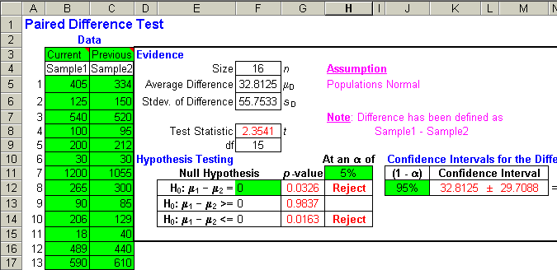
Example 8-1: Template for Testing Paired Differences

Slide 11
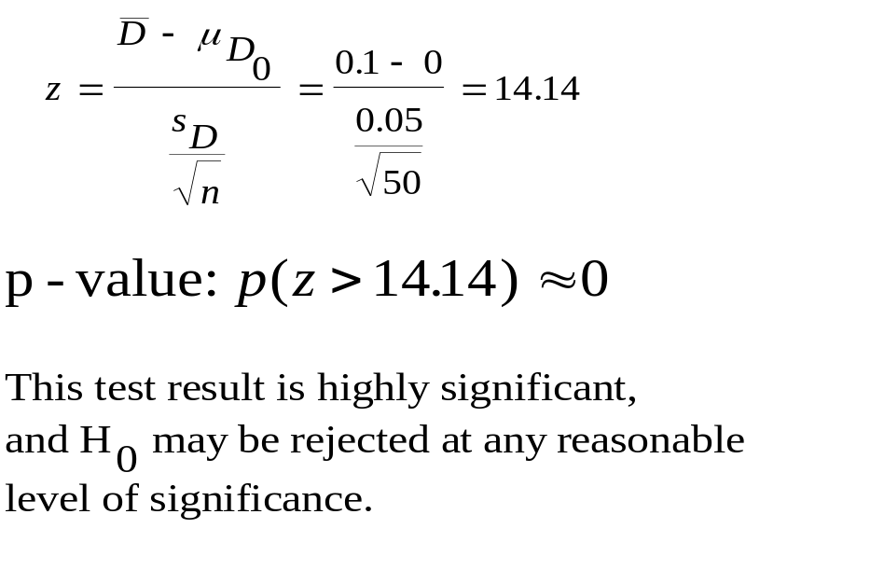
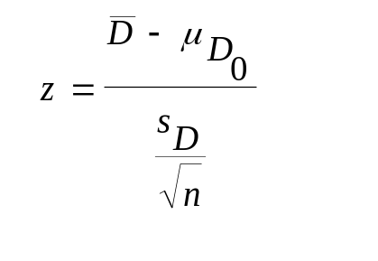
Example 8-2
It has recently been asserted that returns on stocks may change once a story about a company appears in The Wall Street Journal column “Heard on the Street.” An investments analyst collects a random sample of 50 stocks that were recommended as winners by the editor of “Heard on the Street,” and proceeds to conduct a two-tailed test of whether or not the annualized return on stocks recommended in the column differs between the month before and the month after the recommendation. For each stock the analysts computes the return before and the return after the event, and computes the difference in the two return figures. He then computes the average and standard deviation of the differences.
H₀: μ_{D} ≤ 0
H₁: μ_{D} > 0
n = 50
D = 0.1%
s_{D} = 0.05%
Test Statistic:

Slide 12
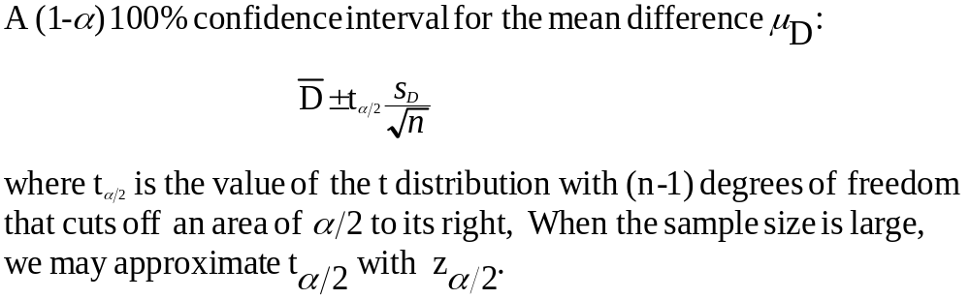
Confidence Intervals for Paired Observations

Slide 13
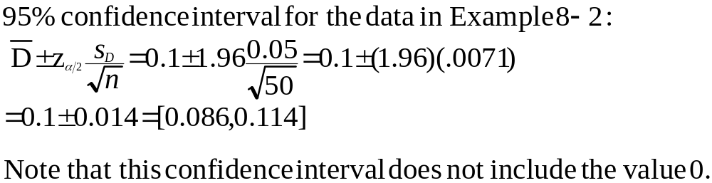
Confidence Intervals for Paired Observations – Example 8-2

Slide 14
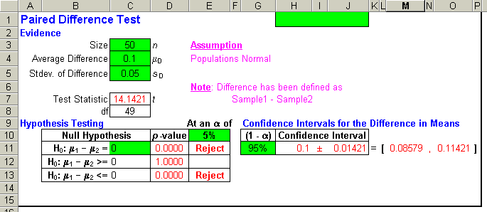
Confidence Intervals for Paired Observations – Example 8-2 Using the Template

Slide 15
8-3 A Test for the Difference between Two Population Means Using Independent Random Samples
When paired data cannot be obtained, use independent random samples drawn at different times or under different circumstances.
  Large sample test if:
    Both n₁≥ 30 and n₂≥ 30 (Central Limit Theorem), or
    Both populations are normal and σ₁ and σ₂ are both known
  Small sample test if:
    Both populations are normal and σ₁ and σ₂ are unknown

Slide 16
Comparisons of Two Population Means: Testing Situations
I: Difference between two population means is 0
  μ₁= μ₂
    H₀: μ₁ -μ₂ = 0
    H₁: μ₁ -μ₂ ≠ 0
II: Difference between two population means is less than 0
  μ₁≤ μ₂
    H₀: μ₁ -μ₂ ≤ 0
    H₁: μ₁ -μ₂ > 0
III: Difference between two population means is less than D
  μ₁ ≤ μ₂+D
    H₀: μ₁ -μ₂ ≤ D
    H₁: μ₁ -μ₂ > D

Slide 17
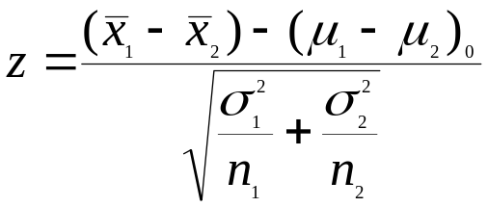
Comparisons of Two Population Means: Test Statistic
Large-sample test statistic for the difference between two population means:
The term (μ₁- μ₂)₀ is the difference between μ₁ an μ₂ under the null hypothesis. Is is equal to zero in situations I and II, and it is equal to the prespecified value D in situation III. The term in the denominator is the standard deviation of the difference between the two sample means (it relies on the assumption that the two samples are independent).

Slide 18
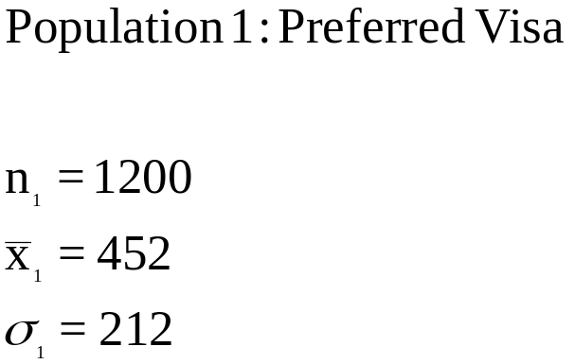
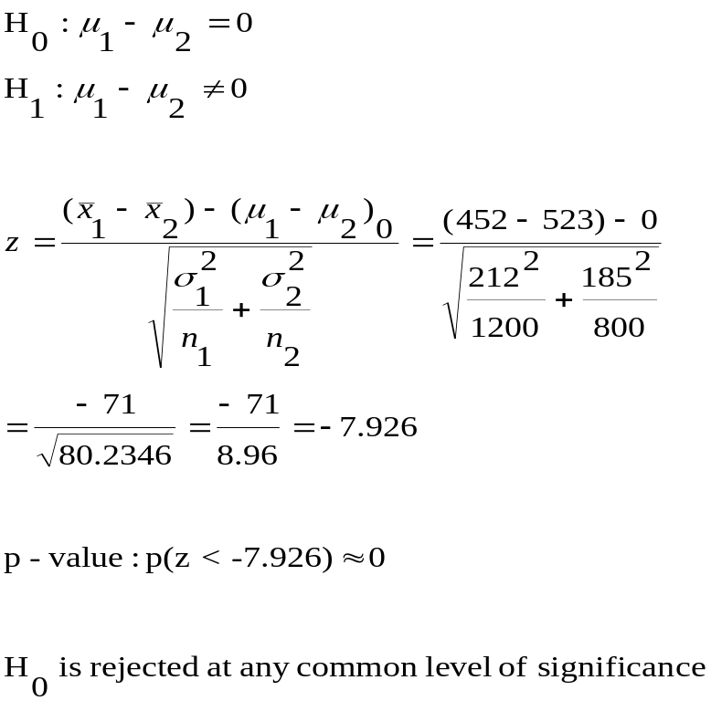
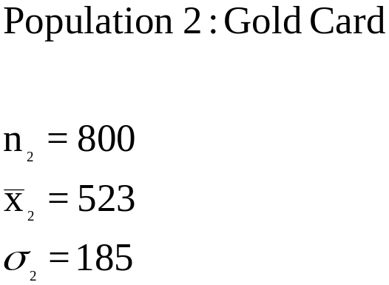
Two-Tailed Test for Equality of Two Population Means: Example 8-3
Is there evidence to conclude that the average monthly charge in the entire population of American Express Gold Card members is different from the average monthly charge in the entire population of Preferred Visa cardholders?

Slide 19
Example 8-3: Carrying Out the Test
Standard Normal Distribution
Since the value of the test statistic is far below the lower critical point, the null hypothesis may be rejected, and we may conclude that there is a statistically significant difference between the average monthly charges of Gold Card and Preferred Visa cardholders.
0
.
4
0
.
3
)
z
(
0
.
f
2
0
.
1
0
.
0
z
-z_{0.01}=-2.576
0
z_{0.01}=2.576
Rejection
Region
Nonrejection
Region
Rejection
Region
Test Statistic=-7.926

Slide 20
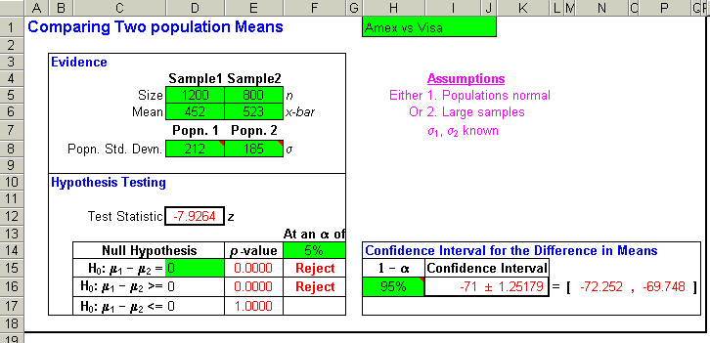
Example 8-3: Using the Template

Slide 21
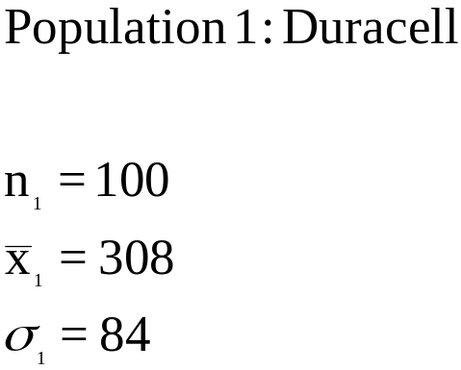
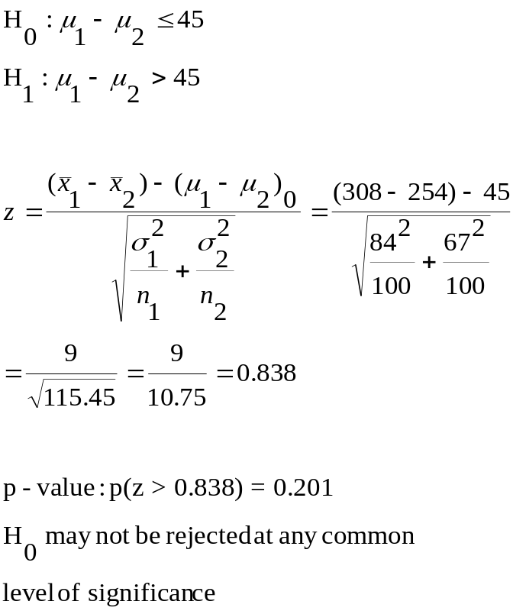
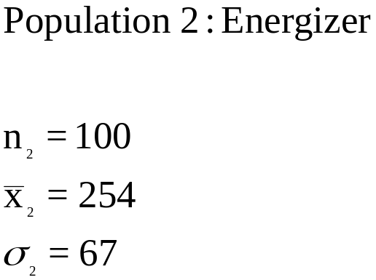
Two-Tailed Test for Difference Between Two Population Means: Example 8-4
Is there evidence to substantiate Duracell’s claim that their batteries last, on average, at least 45 minutes longer than Energizer batteries of the same size?

Slide 22
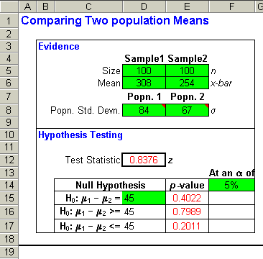
Two-Tailed Test for Difference Between Two Population Means: Example 8-4 – Using the Template
Is there evidence to substantiate Duracell’s claim that their batteries last, on average, at least 45 minutes longer than Energizer batteries of the same size?

Slide 23
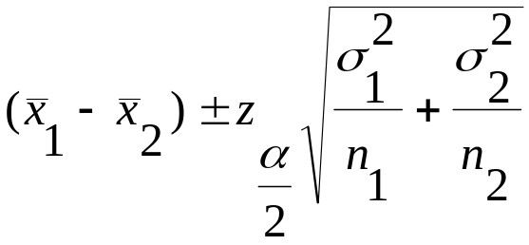
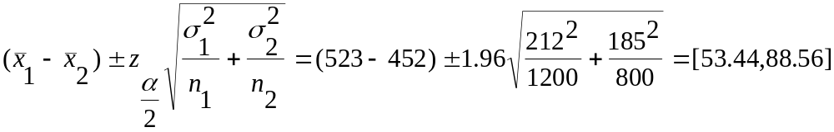
Confidence Intervals for the Difference between Two Population Means
A large-sample (1-α)100% confidence interval for the difference between two population means, μ₁- μ₂ , using independent random samples:
A 95% confidence interval using the data in example 8-3:

Slide 24
A Test for the Difference between Two Population Means: Assuming Equal Population Variances
If we might assume that the population variances σ₁² and σ₂² are equal (even though unknown), then the two sample variances, s₁² and s₂², provide two separate estimators of the common population variance. Combining the two separate estimates into a pooled estimate should give us a better estimate than either sample variance by itself.
Deviation from the mean. One for each sample data point.
Deviation from the mean. One for each sample data point.
}
}
*
*
*
*
*
*
*
*
*
*
*
*
*
*
*
*
*
*
*
*
*
*
*
*
*
*
*
*
Sample 1
Sample 2
x₁
x₂
From sample 1 we get the estimate s₁² with (n₁-1) degrees of freedom.
From sample 2 we get the estimate s₂² with (n₂-1) degrees of freedom.
From both samples together we get a pooled estimate, s_{p}² , with (n₁-1) + (n₂-1) = (n₁+ n₂ -2) total degrees of freedom.

Slide 25
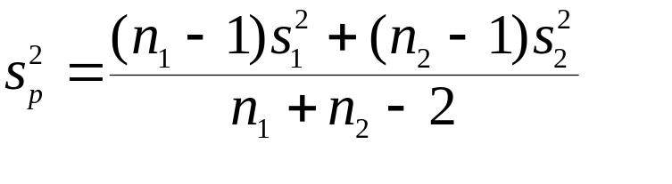
Pooled Estimate of the Population Variance
A pooled estimate of the common population variance, based on a sample variance s₁² from a sample of size n₁ and a sample variance s₂² from a sample of size n₂ is given by:
The degrees of freedom associated with this estimator is:
df = (n₁+ n₂-2)
The pooled estimate of the variance is a weighted average of the two individual sample variances, with weights proportional to the sizes of the two samples. That is, larger weight is given to the variance from the larger sample.

Slide 26
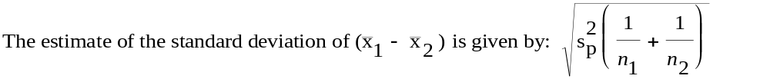
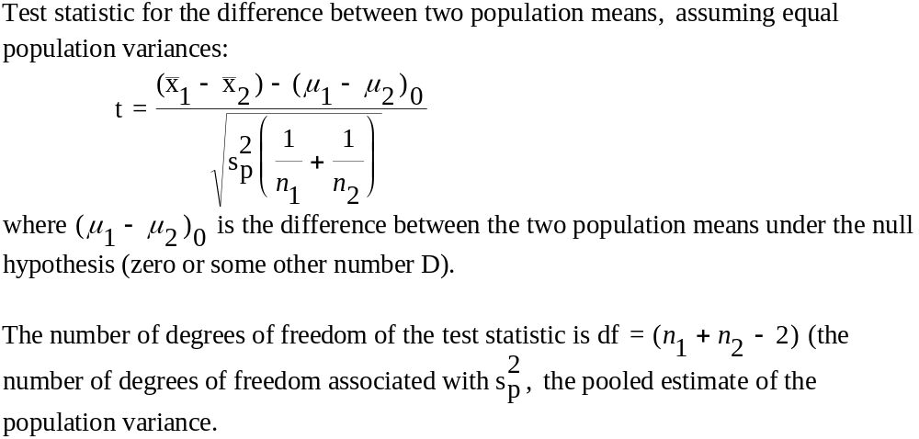
Using the Pooled Estimate of the Population Variance

Slide 27
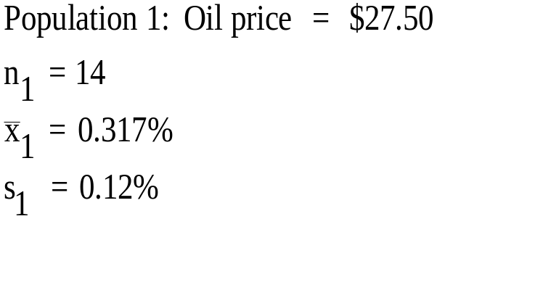
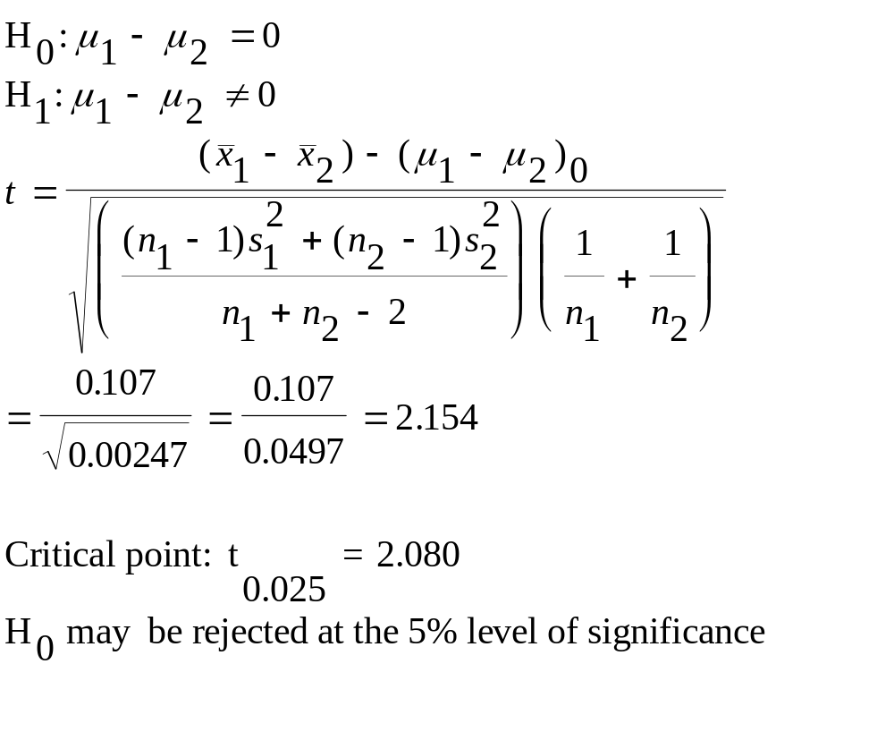
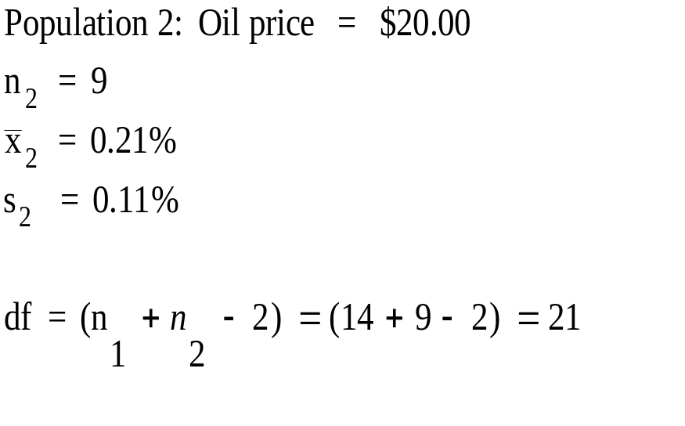
Example 8-5
Do the data provide sufficient evidence to conclude that average percentage increase in the CPI differs when oil sells at these two different prices?

Slide 28
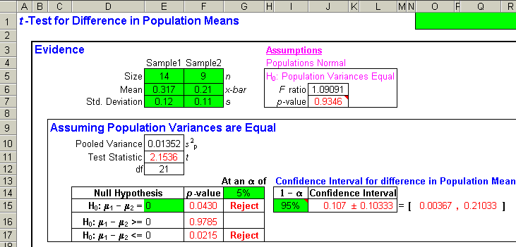
Example 8-5: Using the Template
Do the data provide sufficient evidence to conclude that average percentage increase in the CPI differs when oil sells at these two different prices?
P-value = 0.0430, so reject H₀ at the 5% significance level.

Slide 29
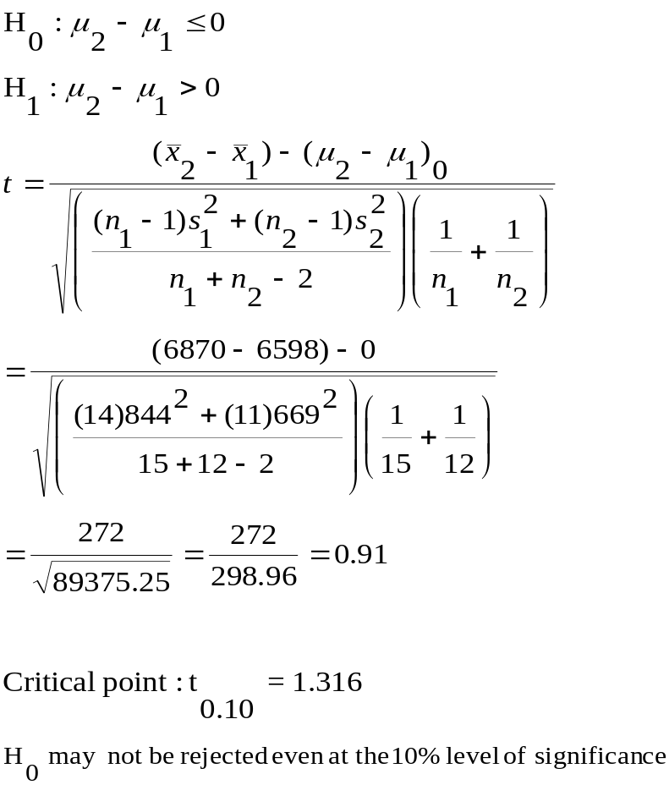
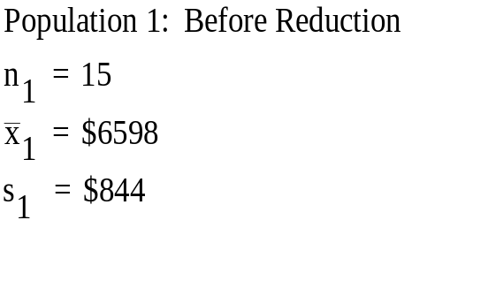
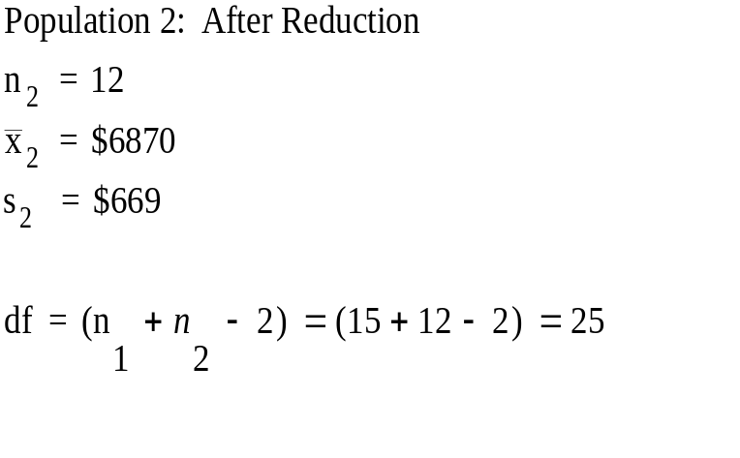
Example 8-6
The manufacturers of compact disk players want to test whether a small price reduction is enough to increase sales of their product. Is there evidence that the small price reduction is enough to increase sales of compact disk players?

Slide 30
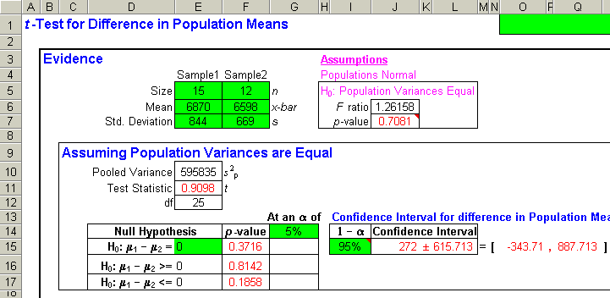
Example 8-6: Using the Template
P-value = 0.1858, so do not reject H₀ at the 5% significance level.

Slide 31
Example 8-6: Continued
t
D
i
s
t
r
i
b
u
t
i
o
n
:
d
f
=
2
5
Since the test statistic is less than t_{0.10,} the null hypothesis cannot be rejected at any reasonable level of significance. We conclude that the price reduction does not significantly affect sales.
0
.
4
0
.
3
)
t
(
f
0
.
2
0
.
1
0
.
0
t
-
5
-
4
-
3
-
2
-
1
0
1
2
3
4
5
t_{0.10}=1.316
Nonrejection
Region
Rejection
Region
Test Statistic=0.91

Slide 32
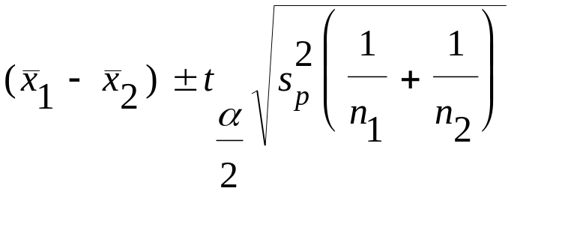
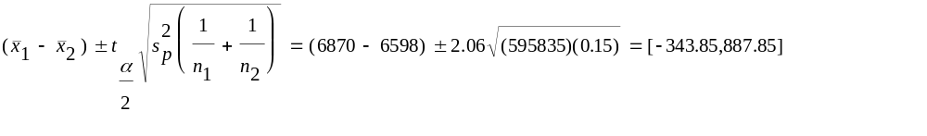
Confidence Intervals Using the Pooled Variance
A (1-α) 100% confidence interval for the difference between two population means, μ₁- μ₂ , using independent random samples and assuming equal population variances:
A 95% confidence interval using the data in Example 8-6:

Slide 33
Confidence Intervals Using the Pooled Variance and the Template-Example 8-6
Confidence Interval

Slide 34
8-4 A Large-Sample Test for the Difference between Two Population Proportions
Hypothesized difference is zero
  I: Difference between two population proportions is 0
    p₁= p₂
      H₀: p₁ -p₂ = 0
      H₁: p₁ -p₂ ≠ 0
  II: Difference between two population proportions is less than 0
    p₁≤ p₂
      H₀: p₁ -p₂ ≤ 0
      H₁: p₁ -p₂ > 0
Hypothesized difference is other than zero:
  III: Difference between two population proportions is less than D
    p₁ ≤ p₂+D
      H₀:p-p₂ ≤ D
      H₁: p₁ -p₂ > D

Slide 35
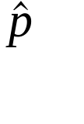
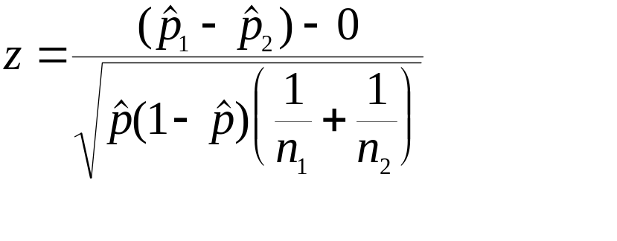
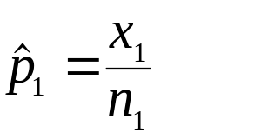
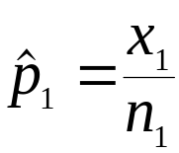
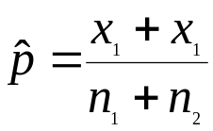
Comparisons of Two Population Proportions When the Hypothesized Difference Is Zero: Test Statistic
When the population proportions are hypothesized to be equal, then a pooled estimator of the proportion ( ) may be used in calculating the test statistic.
A large-sample test statistic for the difference between two population proportions, when the hypothesized difference is zero:
where is the sample proportion in sample 1 and is the sample
proportion in sample 2. The symbol stands for the combined sample proportion in both samples, considered as a single sample. That is:

Slide 36
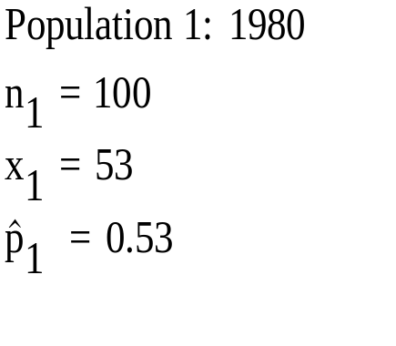
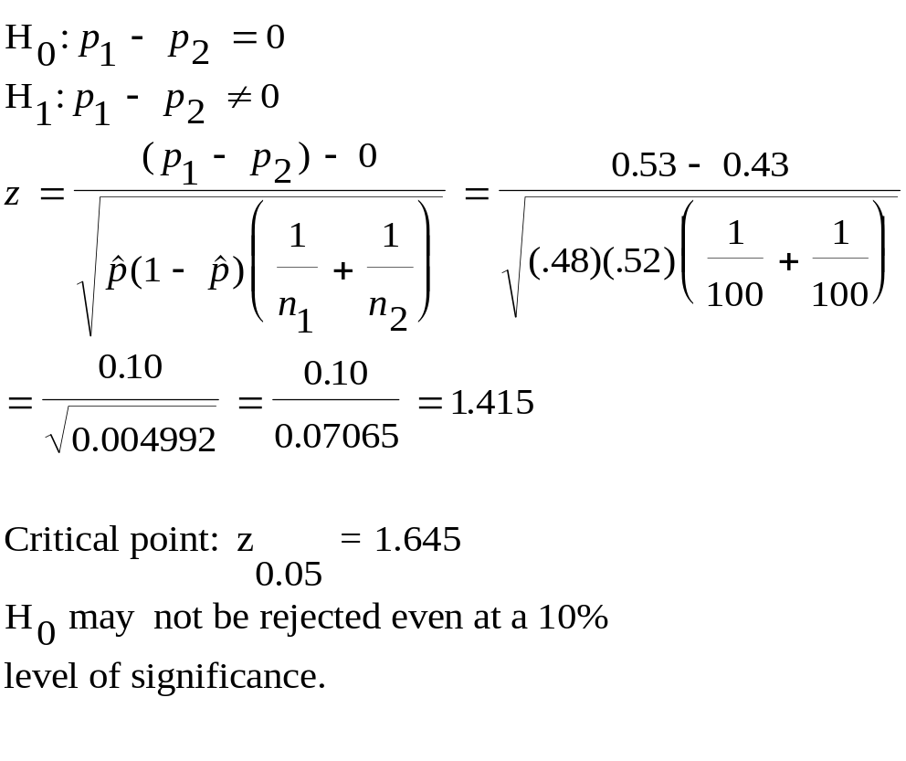
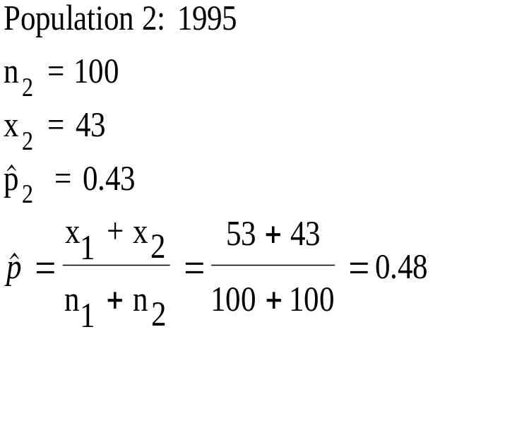
Comparisons of Two Population Proportions When the Hypothesized Difference Is Zero: Example 8-7
Carry out a two-tailed test of the equality of banks’ share of the car loan market in 1980 and 1995.

Slide 37
Example 8-7: Carrying Out the Test
Standard Normal Distribution
Since the value of the test statistic is within the nonrejection region, even at a 10% level of significance, we may conclude that there is no statistically significant difference between banks’ shares of car loans in 1980 and 1995.
0
.
4
0
.
3
)
z
(
0
.
f
2
0
.
1
0
.
0
z
-z_{0.05}=-1.645
0
z_{0.05}=1.645
Rejection
Region
Nonrejection
Region
Rejection
Region
Test Statistic=1.415

Slide 38
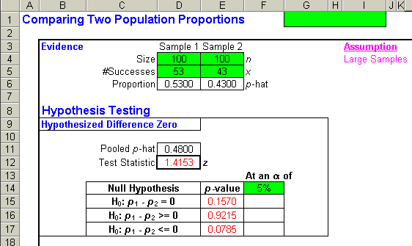
Example 8-7: Using the Template
P-value = 0.157, so do not reject H₀ at the 5% significance level.

Slide 39
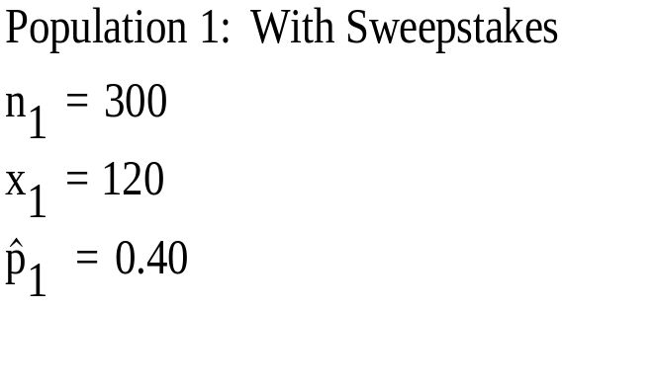
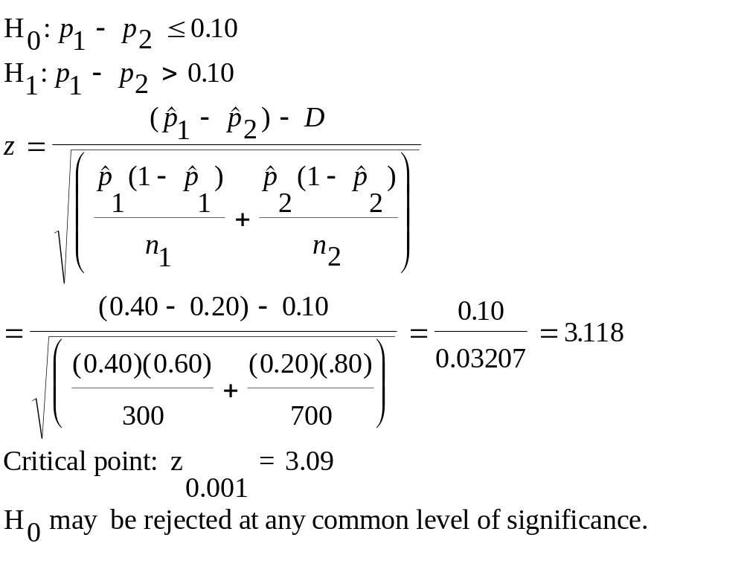
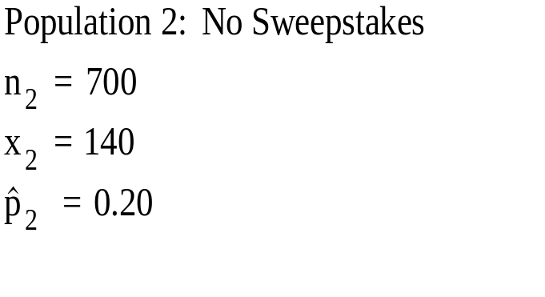
Comparisons of Two Population Proportions When the Hypothesized Difference Is Not Zero: Example 8-8
Carry out a one-tailed test to determine whether the population proportion of traveler’s check buyers who buy at least $2500 in checks when sweepstakes prizes are offered as at least 10% higher than the proportion of such buyers when no sweepstakes are on.

Slide 40
Example 8-8: Carrying Out the Test
Standard Normal Distribution
Since the value of the test statistic is above the critical point, even for a level of significance as small as 0.001, the null hypothesis may be rejected, and we may conclude that the proportion of customers buying at least $2500 of travelers checks is at least 10% higher when sweepstakes are on.
0
.
4
0
.
3
)
z
(
0
.
f
2
0
.
1
0
.
0
z
0
z_{0.001}=3.09
Nonrejection
Region
Rejection
Region
Test Statistic=3.118

Slide 41
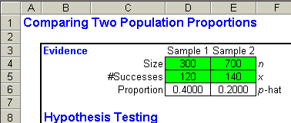
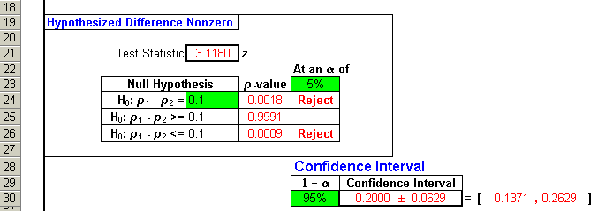
Example 8-8: Using the Template
P-value = 0.0009, so reject H₀ at the 5% significance level.

Slide 42
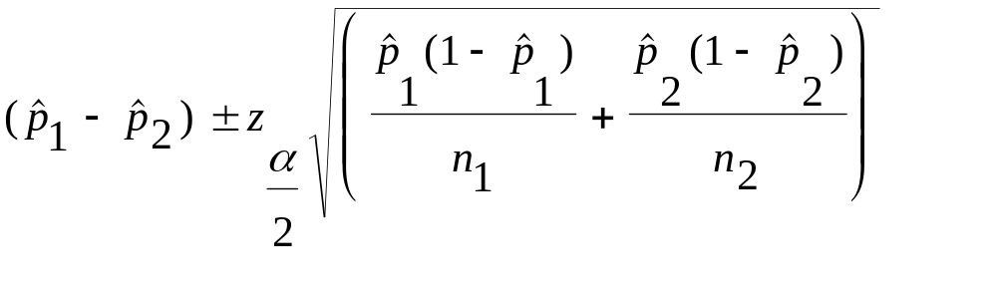
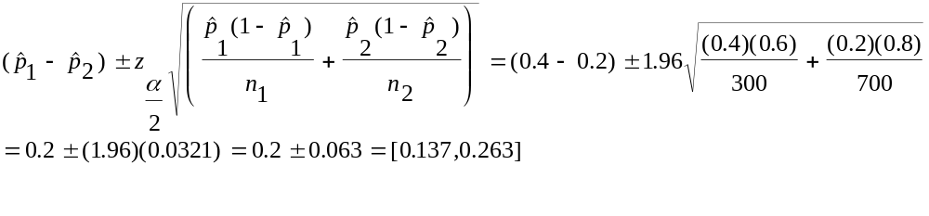
Confidence Intervals for the Difference between Two Population Proportions
A (1-α) 100% large-sample confidence interval for the difference between two population proportions:
A 95% confidence interval using the data in example 8-8:

Slide 43
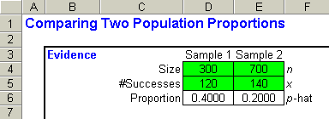

Confidence Intervals for the Difference between Two Population Proportions – Using the Template – Using the Data from Example 8-8

Slide 44

8-5 The F Distribution and a Test for Equality of Two Population Variances
The F distribution is the distribution of the ratio of two chi-square random variables that are independent of each other, each of which is divided by its own degrees of freedom.
An F random variable with k₁ and k₂ degrees of freedom:

Slide 45
The F Distribution
The F random variable cannot be negative, so it is bound by zero on the left.
The F distribution is skewed to the right.
The F distribution is identified the number of degrees of freedom in the numerator, k₁, and the number of degrees of freedom in the denominator, k₂.
F
D
i
s
t
r
i
b
u
t
i
o
n
s
w
i
t
h
d
i
f
f
e
r
e
n
t
D
e
g
r
e
e
s
o
f
F
r
e
e
d
o
m
1
F_{(25,30)}
.
f(F)
0
F_{(10,15)}
0
.
5
0
F_{(5,6)}
.
0
0
1
2
3
4
5
F

Slide 46

Using the Table of the F Distribution
Critical Points of the F Distribution Cutting Off a
Right-Tail Area of 0.05
k₁ 1 2 3 4 5 6 7 8 9
k₂
1 161.4 199.5 215.7 224.6 230.2 234.0 236.8 238.9 240.5
2 18.51 19.00 19.16 19.25 19.30 19.33 19.35 19.37 19.38
3 10.13 9.55 9.28 9.12 9.01 8.94 8.89 8.85 8.81
4 7.71 6.94 6.59 6.39 6.26 6.16 6.09 6.04 6.00
5 6.61 5.79 5.41 5.19 5.05 4.95 4.88 4.82 4.77
6 5.99 5.14 4.76 4.53 4.39 4.28 4.21 4.15 4.10
7 5.59 4.74 4.35 4.12 3.97 3.87 3.79 3.73 3.68
8 5.32 4.46 4.07 3.84 3.69 3.58 3.50 3.44 3.39
9 5.12 4.26 3.86 3.63 3.48 3.37 3.29 3.23 3.18
10 4.96 4.10 3.71 3.48 3.33 3.22 3.14 3.07 3.02
11 4.84 3.98 3.59 3.36 3.20 3.09 3.01 2.95 2.90
12 4.75 3.89 3.49 3.26 3.11 3.00 2.91 2.85 2.80
13 4.67 3.81 3.41 3.18 3.03 2.92 2.83 2.77 2.71
14 4.60 3.74 3.34 3.11 2.96 2.85 2.76 2.70 2.65
15 4.54 3.68 3.29 3.06 2.90 2.79 2.71 2.64 2.59
F
D
i
s
t
r
i
b
u
t
i
o
n
w
i
t
h
7
a
n
d
1
1
D
e
g
r
e
e
s
o
f
F
r
e
e
d
o
m
0
.
7
0
.
6
0
.
5
)
0
.
F
4
(
f
0
.
3
0
.
2
0
.
1
0
F
.
0
0
1
2
3
4
5
3.01
F_{0.05}=3.01
The left-hand critical point to go along with F_{(k1,k2)} is given by:
Where F_{(k1,k2)} is the right-hand critical point for an F random variable with the reverse number of degrees of freedom.

Slide 47

Critical Points of the F Distribution:
F(6, 9), α = 0.10
F
The right-hand critical point read directly from the table of the F distribution is:
F_{(6,9)} =3.37
The corresponding left-hand critical point is given by:
D
i
s
t
r
i
b
u
t
i
o
n
w
i
t
h
6
a
n
d
9
D
e
g
r
e
e
s
o
f
F
r
e
e
d
o
m
0
.
7
0
0.90
.
0.05
6
0
.
5
)
0
.
F
4
(
f
0
.
3
0.05
0
.
2
0
.
1
0
.
0
F
0
1
2
3
4
5
F_{0.95}=(1/4.10)=0.2439
F_{0.05}=3.37

Slide 48

Test Statistic for the Equality of Two Population Variances
I: Two-Tailed Test
  σ₁ = σ₂
      H₀: σ₁ = σ₂
      H₁: σ₁ ≠ σ₂
II: One-Tailed Test
  σ₁≤σ₂
      H₀: σ₁ ≤ σ₂
      H₁: σ₁ > σ₂

Slide 49


Example 8-9
The economist wants to test whether or not the event (interceptions and prosecution of insider traders) has decreased the variance of prices of stocks.

Slide 50
Example 8-9: Solution
Distribution with 24 and 23 Degrees of Freedom
Since the value of the test statistic is above the critical point, even for a level of significance as small as 0.01, the null hypothesis may be rejected, and we may conclude that the variance of stock prices is reduced after the interception and prosecution of inside traders.
0
.
7
0
.
6
0
.
5
)
0
.
F
4
(
f
0
.
3
0
.
2
0
.
1
0
F
.
0
0
1
2
3
4
5
F_{0.01}=2.7
Test Statistic=3.1

Slide 51

Example 8-9: Solution Using the Template
Observe that the p-value for the test is 0.0042 which is less than 0.01. Thus the null hypothesis must be rejected at this level of significance of 0.01.

Slide 52


Example 8-10: Testing the Equality of Variances for Example 8-5

Slide 53
Example 8-10: Solution
F Distribution with 13 and 8 Degrees of Freedom
Since the value of the test statistic is between the critical points, even for a 20% level of significance, we can not reject the null hypothesis. We conclude the two population variances are equal.
0
.
7
0
0.80
.
0.10
6
0
.
5
)
0
.
F
4
(
f
0
.
3
0.10
0
.
2
0
.
1
0
.
0
F
0
1
2
3
4
5
F_{0.90}=(1/2.20)=0.4545
F_{0.10}=3.28
Test Statistic=1.19

Slide 54

Template to test for the Difference between Two Population Variances: Example 8-10
Observe that the p-value for the test is 0.8304 which is larger than 0.05. Thus the null hypothesis cannot be rejected at this level of significance of 0.05. That is, one can assume equal variance.

Slide 55

The F Distribution Template

Slide 56

The Template for Testing Equality of Variances

