Slide 1
COMPLETE
BUSINESS
STATISTICS
by
AMIR D. ACZEL
&
JAYAVEL SOUNDERPANDIAN
6th edition (SIE)

Slide 2
Chapter 10
Simple Linear Regression and Correlation

Slide 3
10
Simple Linear Regression and Correlation
Using Statistics
The Simple Linear Regression Model
Estimation: The Method of Least Squares
Error Variance and the Standard Errors of Regression Estimators
Correlation
Hypothesis Tests about the Regression Relationship
How Good is the Regression?
Analysis of Variance Table and an F Test of the Regression Model
Residual Analysis and Checking for Model Inadequacies
Use of the Regression Model for Prediction
The Solver Method for Regression

Slide 4
10
LEARNING OBJECTIVES
After studying this chapter, you should be able to:
Determine whether a regression experiment would be useful in a given instance
Formulate a regression model
Compute a regression equation
Compute the covariance and the correlation coefficient of two random variables
Compute confidence intervals for regression coefficients
Compute a prediction interval for the dependent variable

Slide 5
10
LEARNING OBJECTIVES (continued)
After studying this chapter, you should be able to:
Test hypothesis about a regression coefficients
Conduct an ANOVA experiment using regression results
Analyze residuals to check if the assumptions about the regression model are valid
Solve regression problems using spreadsheet templates
Apply covariance concept to linear composites of random variables
Use LINEST function to carry out a regression

Slide 6
10-1 Using Statistics
Regression refers to the statistical technique of modeling the
relationship between variables.
In simple linear regression, we model the relationship between two variables.
One of the variables, denoted by Y, is called the dependent variable and the other, denoted by X, is called the independent variable.
The model we will use to depict the relationship between X and Y will be a straight-line relationship.
A graphical sketch of the the pairs (X, Y) is called a scatter plot.

Slide 7
10-1 Using Statistics
This scatterplot locates pairs of observations of advertising expenditures on the x-axis and sales on the y-axis. We notice that:
Larger (smaller) values of sales tend to be associated with larger (smaller) values of advertising.
S
c
a
t
t
e
r
p
l
o
t
o
f
A
d
v
e
r
t
i
s
i
n
g
E
x
p
e
n
d
i
t
u
r
e
s
(
X
)
a
n
d
S
a
l
e
s
(
Y
)
1
4
0
1
2
0
1
0
0
s
8
0
e
l
a
S
6
0
4
0
2
0
0
0
1
0
2
0
3
0
4
0
5
0
A
d
v
e
r
t
i
s
i
n
g
The scatter of points tends to be distributed around a positively sloped straight line.
The pairs of values of advertising expenditures and sales are not located exactly on a straight line.
The scatter plot reveals a more or less strong tendency rather than a precise linear relationship.
The line represents the nature of the relationship on average.

Slide 8
Examples of Other Scatterplots
0
0
Y
Y
Y
0
0
X
0
X
X
Y
Y
Y
X
X
X

Slide 9
Model Building
The inexact nature of the relationship between advertising and sales suggests that a statistical model might be useful in analyzing the relationship.
A statistical model separates the systematic component of a relationship from the random component.
Data
In ANOVA, the systematic component is the variation of means between samples or treatments (SSTR) and the random component is the unexplained variation (SSE).
In regression, the systematic component is the overall linear relationship, and the random component is the variation around the line.
Statistical
model
Systematic
component
+
Random
errors

Slide 10
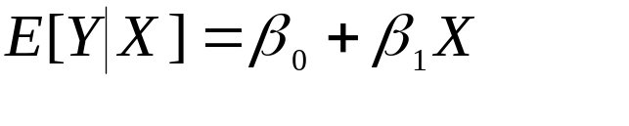
10-2 The Simple Linear Regression Model
The population simple linear regression model:
Y= β₀ + β₁ X + ε
Nonrandom or Random
Systematic Component
Component
where
Y is the dependent variable, the variable we wish to explain or predict
X is the independent variable, also called the predictor variable
ε is the error term, the only random component in the model, and thus, the
only source of randomness in Y.
β₀ is the intercept of the systematic component of the regression relationship.
β₁ is the slope of the systematic component.
The conditional mean of Y:

Slide 11
Picturing the Simple Linear
Regression Model
Y
Regression Plot
The simple linear regression model gives an exact linear relationship between the expected or average value of Y, the dependent variable, and X, the independent or predictor variable:
E[Y_{i}]=β₀ + β₁ X_{i}
Actual observed values of Y differ from the expected value by an unexplained or random error:
Y_{i} = E[Y_{i}] + ε_{i}
= β₀ + β₁ X_{i} + ε_{i}
E[Y]=β₀ + β₁ X
Y_{i}
{
}
}
Error: ε_{i}
β₁ = Slope
1
β₀ = Intercept
X
X_{i}

Slide 12
Assumptions of the Simple Linear Regression Model
The relationship between X and Y is a straight-line relationship.
The values of the independent variable X are assumed fixed (not random); the only randomness in the values of Y comes from the error term ε_{i}.
The errors ε_{i} are normally distributed with mean 0 and variance σ². The errors are uncorrelated (not related) in successive observations. That is: ε~ N(0,σ²)
Assumptions of the Simple Linear Regression Model
Y
E[Y]=β₀ + β₁ X
Identical normal distributions of errors, all centered on the regression line.
X

Slide 13
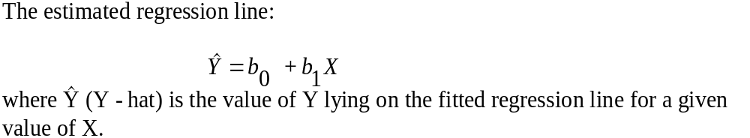
10-3 Estimation: The Method of Least Squares
Estimation of a simple linear regression relationship involves finding estimated or predicted values of the intercept and slope of the linear regression line.
The estimated regression equation:
Y = b₀ + b₁X + e
where b₀ estimates the intercept of the population regression line, β₀ ;
b₁ estimates the slope of the population regression line, β₁;
and e stands for the observed errors - the residuals from fitting the estimated regression line b₀ + b₁X to a set of n points.

Slide 14
Fitting a Regression Line
Y
Y
Data
Three errors from the least squares regression line
X
X
Y
Three errors from a fitted line
Errors from the least squares regression line are minimized
X
X

Slide 15

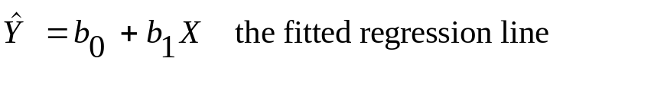

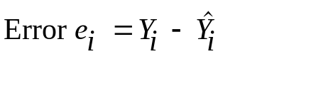
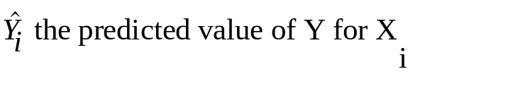
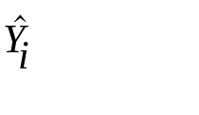
Errors in Regression
Y
.
{
X
X_{i}

Slide 16
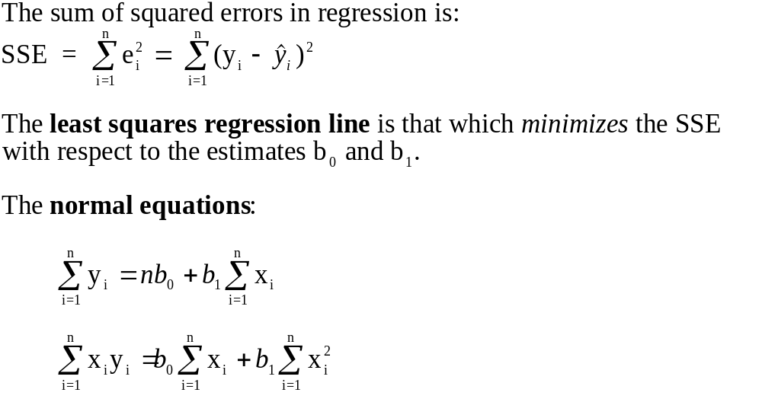
Least Squares Regression
SSE
b₀
At this point SSE is minimized with respect to b₀ and b₁
Least squares b₀
Least squares b₁
b₁

Slide 17
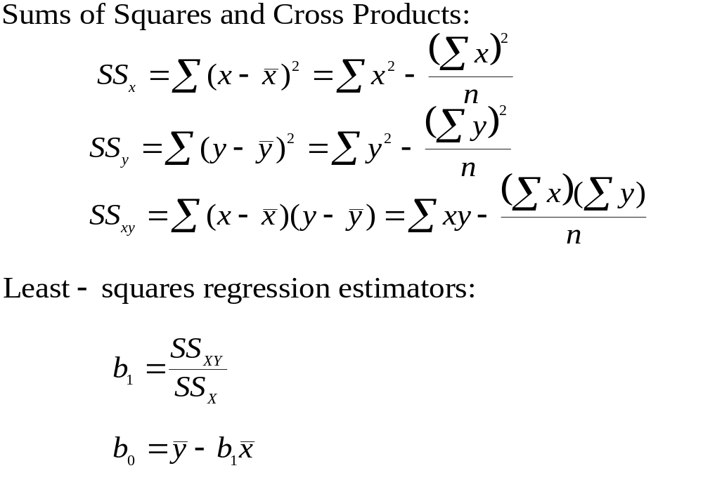
Sums of Squares, Cross Products, and Least Squares Estimators

Slide 18
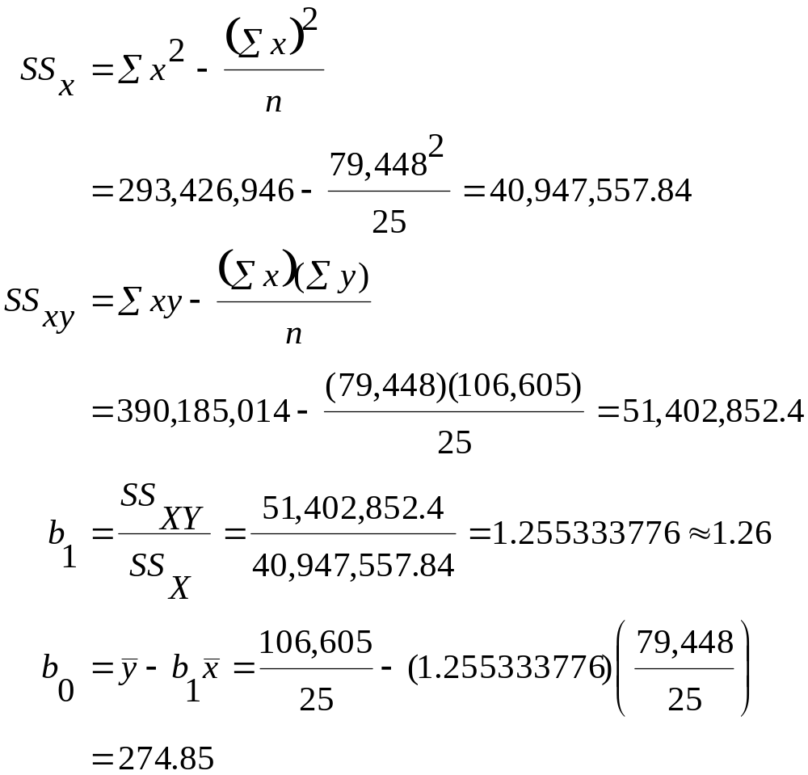
Example 10-1
Miles Dollars Miles ² Miles*Dollars
1211 1802 1466521 2182222
1345 2405 1809025 3234725
1422 2005 2022084 2851110
1687 2511 2845969 4236057
1849 2332 3418801 4311868
2026 2305 4104676 4669930
2133 3016 4549689 6433128
2253 3385 5076009 7626405
2400 3090 5760000 7416000
2468 3694 6091024 9116792
2699 3371 7284601 9098329
2806 3998 7873636 11218388
3082 3555 9498724 10956510
3209 4692 10297681 15056628
3466 4244 12013156 14709704
3643 5298 13271449 19300614
3852 4801 14837904 18493452
4033 5147 16265089 20757852
4267 5738 18207288 24484046
4498 6420 20232004 28877160
4533 6059 20548088 27465448
4804 6426 23078416 30870504
5090 6321 25908100 32173890
5233 7026 27384288 36767056
5439 6964 29582720 37877196
79,448 106,605 293,426,946 390,185,014

Slide 19
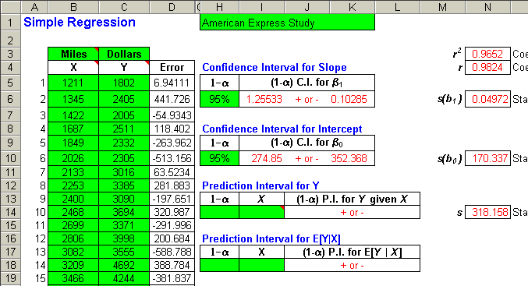
Template (partial output) that can be used to carry out a Simple Regression

Slide 20
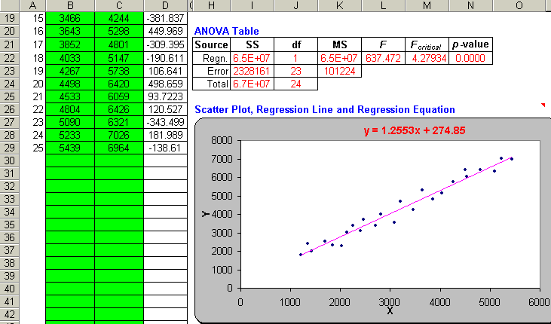
Template (continued) that can be used to carry out a Simple Regression

Slide 21
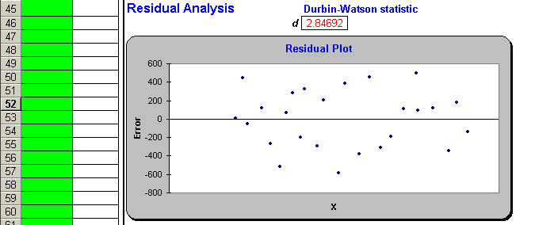
Template (continued) that can be used to carry out a Simple Regression
Residual Analysis. The plot shows the absence of a relationship
between the residuals and the X-values (miles).

Slide 22
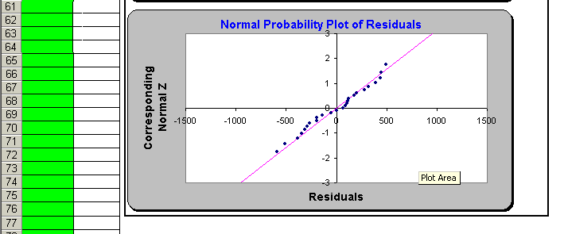
Template (continued) that can be used to carry out a Simple Regression
Note: The normal probability plot is approximately linear. This would indicate that the normality assumption for the errors has not been violated.

Slide 23

Total Variance and Error Variance
Y
Y
X
X
What you see when looking at the total variation of Y.
What you see when looking along the regression line at the error variance of Y.

Slide 24
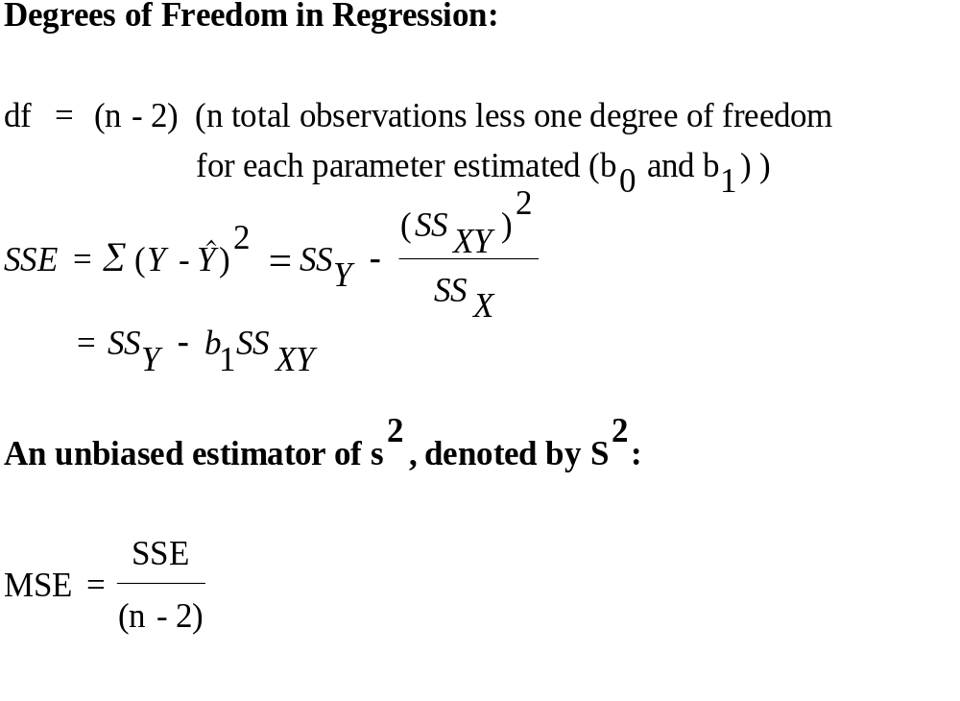
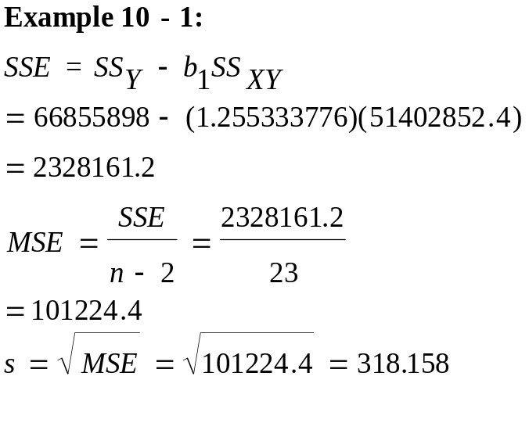
10-4 Error Variance and the Standard Errors of Regression Estimators
Y
Square and sum all regression errors to find SSE.
X

Slide 25
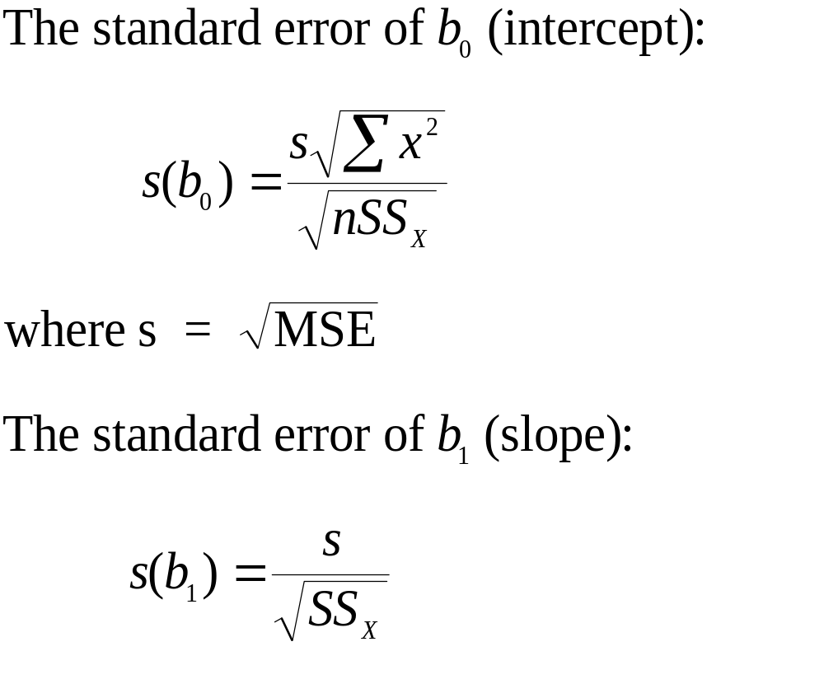
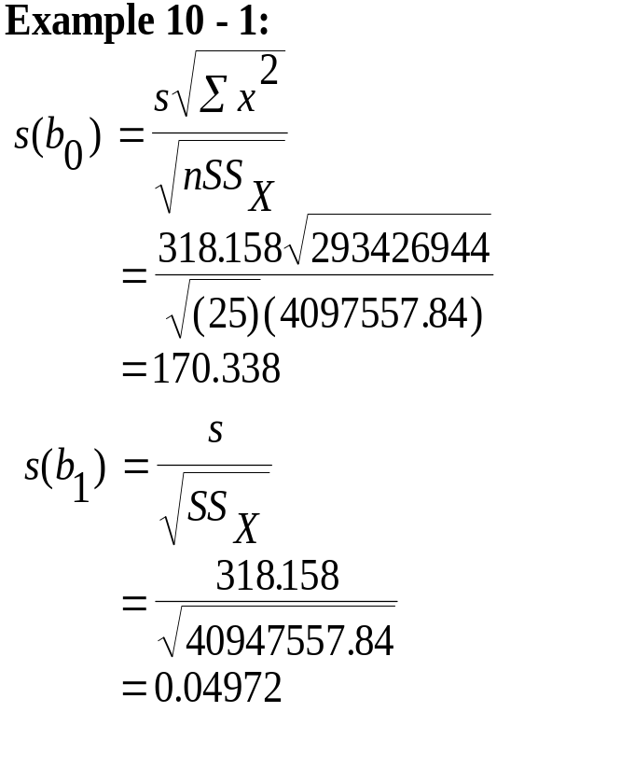
Standard Errors of Estimates in Regression

Slide 26
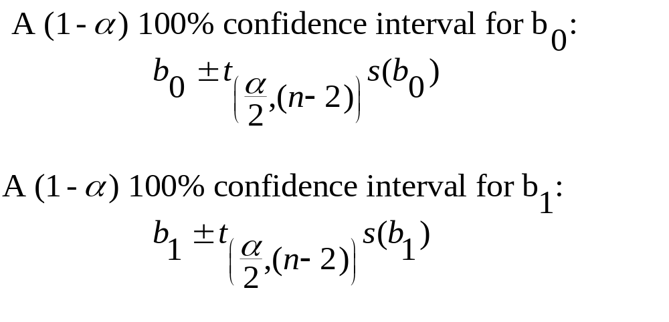
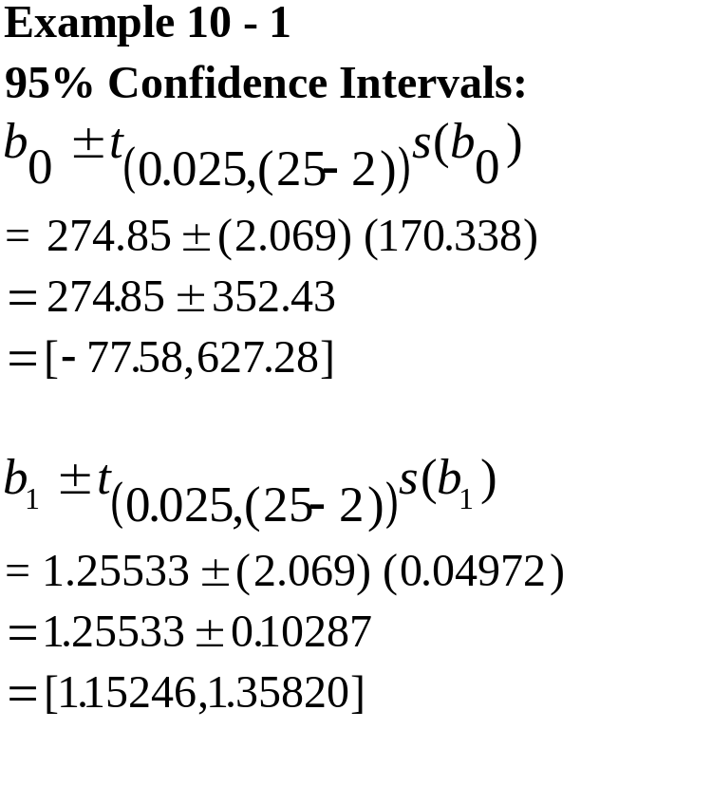
Confidence Intervals for the Regression Parameters
Least-squares point estimate:
b₁=1.25533
Upper 95% bound on slope: 1.35820
Height = Slope
Lower 95% bound: 1.15246
Length = 1
0
(not a possible value of the
regression slope at 95%)

Slide 27
Template (partial output) that can be used to obtain Confidence Intervals for β₀ and β₁

Slide 28
10-5 Correlation
The correlation between two random variables, X and Y, is a measure of the degree of linear association between the two variables.
The population correlation, denoted by ρ, can take on any value from -1 to 1.
ρ = −1 indicates a perfect negative linear relationship
-1 < ρ < 0 indicates a negative linear relationship
ρ = 0indicates no linear relationship
0 < ρ < 1 indicates a positive linear relationship
ρ = 1 indicates a perfect positive linear relationship
The absolute value of ρ indicates the strength or exactness of the relationship.

Slide 29
Illustrations of Correlation
Y
Y
Y
ρ = -1
ρ = 0
ρ = 1
X
X
X
Y
ρ = -.8
Y
ρ = 0
Y
ρ = .8
X
X
X

Slide 30
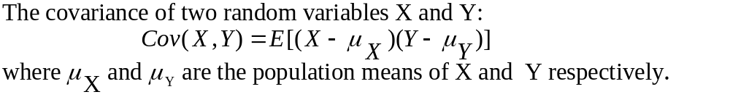
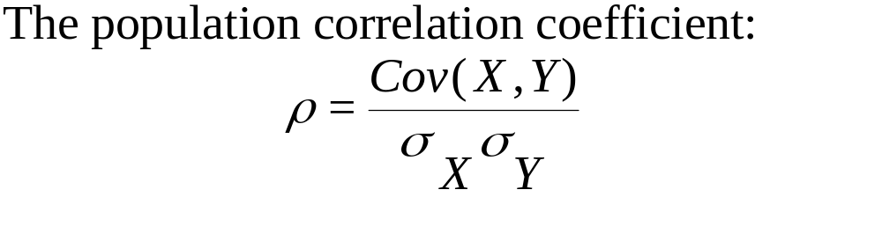
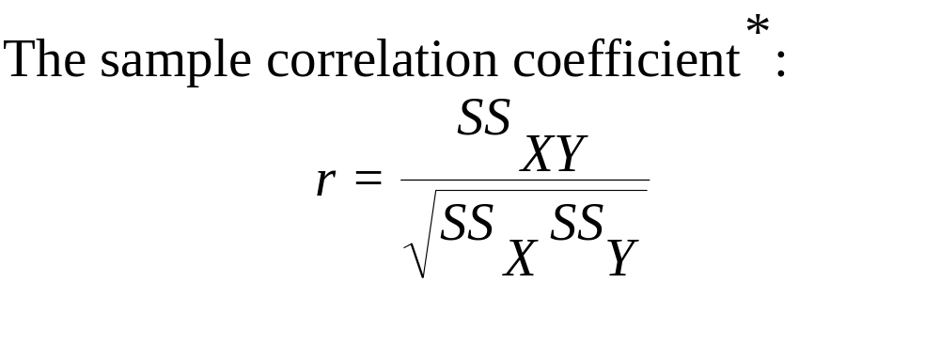
Covariance and Correlation
Example 10
-
1:
SS
r
=
XY
SS
SS
X
Y
51402852.
4
=
(
40947557.
84
)(
66855898
)
51402852.
4
=
=
.
9824
52321943
.
29
*Note: If ρ < 0, b₁ < 0 If ρ = 0, b₁ = 0 If ρ > 0, b₁ >0

Slide 31
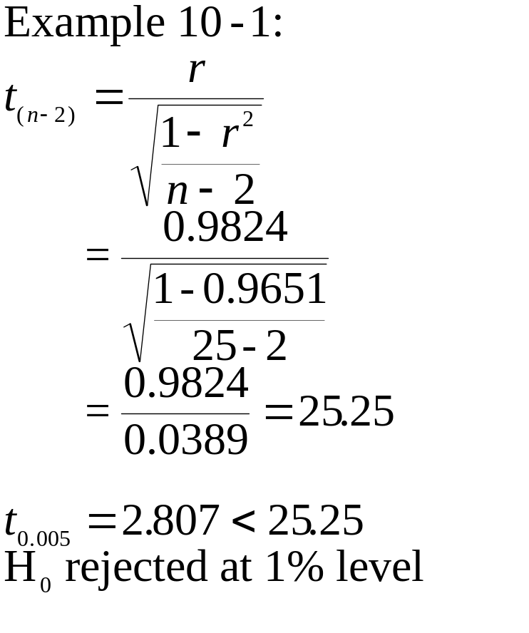
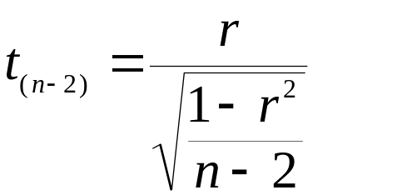
Hypothesis Tests for the Correlation Coefficient
H₀: ρ = 0 (No linear relationship)
H₁: ρ ≠ 0 (Some linear relationship)
Test Statistic:

Slide 32
10-6 Hypothesis Tests about the Regression Relationship
Constant Y
Unsystematic Variation
Nonlinear Relationship
Y
Y
Y
X
X
X
A hypothes
is test fo
r the exis
tence of a
linear re
lationship
between X
and Y:
H
0
:
β
1
=
0
H
1
:
β
1
≠
0
Test stati
stic for t
he existen
ce of a li
near relat
ionship be
tween X an
d Y:
b
t
=
1
(
n
-
2
)
s
(
b
)
1
where
b
is the le
ast
-
squares es
timate of
the regres
sion slope
and
s
(
b
) is the s
tandard er
ror of
b
.
1
1
1
When the
null hypot
hesis is t
rue,
the stati
stic has a
t
distribu
tion with
n
-
2
degrees o
f
freedom.

Slide 33
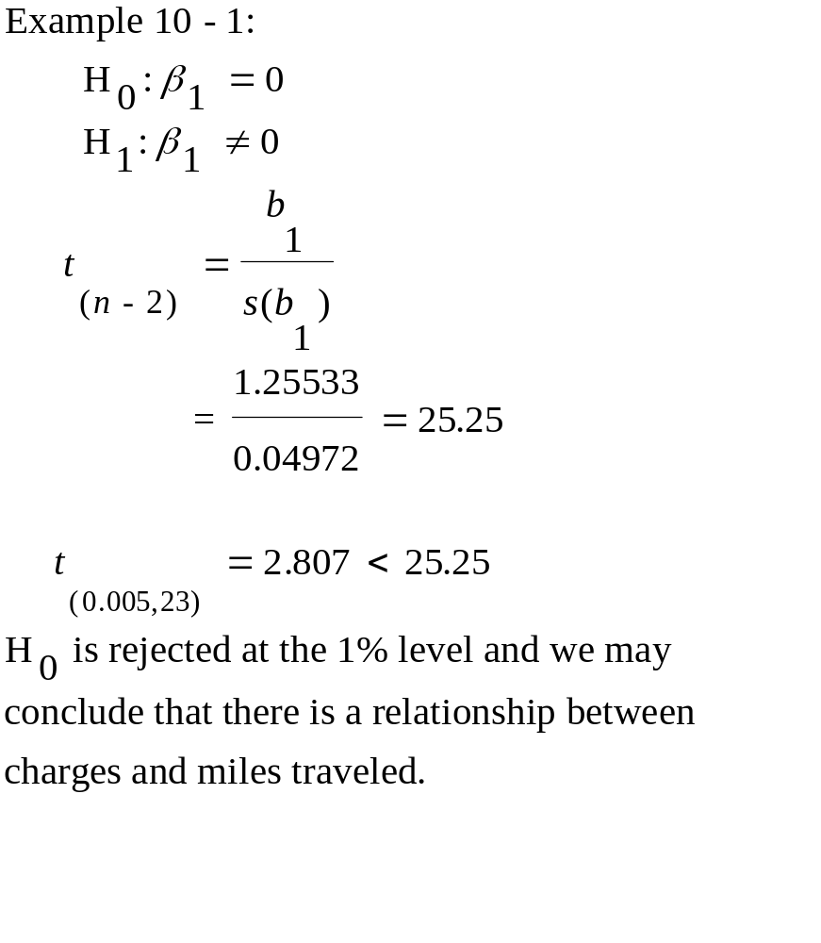
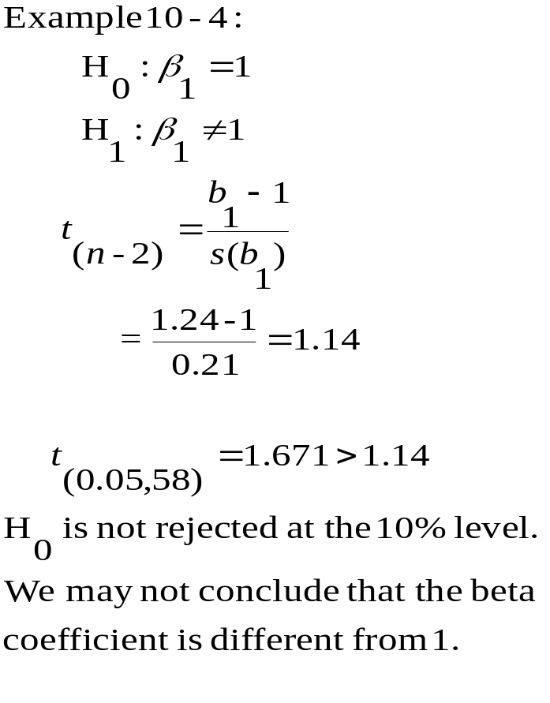
Hypothesis Tests for the Regression Slope

Slide 34
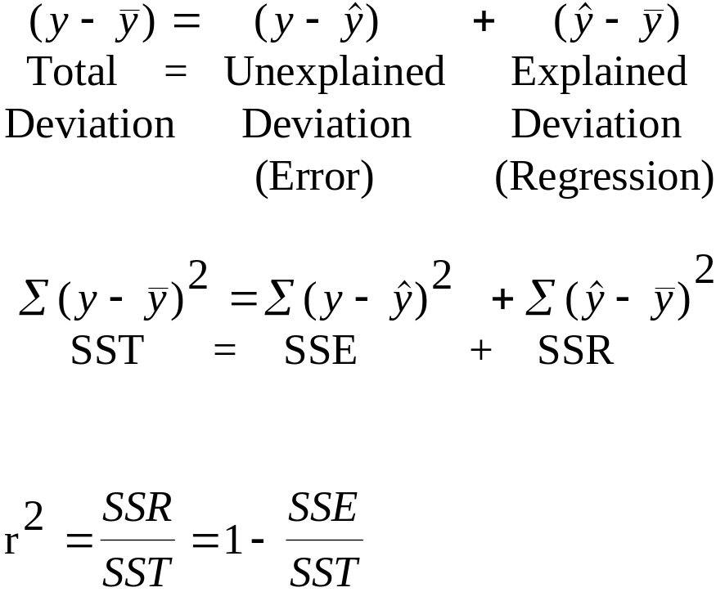

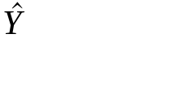
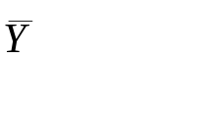

10-7 How Good is the Regression?
The coefficient of determination, r², is a descriptive measure of the strength of the regression relationship, a measure of how well the regression line fits the data.
Y
.
}
{
Unexplained Deviation
{
Total Deviation
Explained Deviation
Percentage of total variation explained by the regression.
X

Slide 35
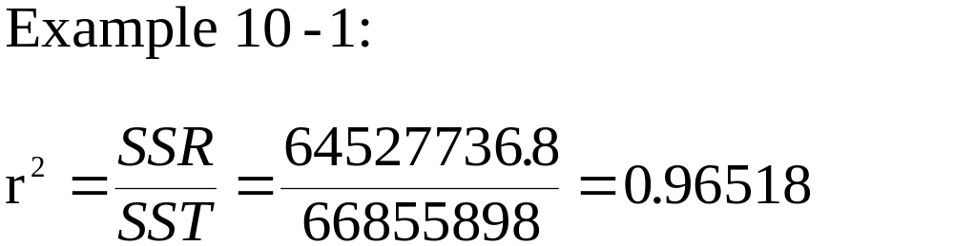
The Coefficient of Determination
Y
Y
Y
X
X
X
SST
SST
SST
r² = 0
SSE
r² = 0.50
SSE
SSR
r² = 0.90
S
S
E
SSR
7
0
0
0
6
0
0
0
s
5
0
0
r
0
a
l
l
o
D
4
0
0
0
3
0
0
0
2
0
0
0
1
0
0
0
1
5
0
0
2
0
0
0
2
5
0
0
3
0
0
0
3
5
0
0
4
0
0
0
4
5
0
0
5
0
0
0
5
5
0
0
M
i
l
e
s

Slide 36
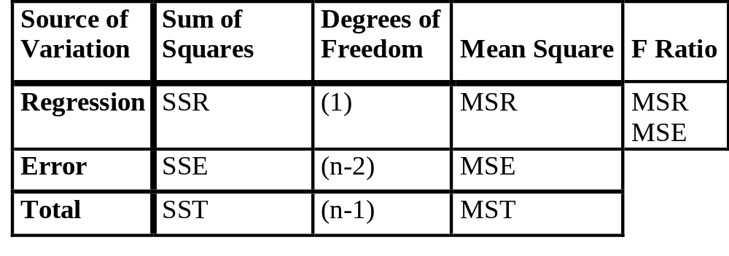
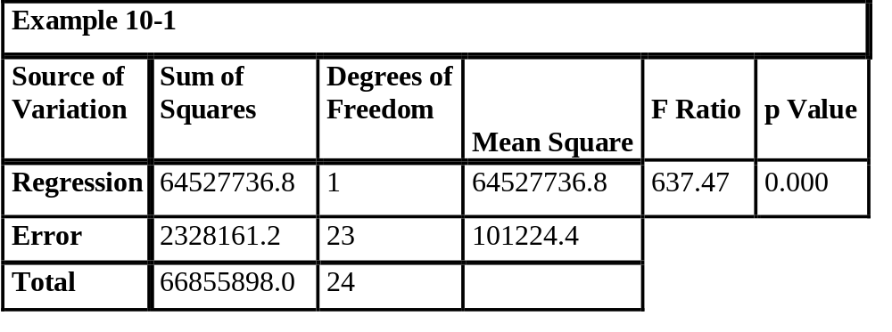
10-8 Analysis-of-Variance Table and an F Test of the Regression Model

Slide 37
Template (partial output) that displays Analysis of Variance and an F Test of the Regression Model

Slide 38

10-9 Residual Analysis and Checking for Model Inadequacies
Residuals
Residuals
0
0
Homoscedasticity: Residuals appear completely random. No indication of model inadequacy.
Heteroscedasticity: Variance of residuals increases when x changes.
Residuals
Residuals
0
0
Time
Curved pattern in residuals resulting from underlying nonlinear relationship.
Residuals exhibit a linear trend with time.

Slide 39
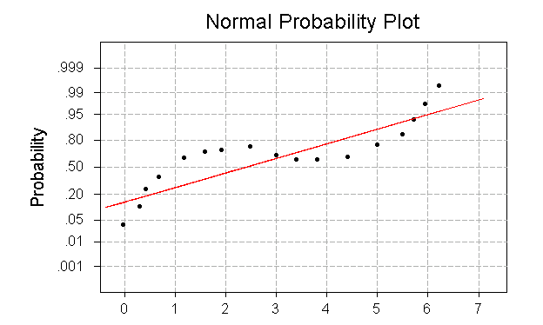
Normal Probability Plot of the Residuals
Flatter than Normal

Slide 40
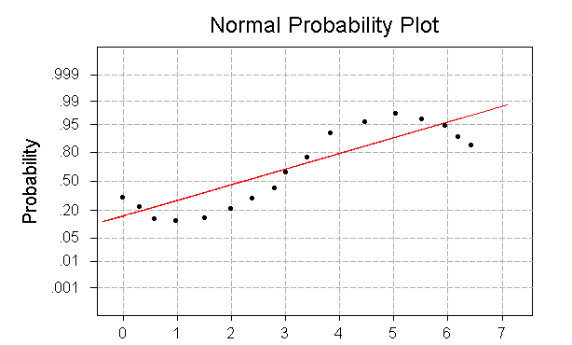
Normal Probability Plot of the Residuals
More Peaked than Normal

Slide 41
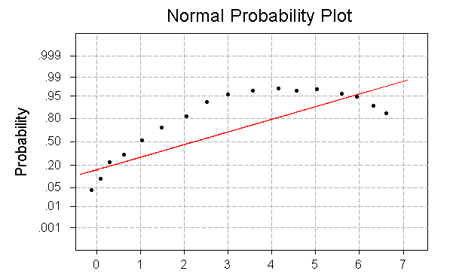
Normal Probability Plot of the Residuals
Positively Skewed

Slide 42
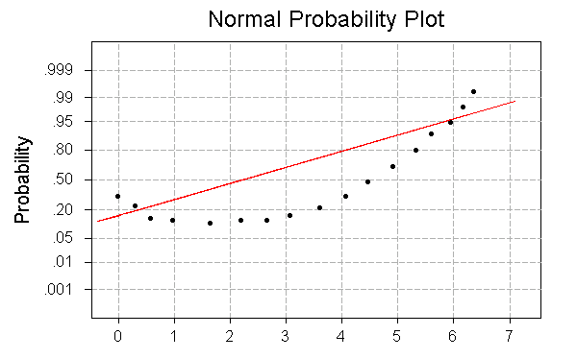
Normal Probability Plot of the Residuals
Negatively Skewed

Slide 43
10-10 Use of the Regression Model for Prediction
Point Prediction
  A single-valued estimate of Y for a given value of X obtained by inserting the value of X in the estimated regression equation.
Prediction Interval
  For a value of Y given a value of X
    Variation in regression line estimate
    Variation of points around regression line
  For an average value of Y given a value of X
    Variation in regression line estimate

Slide 44
Errors in Predicting E[Y|X]
Y
Upper limit on slope
Y
Upper limit on intercept
Regression line
Regression line
Y
Lower limit on slope
Y
Lower limit on intercept
X
X
X
X
1) Uncertainty about the slope of the regression line
2) Uncertainty about the intercept of the regression line

Slide 45
Prediction Interval for E[Y|X]
Y
Prediction band for E[Y|X]
The prediction band for E[Y|X] is narrowest at the mean value of X.
The prediction band widens as the distance from the mean of X increases.
Predictions become very unreliable when we extrapolate beyond the range of the sample itself.
Regression
line
Y
X
X
Prediction Interval for E[Y|X]

Slide 46
Additional Error in Predicting Individual Value of Y
Y
Regression line
Y
Prediction band for E[Y|X]
Regression
line
Y
Prediction band for Y
X
X
X
3) Variation around the regression
line
Prediction Interval for E[Y|X]

Slide 47
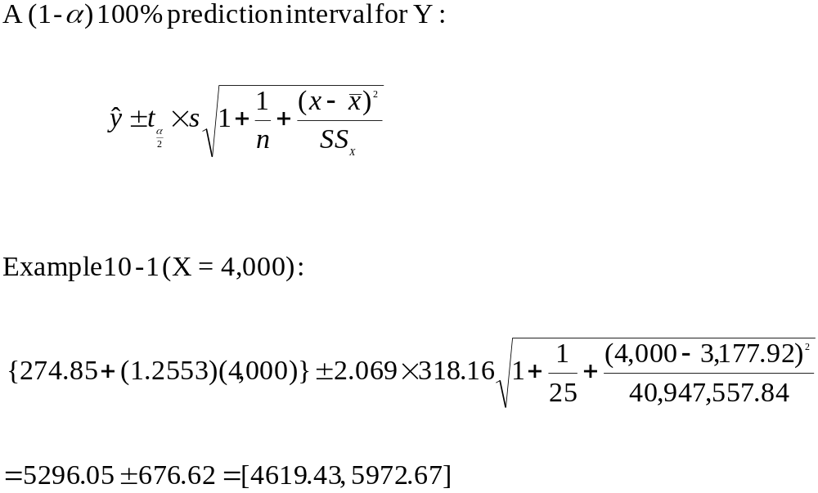
Prediction Interval for a Value of Y

Slide 48
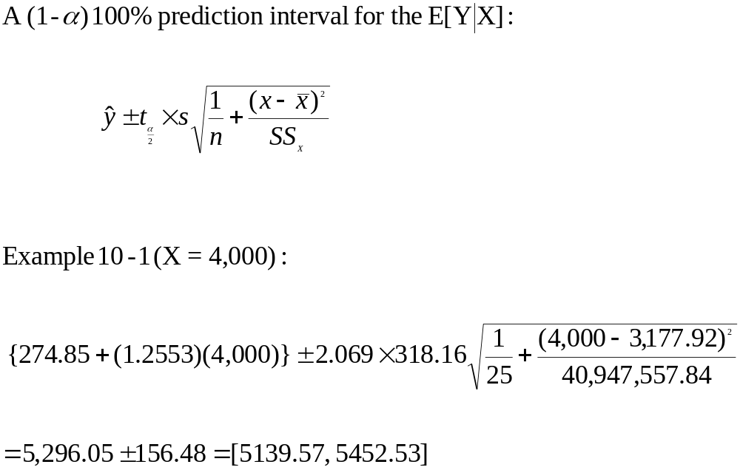
Prediction Interval for the Average Value of Y

Slide 49
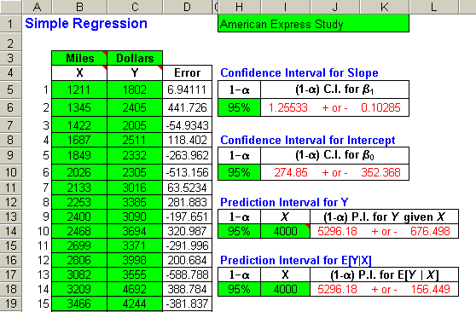
Template Output with Prediction Intervals

Slide 50
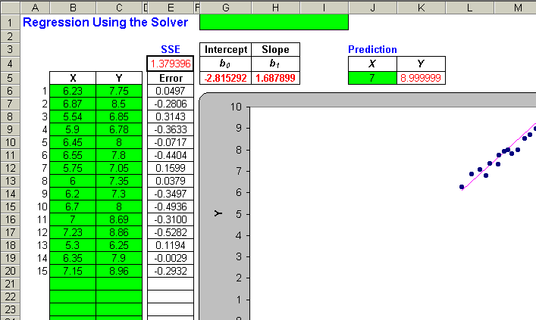
10-11 The Solver Method for Regression
The solver macro available in EXCEL can also be used to conduct a simple linear regression. See the text for instructions.

Slide 51
10-12 Linear Composites of Dependent Random Variables
The Case of Independent Random Variables:
  For independent random variables, X₁, X₂, …, X_{n}, the expected value for the sum, is given by:
E(X₁ + X₂ + … + X_{n}) = E(X₁) + E(X₂)+ … + E(X_{n})
For independent random variables, X₁, X₂, …, X_{n}, the variance for the sum, is given by:
V(X₁ + X₂ + … + X_{n}) = V(X₁) + V(X₂)+ … + V(X_{n})

Slide 52
10-12 Linear Composites of Dependent Random Variables
The Case of Independent Random Variables with Weights:
  For independent random variables, X₁, X₂, …, X_{n}, with respective weights α₁, α₂, …, α_{n}, the expected value for the sum, is given by:
E(α₁ X₁ + α₂ X₂ + … + α_{n} X_{n}) = α₁ E(X₁) + α₂ E(X₂)+ … + α_{n} E(X_{n})
  For independent random variables, X₁, X₂, …, X_{n}, with respective weights α₁, α₂, …, α_{n}, the variance for the sum, is given by:
V(α₁ X₁ + α₂ X₂ + … + α_{n} X_{n}) = α₁² V(X₁) + α₂² V(X₂)+ … + α_{n}² V(X_{n})

Slide 53
Covariance of two random variables X₁ and X₂
The covariance between two random variables X₁ and X₂ is given by:
Cov(X₁, X₂) = E{[X₁ – E(X₁)] [X₂ – E(X₂)]}
A simpler measure of covariance is given by:
Cov(X₁, X₂) = ρ SD(X₁) SD(X₂) where ρ is the correlation between X₁ and X₂.

Slide 54
10-12 Linear Composites of Dependent Random Variables
The Case of Dependent Random Variables with Weights:
  For dependent random variables, X₁, X₂, …, X_{n}, with respective weights α₁, α₂, …, α_{n}, the variance for the sum, is given by:
V(α₁ X₁ + α₁ X₂ + … + α_{n} X_{n}) = α₁² V(X₁) + α₂² V(X₂)+ … + α_{n}² V(X_{n}) + 2 α₁ α₂Cov(X₁, X₂) + … + 2 α_{n-1} α_{n}Cov(X_{n-1}, X_{n})

