Slide 1
Course Match Mechanism Design
Brando Socarras

Slide 2
Northwestern’s Course Match Mechanism:
Students assigned a day to select courses by seniority, student-athlete status
Each student randomly assigned a time to select all courses still available
Students with early registration times get all courses they want
Students with late registration times get screwed

Slide 3
Goal: Design truthful, fair, and efficient mechanism for allocating course seats to students based off Random Partial Improvement Mechanism [Abebe et. al]
In truthful course match mechanism, student’s best strategy to truthfully report value for each course to mechanism
A fair course match mechanism allocates courses so that no student prefers another’s course schedule to her own
An efficient course match mechanism outputs schedules such that it cannot make one student’s course schedule better by reallocating course seats without making other student’s schedule’s even worse in the process

Slide 4
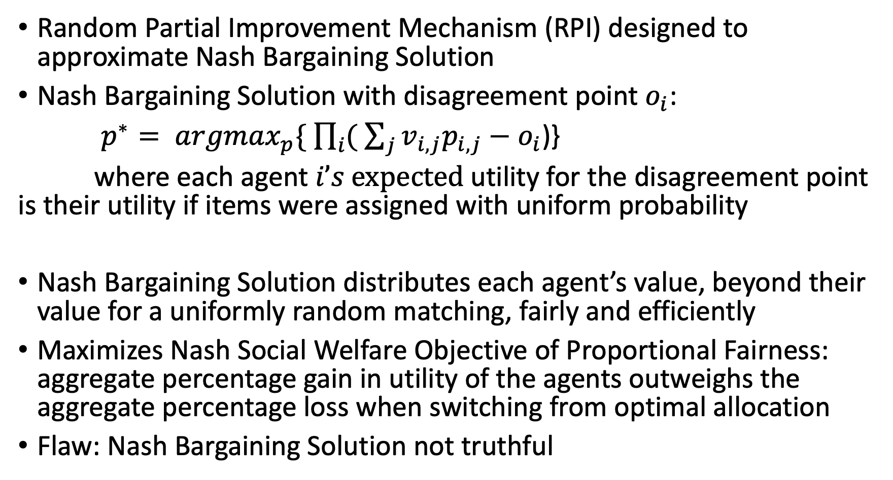
Random Partial Improvement Mechanism (RPI) designed to approximate Nash Bargaining Solution
Nash Bargaining Solution with disagreement point $o_{i}$:
$p^{∗}= {argmax}_{p}\{ \prod_{i}{( \sum_{j}{v_{i,j}p_{i,j}−o_{i}}}$)}
where each agent $i’s \text{expected}$utility for the disagreement point is their utility if items were assigned with uniform probability
Nash Bargaining Solution distributes each agent’s value, beyond their value for a uniformly random matching, fairly and efficiently
Maximizes Nash Social Welfare Objective of Proportional Fairness: aggregate percentage gain in utility of the agents outweighs the aggregate percentage loss when switching from optimal allocation
Flaw: Nash Bargaining Solution not truthful

Slide 5
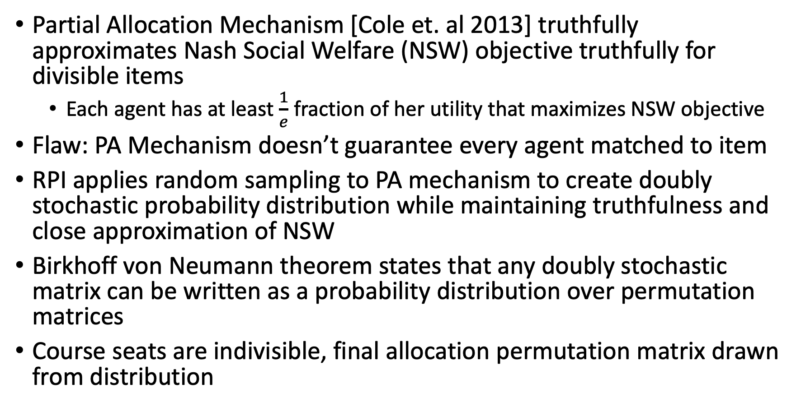
Partial Allocation Mechanism [Cole et. al 2013] truthfully approximates Nash Social Welfare (NSW) objective truthfully for divisible items
Each agent has at least $\frac{1}{e}$ fraction of her utility that maximizes NSW objective
Flaw: PA Mechanism doesn’t guarantee every agent matched to item
RPI applies random sampling to PA mechanism to create doubly stochastic probability distribution while maintaining truthfulness and close approximation of NSW
Birkhoff von Neumann theorem states that any doubly stochastic matrix can be written as a probability distribution over permutation matrices
Course seats are indivisible, final allocation permutation matrix drawn from distribution

Slide 6
Summer Project Objectives:
Implement RPI
Implement Random Serial Dictatorship Mechanism
Get course data from students
Evaluate RPI average case
Modify it to optimize average case, other aspects of student course allocation

