Slide 1
Exede Group Downloads
Andrew Paon
Matthew Silverstein
Brian Soe
Matthew Zenzie

Slide 2
Exede in 2020
Caps
Larger and Faster
Larger Files
4k videos, 100GB
Large Game Files
Leverage strengths of Satellite Internet
Notes:
We can expect exede in 2020 to be faster, with higher data caps. At the same time, we can expect there to be many large file formats that will still be unfeasbile on a capped connection – for example, 4k videos are already on the order of 100GB files. By 2020, perhaps 8k video will be released, and one family’s monthly usage limit will be insufficient in these cases. In order to get around this, we can leverage one of the great strengths of satellite internet

Slide 3
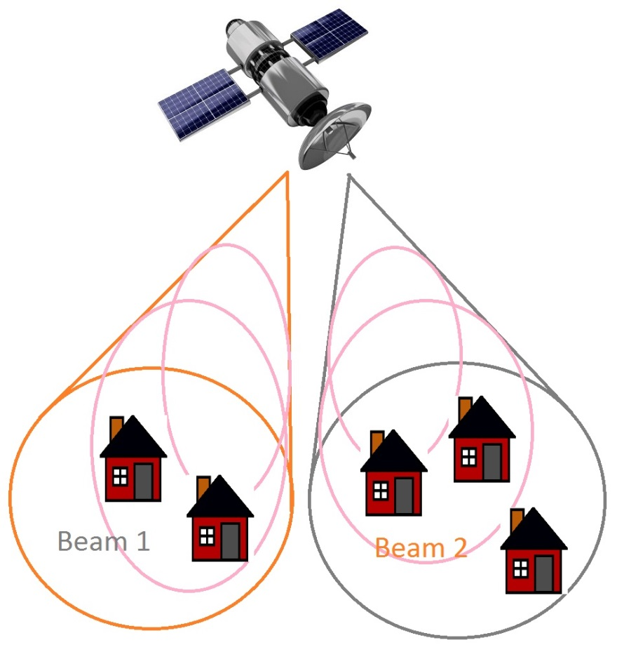
How Group Download Works
Satellite Infrastructure
When one customer requests a file, that file can be received by any other customer on the beam for free
Beams contain 10-20k

Slide 4
Implications of Group Download
Scenario:
5 person group wants to download a large file
Each person responsible for requesting/downloading one fifth of this file
Every member capable of receiving every other member’s portion in parallel
Download speed increase proportional to group size, up to some limit imposed by receiving hardware
Bandwidth usage inversely proportional to group size

Slide 5
Project Goals
User Interface
Submit requests for specific files.
Browse categories and vote for different downloads.
Enjoy more and faster downloads.
Server Simulation
Demonstrate basic multicasting functionality.

Slide 6
Demo

Slide 7
Questions

