Slide 1
Hackathon 2014
The Pingable Pingbots

Slide 2
Exede in 2020
Caps
Capped Data
Capped Speeds
Larger Files
4k videos, 100GB
Large Game Files
Leverage strengths of Satellite Internet

Slide 3
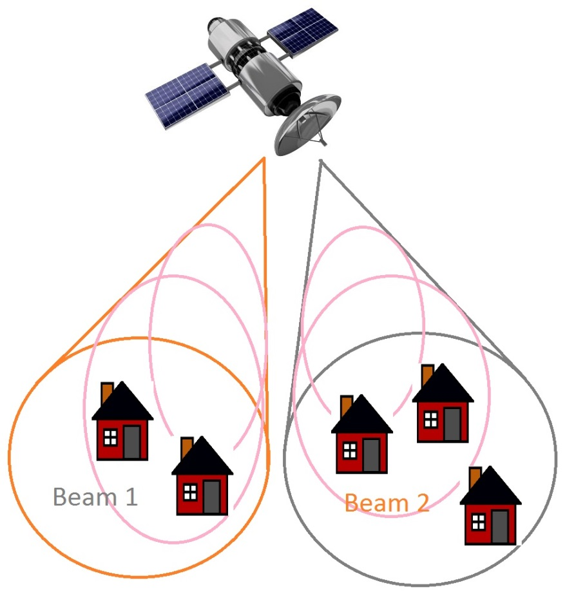
How Group Download Works
Satellite Infrastructure
When the satellite sends a signal to your house, it gets broadcasts to everyone on the beam
Beams contain 10-20k

Slide 4
Implications of Group Download
Share Downloads
Multiple customers downloading the same file.
Satellite can increase download speed since it’s providing a signal for several customers.
Bandwidth is shared across everyone.

Slide 5
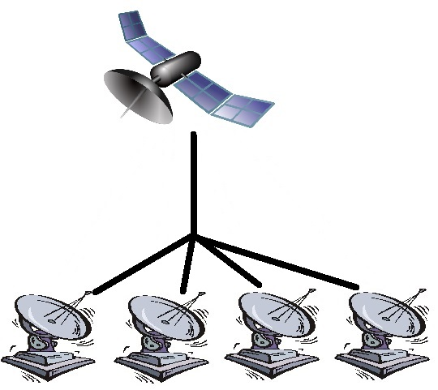
In Action, Synced
Four people downloading a large file.
Bandwidth Charged: 25GB (each).
Speed: 48Mb/s.
Time: 4.5 hours.

Slide 6
Project Goals
User Interface
Submit requests for specific files.
Browse categories and vote for different downloads.
Enjoy more and faster downloads.
Server Simulation
Demonstrate basic multicasting functionality.

Slide 7
Demo

Slide 8
Questions

