Slide 1
Course Availability Final
By: Branden Ogata, and Hansen Cheng

Slide 2
Course Availability Project
Looks at UH Course Availability site
Tracks courses that a user is interested in
If there are seats available, sends notification to user

Slide 3
Technology
Ruby on Rails because it provides an organized structure for web development. It also provides Bootstrap (through the installation of gems) for responsiveness
Use of Gmail to send out a welcome message and notifications of course availability

Slide 4
Program Flow
UH Course Availability Site
User
Course
Email
Notes:
User sets interval for checking site->Application loops through all users->if time for update check, look on site->if changed, update Course entry and send message to user

Slide 5
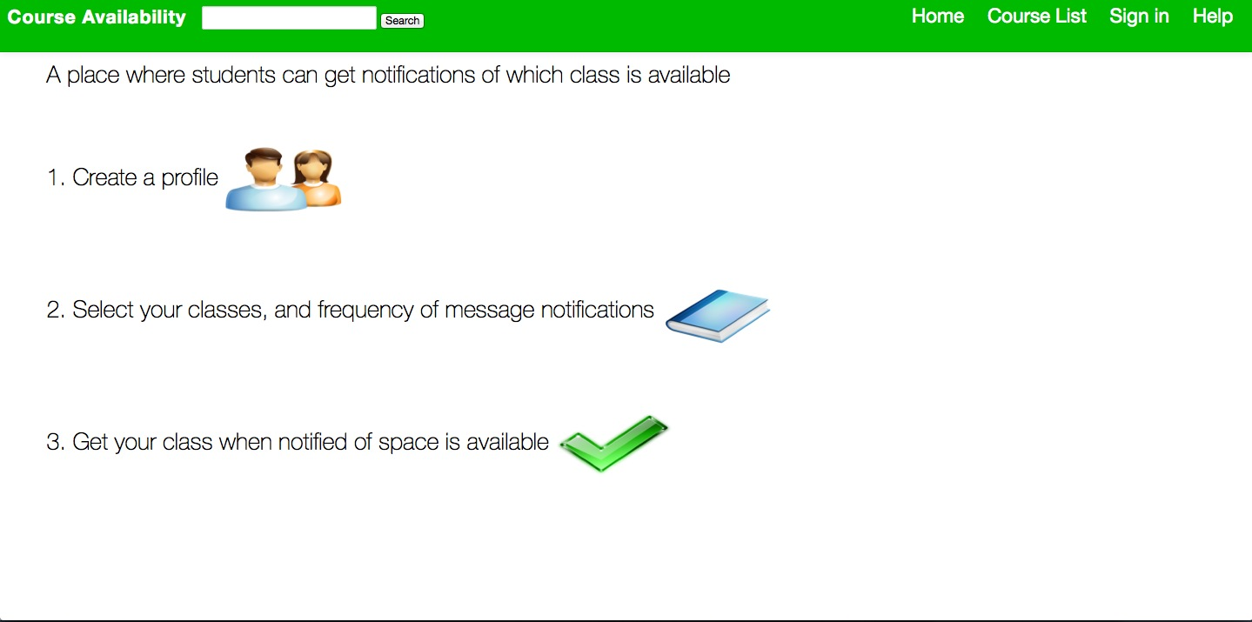

Slide 6
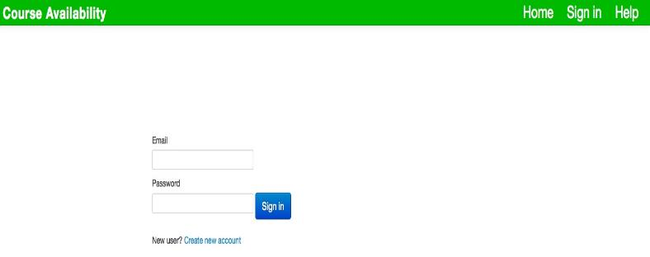

Slide 7
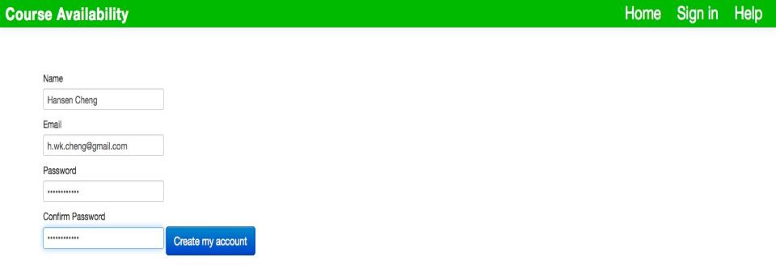

Slide 8
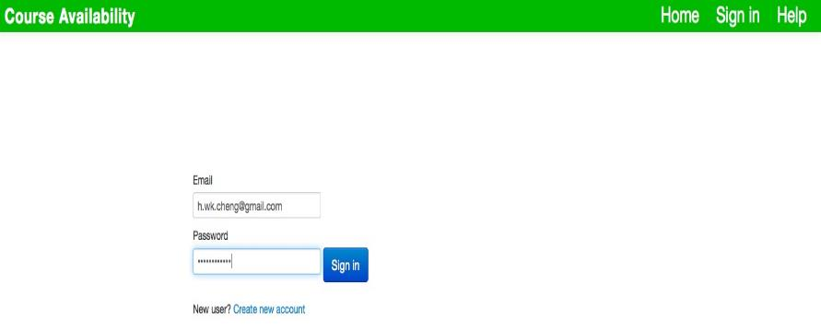

Slide 9
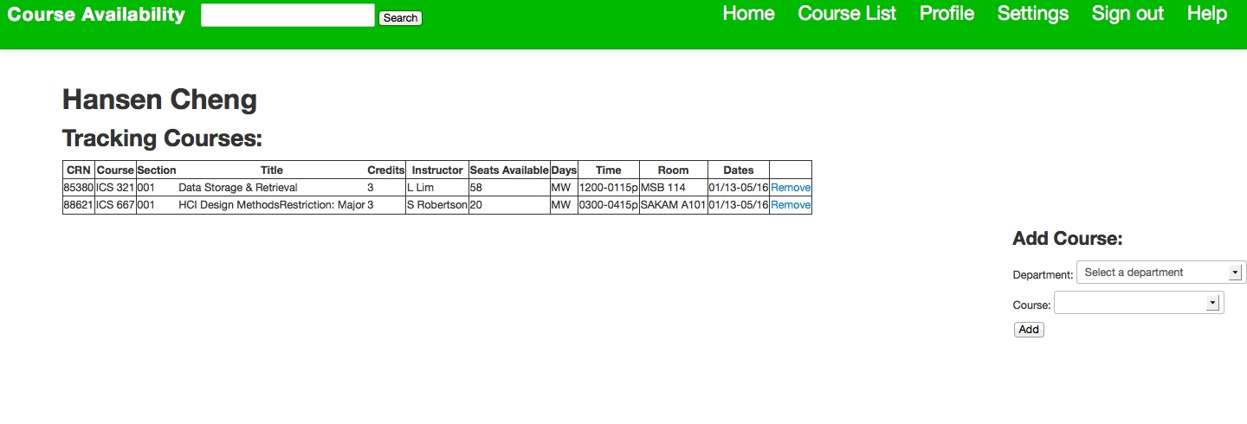

Slide 10
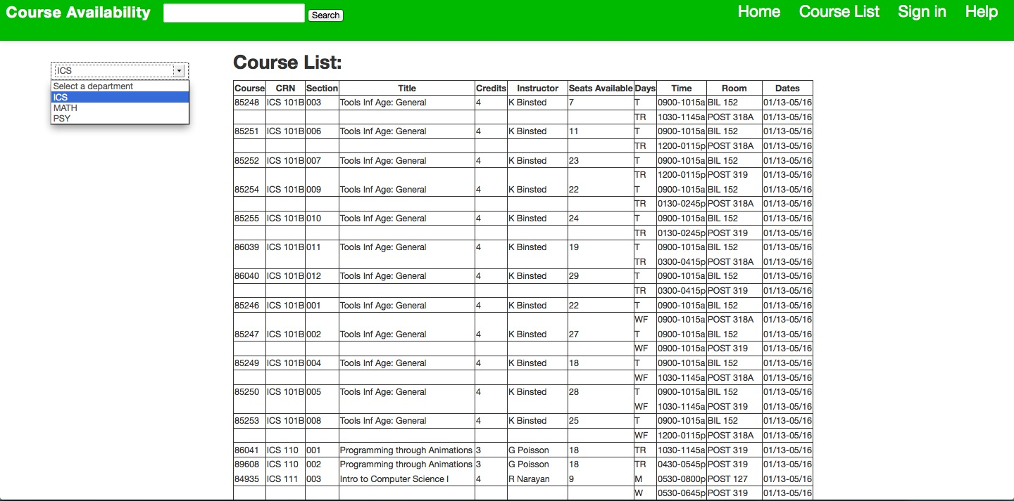

Slide 11
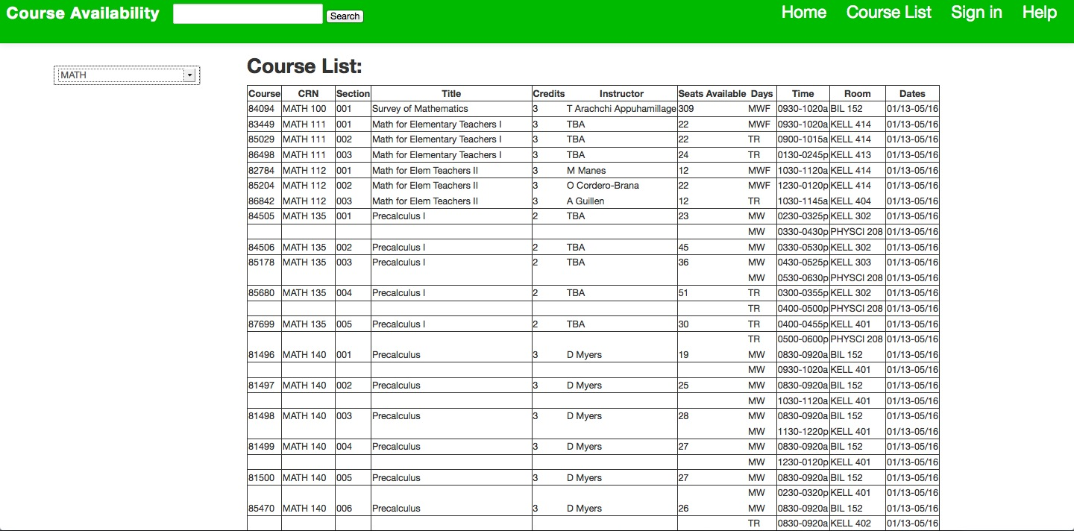

Slide 12
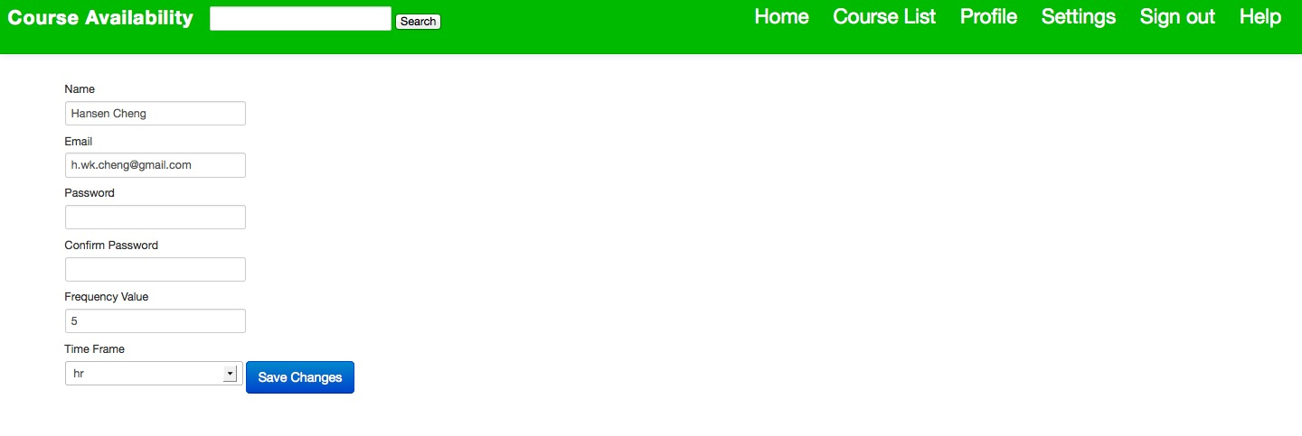

Slide 13
