Slide 1
Course Availability Progress Report
By: Branden Ogata, and Hansen Cheng

Slide 2
Course Availability
Purpose: Allow users to be notified of seat availability on the UH course list and increase chance of getting the class
Functionality: User creates a profile then search for their interested class. Then select which ones they want to be notified and the frequency of the messages

Slide 3
Technology
Ruby on Rails because it provides an organized structure for web development. It also provides Bootstrap (through the installation of gems) for responsiveness
Use of a dummy email on Gmail for testing (in upcoming weeks) of notification system.

Slide 4
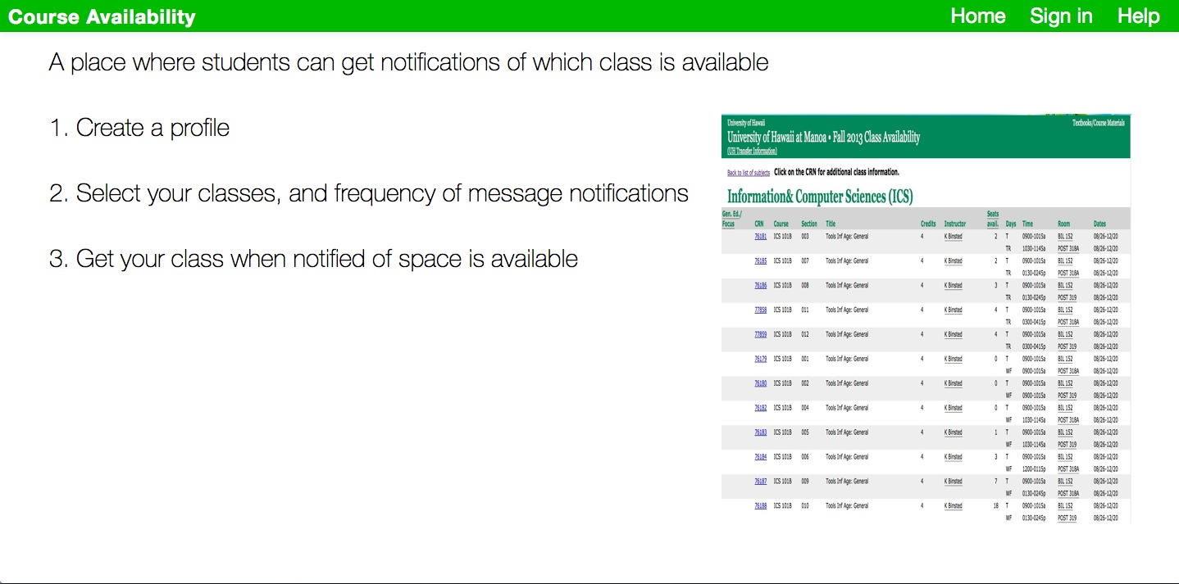

Slide 5
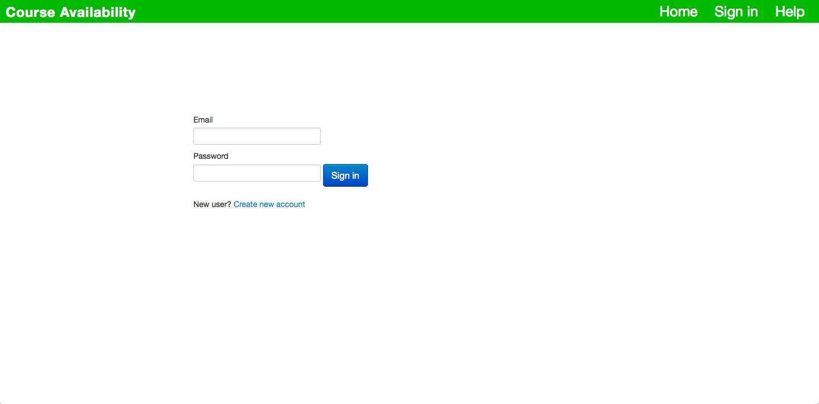

Slide 6
