Slide 1
Airline Ticket Retail Sales
Bohdan Solovei

Slide 2
Business background
The selected business domain is Airline Ticket Retail Sales. Two source systems are used to populate the data warehouse.
Source System 1 – Customer Satisfaction System
Source System 2 – Booking and Sales System

Slide 3
Problems because of poor data management
Inconsistent Customer Information
The same customer may appear in multiple source systems. Without a centralized repository and common business definitions, inconsistencies may occur in customer-related information, making customer analysis difficult and potentially reducing data reliability.
Data Quality Issues
The existence of multiple independent systems increases the likelihood of duplicated records, inconsistent data definitions, missing values, and data synchronization problems. Such issues may negatively affect the accuracy of business reports and analytical results.

Slide 4
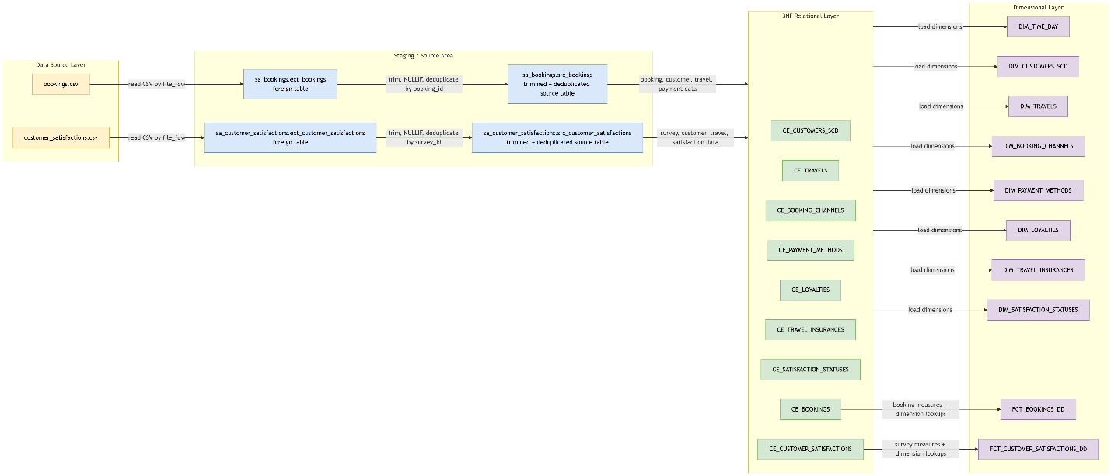
Logical schema

Slide 5
Files with 95% of your data for initial load
SELECT COUNT(*) AS sa_booking_rows_before
FROM sa_bookings.src_bookings;
SELECT COUNT(*) AS sa_satisfaction_rows_before
FROM sa_customer_satisfactions.src_customer_satisfactions;
-- 2. BL_3NF row counts
SELECT COUNT(*) AS ce_booking_rows_before
FROM bl_3nf.ce_bookings;
SELECT COUNT(*) AS ce_satisfaction_rows_before
FROM bl_3nf.ce_customer_satisfactions;
-- 3. Fact row counts
SELECT COUNT(*) AS booking_fact_rows_before
FROM bl_dm.fct_bookings_dd;
SELECT COUNT(*) AS satisfaction_fact_rows_before
FROM bl_dm.fct_customer_satisfactions_dd;
Notes:
SELECT COUNT(*) AS sa_booking_rows_before
FROM sa_bookings.src_bookings;
SELECT COUNT(*) AS sa_satisfaction_rows_before
FROM sa_customer_satisfactions.src_customer_satisfactions;
-- 2. BL_3NF row counts
SELECT COUNT(*) AS ce_booking_rows_before
FROM bl_3nf.ce_bookings;
SELECT COUNT(*) AS ce_satisfaction_rows_before
FROM bl_3nf.ce_customer_satisfactions;
-- 3. Fact row counts
SELECT COUNT(*) AS booking_fact_rows_before
FROM bl_dm.fct_bookings_dd;
SELECT COUNT(*) AS satisfaction_fact_rows_before
FROM bl_dm.fct_customer_satisfactions_dd;

Slide 6
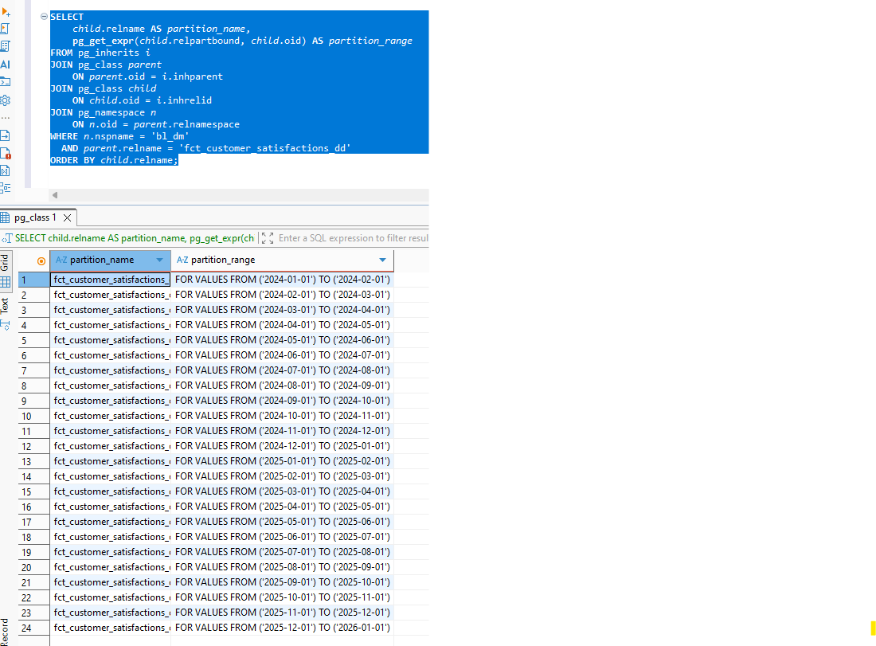
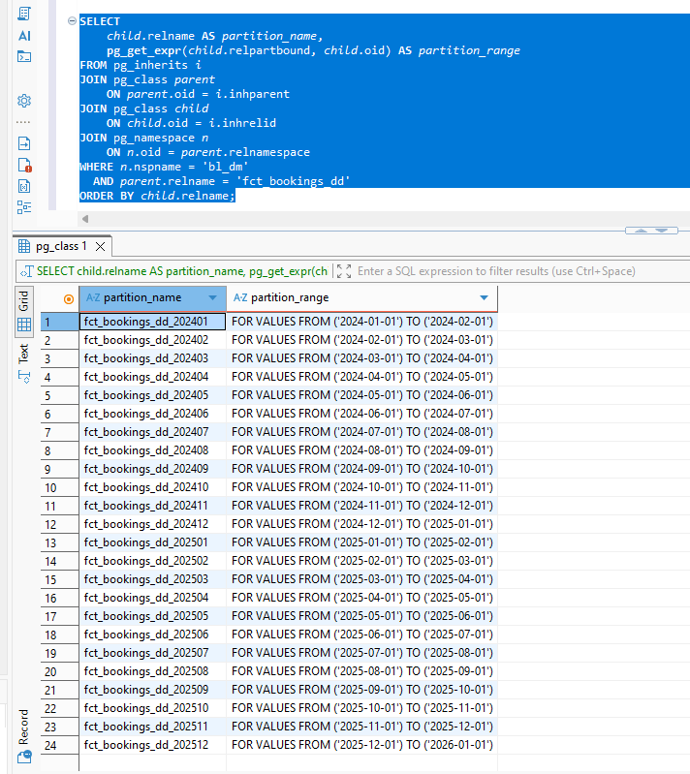
Initial load partitions
Notes:
SELECT
child.relname AS partition_name,
pg_get_expr(child.relpartbound, child.oid) AS partition_range
FROM pg_inherits i
JOIN pg_class parent
ON parent.oid = i.inhparent
JOIN pg_class child
ON child.oid = i.inhrelid
JOIN pg_namespace n
ON n.oid = parent.relnamespace
WHERE n.nspname = 'bl_dm'
AND parent.relname = 'fct_bookings_dd'
ORDER BY child.relname;

Slide 7
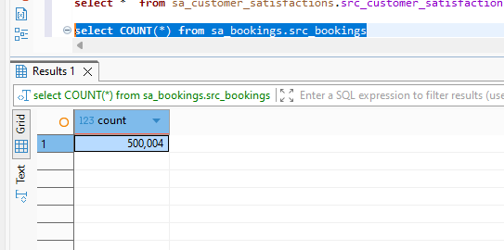
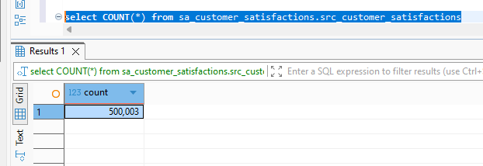
Load increment

Slide 8
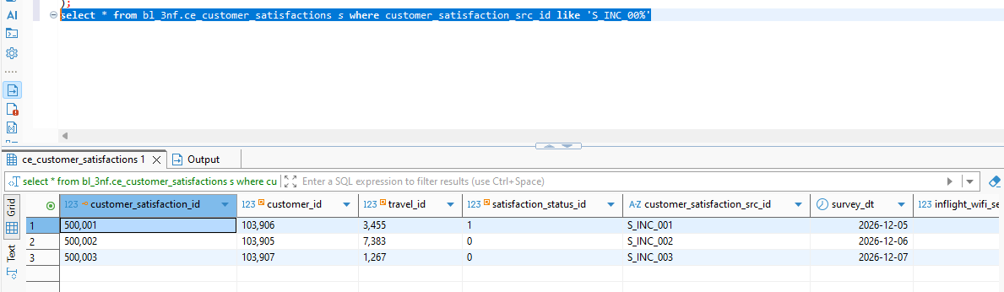
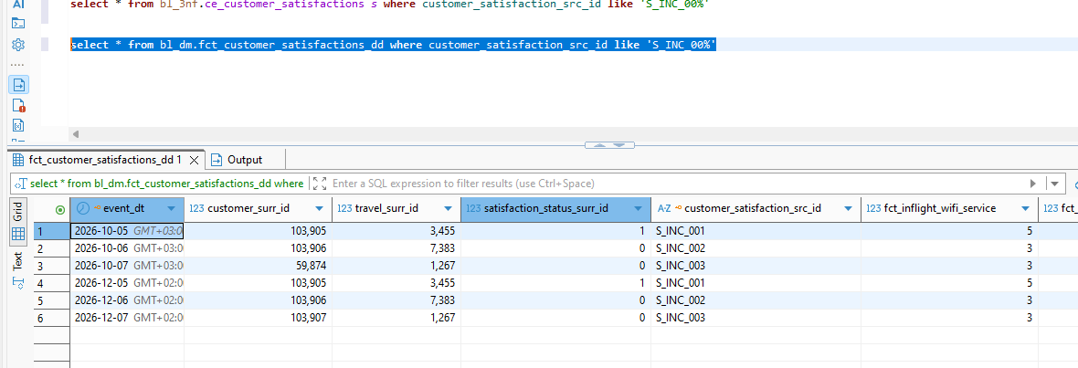
Load increment into bl_3nf, bl_dm
Notes:
CALL bl_cl.pr_load_all_increment
(
DATE '2027-11-05',
DATE '2027-11-07',
false
);
select count(*) from bl_3nf.ce_customer_satisfactions s where customer_satisfaction_src_id like 'S_INC_%'
select * from bl_3nf.ce_bookings where booking_id::text like '600%' order by booking_id
CREATE OR REPLACE PROCEDURE bl_cl.pr_load_bl_3nf_increment()
LANGUAGE plpgsql
AS $$
BEGIN
CALL bl_cl.pr_load_ce_booking_channels();
CALL bl_cl.pr_load_ce_payment_methods();
CALL bl_cl.pr_load_ce_loyalties();
CALL bl_cl.pr_load_ce_travel_insurances();
CALL bl_cl.pr_load_ce_satisfaction_statuses();
CALL bl_cl.pr_load_ce_travels();
CALL bl_cl.pr_load_ce_customers_scd();
CALL bl_cl.pr_load_ce_bookings();
CALL bl_cl.pr_load_ce_customer_satisfactions();
CALL bl_cl.pr_write_log(
'bl_cl.pr_load_bl_3nf_increment', 0, 'SUCCESS',
'All BL_3NF procedures completed in dependency order.'
);
EXCEPTION WHEN OTHERS THEN
CALL bl_cl.pr_write_log(
'bl_cl.pr_load_bl_3nf_increment', 0, 'FAILED',
format('SQLSTATE=%s; %s', SQLSTATE, SQLERRM)
);
RAISE;
END;
$$;
CREATE OR REPLACE PROCEDURE bl_cl.pr_load_bl_dm_increment
(
p_from_date DATE DEFAULT NULL,
p_to_date DATE DEFAULT NULL
)
LANGUAGE plpgsql
AS $$
BEGIN
CALL bl_cl.pr_load_dim_booking_channels();
CALL bl_cl.pr_load_dim_payment_methods();
CALL bl_cl.pr_load_dim_loyalties();
CALL bl_cl.pr_load_dim_travel_insurances();
CALL bl_cl.pr_load_dim_satisfaction_statuses();
CALL bl_cl.pr_load_dim_travels();
CALL bl_cl.pr_load_dim_customers_scd();
/* Keep the existing restartable time-dimension procedure. */
CALL bl_cl.pr_load_dim_time_day();
CALL bl_cl.pr_load_fct_bookings_dd(p_from_date, p_to_date);
CALL bl_cl.pr_load_fct_customer_satisfactions_dd(p_from_date, p_to_date);
CALL bl_cl.pr_write_log(
'bl_cl.pr_load_bl_dm_increment', 0, 'SUCCESS',
'All BL_DM procedures completed in dependency order.'
);
EXCEPTION WHEN OTHERS THEN
CALL bl_cl.pr_write_log(
'bl_cl.pr_load_bl_dm_increment', 0, 'FAILED',
format('SQLSTATE=%s; %s', SQLSTATE, SQLERRM)
);
RAISE;
END;
$$;
CREATE OR REPLACE PROCEDURE bl_cl.pr_load_all_increment
(
p_from_date DATE DEFAULT NULL,
p_to_date DATE DEFAULT NULL,
p_run_tests BOOLEAN DEFAULT TRUE
)
LANGUAGE plpgsql
AS $$
BEGIN
CALL bl_cl.pr_load_bl_3nf_increment();
CALL bl_cl.pr_load_bl_dm_increment(p_from_date, p_to_date);
IF p_run_tests THEN
CALL bl_cl.pr_run_data_quality_tests();
END IF;
CALL bl_cl.pr_write_log(
'bl_cl.pr_load_all_increment', 0, 'SUCCESS',
'Complete incremental DWH load finished successfully.'
);
EXCEPTION WHEN OTHERS THEN
CALL bl_cl.pr_write_log(
'bl_cl.pr_load_all_increment', 0, 'FAILED',
format('SQLSTATE=%s; %s', SQLSTATE, SQLERRM)
);
RAISE;
END;
$$;

Slide 9
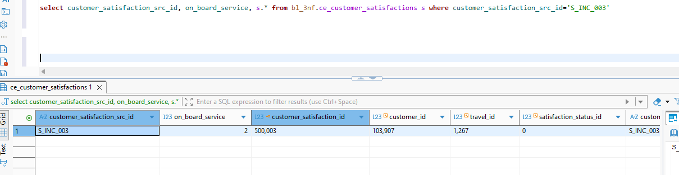
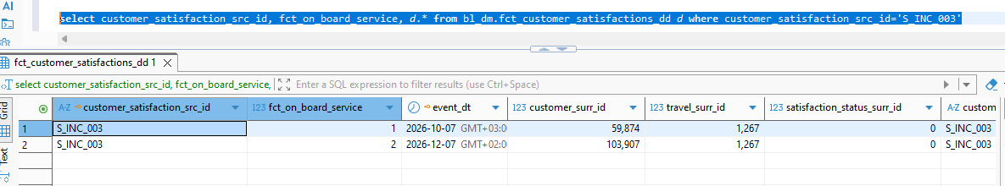
SCD1
Test Objective: Verify that SCD Type 1 dimensions overwrite changed descriptive attributes without creating duplicate records.
Test Steps
Modify an existing on_board_service in the source system for the client
Execute the incremental ETL process.
Run the SCD1 MERGE procedure for dimension loading.
Compare the dimension table before and after the load.
Expected Result
The existing dimension record is updated.
The surrogate key remains unchanged.
No duplicate business keys are created.
In fact table the new record is added for historical purpose.
Notes:
select customer_satisfaction_src_id, on_board_service, s.* from bl_3nf.ce_customer_satisfactions s where customer_satisfaction_src_id='S_INC_003’
select customer_satisfaction_src_id, fct_on_board_service, d.* from bl_dm.fct_customer_satisfactions_dd d where customer_satisfaction_src_id='S_INC_003’
CALL bl_cl.pr_load_all_increment
(
DATE '2027-11-05',
DATE '2027-11-07',
false
);

Slide 10
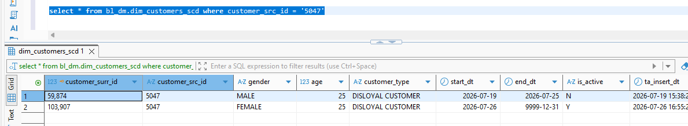
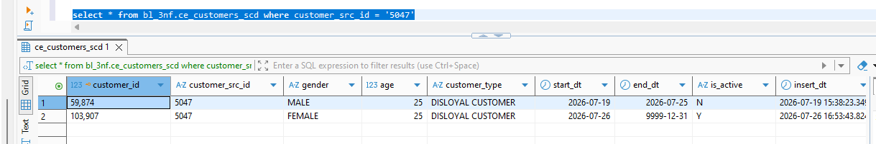
SCD2
Test Objective - Verify historical tracking of customer attribute changes.
Test Steps
Update a customer attribute (for example, gender, age, or customer type) in the source system.
Execute the incremental ETL process.
Run the SCD2 loading procedure.
Query the customer dimension before and after loading.
Expected Result
The previous version of the customer record is closed (is_active = 'N').
end_dt is populated for the historical record.
A new active version is inserted with a new surrogate key.
Complete change history is preserved.
Notes:
select * from bl_3nf.ce_customers_scd where customer_src_id = '5047’
select * from bl_dm.dim_customers_scd where customer_src_id = '5047’
CALL bl_cl.pr_load_all_increment
(
DATE '2027-11-05',
DATE '2027-11-07',
false
);

Slide 11
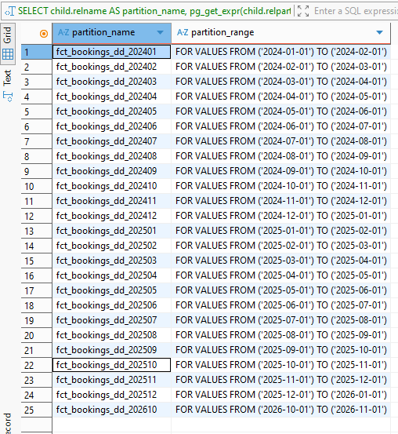
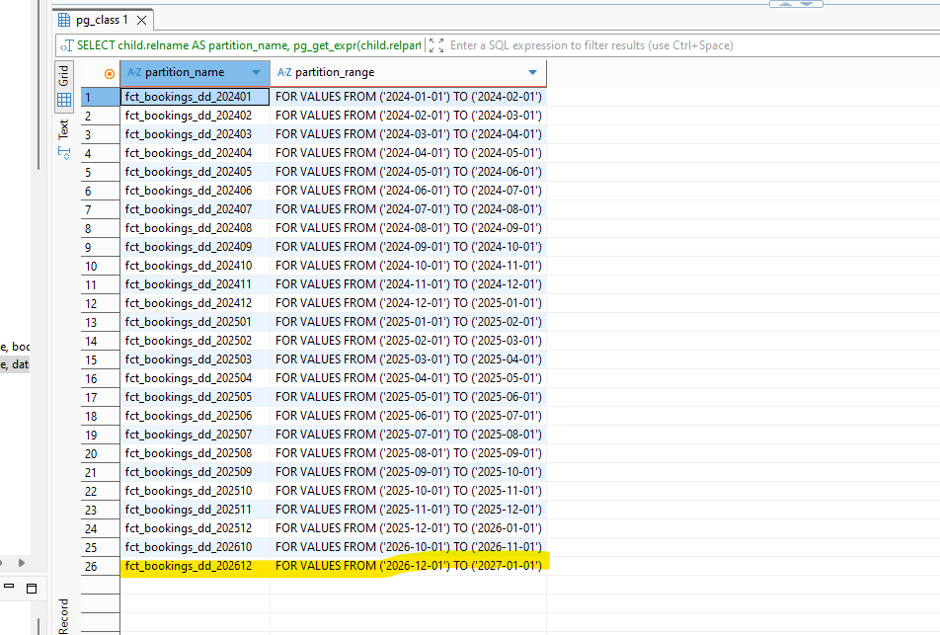
Fact table is loaded using partition
Test Objective - Verify incremental loading of partitioned fact tables.
Test Steps
Add new booking and customer satisfaction records for a new month (e.g., October or December 2026).
Execute:
CALL bl_cl.pr_load_all_increment(
DATE '2026-10-01',
DATE '2026-10-31',
TRUE
);
Refresh or automatically create the required monthly partition.
Verify the loaded fact records.
Expected Result
A new monthly partition (e.g., fct_bookings_dd_202610) is created or refreshed.
New fact rows are loaded into the correct partition.
Existing partitions remain unchanged.
Repeated execution of the incremental load does not create duplicate fact records.
Notes:
SELECT
parent.relname AS parent_table,
child.relname AS partition_name,
pg_get_expr(
child.relpartbound,
child.oid
) AS partition_range
FROM pg_inherits AS i
JOIN pg_class AS parent
ON parent.oid = i.inhparent
JOIN pg_class AS child
ON child.oid = i.inhrelid
JOIN pg_namespace AS ns
ON ns.oid = parent.relnamespace
WHERE ns.nspname = 'bl_dm'
AND parent.relname IN
(
'fct_bookings_dd',
'fct_customer_satisfactions_dd'
)
ORDER BY
parent.relname,
partition_name;

Slide 12
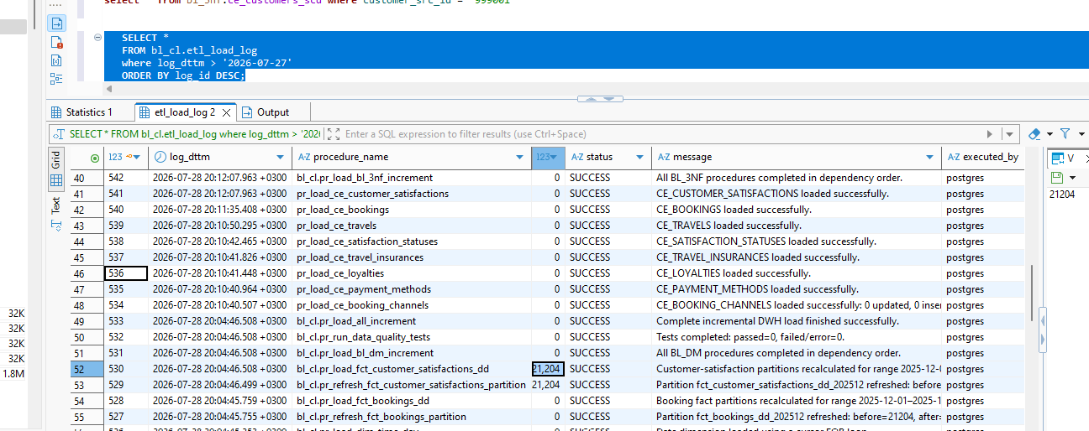
Log table
Notes:
SELECT *
FROM bl_cl.etl_load_log
where log_dttm > '2026-07-27'
ORDER BY log_id DESC;

