Slide 1
Supplier Data Processing
Brais Sotelo

Slide 2

Process overview
Data processing
Processing
Normalisation
Integration
Further considerations

Slide 3
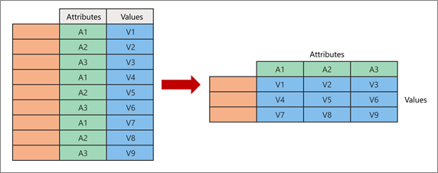
Processing
PROBLEM
SOLUTION
We noticed that the data was structured in an extended way: several rows for the same product indicating different categories and values.
We pivot the columns so that we have a single line for each product. This is necessary for future processing and to make it easier to see the different characteristics.

Slide 4
Normalisation
EXAMPLES
Format variable into our standards.
Extract meaningful variables from the fields they gave us.
Group certain characteristics to match our categories.
MERCEDES-BENZ
Mercedes-Benz
ConsumptionTotalText
11.5 l/100km
fuel_consumption_unit
l_km_consumption
Wohnkabine
Kleinwagen
Minivan
Pick-up
Other

Slide 5


Integration
Delete unnecessary data.
Rename the remaining columns to match your company naming convention.

Slide 6

Further considerations
Some fields like the carType or even the color are stored by groups.
To make a consistent association we should make a master dataset to map efficiently this fields to their associated groups.
Would be necessary to do the same for translating purposes, since is not best practice to depend on third party APIs like googles and is not a very large set of words to map.

Slide 7
Further considerations
Some changes that need to be made
Mileage unit: we can define it using the consumption field.
Price on request, drive, zip: We do not have a way do define it, we should ask the supplier if he can give it to us.
Type: Define our data standard.
Country: They only gave us the “City” field. In this case all products are in Switzerland, so was easy to map but we have to consider getting a dataset to map cities to its countries.

