Slide 1
Railway Track Monitoring System:

Slide 2
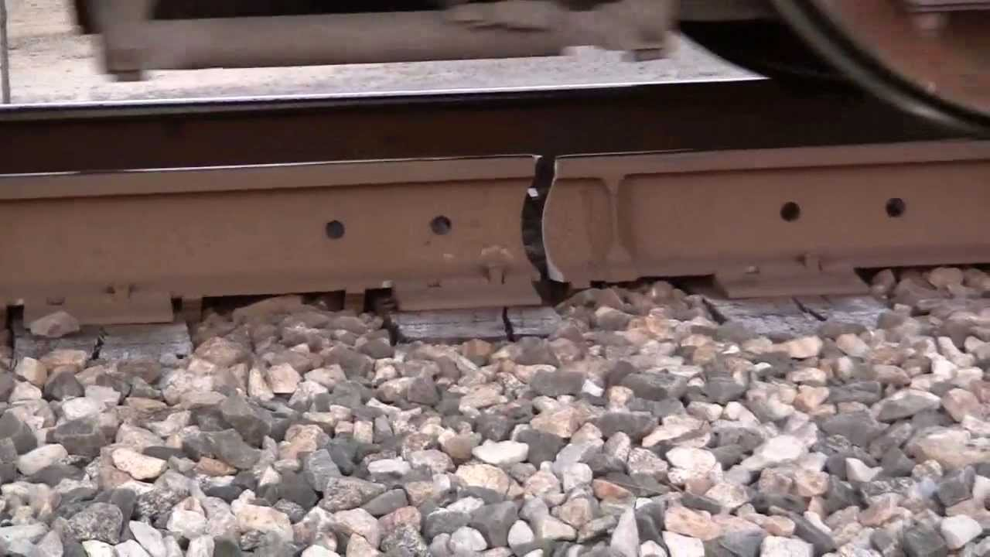
Overview
➢ Railway is one of the most used means of transportation. ➢ In country like ours, derailment is a serious threat. ➢ In this project, we driven an arbitrary idea for detecting cracks in tracks of railways.

Slide 3
Abstract
➢ The crude idea is the distance factor, if we are able to maintain a constant distance from a level to track and if that varies then there is a potential for finding a crack. ➢ Then we can take steps accordingly.

Slide 4
Components
➢ Arduino UNO
➢ Ultrasonic Sensor HC-SR-04
➢ Motor Driver L293
➢ Motor Wheel

Slide 5
Arduino
➢ Arduino is an open-source electronics platform based on easy-to-use hardware and software.
➢ A program for Arduino may be written in any programming language with compilers that produce binary machine code for the target processor.
➢Basically it is the root which connects every other component and is responsible for providing power to them.

Slide 6
➢ In our simulation we integrated ultrasonic sensor and motor driver with Arduino. Based on the value from ultrasonic sensor it calculates the distance from crack and uses it to operate motor driver accordingly. We drew the line at 150 cm for marking a crack and if the value crosses that, arduino deactivates the driver motor and stops the driver wheel.

Slide 7
Ultrasonic Sensor
➢ The ultrasonic sensor works on the principle of reflection of waves. It sends out a high-frequency sound pulse and then calculate the time for the echo of the sound to reflect back. The sensor has 2 openings on its front. One opening transmits ultrasonic waves, like a tiny speaker, the other receives them, (like a tiny microphone),.
➢Based on the time arduino calculates the distance.

Slide 8
Motor Driver
➢ This basically is used to regulate the power from an external power source. Here this is used to make a connection between arduino and motor wheel.

Slide 9
Motor
➢ We used this to substitute wheel, if the value 150 cm is crossed arduino disconnects the power to motor driver and in turn the motor, which by the way used to imitate the bot wheel. It will rotate until the crack is detected.

Slide 10
Block Diagram
Battery
Crack is detected
Arduino
Ultra sonic sensor
Motor Driver
Stops The Motor wheel

Slide 11
Advantages
➤ With this method even the minute cracks can be detected and mended immediately.
➤Less cost, low power consumption and less analysis time.

