Slide 1

home
About
About
Services
Work and School
Contact
John Yoo
This is my business website, where I tell you barebones what I’ve done, what I’m good at, and where I’d like to be.
About
Services
Work and School
Contact
I made this website in Next.js (probably overkill)
F8AA27
FAC55B
FFF8B6
20655F

Slide 2
home
While I believe nurture plays a huge role in defining your character, genetics especially from your immediate parents play a significant role in determining your approach to life, and how you choose to be nurtured [1].
My mom is a very likeable, breadth-first left leaning right brained intellectually curious, introverted extrovert with feminine traits.
My dad is a stoic, depth-first left brained intellectually curious, introvert with masculine traits and principles.
Lucky for me I get the best of both worlds, with an emphasis on breadth and depth-first intellectual curiosity. Basically I know a little about a lot, and a lot about a few specific things.
I went to school, learned that P does and does not equal NP, worked as a software developer at big firms, optimized memory allocation in C, learned how to shoot 5.56 and 7.62 rounds in the army, wrote music and poetry, coded twitter bots, loved, and lost. One that I had loved (and lost), was far more intellectually curious than I; she put my semen under a microscope to verify I had swimmers (I do).
There are stereotypes about Asians (and Koreans specifically for me), but while I’m subtly aligned with some you’ll find I do not conform to these like you’d expect. I don’t know if it’s the Alberta beef I’ve been fed since I was a baby, or the pot I smoked in the 9th grade, growing up in a Canadian hippie cosmopolitan yet smallish community tucked in a valley, being friends with skaters, nerds, tough guys, and nerdy skater tough guys. I don’t know. I still don’t know my identity fully compared to those yokles but I’m getting close. And my journey to self-discovery has led me to learn a lot and master skills that may be useful for your business. (click for services)
About
About
Projects
Work and School
Contact
The orange box is gonna animate as follows:
Case 1: from home page, if user clicks About (which slides to the top left and grows), then the navitems slide under, and the orange box appears. Small about turns bright green to indicate the page.
Case 2: user clicks a different nav item from this page; big About shrinks/fades; the new (e.g. Project) replaces About (moves and grows)

Slide 3
home
Services
About
Projects
Work and School
Contact
Bots
Web3
Websites
Skills
Google Cloud Run
Python
Javascript
Next.js, React
Node.js
@OpenGovTrades
Built a fully automated system to scrape, analyze, and tweet financial disclosures by U.S. politicians using Node.js, Python, and Google Cloud.
1. Node.js Politician Trades Scraper - cloudScraper.js
Scraping tool that pulls and stores stock trading data for U.S. politicians over the past 3 years
Leverages Puppeteer-core with Sparticuz Chromium to scrape capitoltrades.com
Stores data in a Supabase/PostgreSQL database
2. Python Twitter Bot - twitterBot.py
Twitter Bot that pulls from Supabase the output of 1., creates catchy Twitter/X posts for each recent trade disclosure, and posts
Leverages OpenAI/ChatGPT API to generate tweet, Flask, and Tweepy
3. Google Cloud Run Docker Cron Job
Created and configured dockerfiles for both 1 and 2 to be run as cron jobs on Google Cloud Run
Casabonita-page.vercel.app – Hotel Business Website
Rebuilt and deployed a website for a small hotel in Mexico after the original WordPress/Elementor version became unstable.
Used Next.js and Tailwind CSS to build from scratch
Deployed on Vercel with custom domain setup and environment configuration
TwitterGPT Responder – Automated Engagement Tool (Prototype)
Prototyped an AI Twitter bot to help businesses auto-engage with mentions using GPT-generated replies.
Pulled unaddressed tweets mentioning a business using Twikit and Twitter’s API
Auto-generated replies using ChatGPT API, with like/retweet and regenerate/discard logic
Implemented review, regenerate, discard, like/retweet functionalities
Paused development due to API policy changes and rate-limit concerns on business accounts
isredditdown.net – Real-time Reddit Status Monitoring Platform
Developed a full-stack web app to monitor Reddit’s service status with historical data and user interactions.
Enabled user input to report issues, integrating crowd-sourced data with automated status monitoring
Frontend: Vite/React
Backend: Next.js (API routes)/Supabase
Deploy: Vercel
Cron Job: Google Cloud Run to ping Reddit’s status endpoints and record uptime/downtime history
Smart Contract Project

Slide 4
home
Work and School
About
Projects
Work and School
Contact
Business Analyst/Project Coordinator – Government of Alberta May 2024 – Present
Mapped 10+ complex workflows in Visio to support gap analyses and system redesigns.
Built Power BI dashboards and Excel VBA tools to track burn rates, resourcing, and mandate alignment.
Automated project intake and reporting workflows using SharePoint and MS Forms, improving data quality and exec visibility.
Non-Commissioned Member – Canadian Armed Forces Jul 2023 – Jun 2024
Completed Basic Military Qualification and certified in Military First Aid and CBRN response.
Passed all weapons handling and marksmanship exams for C7, C9, C6, and M203 during Infantry DP1 training.
Commended by sergeants and officers for leadership, discipline, and performance.
Business Analyst– Maximus Canada May 2018 – Aug 2021
Facilitated stakeholder alignment by gathering and communicating requirements across clients, subcontractors, and legal/technical teams—ensuring clarity on goals, responsibilities, and tradeoffs.
Drafted and coordinated approval for 12+ Change Orders (6–7 figures), analyzing compliance with master contracts and advising on legal/technical feasibility during execution.
Designed tools to monitor costs and project health, integrating acceptance criteria, sign-off dependencies, and variance tracking to ensure readiness for go-live.
Delivered tailored financial and project reports to executives and working groups, providing insight into risks, progress, and outstanding actions.
Agile Developer – SAP Jan 2017 – Aug 2017
Executed bi-weekly regression, smoke, and stress testing on core predictive analytics and SAP Analytics Cloud platform to ensure quality and seamless feature integration.
Developed front-end enhancements and resolved bugs using SAPUI5 framework, PHP, and web developer tools, improving UI functionality and stability.
Managed issue tracking and backlog prioritization in JIRA, maintained feature documentation, and communicated progress and challenges during daily scrums and knowledge-sharing sessions.
Jr. Programmer Analyst – UBC Psychology Sept 2016 – Nov 2016
Developed a batch script to solve any and all printing issues across the Department of Psychology, leveraging MSI
Debugged and deployed (Xcode) a developer build of iOS apps leveraged by Psychology labs
Resolved IT tickets pertaining to both hardware and software issues
Implemented new digital workspaces for several offices
Software Engineer Co-op – General Dynamics Jan 2016 – Aug 2016
Developed and debugged radar equipment in the ADA programming language
Compiled, executed, and managed file systems using UNIX on various Linux and Solaris
Implemented, several functional and regression test suites, leveraging IBM rational tools
Designed high level process flows and mockups of features, leveraging IBM rational tools
Engaged with clients directly monthly to deliver updated products
Received a Special Recognition Award for major contributions to two successful software releases
School (incl logo):
University of British Columbia:
B.Com
Combined Major in Business and Computer Science

Slide 5
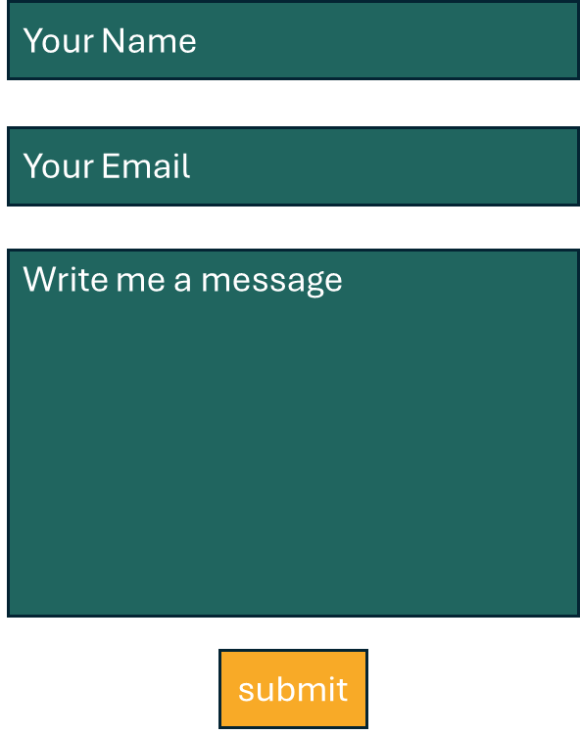
home
Contact
About
Projects
Work and School
Contact
Your Name
Your Email
Write me a message
submit

