Slide 1

Hurricane Emergency Evacuation
Bobby Kelsey
Jacqueline Ly
Brandon Spiegel
August 2, 2019

Slide 2
Problem Statement
During an emergency, like when a hurricane is barreling down with severe wind gust and floods expecting to close roads and evacuation orders are issue, can you rely on current navigation systems to get you to safety?
Currently, first responders are slow to receive updates.
Can we rely on social media to provide real-time updates to get you to safety?

Slide 3


Methodology
Problem Statement
Data Collection
Data Cleaning
Feature Extraction
Generating Latitude
and Longitude
Mapping Road Closures
Twitter: Specific accounts & hashtags
Using keywords to classify tweets by road status
Search for roads, counties, cities, and highways in text
ArcGIS category filtering
Bokeh and GoogleMaps

Slide 4
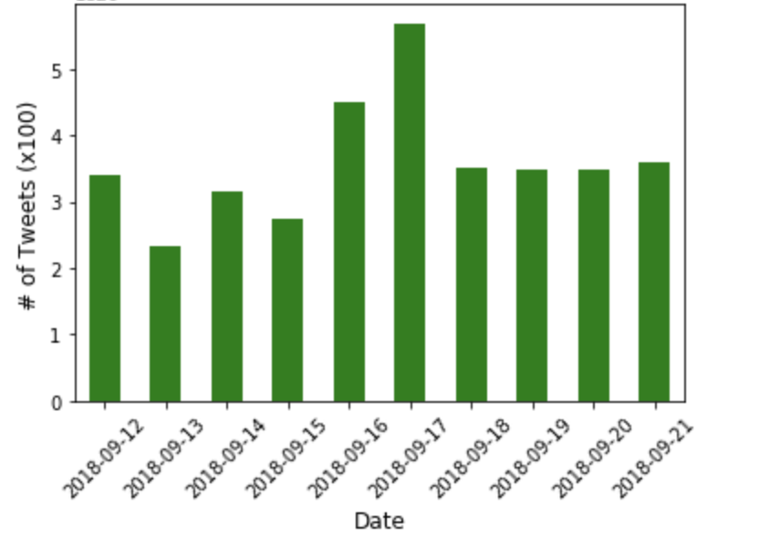
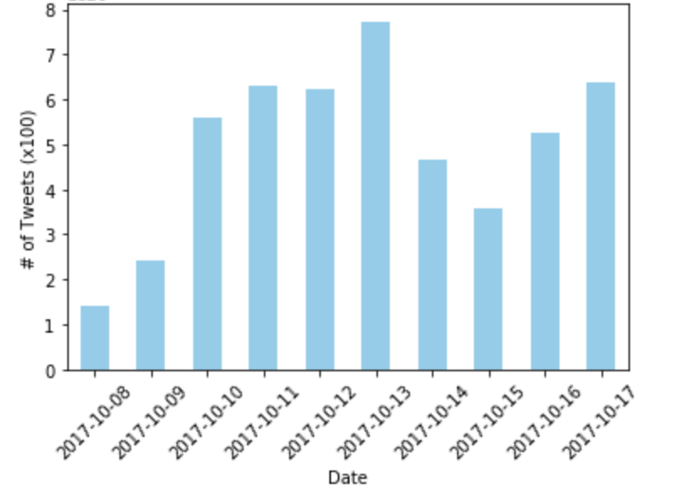
Data Collection
Posts were gathered from ~ three days before hurricane to one week following hurricane landfall.
 | Florence | Michael
Number of Accounts | 15 | 14
Total # of Posts | 3446 | 5437
Dates Captured | Sept. 7 – 17, 2018 | Oct. 8 – 17, 2017
Distribution of Tweets

Slide 5
Data Cleaning
Removing Unwanted Characters, Images, and Links
http://bit.ly/2DjxINZ , I-40, East, MM 286, Near Raleigh, Vehicle Crash, Lane Closed, at 9/21 5:39 PM
i-40 east mm 286 near raleigh vehicle crash lane closed at 921 5:39 pm'
Categorizing tweet by road closing, opening, and original cause
flooding blocks the exit ramp in #northside on 45 n fwy sb at the n sam houston pkwy #traffic
fm-521 northbound at fort bend county rd cr 56 - high water - status: cleared at 6:55 am
Removing Tweets Regarding Reopen
beltway 8-east northbound at wallisville - accident - status: cleared at 2:41 am

Slide 6
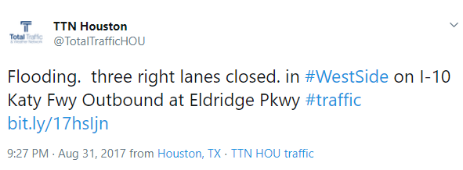
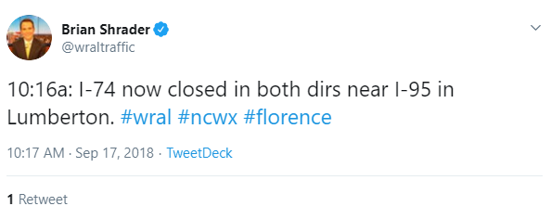
Feature Extraction (1 of 4)
Goal: Extract as much possible geographic information from tweets as possible to maximize chance of locating the incident
First highway is site of incidence
Additional roads help locate incident along first road
Suffixes often abbreviated
Restriction words can differentiate from non-relevant highway mentions
Cities and counties can narrow down geography
Many accounts are specific to a state or city
Hashtags can identify relevant tweets across all accounts
Room for improvement: use words such as “in”, “on”, and “at” to identify relationships between roads and concepts mentioned

Slide 7
Feature Extraction (2 of 4)
A wide variety of potential geographic features were gathered via government websites.
800+ Interstate and Auxiliary Highways
200 US Routes
5,000+ State highways*
2,700 Cities and towns*
3,100 Counties
300 Road Suffixes
* Only gathered for 5 states specifically impacted by Hurricanes Harvey, Michael and Florence – Virginia, North and South Carolina, Florida, and Texas

Slide 8
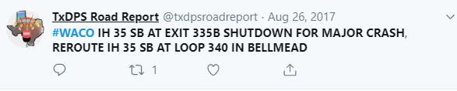
Feature Extraction (3 of 4)
Using extracted geographic info, potential addresses were created for each tweet.
“I-35, Exit 335B, Bellmead, Texas”
“I-35, Loop 340, Bellmead, Texas”

Slide 9
Feature Extraction (4 of 4)
In turn, we were able to take 2,400 tweets and funnel down to 700 with a high probability of finding an accurate location.
2400 Tweets For Hurricanes Maria and Florence*
1900 + Containing a Highway
~700 With Easily Identified
Intersecting Road/Exit

Slide 10

Generating Latitude and Longitude
ArcGIS’s easy-to-use Python package GeoPy and robust geocoding made it easy to extract latitude and longitude coordinates from constructed addresses.
“I-35, Exit 335B, Bellmead, Texas”
“I-35, Loop 340, Bellmead, Texas”
Robust Category and Point of Interest Geocoding Capabilities
Longitude: -97.1179799999
Latitude: 31.55962000
ArcGIS Match Score: 92.26
Longitude: -97.1057205
Latitude: 31.604211
ArcGIS Match Score: 99.22

Slide 11
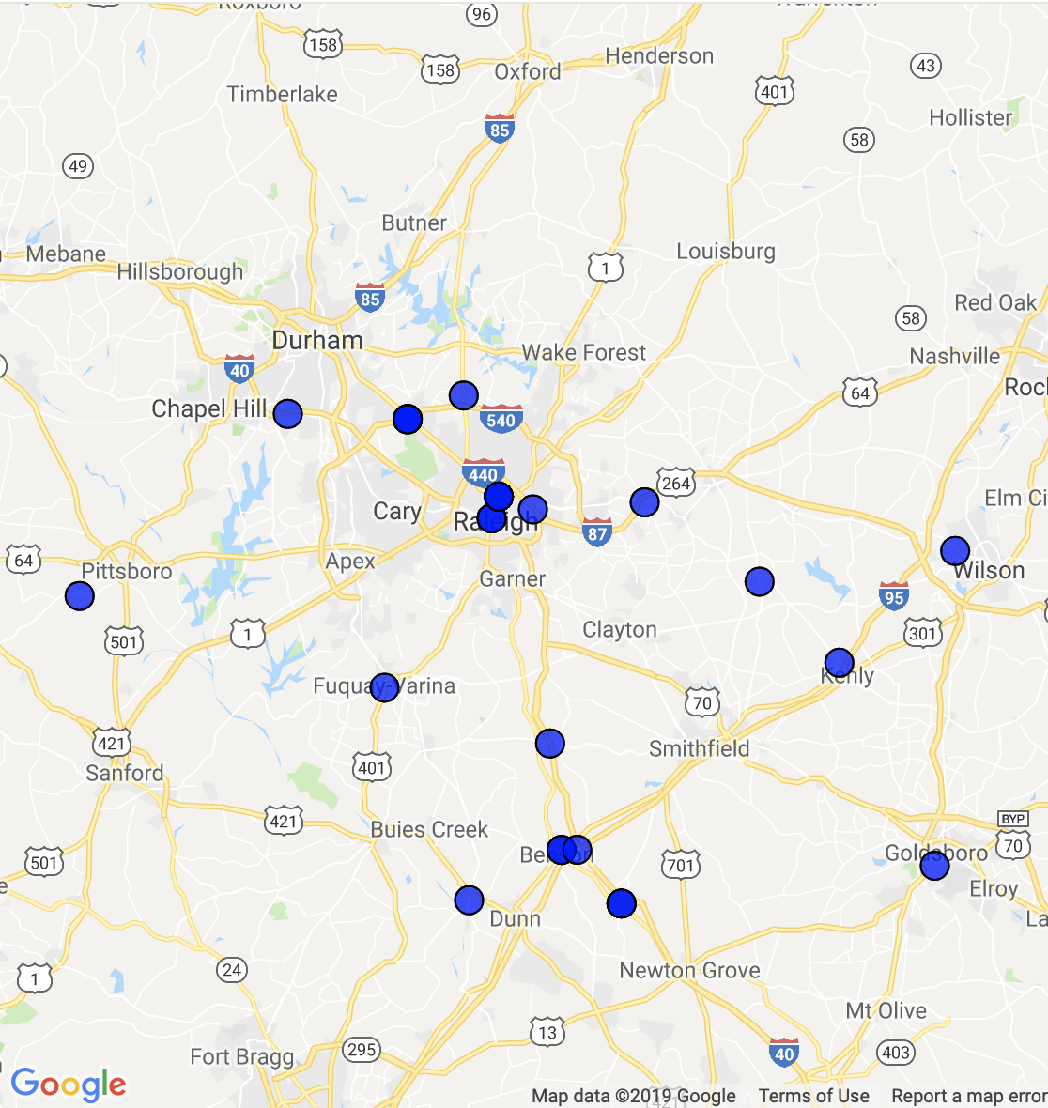
Mapping Road Closures - Hurricane Florence
Tweets often refer to main roads, so smaller back roads may not be captured via twitter.
Areas outside of city do not receive the same twitter coverage.

Slide 12
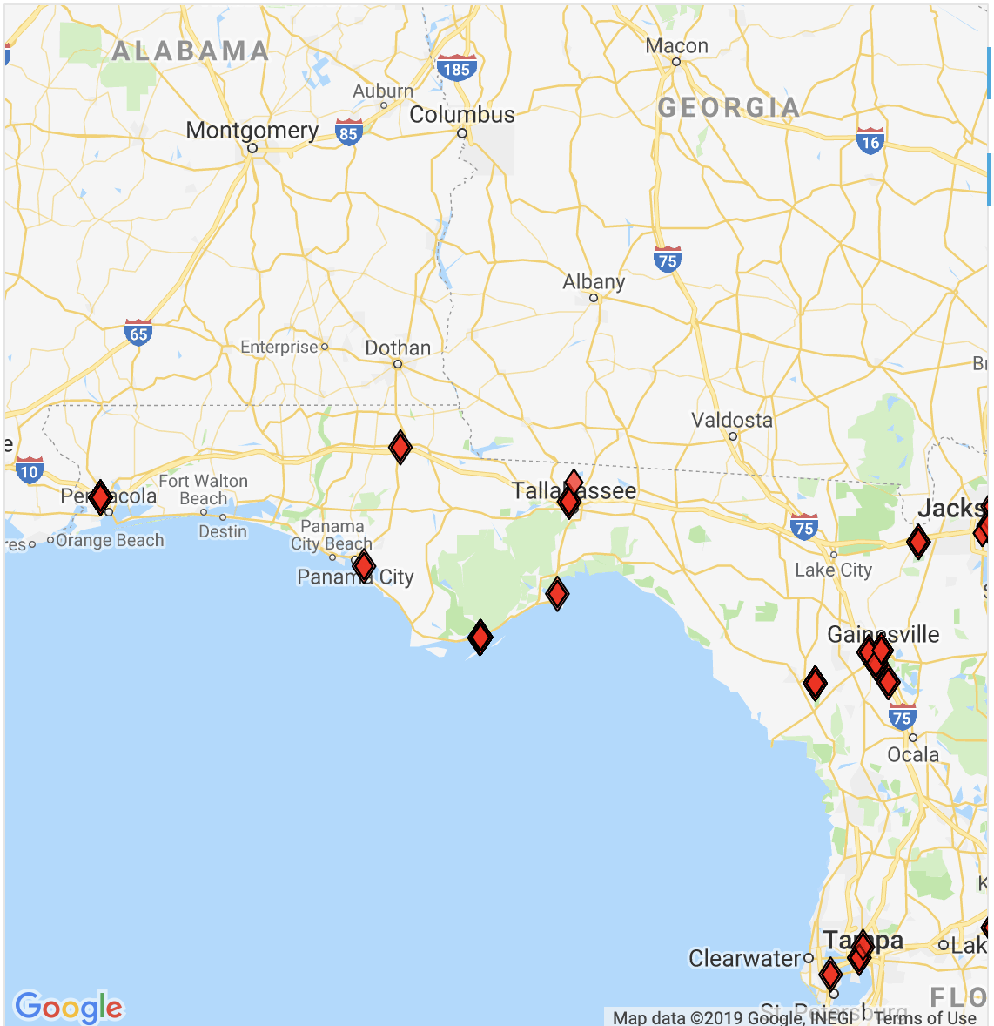
Mapping Road Closures - Hurricane Michael
Limited use of twitter for road condition updates.
Many points captured were related to Miami and Jacksonville, which weren’t the main targets of Michael.

Slide 13
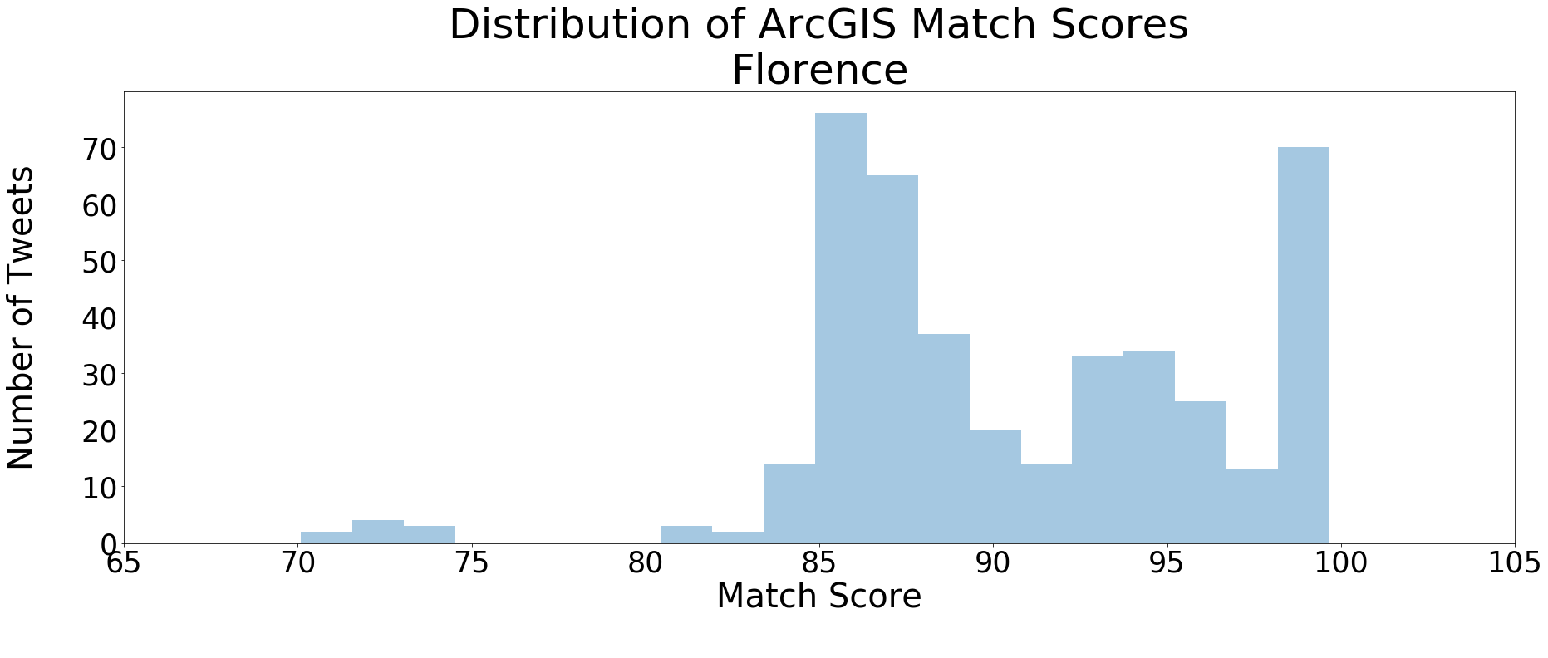
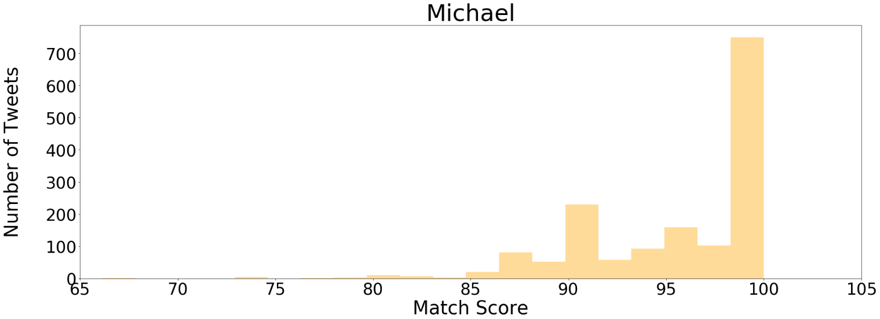
Mapping Performance
Weaker
Matches
Stronger Matches
Spot check of matches shows strong matches had scores above 90.
Were able to generate tweets from Hurricane Michael tweets slightly better than for Florence
Duplicate locations were not removed on these charts

Slide 14
Next Steps
Expand twitter search techniques to identify relevant tweets not attached to key accounts or hashtags
Explore other media platforms outside of twitter
Automate and speed up process
Incorporate advanced NLP techniques for parsing tweets
Expand use of ArcGIS category and POI filtering to improve accuracy
Generate labeled training data to enable model development

