Slide 1


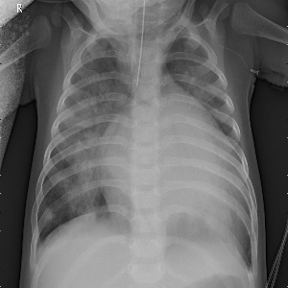
Detecting Pneumonia in X-Ray images using Convolution Neural Networks
Bob Spoonmore
July 2021
Problem Statement
How can images of infant chest X-Rays be viewed algorithmically such that Pneumonia can be detected from Normal conditions with a level of confidence above 90%?
A Deep Learning algorithm of Convolution Neural Networks will be applied to images of pediatric X-Rays separated into Pneumonia and Normal labeled groups to determine if images can predict results based on training a supervised image model

Slide 2


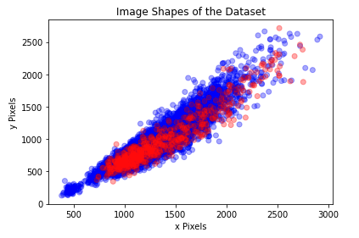

Exploratory Data Analysis
Images from the Kaggle Dataset:
Pediatric Pneumonia Chest X-ray https://www.kaggle.com/andrewmvd/pediatric-pneumonia-chest-xray
Dataset by Daniel Kermany and Michael Goldbaum in 2018. All images labelled as either pneumonia or normal
Kermany, Daniel; Zhang, Kang; Goldbaum, Michael (2018), “Labeled Optical Coherence Tomography (OCT) and Chest X-Ray Images for Classification”, Mendeley Data, v2 http://dx.doi.org/10.17632/rscbjbr9sj.2
Data set 5856 images in folders: All images jpeg with various resolutions and proportions, no missing data
Final Train, Test, Valid split: 80%, 10%, 10%
Model Dataset:
157 files
157 files
1267 files
1799 files
Unbalanced number of files:
- Pics: 1583 Normal, 4274 pneumonia
- Small number of files lower in resolution
- Most image ratios within consistent spread
- Copied files into modeling folders
Test: 10% of data, equal # norm, pneu
Train: 80% of data, rest of norm, % above pneu
Valid: 10% of data, equal # norm, pneu
157 files
Source Files :
Original split (Test/Train)
combined into single set of NORMAL and PNEUMONIA Source Dataset remains intact
157 files
NORMAL
Modeling Files:
New folder structure (test,train,valid)
Unbalanced file count – could impact analysis
Copied % of pneumonia train to discard folder to balance file counts
PNEUMONIA

Slide 3
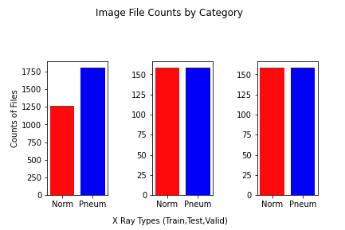
Image Preprocessing
Preprocess to make images similar and comparable
Read each file individually, and applied the following:
Resize: set all to 300 pixels x 300 pixels. (square)
Alpha: Contrast, set to 1.0
Beta: Brightness, set to 1.0
(note: multiple runs tested alpha, beta combos between 0.5 and 1.2 inclusively and best results found for 1.0 each)
Grayscale: all images changed from RGB to gray
Normalize: all values normalized to 1 based on #/255
Multiple test sets established: varied between Train folder holding same number of files each to progressive steps of 10% more pneumonia files. Was worried about tradeoff between biasing results and removing files from training.

Slide 4

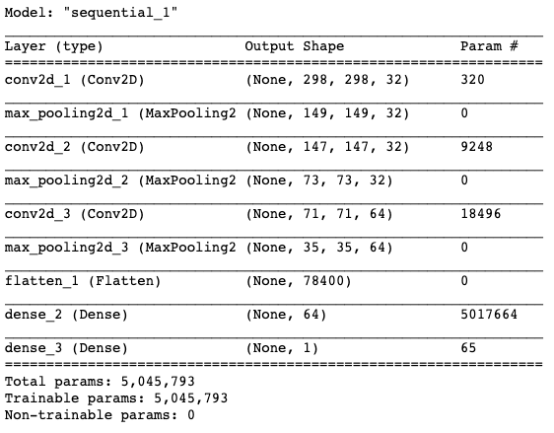
CNN Model Build
Pooling
Flatten
Convolution
Dense
Convolution
Pooling
Sigmoid
0
1
Feature
Map
Feature
Map
Image
Feature Map
Feature Map
Layer 1
Layer 2 …
Flatten/Dense
Layer reduction
Sequential Model: all outputs lead to inputs next layer
Rectified Linear approach: directed outputs- easy to train
Sigmoid: final reduction results in a 1 or 0 – used for predictions
Optimizer = ‘adam’
Loss = ‘binary_crossentropy’
Early stopping: metric “accuracy”, min_delta=0.01, patience=2
Three models were applied on each analysis:
Model 1 = 1 layer
Model 2 = 3 Layers (shown above)
Model 3 = 5 Layers
Three models used for analysis on which was better fit: Not known initially

Slide 5
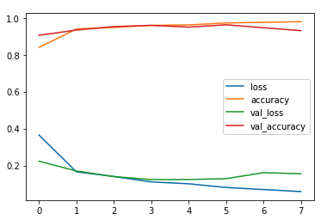

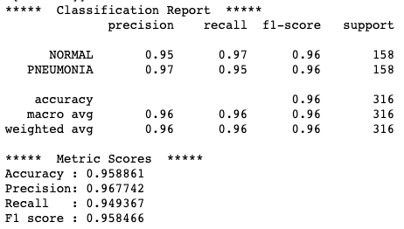
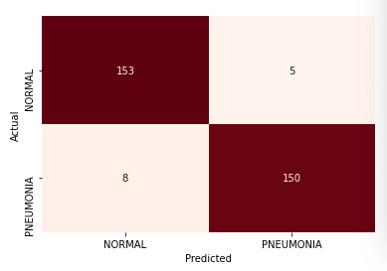
Model Performance
Model 2 chosen:
Performed better for all parameters
Best for dataset with 40% more pneumonia files than normal files
Model stopped at 7 Epochs
Accuracy : 95.8%
Precision : 96.8%
Recall : 94.9%
F1 score : 95.8%
This model accurately predicted pneumonia 150 times, incorrectly
Predicted it as normal only 8 times.
This model accurately predicted normal 153 times, incorrectly predicted it as pneumonia only 5 times.

Slide 6
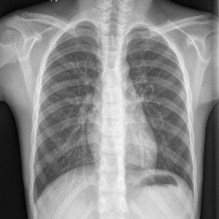
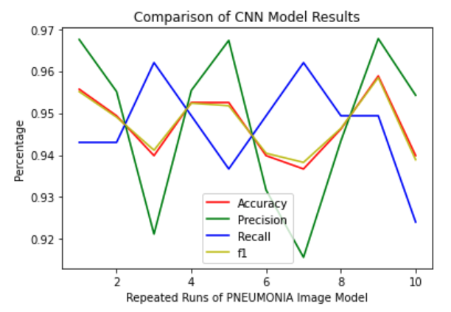
Recommendations
Normal
Pneumonia
The image evaluation model produced accurate results with 94.7% accuracy¹
The model met the objectives and did predict with a level of confidence above 90%.
This model had a balanced level of precision and recall to avoid bias towards normal or pneumonia.
¹The model was run 10 consecutive times on the same dataset, it was shown that a potential range of accuracy of 93.6% to 95.8% was possible. The average accuracy over these 10 runs was 94.7% with a standard deviation of 0.8%

