Slide 1


BSRA
Presents
Smart E-Training Solutions
Powered
by

Slide 2


Vision Statement
“Our vision is to provide innovative technical solutions and consultation to empower businesses and organizations while maintaining efficiency, trust, integrity, cost-effectiveness and customer satisfaction.”

Slide 3

ABOUT OUR COMPANY
BSRA Technical Consultancy services formed to provide enterprise solutions and consultancy in IT, Communication and Healthcare sectors.
BSRA is a firm which combines experienced senior leaders with rich and diverse domain expertise in several domains.
The combined experience of our senior leaders enables us to perceive customer’s business requirements, culture and vision and allow us to accordingly offer customer oriented highly reliable solutions.
Our integrated value-added solution offerings are highly cost effective and state of art.

Slide 4

Advantage with BSRA
Technology
Time
Our endeavour is to ensure we provide our customers with the latest technology and business processes to provide state-of-the-art solutions
  We aim to deliver well researched and time bound services and solutions as per the customer/project timelines and milestones
BEST OPTION
Security
Cost
Your data security is BSRA’s priority. Our anti-theft and anti-data-loss strategies follow the best security practices to ensure that your data is always safe
  Our services are designed with cost-effectiveness as our priority while keeping our operational costs optimized to align with our client’s budget.

Slide 5
Digitally Transforming the Training Sector
The Need…
Training sector is undergoing major transformational changes.
While learning community demands greater ease of access to knowledge, management’s focus is towards cost effective delivery.
Geographically dispersed campuses necessitates technology solutions enabling distance-learning programs with reliable and intuitive online tools those providing enriching interaction between trainee and the trainer staff.

Slide 6
Virtual Classroom Software Solution
The Solution
Video Learning Management Software (vLMS) and InstaCast [a webcasting software] of PeopleLink’s ACCUMEN are ideal solutions for enabling this process.
Enables trainers to teach and hand out assignments.
Assist learners who can access courses/assignments online and interact with peers, leading to better understanding of the topic through audio/visual methodology.

Slide 7
What is E-Training
E-Training application is a software platform designed to enable interactive learning within the classroom, shifting the training process from a one-way communication to a collaborative approach that encourages trainee participation.
Synchronous Training
This method of training facilitates scheduled courses where trainees attend real time video enabled lectures at specified timings.
The entire course follows a structured format, meaning lectures, discussions and submissions happen at a specified time.
Asynchronous Training
In this method trainees also have the option of taking up courses which allow them to learn at their own pace.
They are provided the content beforehand, and given a deadline before which they need to complete course readings and assignment submissions.

Slide 8
Benefits for Trainers..
Helps trainer plans lesson for the training, build courses for trainees. Keep track of the classroom, monitor trainee performances and offer remedial courses.
Prepare Calendar
Manage training program easily
Prepare a day-to-day schedule of lessons planed, topics to be covered, time required for a topic, for the entire academic year.
Track Trainee attendance, conduct in-training, group activities and engage trainees with quizzes and tests
Enhance Learning Outcomes
Prepare Quality Courses
Provide customized feedback for each trainee. Built-in course authoring feature helps trainers to create personalized courses for trainees that include videos, PPTs, audio and more.
Create, upload and share video and audio content, PPTs, and documents, and import content from external sources.

Slide 9
Benefits for Trainees..
Access courses from anywhere, view video lectures, complete and submit assignments through Acumen. Stay engaged in the classroom, compete with your classmates on tests and assignments, and get additional support from teachers.
Access Audio & Video Lessons
Understand concepts better through video and audio demonstrations, and additional learning materials.
Collaborate With Peers
Engage in debates, share ideas, and brainstorm with peers using interactive learning tools such as forums and group chats.
Learn on the Go
Complete and submit assignments, read course material from anywhere with simple mobile access.

Slide 10

Managing Training..
Monitor performances of each classroom from each branch of the institution; ensure timely completion of syllabus and consistency of content delivery at all levels of the institution.
Manage Multiple Branches
Standardize Teaching Delivery
The software platform has multitenancy feature which provides management with reports on the performances of trainers and trainees for multi-location training.
Trainers can collaborate on lesson preparation using content accessed from the central content repository, or a senior trainer can create one best course to be followed by all the other trainers.
Monitor whether each trainers follows the course and delivers the content the exact same way to ensure the same standard of teaching is maintained across all classrooms.

Slide 11
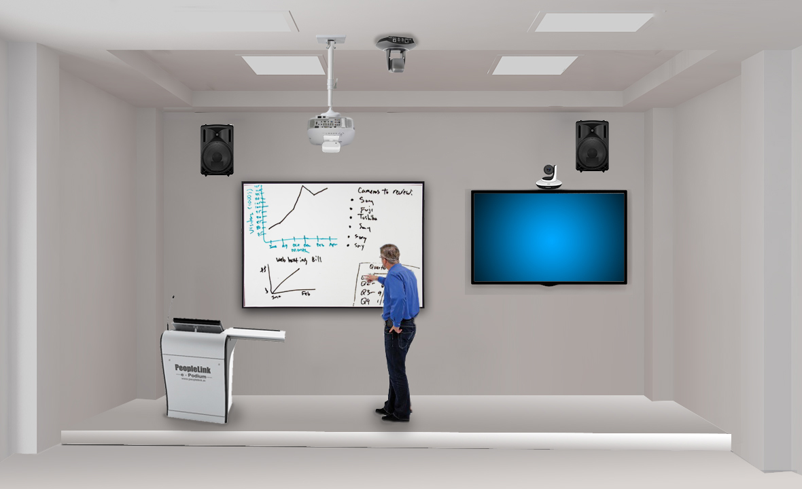

Smart training Components
Smarter In-Class Education
Video LMS
Digital podium with inbuilt tablet PC and IOT controller allows to manage the ambience and the presentation right for the podium.
Lock & track camera moves to track the lecturer’s movement in the class
Connected speakers enhance the audio experience of the classroom
Smart classroom
Smarter Distance Education
Video LMS
Video Learning Management System (LMS) not only make the class more engaging with interactive tools but also connects multiple classes.
The lecture could be streamed to multiple locations and be remotely managed by the faculty
The content and assignment are delivered online to standardize the teaching delivery.
Each class could be recorded and stored centrally
Video LMS

Slide 12
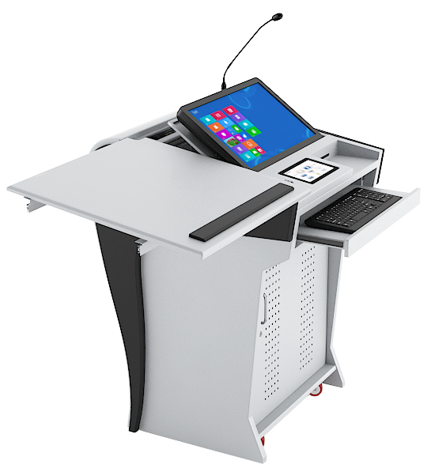


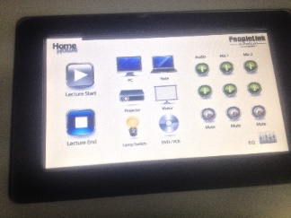
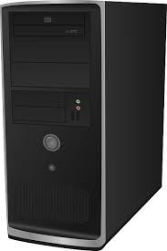
Smart Classroom – Podium
Cardioid Gooseneck Mic
Interface for external device:
VGA x 1, HDMI x 1, Audio In x 1, Audio Out x 1, USB x 4, Tablet x 1, LAN x 1, 220V socket
Wireless Microphone system Handheld mics and Lapel Mics
Video LMS
19 inch touch tablet
7 inch customized touch controller : Projector on/off control, Motorized screen control, Lighting control, Mic mute, media control
Podium CPU for Interface, Audio /Video Generic Codec for Video Communication along with Professional H.264 compression Video graphic processor & 4 Channel Video Mixer option
Digital Amplifier with Controller, Amplifier – 300W (150W x 2) 4 Ω Matrix switcher – 2 x2 Controller with Relay to control motorized items, controller with Projector on/off control and also lighting controlDSP ( Digital Signal Processor)

Slide 13
Contact us
Call Us +91 9910381041
+91 8884899914
+91 9890396926
Write to us @ sales@bsratech.com
bsra.technology@gmail.com
LinkedIn https://www.linkedin.com/in/bsra-technical-consultancy-and-services-llp-1071651ba/
Website https://www.bsratech.com

