Slide 1
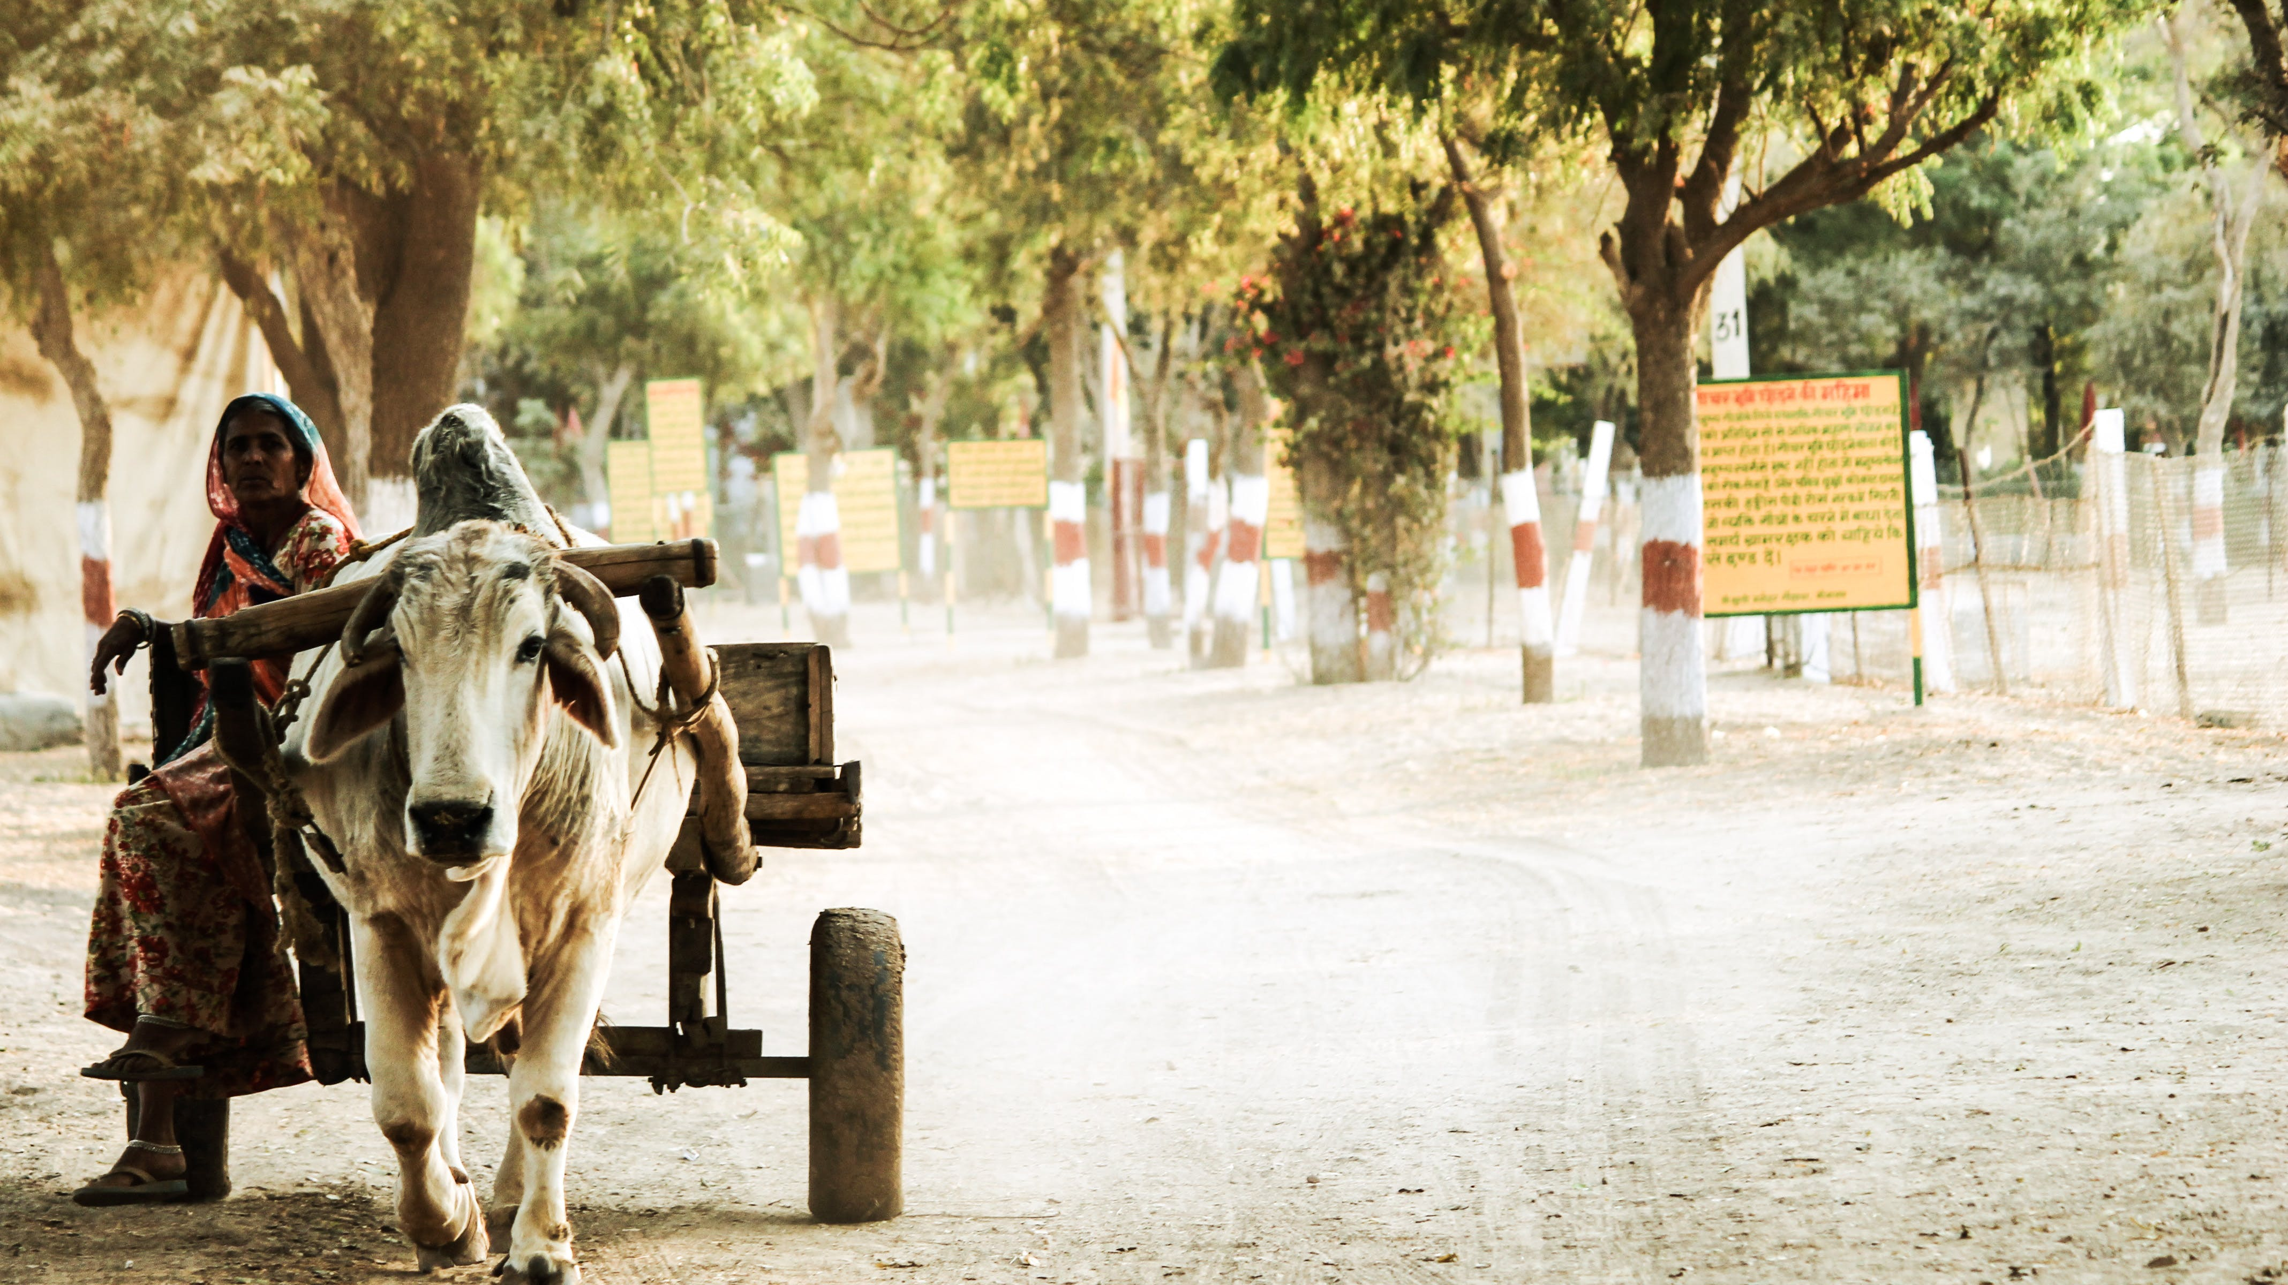
Innovation Management
DOMAIN : Rural Development Reporting
Section : 6
Balaji – 2320030016
BSR Chaitanya - 2320030142

Slide 2



Problem statement
No quick addressing of the problems by Government.
Some of the problems are not identified in some remote villages.
Time taking process.
No proper development in rural areas.

Slide 3

ideate
An app or website
Conducting surveys to identify the problems
Bringing awareness in the people about government funds and projects which can solve their problems

Slide 4


Why you choose the idea as best
Smart phones availability.
More usage of internet.
Easy to communicate.
Spread the issue rapidly.
Time efficient.

Slide 5
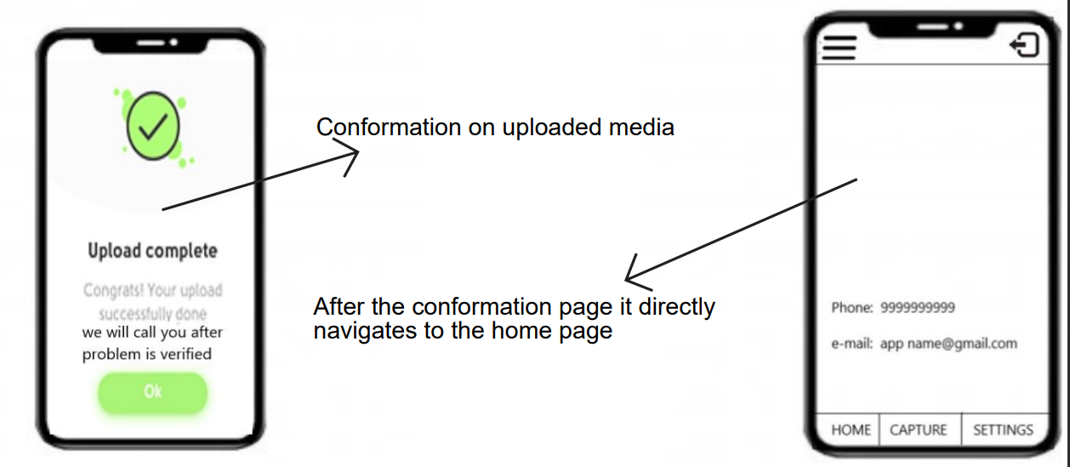
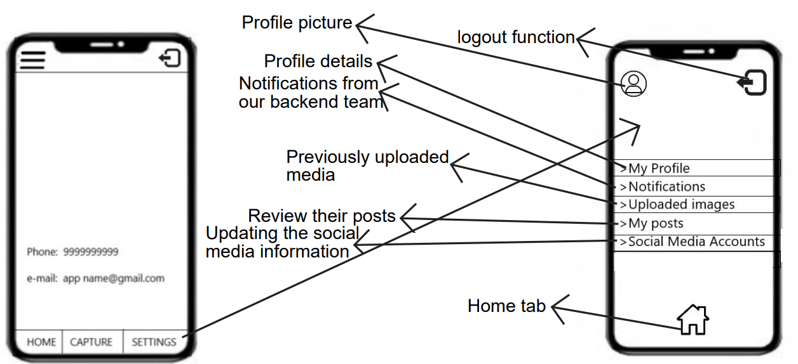
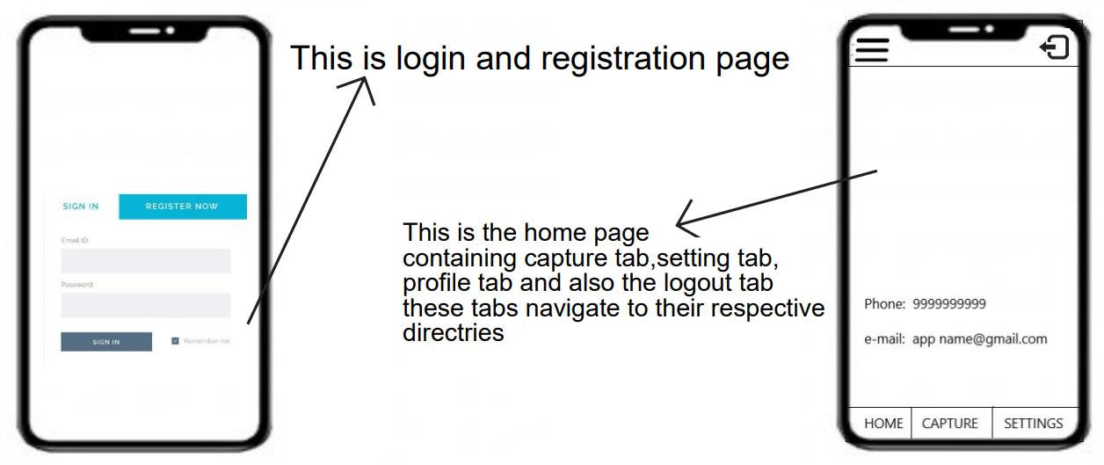
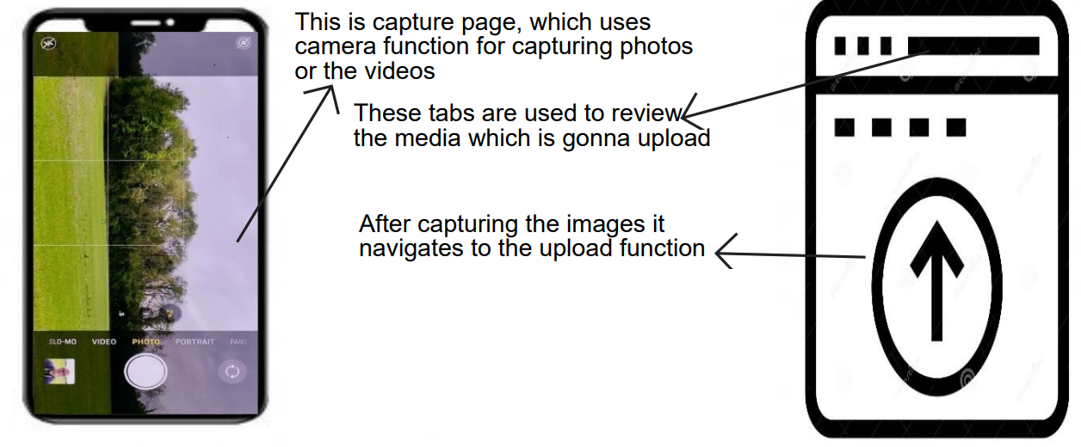
Rough prototype

Slide 6


Thank you

