Slide 1
Travel agency · flights from New York
Can we tell which flights will go wrong, two hours before they leave?
What we found in the 2023 flights from JFK, LGA and EWR, what we can predict, and what the agency can do about it.
435,352
flights analysed
NYC flights 2023 · predicting late and cancelled departures
1 / 12
Notes:
Open with the question the agency cares about: can we know two hours ahead which flights will go wrong?
Where the numbers come from:
- 435,352: 04_metrics_by_month.csv (flights (sum))

Slide 2
Nearly 1 flight in 4 leaves late or is cancelled
22.9%
Late means
More than 15 minutes after the scheduled time, or the flight never leaves.
of flights left more than 15 minutes late, or never left
Why it matters
A client misses a connection or a meeting.
If we knew two hours before which flights are at risk, we could warn the client and arrange a backup.
Our two questions
Will this flight be late or cancelled? And how many minutes late will it be?
NYC flights 2023 · predicting late and cancelled departures
2 / 12
Notes:
If we knew two hours before which flights are at risk, we could warn the client and arrange a backup.
Where the numbers come from:
- 4: 04_metrics_by_month.csv (1 / late_or_cancelled_rate (weighted))
- 22.9%: 04_metrics_by_month.csv (late_or_cancelled_rate, flights (weighted))

Slide 3
We checked the data before trusting it, and lost no flight
14 checks
10,738 cancelled flights
Kept and marked. They are exactly the flights we want to warn about.
run on the data, with a decision for each problem
1,913 flights with no plane number, 826 with no weather reading
Nothing was thrown away: the gaps are marked and handled.
All 435,352 flights were kept.
What the data cannot tell us
Only one year, only flights leaving New York, no passengers or prices, no reasons for delays.
NYC flights 2023 · predicting late and cancelled departures
3 / 12
Notes:
All 435,352 flights were kept.
Where the numbers come from:
- 435,352: 04_metrics_by_month.csv (flights (sum))
- 14 checks: 01_data_report.csv (problem (count of rows))
- 10,738: 01_data_report.csv (rows (cancelled))
- 1,913: 01_data_report.csv (rows (missing_tailnum))
- 826: 01_data_report.csv (rows (weather_gap))

Slide 4
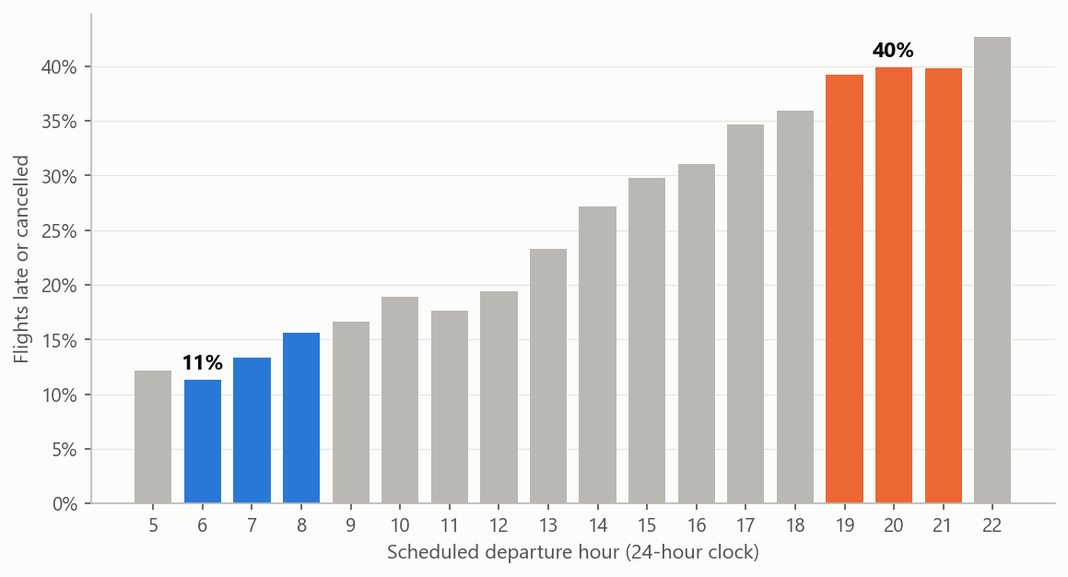
The risk of delay climbs through the day
13% → 40%
late or cancelled: flights at 6-9 am against 7-10 pm
Flights scheduled in the morning are rarely late; in the evening far more of them are. Clients with tight connections should fly in the morning.
NYC flights 2023 · predicting late and cancelled departures
4 / 12
Notes:
Flights scheduled in the morning are rarely late; in the evening far more of them are. Clients with tight connections should fly in the morning.
Where the numbers come from:
- 13%: 02_findings.csv (number (row 1))
- 40%: 02_findings.csv (number (row 1))

Slide 5
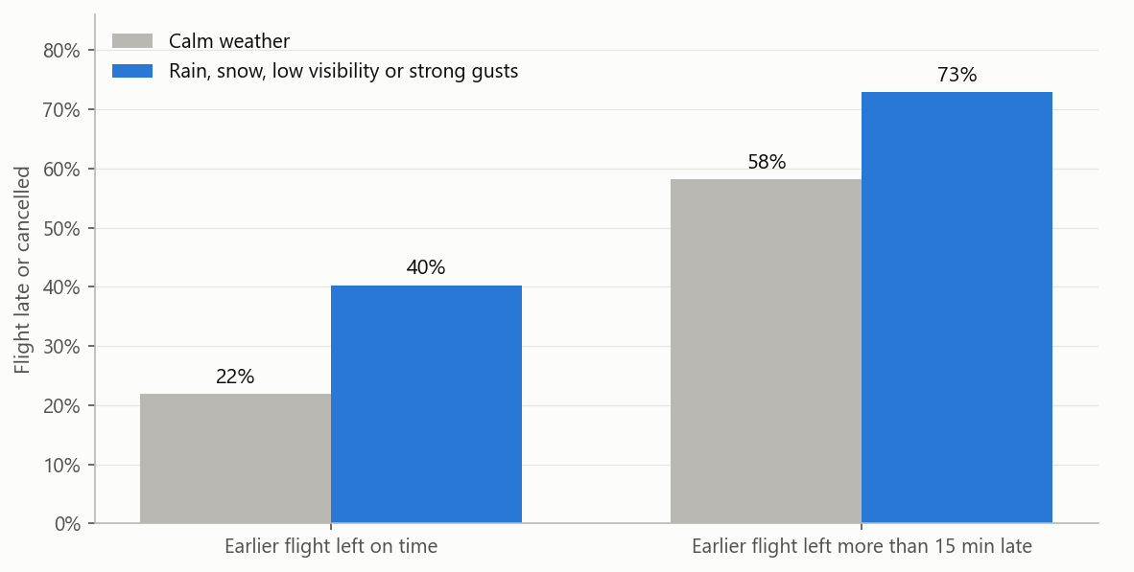
A late earlier flight is a strong warning sign, stronger than everyday bad weather
+36 vs +18
points of extra risk: a late earlier flight against everyday bad weather (rain, snow, low visibility, strong gusts)
When the same plane's earlier flight left more than 15 minutes late, 61% of its next flights are late or cancelled, against 25% otherwise. Part of that is a shared bad day: within the same day, airport and part of the day, the overall gap of 37 points shrinks to 26. The agency can see the earlier flight two hours ahead. This is against everyday bad weather; the rarest severe storms can be worse.
NYC flights 2023 · predicting late and cancelled departures
5 / 12
Notes:
When the same plane's earlier flight left more than 15 minutes late, 61% of its next flights are late or cancelled, against 25% otherwise. Part of that is a shared bad day: within the same day, airport and part of the day, the overall gap of 37 points shrinks to 26. The agency can see the earlier flight two hours ahead. This is against everyday bad weather; the rarest severe storms can be worse.
Where the numbers come from:
- 61%: 02_findings.csv (number (row 2))
- 25%: 02_findings.csv (number (row 2))
- 37: 02_domino_adjusted.csv (raw_gap_points)
- 26: 02_domino_adjusted.csv (same_day_gap_points)
- 36: 02_findings.csv (number (row 4))
- 18: 02_findings.csv (number (row 4))

Slide 6
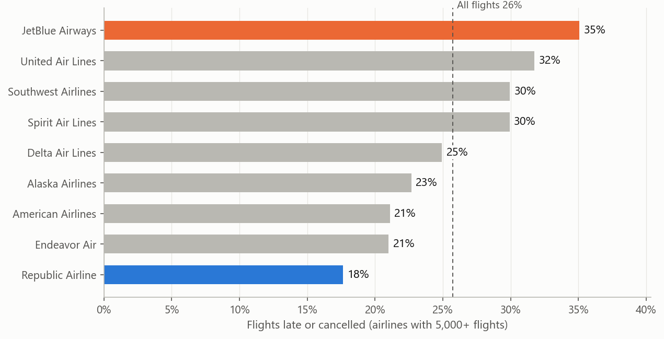
Airlines differ a lot, and airport and time of day do not explain it
35% vs 18%
late or cancelled: JetBlue Airways against Republic Airline
Even when we compare flights from the same airport at the same time of day, the gap remains. For a tight connection, prefer the steadier airlines.
NYC flights 2023 · predicting late and cancelled departures
6 / 12
Notes:
Even when we compare flights from the same airport at the same time of day, the gap remains. For a tight connection, prefer the steadier airlines.
Where the numbers come from:
- 35%: 02_findings.csv (number (row 3))
- 18%: 02_findings.csv (number (row 3))

Slide 7
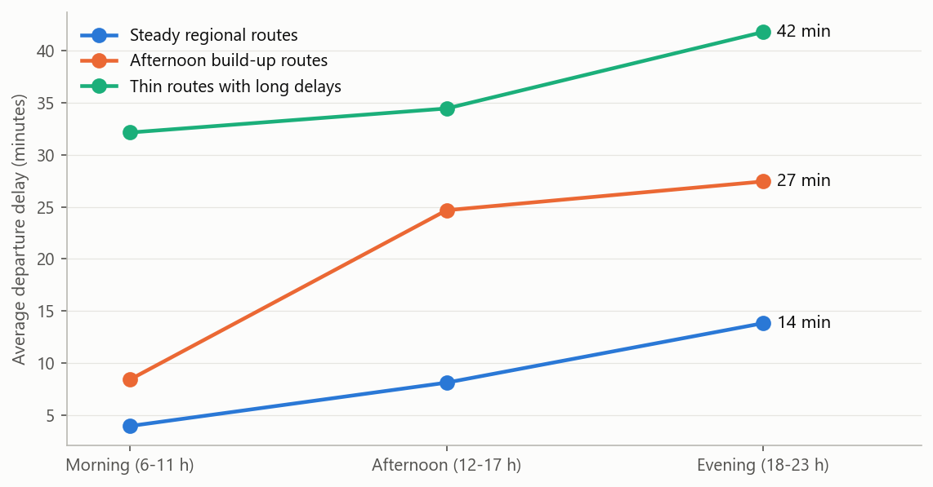
Destinations fall into three types, each needing a different action
64 steady routes
Short delays all day, but a few more cancellations. Keep a backup for tight connections.
39 afternoon build-up routes
Fine in the morning, late after noon. Offer a morning flight.
6 thin routes
About one flight a day, 53% of them late. Offer a flexible ticket.
The groups are a simplification: they shift when built from other months, and 'thin routes' is the least stable.
NYC flights 2023 · predicting late and cancelled departures
7 / 12
Notes:
Destinations were grouped by their delay pattern. Each type gets a different action.
Where the numbers come from:
- 64: 03_groups.csv (size (steady))
- 39: 03_groups.csv (size (build-up))
- 6: 03_groups.csv (size (thin))
- 53%: 03_groups.csv (typical (thin))

Slide 8
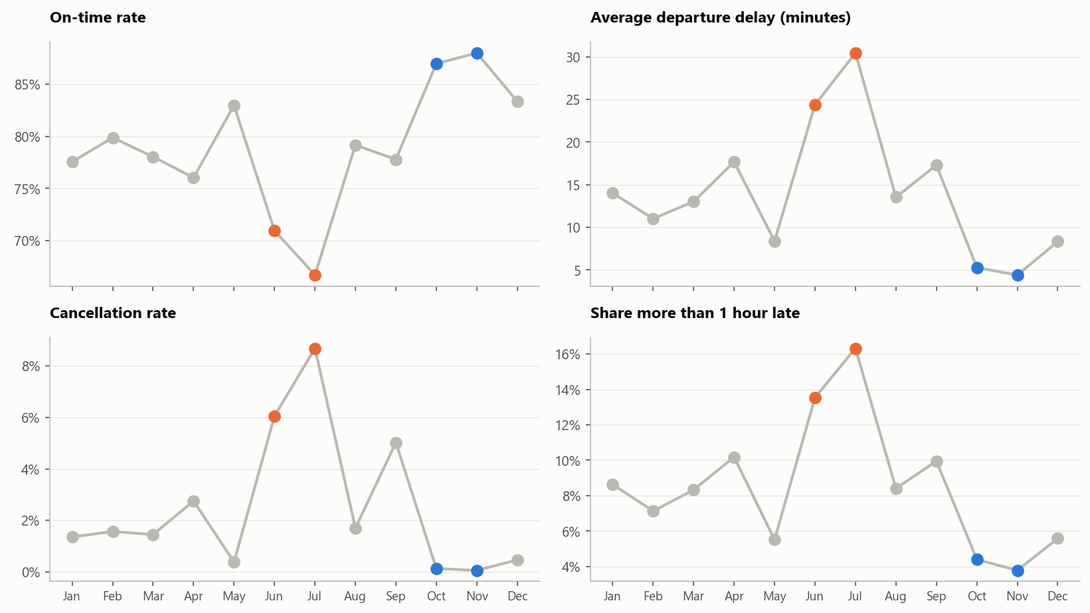
July was the worst month and autumn the calmest
39% vs 12%
late or cancelled: July against November. These are the monthly numbers to follow.
In July 8.7% of flights were cancelled. Just 10 days hold 35% of all cancellations up to September, and the weather at the airports does not fully explain them: the cause is not in our data.
NYC flights 2023 · predicting late and cancelled departures
8 / 12
Notes:
In July 8.7% of flights were cancelled. Just 10 days hold 35% of all cancellations up to September, and the weather at the airports does not fully explain them: the cause is not in our data.
Where the numbers come from:
- 8.7%: 04_metrics_by_month.csv (cancellation_rate (July))
- 35%: 02_findings.csv (number (row 5))
- 39%: 04_metrics_by_month.csv (late_or_cancelled_rate (July))
- 12%: 04_metrics_by_month.csv (late_or_cancelled_rate (November))

Slide 9
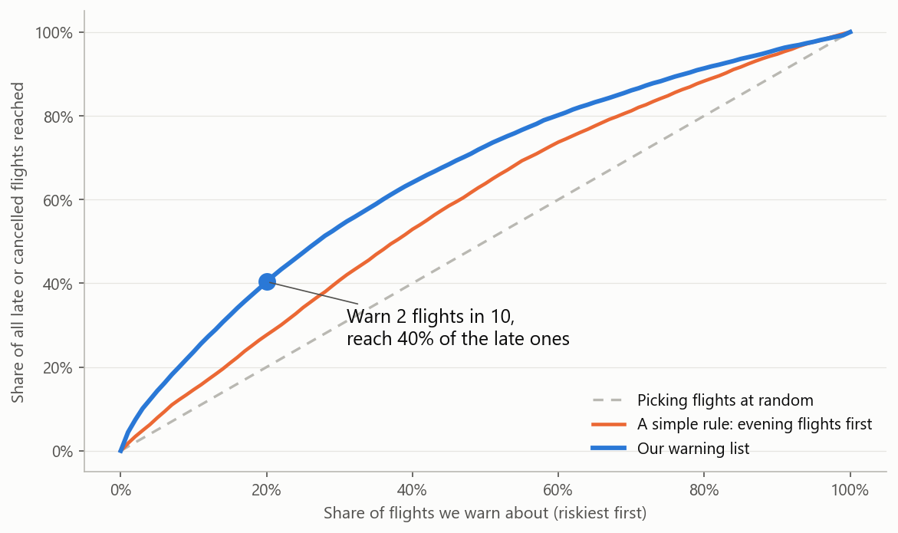
Prediction 1: warn 2 flights in 10 and reach 2.0 times as many late ones as luck
40% vs 20%
of the late or cancelled flights reached, against picking at random
In October to December we would have warned 20,894 flights (2 in 10) and reached 5,929 late or cancelled ones, against about 2,937 by luck. 28 warnings in 100 were right; 14 flights in 100 were late. Run live, with the cut-off set from the previous 7 days, it reaches 40%.
Learn and tune
Jan-Sep
Test, kept aside
Oct-Dec
NYC flights 2023 · predicting late and cancelled departures
9 / 12
Notes:
In October to December we would have warned 20,894 flights (2 in 10) and reached 5,929 late or cancelled ones, against about 2,937 by luck. 28 warnings in 100 were right; 14 flights in 100 were late. Run live, with the cut-off set from the previous 7 days, it reaches 40%.
Where the numbers come from:
- 20,894: 07_value_first.csv (flagged)
- 2 in 10: 07_value_first.csv (share_flagged)
- 5,929: 07_value_first.csv (hits)
- 2,937: 07_value_first.csv (hits, recall, random_recall)
- 28: 07_value_first.csv (precision)
- 14: 07_value_first.csv (base_rate)
- 40%: 07_value_first.csv (recall_live_rule)
- 2 flights in 10: 07_value_first.csv (share_flagged)
- 2.0: 07_value_first.csv (lift)
- 40%: 07_value_first.csv (recall)
- 20%: 07_value_first.csv (random_recall)

Slide 10
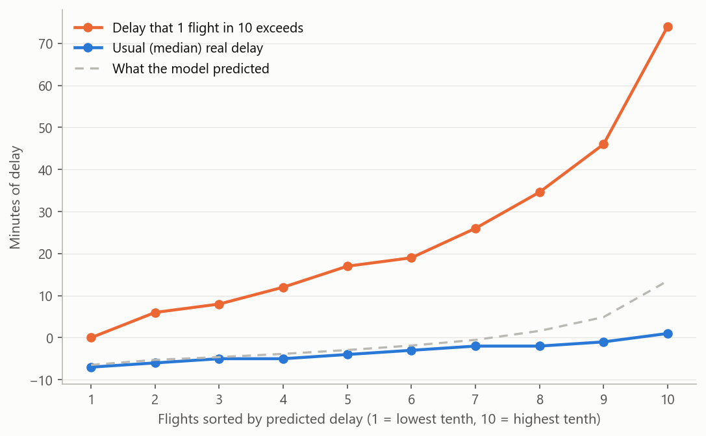
Prediction 2: how late will a flight be? A modest gain, honestly reported
3.4×
more long delays (45+ minutes) among the 5% of flights with the highest predicted delay: 21% against 6%
On average the predicted delay is only 0.14 minutes closer than a simple guess, because a few extreme delays cannot be foreseen. We use it to rank flights for a connection check, not to promise a number of minutes.
NYC flights 2023 · predicting late and cancelled departures
10 / 12
Notes:
On average the predicted delay is only 0.14 minutes closer than a simple guess, because a few extreme delays cannot be foreseen. We use it to rank flights for a connection check, not to promise a number of minutes.
Where the numbers come from:
- 0.14: 07_value_second.csv (gain_minutes)
- 3.4: 07_value_second.csv (lift)
- 21%: 07_value_second.csv (precision_long)
- 6%: 07_value_second.csv (base_rate_long)

Slide 11
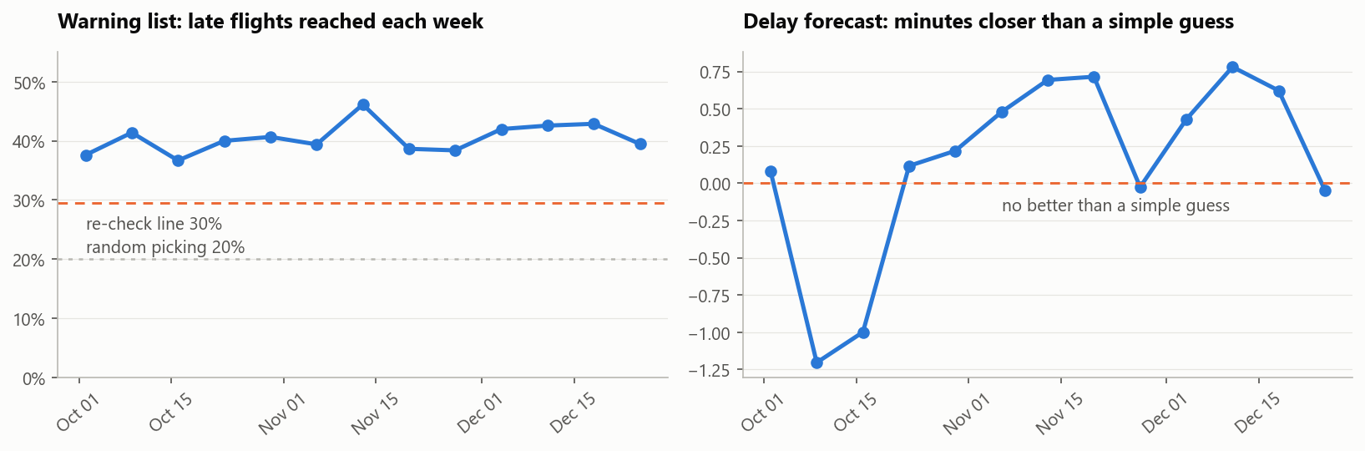
Two decision cards: what to do, for how many flights, and when to re-check
Card 1 · warn the client
Who: the 2 in 10 riskiest flights (20,894 in the 3 months, ranked together).
Do: warn the client and check the connection. A person confirms first.
Re-check if the weekly reach falls below 30% two weeks in a row. It stayed between 37% and 46%.
Card 2 · check the connection
Who: the 1 in 20 flights with the highest predicted delay, 5,212 in 3 months.
Do: tell the client to expect a long delay and prepare a backup.
Re-check or drop it if it is no better than a simple guess two weeks in a row: its gain comes and goes.
Assumptions to confirm with the agency: it can warn about 2 flights in 10 and check 1 in 20. If not, we change one number and everything updates.
NYC flights 2023 · predicting late and cancelled departures
11 / 12
Notes:
Card 1 is a warning made two hours before each departure. Card 2 helps order the connection checks; its gain is small and fragile, and the card says so.
Where the numbers come from:
- 2 in 10: 07_value_first.csv (share_flagged)
- 20,894: 07_value_first.csv (flagged)
- 30%: 07_value_first.csv (recheck_line)
- 37%: 07_weekly_scores.csv (value (min))
- 46%: 07_weekly_scores.csv (value (max))
- 1 in 20: 07_value_second.csv (flagged)
- 5,212: 07_value_second.csv (flagged)

Slide 12
What we do not know, what comes next, and how AI helped
What we do not know
The test months were calm: the model expected 22% late flights, 14% were. We trust the ranking, not the percentages.
It reaches only 7% of the late morning flights, but 70% of the evening ones.
One year of data, no prices, no reasons for delays.
What comes next
Confirm the two capacities with the agency.
Add a second year, so seasons can be learned.
Set a separate warning quota for each part of the day.
Add the agency's own costs to put a value on each warning.
How AI helped
Claude Code, an AI assistant, wrote the code, ran the analysis and drafted these slides, following my instructions. It also recorded its own mistakes and corrections.
What I checked myself, on an earlier version of the project:
re-ran everything from scratch; the checks passed
recomputed a headline number from the raw data
recomputed the value of the warning list
read how the models are kept from using future information
confirmed the test months stay untouched until the end
read the leak found by the independent review and how it was fixed
went through all 8 notebooks and the log of mistakes
The project changed after that; I have not yet repeated these checks on the final version.
NYC flights 2023 · predicting late and cancelled departures
12 / 12
Notes:
Be upfront about the limits. The last panel says exactly what the AI did and what the owner personally checked.
Where the numbers come from:
- 22%: 06a_calibration.csv (mean_predicted, flights (weighted))
- 14%: 07_value_first.csv (base_rate)
- 7%: 06a_group_errors.csv (value (hour_band recall, morning))
- 70%: 06a_group_errors.csv (value (hour_band recall, evening))

