Slide 1

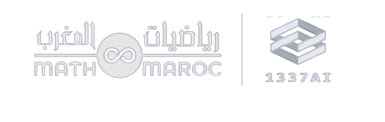

LFAHEM
AI Legal Assistant for Moroccan Law
Mohamed Ouaicha
Yassir Salmi

Slide 2
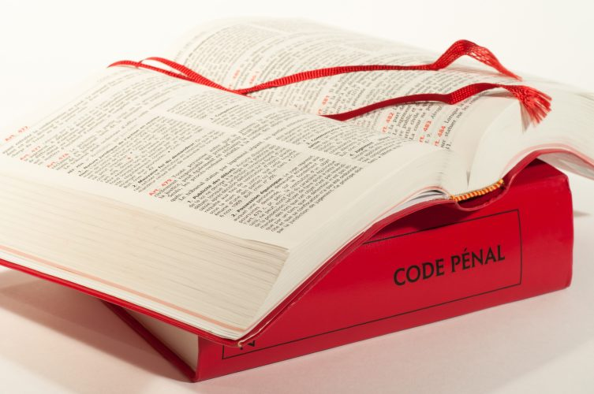
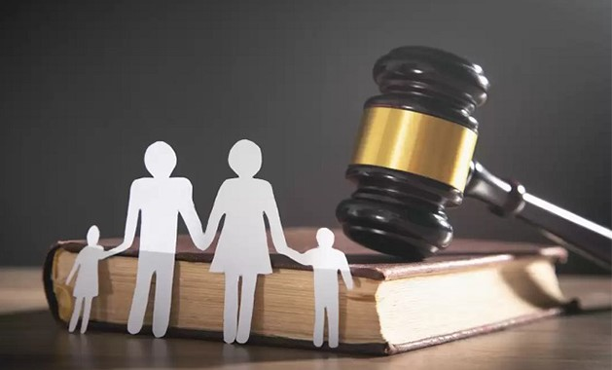
Hi, I’m Lfahem
I’m an AI-powered chatbot designed to assist you as a moroccan who want to know the law.
helping you understand your rights and obligations.
assisting you to understand article from the law.

Slide 3
What can I do?
Respond To Your Question.
Assist You For Decision Making.
Give You References To Articles From The Moroccan Law.

Slide 4
Data Pre-Processing
Penal Code,Family Code (PDF in french)
Minister of Justice
Translation of the documents to English
Google translate
Conversion to Doc And remove the header and the footer ,Extract text
Finale Txt file to use

Slide 5
Architecture

Slide 6


Models Used
Gemma 7B Instruct
LLama 3 8B Instruct

Slide 7
Examples

Slide 8

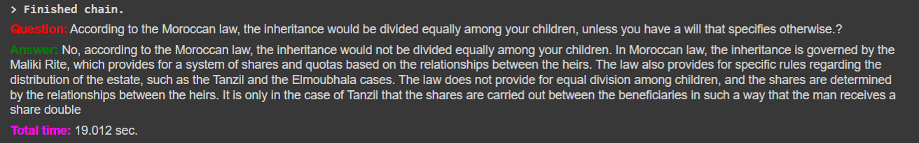
How I Work?
1- You Ask A Question:
According to the Moroccan law, the inheritance would be divided equally among your children, unless you have a will that specifies otherwise?
2- I Process The Asked Question:
3- You Get The Response:

Slide 9
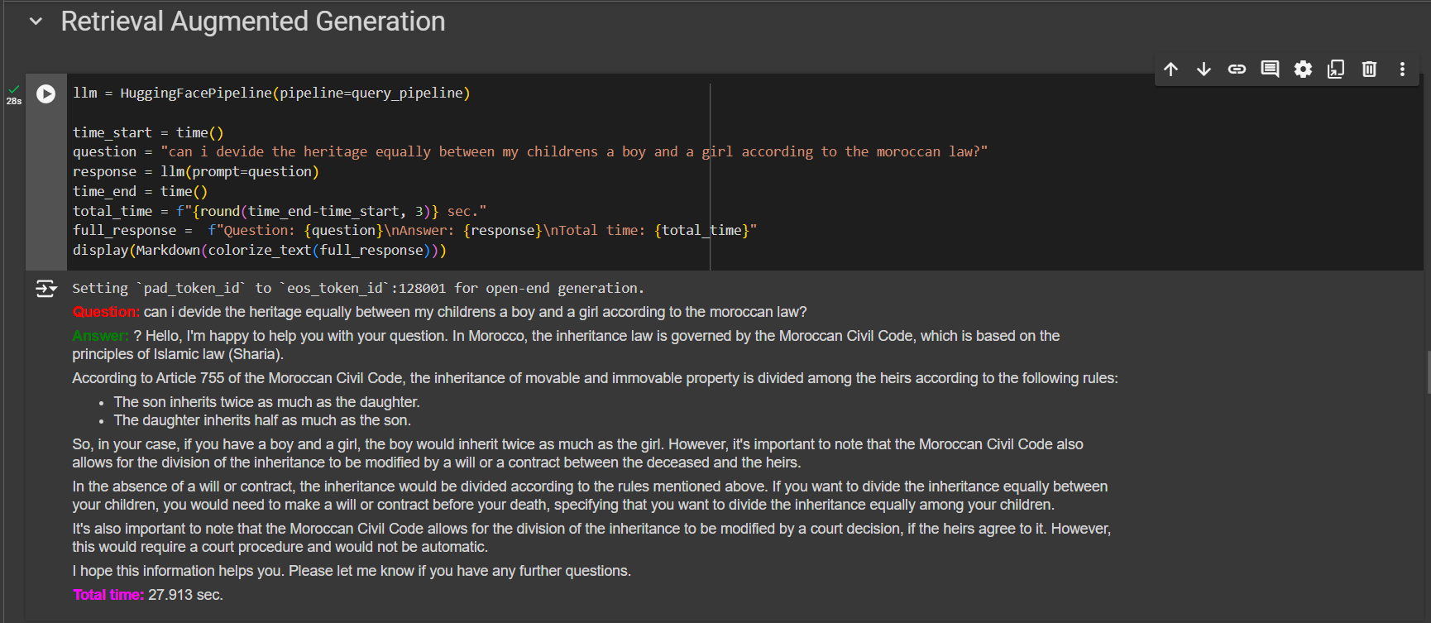

Slide 10
Tha
You
nk
.

