Slide 1
Institution Information Technology
Software Project Lab 1
-SE 305

Slide 2
Project Name : Implementation Of Hidden Markov Model Presented By: Md. Ibrahim Khalil BSSE 1009
Supervised By : Dr. Ahmedul Kabir
Notes:
21.644 citations

Slide 3
Introduction
What‘s HMM?
A Statistical Model
Applied in a wide range of applications
Applications:
Speech recognition
Handwriting recognition
Bioinformatics

Slide 4
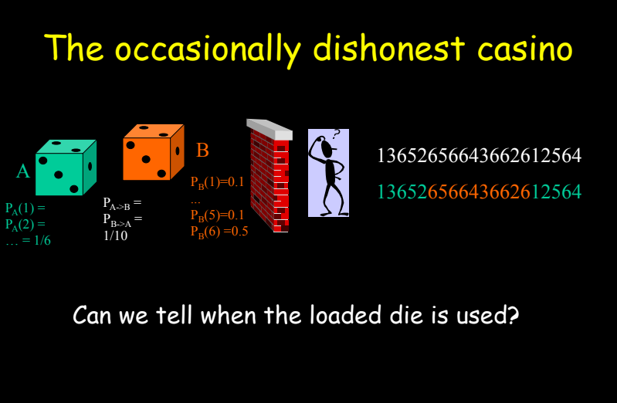
Introduction

Slide 5
HMM Example
0.1
0.9
0.3
F
B
State transition prob.
States
0.7
0.5
0.5
0.8
0.2
Observation symbol prob.
H
T
H
T
Observation symbols
HTHHTTHHHTHTHTHHTHHHHHHTHTHH
Observation sequence
FFFFFFBBBFFFFFFBBBBBBBBFFFFFF
State sequence

Slide 6
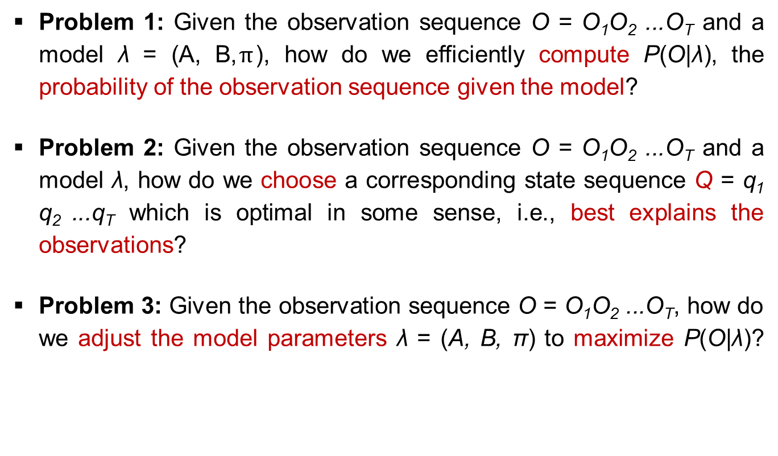
Three basic problems for HMMs
Problem 1: Given the observation sequence O = O₁O₂ ...O_{T} and a model λ = (A, B,$π$), how do we efficiently compute P(O|λ), the probability of the observation sequence given the model?
Problem 2: Given the observation sequence O = O₁O₂ ...O_{T} and a model λ, how do we choose a corresponding state sequence Q = q₁ q₂ ...q_{T} which is optimal in some sense, i.e., best explains the observations?
Problem 3: Given the observation sequence O = O₁O₂ ...O_{T}, how do we adjust the model parameters λ = (A, B, π) to maximize P(O|λ)?

Slide 7

Problem 1: Evaluation
Input: O = O₁O₂ ...O_{T} and λ = (A, B,$π$)
Output: P(O|λ)?
Solution: Use Forward Algorithm

Slide 8
Forward Algorithm
We define a forward variable α_{t}(i) as the probability of the partial observation seq. until time t, with state S_{i} at time t
Step 1 - Initialization:
Step 2 - Induction:
Step 3 – Termination:
Notes:
TN^2

Slide 9
Forward Algorithm - Example
Coin toss, O = HTTH
Initialization:
Induction:
Prob. of seeing H₄ from F₄ or B₄
Termination:
F
F
F
F
+
+
+
H T T H
+
+
+
B
B
B
B

Slide 10
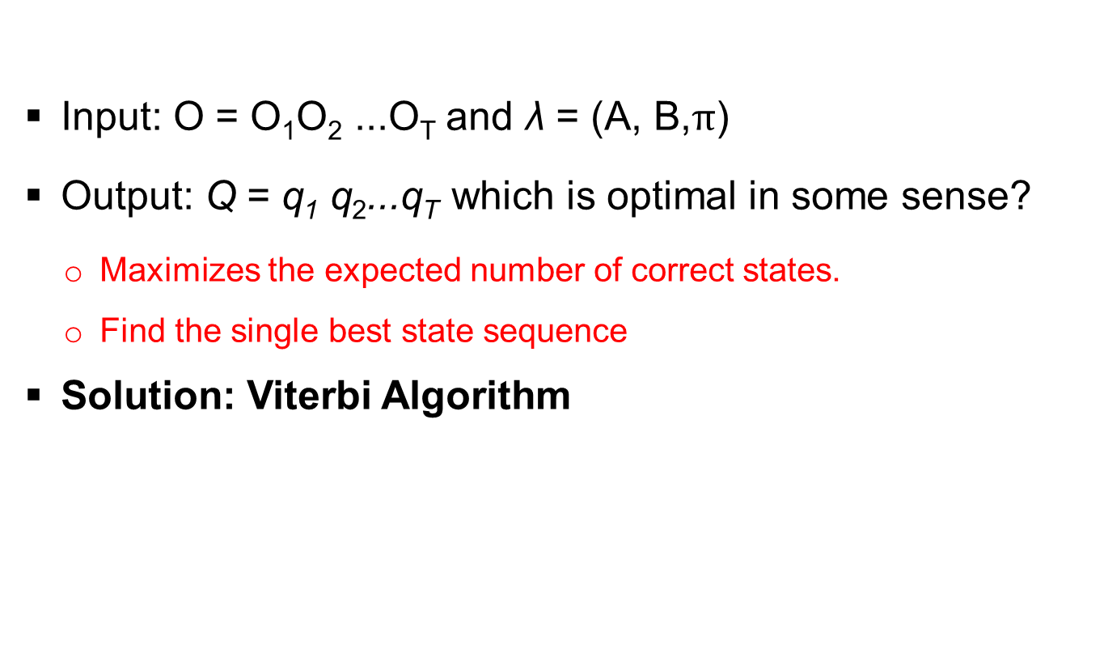
Problem 2: Decoding
Input: O = O₁O₂ ...O_{T} and λ = (A, B,$π$)
Output: Q = q₁ q₂...q_{T} which is optimal in some sense?
Maximizes the expected number of correct states.
Find the single best state sequence
Solution: Viterbi Algorithm
Notes:
What happens if a_{ij} = 0

Slide 11
Viterbi Algorithm - Example
Observe: HTTH
Initiation:
Recursion:
Termination: pick state that gives final best δ score, and backtrack to get path ➔ FFFB most likely to give HTTH
0.09
0.0405
0.018225
0.2
F
F
F
F
H T T H
0.0672
0.0094
0.0324
0.48
B
B
B
B

Slide 12
Problem 3: Estimate Parameters
How do we adjust the model parameters λ = (A, B, π) to maximize P(O|λ)?
Solution: Baum-Welch algorithm
Random initialize λ =(A,B,π)
Run Viterbi based on λ and O
Update λ =(A,B,π)
Notes:
There is no known way to analytically solve for the model which maximizes the probability of the observation sequence

Slide 13
Features
Calculate probability of a observe sequence
Estimate Current Hidden State
Estimate Likeliest Hidden state sequence
Estimate the Next Hidden State

Slide 14
Background Study
Bayes Theorem
Markov chain
HMM
Forward Algorithm
Viterbi Algorithm

Slide 15
Progress
Background Study (January)
Implement Bayes Theorem (January)
Forward Algorithm (February)
Viterbi Algorithm (February)
Simple GUI (February- March)
Link : http://www.cs.cmu.edu/~awm/15781/slides/hmm14a.pdf

Slide 16
Github Repositories
Link1:
https://github.com/bsse1009/SPL1
Link2 :
https://github.com/bsse1009/SPL1-HMM

Slide 17
Road Map
(March – April)
Implement Next state estimation
Generating and fit this model
Building a GUI*
Use this Model in an Application

Slide 18
“The best preparation for tomorrow is doing your best today”
SPL 1 Presentation

Slide 19
References
http://www.cs.cmu.edu/~awm/15781/slides/hmm14a.pdf
https://web.stanford.edu/~jurafsky/slp3/A.pdf
https://web.math.princeton.edu/~rvan/orf557/hmm080728.pdf
http://www.iitg.ac.in/samudravijaya/tutorials/hmmTutorialBarbaraExercises.pdf

