Slide 1
SPL1 Presentation Thakurmar Jhuli: an action adventure game
Name: Syed Ahmedul Kavi
Roll : 1017
Supervized by: Prof. Dr. Kazi Muhaymin-Us-Sakib

Slide 2


Slide 3
Goal of my project:
To make a 2D side scrolling action adventure game
2. It will be based on “Thakurmar Jhuli”
3. Nilkamal will be the main character
4. Though the game story will feature characters from Thakurmar Jhuli the story is
written by me
5. Features like jump and dodge will be included in combat

Slide 4
My understanding about the project:
Java language will be used due to structural similarity with Object Oriented
Programming
2. JavaFX library will be used for graphics rendering
3. In game mechanics and physics will be implemented by me.
4. Artificial Intelligence for enemies will be coded by me.

Slide 5
My Progress:
Independence of different components of game namely Graphics engine, Sound
engine, Input engine and an organizer class Game
2. All characters including Protagonist, Enemies and Boss inherit from a Super class Sprite
which further inherits from a general class Game object.
3. Protagonist can fluently move, jump and attack with the pressing of mapped key
Movement – directional keys
Jump – Up
Attack – Control
4. Enemies can patrol and attack the protagonist
5. All sprites have health, damage, attack range and health bar is drawn differently
for Hero, Enemies and Boss.

Slide 6
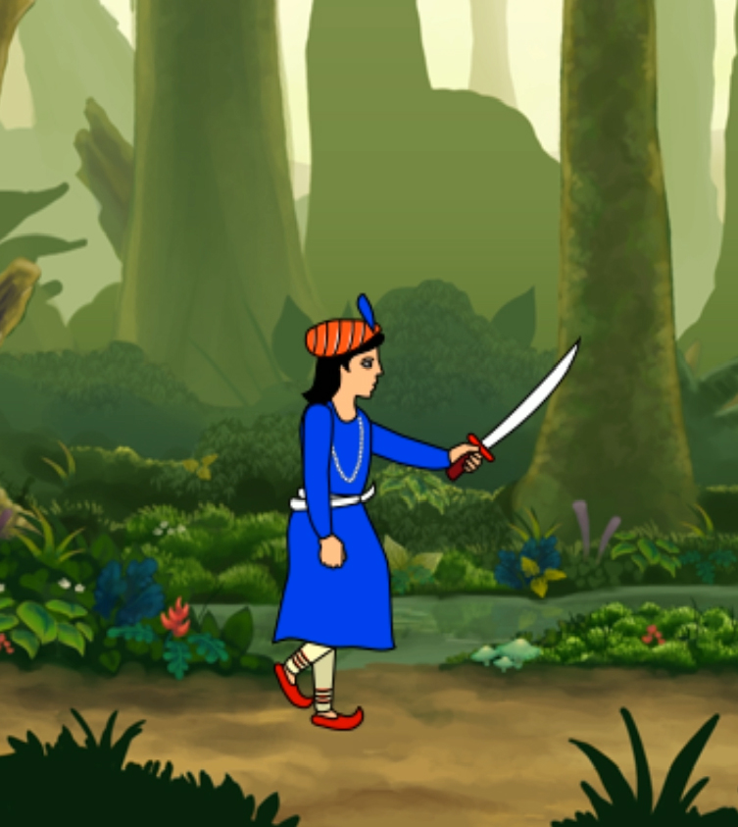
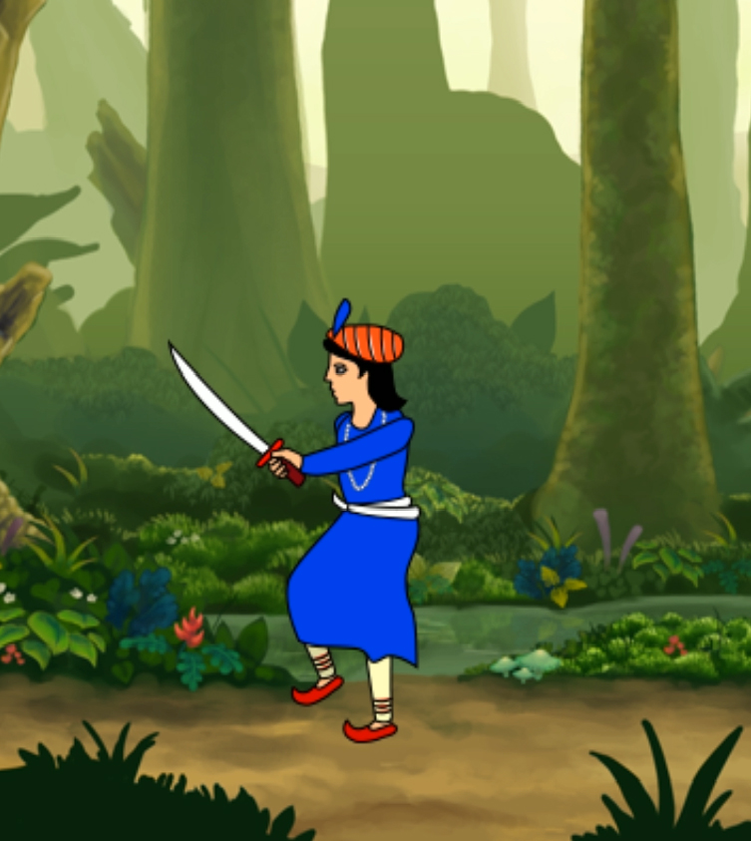
Complexity of code:
(This includes difficulties I faced and the complex parts of my code)
Successfully rendering movement animation and accurate background translation

Slide 7
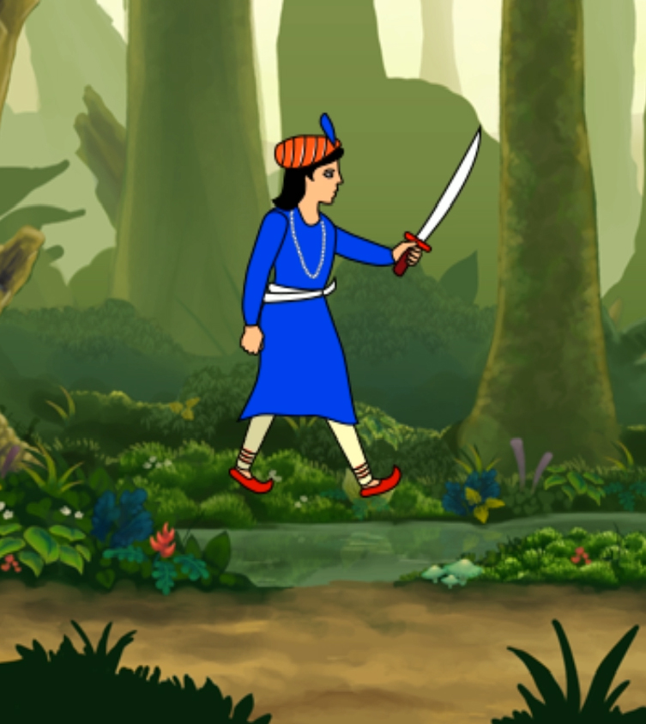
Complexity of code:
Implementing Jump.

Slide 8
Complexity of code:
Implementing response for pressing a key once rather than holding it
Refactoring game code into different engines and making the Sprite class
independent of any drawing, input handing or media playing.

Slide 9
Game Engine
Sound
Engine
Input
Engine
Graphics
Engine
Sprite
Gives position
Changes Position

Slide 10
Game
Object
Sprite
Protagonist
Enemy
Boss

Slide 11
My progress:
Making the Graphics Engine work by using a map with key as Sprite and Image as value. It gets the position of the objects from the key and renders the value image in that position.
Changing Background music as background transitions into a different part
Loading resources for making .exe

Slide 12
Here is the executable file for my game:
Nilkomol.exe

Slide 13
References for these project are:
All sprites and animation are made by my father Syed Kamal Hossain,
Chief of Graphics, Channel I
2. Idea for character input control and motion is taken from:
https://gamedevelopment.tutsplus.com/tutorials/introduction-to-javafx-for-
game-development--cms-23835
3. Single input handling idea was taken from Stack Overflow:
https://stackoverflow.com/questions/37472273/detect-single-key-press-in-javafx
4. Music taken from:
https://www.youtube.com/watch?v=MzLnzTDqQ30&t=3s
https://www.youtube.com/watch?v=u--BHiiW9OI

Slide 14
The link to my github repository:
https://github.com/bsse1017kavi/SPL1

Slide 15
Thank You

