Slide 1
TimeTableX
Automated University Class Routine
Generator and Optimizer
SPL-1 Project Proposal
Mohammad Seraz Alam
Institute of Information Technology
University of Dhaka

Slide 2
Why TimeTableX?
Manual routine preparation is time-consuming
Scheduling conflicts are difficult to avoid manually
Multiple teachers, batches, rooms and constraints make scheduling complex
Routine modification becomes difficult when requirements change
Need: A systematic way to generate valid
university routines automatically.

Slide 3
Proposed Solution
Automatically generate a conflict-free timetable
from academic requirements and constraints.
Automatic Routine Generation
Teacher Clash Prevention
Batch Clash Prevention
Room Clash Prevention
Teacher Availability Handling
Lecture & Consecutive Lab Scheduling
Routine Optimization
TimeTableX Engine
Optimized
Routine
Input Data
→
→
Teachers • Courses • Rooms
Batches • Constraints

Slide 4
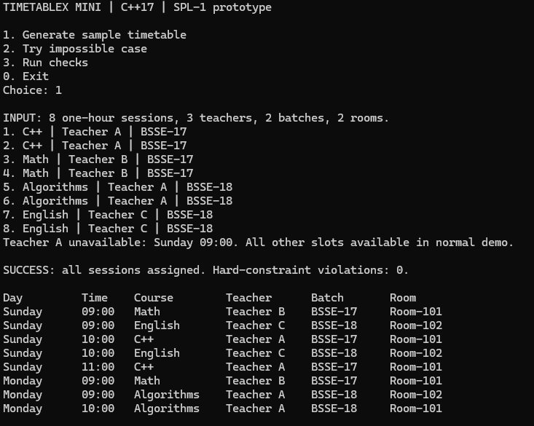
Target Users & Technical Approach
Target Users
University Departments • Academic Coordinators
Routine Management Committees
Core Technology
C++17 • STL • Object-Oriented Programming
Algorithms / Scheduling Approach
Constraint Checking • Backtracking Search
MRV / Heuristic Selection
Routine Optimization Heuristics
Development Tools
Early CLI Prototype
CMake • Git & GitHub • Qt (Planned GUI)
Current: C++ CLI → Planned: Qt GUI

Slide 5
Expected Outcome
Accept university scheduling data
Generate a valid weekly routine
Detect and prevent scheduling conflicts
Handle academic constraints
Optimize the generated timetable
Display/save the final routine
A functional C++-based university timetable
generation and optimization system.

