Slide 1
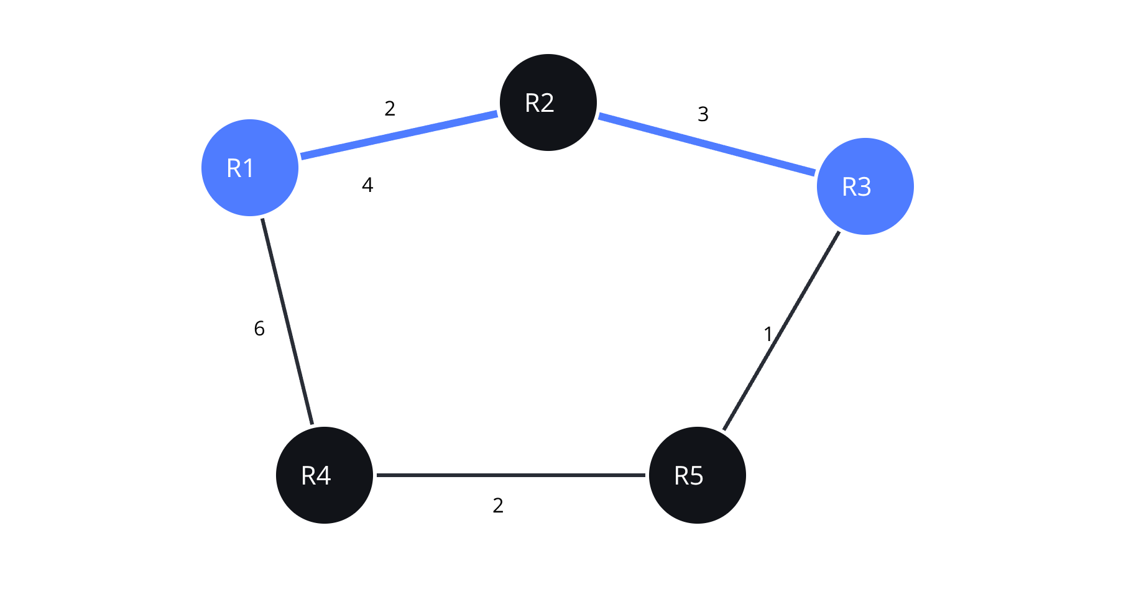
Network Routing and Failure Recovery Simulator
A C-based algorithmic network simulation for SPL-1.
Abid Hasan
· BSSE 1748
· bsse1748@iit.du.ac.bd
IIT, DU
01
Notes:
Introduce the project as a small C-based simulator that connects networking ideas with algorithmic problem solving.
Point to the recurring R1–R5 topology. The cyan route is a visual anchor for later slides, not a claim about real Internet traffic.
Explain that the student context is Structured Programming Lab 1 at Dhaka University — IIT.
Advisor follow-up: “Is this a real network tool?” Answer: No. It is an educational, terminal-based model for studying routing, forwarding, and recovery.

Slide 2

THE CORE ABSTRACTION
A network maps naturally to a graph
NETWORK
Router → vertex
Network link → edge
Link cost → edge weight
Route → path
Next hop → next router on the selected path
Routing table → stored forwarding information
Connect
Map
Links become edges.
Routers become vertices.
Forward
Weight
Next hop stores the action.
Costs guide route choice.
Formal model: G = (V, E, W), where V is routers, E is links, and W is link cost.
05
SPL-1 / NETWORK SIMULATOR
Notes:
Explain the translation from networking language to graph language. A router is a vertex, a connection is an edge, and a link cost is a weight.
A route is a path through the graph. The next hop is the immediate router on that selected path.
The routing table stores forwarding information so the packet does not need to recompute the entire route at every step.
Advisor follow-up: “What does W mean?” Answer: W represents the link-cost information associated with edges in G = (V, E, W).

Slide 3
WHY THIS PROJECT
This project connects networking concepts to algorithms
NETWORKING
ALGORITHMS
STRUCTURED C
Routers, links, packets
Search, paths, decisions
Build the simulator
Routing, forwarding, and recovery give the problem its practical shape.
Graph representation, BFS, DFS, Dijkstra, search, and sorting provide the solution tools.
Functions, arrays, structures, pointers, and file handling connect the model to code.
Networking problem + algorithmic solution = an integrated
SPL-1 / NETWORK SIMULATOR
03
Notes:
Use this slide to explain why the project is appropriate for a structured programming lab. It is not only a networking vocabulary exercise.
The networking side supplies the objects and behaviors. Algorithms supply the reasoning required to inspect the graph and choose paths.
Structured C is the implementation bridge: data structures hold the network, and functions organize the operations.
Beginner-friendly phrasing: “একটা network problem, আর তার algorithmic solution—দুটো একসাথে।”
Advisor follow-up: “Which part is most algorithmic?” Answer: Graph representation, traversal, minimum-cost routing, and recalculation after failure.

Slide 4
SCOPE BOUNDARY
The simulator is not the real Internet
OUTSIDE THE FRAME
INSIDE THE FRAME
Real Internet / real protocol deployment
Simulated topology
Any delay or performance value is simulated, not measured from real traffic.
Routers, weighted links, routes, and routing tables
Packets, failures, hop count, cost, delay, status, and loss
A terminal-based C program
Educational model · simplified behavior · no real packet transmission
SPL-1 / NETWORK SIMULATOR
04
Notes:
Set expectations clearly. The simulator models useful concepts without claiming to reproduce the Internet or deploy a real protocol.
Inside the model are routers, weighted links, route decisions, routing tables, packets, and failure states.
The program can report simulated hop count, cost, delay, packet status, and loss. These are outputs of the model, not measurements from live traffic.
Advisor follow-up: “Why include delay and loss?” Answer: They help demonstrate packet status and failure behavior, but they remain simulated quantities.

Slide 5
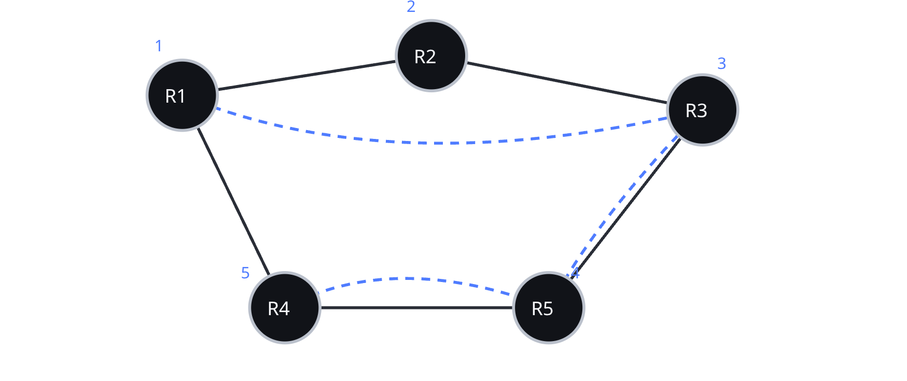
ROUTING VS FORWARDING
Routing decides the path; forwarding moves the packet
PATH DECISION
Routing
Which path should reach the destination?
R1 → R3 → R5
The selected route uses the minimum-cost path for this example.
07
SPL-1 / NETWORK SIMULATOR
Notes:
Separate two ideas that are often blended together. Routing computes or selects a path. Forwarding executes the next step using stored information.
For R1 to R5, the example route is R1 → R3 → R5. Once the route is selected, R1 consults its routing table and forwards the packet to R3.
At R3, the next hop is R5. The packet reaches the destination after two forwarding moves.
Advisor follow-up: “Does every router rerun Dijkstra for every packet?” Answer: No. The simulator stores next hops in routing tables so forwarding can be represented as a local lookup.

Slide 6
ALGORITHM FIT
Algorithms and their purposes :
ALGORITHM | PROJECT PURPOSE | BEST FIT
BFS | Reachability and minimum-hop path | Unweighted levels
DFS | Topology exploration and connectivity analysis | Deep exploration
Dijkstra | Minimum-cost route in weighted graphs | Weighted paths
Search / sort | Lookup and statistics | Data handling
08
SPL-1 / NETWORK SIMULATOR
Notes:
Use the table as a decision guide rather than a list of definitions.
BFS is appropriate when the question is reachability or minimum number of hops. DFS is useful when the goal is deep exploration, connectivity, or failure analysis.
Dijkstra uses the weights and therefore answers a different question: which route has minimum cost?
Search and sort support lookup and statistics but are not route-finding algorithms in this project.
Advisor follow-up: “Why not use BFS for minimum cost?” Answer: BFS minimizes edge count, not weighted link cost. The two objectives can produce different paths.

Slide 7


THE PROJECT OVERVIEW:
Model the network
Route the packet
Recover from failure
Recover
Store
Simulate packet forwarding, failure, and route recalculation.
Route
Store next hops in routing tables.
Inspect
Use Dijkstra to compute minimum-cost routes.
Model
Use BFS and DFS to inspect reachability and topology.
Represent routers and links as a weighted graph.
Computer network → Graph → Route → Routing table → Forward packet → Fail a node/link → Recalculate → Continue.
SPL-1 / NETWORK SIMULATOR
02
Notes:
Walk left to right as the project’s complete loop. First the program represents the network, then it inspects and routes through it.
Clarify that the graph is weighted because links carry costs. BFS and DFS inspect structure; Dijkstra chooses a minimum-cost route.
Next-hop data becomes a routing table, which supports forwarding one hop at a time.
Advisor follow-up: “What happens after a failure?” Answer: The simulator marks a node or link unavailable, recalculates the route, and continues the simulation where possible.

Slide 8
Thank You All !.
SPL-1 / NETWORK SIMULATOR
11

