Slide 1
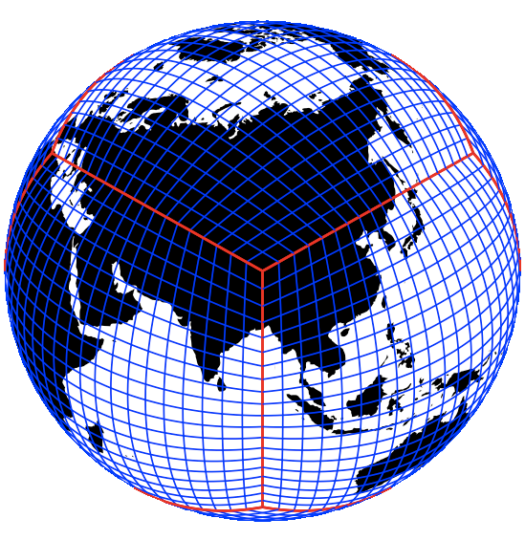


Extreme Weather Analysis (Output)
Climate Data
NEX
Extreme Weather Pipeline
Pre-Processing
[TempestRemap, NCO]
Detection and Characterization
[TempestExtremes]
Post-Processing
Statistical Analysis
Grid Metadata

