Slide 1

Accelerate your C++ development with Visual Studio 2019
Erika Sweet @erikasweet_
Marian Luparu @mluparu
C++ Team @visualc
Questions? #VS2019

Slide 2
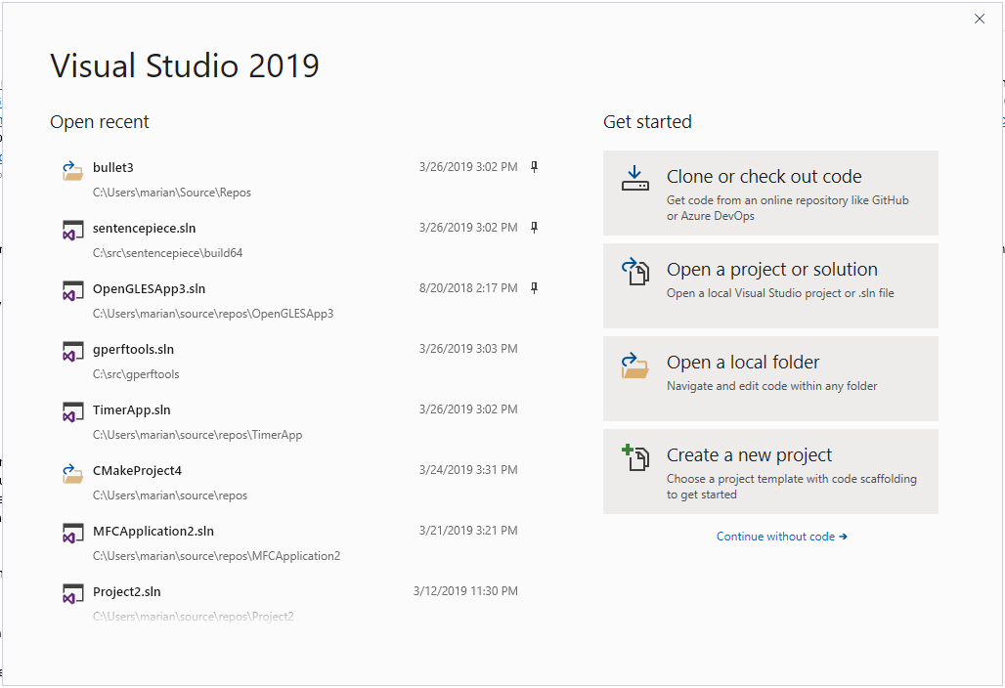
👋 Visual Studio 2019 start window

Slide 3
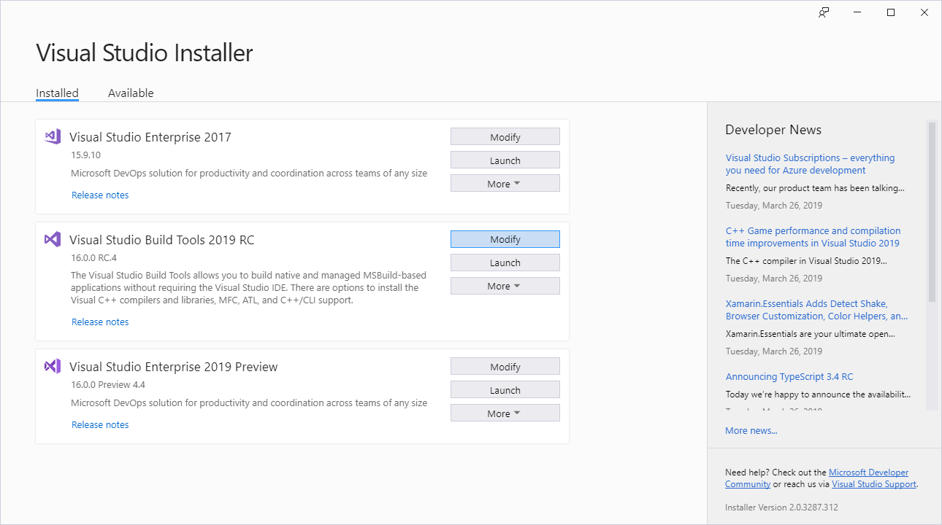
Pain-free upgrades
Learn more at https://aka.ms/cpp/upgrade/2019
Install the latest IDE side-by-side with your current one

Slide 4
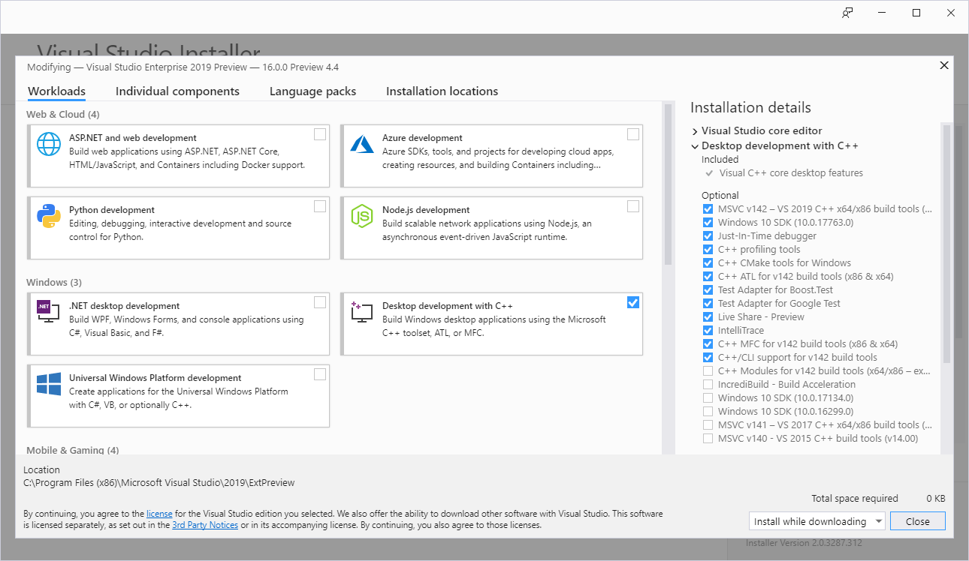
Pain-free upgrades
Learn more at https://aka.ms/cpp/upgrade/2019
Install the latest IDE side-by-side with your current one
Use any MSVC toolset inside the Visual Studio 2019 IDE
🔍

Slide 5
Pain-free upgrades
Learn more at https://aka.ms/cpp/upgrade/2019
Install the latest IDE side-by-side with your current one
Use any MSVC toolset inside the Visual Studio 2019 IDE
Maintain binary compatibility with 3rd party binaries when you upgrade to the latest MSVC toolset
2017
2017
2015
2019
2017
2015

Slide 6
Pain-free upgrades
Learn more at https://aka.ms/cpp/upgrade/2019
Install the latest IDE side-by-side with your current one
Use any MSVC toolset inside the Visual Studio 2019 IDE
Maintain binary compatibility with 3rd party binaries when you upgrade to the latest MSVC toolset
Access the full collection of OSS libraries available in Vcpkg
C:\src> git clone https://github.com/Microsoft/vcpkg.git & cd vcpkg
C:\src\vcpkg> .\bootstrap-vcpkg.bat
C:\src\vcpkg> .\vcpkg install curl

Slide 7
New MSVC toolset version 19.20
Conformance
Runtime performance
Code Analysis
Build throughput

Slide 8
Learn more at https://aka.ms/cpp/conformance
✅ C++98 complete under /permissive-
✅ C++11 complete
✅ C++14 complete
✅ C++17 under /std:c++17
Compiler feature complete
Most complete standard library implementation
☑ C++20 partial support under /std:c++latest
Coroutines (partial support) under /await
Modules (partial support) under /experimental:module
<=> three-way comparison operator (partial support)
Feature-test macros
remove_cvref
Prevent aggregate-init with user-declared or deleted constructors
Conformance
Runtime performance
Code Analysis
Build throughput

Slide 9
Linker improvements
Learn more at https://aka.ms/cpp/throughput
Debug info pruning in compiler
Type and global symbol hash improvements in PDB
Conformance
Runtime performance
Code Analysis
Build throughput
Unreal Engine-based AAA game title, link time (measured in sec)
Debug build configuration | VS 2017 (15.9) | VS 2019 (16.0) | Speedup
/DEBUG:full | 392.1s | 163.3s | 2.40x
/DEBUG:fastlink | 72.3s | 31.2s | 2.32x

Slide 10
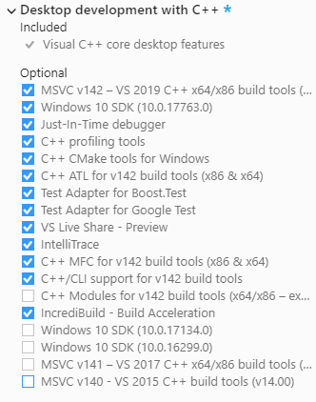
Accelerate with IncrediBuild
Learn more at https://aka.ms/cpp/ib
Speed up your local builds for free for up to 16 cores!
Sign-up to try distributed builds
Conformance
Runtime performance
Code Analysis
Build throughput

Slide 11
Conformance
Runtime performance
Code Analysis
Build throughput
Unreal Engine Infiltrator demo
Frame duration %age improvement | VS 2019 vs. VS 2017
Average | 0.7%
Largest | 2.8%
More optimizer improvements in release mode
Augment SSA optimizer to understand vector (SIMD) code
Control-statement optimization improvements
Improvements to memset generation
Additional removals of redundant copies
OpenMP SIMD extension - with /openmp:experimental
C++ exception handling data size is 60% smaller, leading up to ~20% binary reduction when heavy exceptions are used – with /d2FH4
More aggressive inlining than the default /Ob2 under /O2 – with /Ob3
Learn more at https://aka.ms/cpp/runtimeperf

Slide 12
New Code Analysis checks
Conformance
Runtime performance
Code Analysis
Build throughput
Concurrency checks
Use-after-move check off-by-default, part of C++ Core Check Experimental Rules
Coroutine checks
Lifetime profile checks off-by-default, part of C++ Core Check Lifetime Rules
Concurrency check example
bool HandleRequest(int Id, Request* request) { EnterCriticalSection(&cs_); if (cache_.find(Id) != cache_.end()) return false; // C26115: Failing to release lock 'this->cs_' in function cache_[Id] = request; LeaveCriticalSection(&cs_); }
Learn more at https://aka.ms/cpp/code-analysis

Slide 13
New MSVC toolset version 19.20
Conformance
Runtime performance
Code Analysis
Build throughput

Slide 14

Visual Studio 2019 One IDE for any developer, any app, any platform
Freedom to target any platform from one single IDE
Azure Sphere, ARM microcontrollers, Android, Cygwin/MinGW, iOS, Linux, UWP, Windows
Easy to get started
Keep your CMake/make/Ninja, No conversion to VS solutions, Easy C++ library acquisition
Continue to use your C++ tools of choice, all integrated in the IDE
Choice of LLVM/GCC/MSVC, Clang-format, CTest, Google Test, Boost.Test
Rich and familiar C++ code editing and debugging experiences
IntelliSense, Refactoring, Conditional breakpoints, Debug visualization, Just-my-code debugging

Slide 15
Demo
Erika Sweet

Slide 16
Productivity in Visual Studio 2019
Browse & Edit
Duplicate code with Ctrl + D
Add macro to hint file (quick fix)
ClangFormat support
Expanded macros in Quick Info
Macro to constexpr (quick fix)
IntelliSense in C++ templates
Live Share for C++
IntelliCode for C++
Improved Visual Studio search
Document Health indicator
Context menu for clipboard ring
Add missing #include (quick fix)
Add missing namespace (quick fix)
* to & / & to * (quick fix)
Go to Document on F12
NULL to nullptr (quick fix)
Commit
Improved branch switch performance
Git stash support
Compile
C++17 feature complete (except charconv)
Improved compile times
C++ 20 partial support
Diagnose
Single file code analysis
Just My Code debugging
Step Back debugging
Data breakpoints support in debugging tool windows
64-bit out-of-process debugger process
Code analysis running in background
New C++ Core Checker rules
Lifetime and Concurrency Check rules
Test
CTest, Google Test, Boost.Test support in CMake projects
Boost.Test Add > New Item template
Test Explorer hierarchical view
CodeLens support for unit testing

Slide 17
Q&A
Ask your questions on Twitter #VS2019
Follow us on Twitter at @visualc and on our C++ Team’s blog at https://aka.ms/cpp
Download Visual Studio 2019 from https://visualstudio.microsoft.com today!

