Slide 1
Lab Notebooks and Managing Computational Experiments
Anshu Dubey
(she/her)
Argonne National Laboratory
Software Practices for Reproducible Science tutorial @ ACM-REP 2024
Contributors: Anshu Dubey (ANL), Jared O’Neal (ANL)

Slide 2
License, Citation and Acknowledgements
License and Citation
This work is licensed under a Creative Commons Attribution 4.0 International License (CC BY 4.0).
The requested citation the overall tutorial is: Anshu Dubey and Gregory R. Watson, Software Practices for Reproducible Science tutorial, in 2024 ACM Conference on Reproducibility and Replicability (ACM-REP), Rennes, France and online, 2024. DOI: 10.6084/m9.figshare.26019469.
Individual modules may be cited as Speaker, Module Title, in Tutorial Title, …
Acknowledgements
This work was supported by the U.S. Department of Energy Office of Science, Office of Advanced Scientific Computing Research (ASCR), and by the Exascale Computing Project (17-SC-20-SC), a collaborative effort of the U.S. Department of Energy Office of Science and the National Nuclear Security Administration.
This work was supported by the U.S. Department of Energy, Office of Science, Office of Advanced Scientific Computing Research, Next-Generation Scientific Software Technologies (NGSST) program.
This work was performed in part at the Argonne National Laboratory, which is managed by UChicago Argonne, LLC for the U.S. Department of Energy under Contract No. DE-AC02-06CH11357.
This work was performed in part at the Lawrence Livermore National Laboratory, which is managed by Lawrence Livermore National Security, LLC for the U.S. Department of Energy under Contract No. DE-AC52-07NA27344.
This work was performed in part at the Los Alamos National Laboratory, which is managed by Triad National Security, LLC for the U.S. Department of Energy under Contract No.89233218CNA000001
This work was performed in part at the Oak Ridge National Laboratory, which is managed by UT-Battelle, LLC for the U.S. Department of Energy under Contract No. DE-AC05-00OR22725.
This work was performed in part at Sandia National Laboratories. Sandia National Laboratories is a multi-mission laboratory managed and operated by National Technology and Engineering Solutions of Sandia, LLC., a wholly owned subsidiary of Honeywell International, Inc., for the U.S. Department of Energy’s National Nuclear Security Administration under contract DE-NA0003525.

Slide 3
A minimal definition of a lab notebook
A goal of keeping a lab notebook is "...to write with enough detail and clarity that another scientist could pick up the notebook at some time in the future, repeat the work based on the written descriptions, and make the same observations that were originally recorded. If this guideline is followed, even the original author will be able to understand the notes when looking back on them after considerable time has passed!”
- Howard Kanare, Writing the Laboratory Notebook
Notes:
Module designed with the expectation that attendees have a basic idea of what a lab notebook is as well as some experience (e.g., in university lab classes).
This is just a moment to confirm this and understand the bare minimum of what a lab notebook should do. Put this up front so that people can relate slides to what they understand of lab notes.
Emphasize that this is mostly likely the base minimum. In this sense, the notebook is like a cookbook with a collection of recipes we want others to execute.

Slide 4
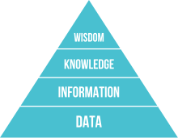
DIKUW
Data, Information, Knowledge, Understanding, Wisdom
A classification scheme that overloads everyday words so that we can use the same language and understand each other.
We will build on this to understand & appreciate
documentation & lab notebooks.
DIKW pyramid (unaltered) – Wikipedia/Longlivetheux
Notes:
Point out that if they search for this, they will find many pages. Those pages have changed over time – it used to be DIKUW, now it’s the DIKW pyramid. I don’t know much beyond this classification, but find the classification to be quite useful and don’t know why they exclude understanding now. I present my understanding and what I see as useful for the following discussion.
We won’t be defining these terms exactly as that is likely quite hard. We will go through examples to gain an intuitive understanding of these concepts.

Slide 5
Data & Information
Data
Collection of numbers, symbols, text, etc.
It has value only because it was recorded and exists.
Example: Timeseries representation of temperature, relative humidity, and precipitation.
Information
Facts gleaned from data.
Answers questions such as who, what, when, how much, how long, etc.
Example: Starting at 2pm the temperature dropped by 5ºF over 15 minutes. At 2:05 pm it started to rain and 0.25” of rain was accumulated over the next 30 minutes.
Notes:
My understanding is that data is *not* facts, as some claim. Rather, data can be flawed and noisy. Information is facts that are true relative to the potentially flawed data.
Data is valuable because it helps us make decisions.
Information is data made (hopefully) useful.

Slide 6
Knowledge & Understanding
Knowledge
Derived from information, experience, and understanding.
Example: When relative humidity levels are high and the temperature drops substantially, there is an increased probability of precipitation.
Understanding
A deep theoretical background in and practical experience with the system whose data was acquired and studied?
The ability to explain why?
“Understanding is a kind of ecstasy” – Carl Sagan
Example: A meteorologist could explain at different levels of detail how the atmosphere works to substantiate the knowledge.
Notes:
Knowledge is generated by a process in such a way that it is an educated best guess. But, it should be a solid and justifiable educated guess. In this sense, it is not true but our best current guess at what is true.
I didn’t use the given timeseries information to derive this knowledge. Someone with understanding of meteorology did. They have a deep understanding derived from years of study and experience. However, that person presented and communicated the knowledge for consumption by those without understanding.
If a person doesn’t have understanding they can speculate at what the knowledge should be. Hopefully having understanding can elevate the statement from speculation to knowledge because understanding can substantiate at a level required by other experts.
It’s hard to define understanding. I have just written down my best guesses.
When you go to school, are your teachers and professors putting understanding in your head or do they share knowledge and create an environment in which one can generate understanding?
Understanding is built on the shoulders of giants. You read an article that helps you generate understanding. But the author of that article generated it from understanding he or she developed from taking classes with other

Slide 7
Knowledge Management
DIKUW is related to knowledge management
We want to
Recognize when we generate knowledge
Capture and preserve that knowledge
Communicate that knowledge
Scientific work can benefit from knowledge management
Is knowledge communication only about communicating to others?
Notes:
Really most any project benefits from putting some thought into knowledge management.
The key is first to recognize when knowledge is generated. Once I became aware of this classification and began to think in terms of it, it became easier for me to recognize knowledge generation. It’s as if a bell goes off in my brain that indicates we need to record what was just said.
The answer to the question is ”clearly no”, We need to communicate to our future selves for the sake of productivity and reproducible research. Refer back to minimal definition of lab notebooks.

Slide 8
Example: Lessons learned
After we live through an experience, we want to derive lessons learned
Experience is valuable, more so if we reflect and are thoughtful
Generate/capture knowledge to grow, improve, and avoid difficulties/mistakes
Hope to improve understanding
We get more if we derive lessons learned together
Create more or higher quality knowledge
Communicate the knowledge implicitly
Should we communicate lessons learned to others?
Notes:
The point of this slide is to map the high-level, abstract concepts (which some might not like) onto a concrete example that we know & understand.
I believe that this is also known as debriefing.

Slide 9
Which leads us to documentation
Documentation is knowledge communication & can build understanding
Data at the bottom. Knowledge as we move up?
Some documents frozen at creation. Others are living.
Does this capture how hard it is to do documentation in a distributed, digital world?
Notes:
Documentation is capture, preserve, & communicate
Not all documents are alike.

Slide 10
And finally, we reach our destination
Lab notebooks are
A fundamental part of communication as well as rigorous, reproducible science in a lab,
A common-place or required part of an experimental laboratory,
Populating a scientific “lab notebook” was an “automated” process at the observatory,
A tool for preventing scientific fraud, and
Record of invention and defending against allegations of fraud.
Lab notebooks
Should be used regularly,
Should be comprehensive and never filtered,
Don’t need perfect grammar and full sentences,
Content is frozen at creation, and
Hopefully contains more than just data (e.g., motivation, reasoning, conclusions).
They aren’t good at communicating knowledge, but
people interact, evolve, and grow by collaborating through the notebook.
Notes:
Automated is in quotes because the TIOs and astronomers still needed to input information into a system. But there was a process for them to input such data into tools that aggregated their input with other notes.
Relate back to minimal lab notebook definition. We want more that just a cookbook.
Notebooks serve as implicit communication

Slide 11
Example notebook entries
A better example
Monday July 25, 2022 (Jared)
9:05 am - Continuing work for study ABC. (See July 7)
- I presently believe that if A happens, then B must also happen.
- To verify this, I intend to
…
***
9:30 am - Started executing this experiment on Bebop.
Built debug version of binary with Intel 20.4
Based on clean commit 5a43b21c
Build log saved to my_test_2022.log
No errors or warnings emitted
Used job script run_my_test with configuration 24 (Job ID 123456)
Stdout/err & results saved in folder ABC
10:07 am - Analysis run with script analyze_my_test.py and results saved in same folder.
- Since no peak seen around 1.5 MeV, I was wrong. But based on this, I now believe that if A happens, then C must also happen.
A bad example
Monday July 25, 2022
9:05 am - Do study ABC
8:47 pm - Lot’s of interesting data!
- Results are in GCE
Notes:
Bad example is not at all comprehensive. Imagine if we have three different researchers acquiring data and taking no notes or just these notes. How can you stitch the whole data set together at the time much less at a later time?
Doesn’t need to be exhaustive. I can just leave myself some bread crumbs with the expectation that writing notes is easier, but recreating notes could be time consuming should I ever need to do so.
Are the bread crumbs enough? Can they determine what flags are implied by debug version? What about the full SW stack? What about the SW stack for the analysis? Is such detail needed for this stage of work and if not, is that filtering?
Note that the build logs are acting as lab notes.
Note also, that we could have included git information in the build logs to make things simpler.
We likely should have included a graphic that points out missing peak. Annotating the graphic with what was expected would be nice.
The better example is also not great.

Slide 12
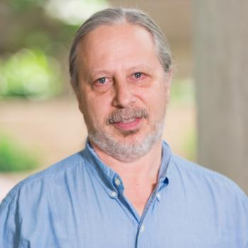
Conversations with Carlo
Carlo Graziani is a Computational Scientist at ANL
BSSw blog article HPC and the Lab Manager
As researchers’ careers progress
The problems become more complex and larger
Previous informal techniques for executing a study start to fail
The researchers' sense that something is missing
They invent processes and tools to compensate
This happened to Carlo and at some point, he realized that
“I had re-invented the lab notebook!”

Slide 13
Not all lab notebooks are alike
Lab notebooks to record work done on instrument
Lab notebooks to record acquisition of data
Pull Request as filtered lab notebook – higher up the hierarchy
PR allows for additional content that’s distinct from the individual commits
Flash-X PR #247 is example
Record process to verify correctness of changes
2-2.5 days effort carried out over a week
Copy/pasted from previous PR and adapted first (designed process)
Improved as I carried out process – converging on a quasi-procedure
Filtered so that reviewers aren’t overwhelmed
Helped me organize effort & design good tests
Senior reviewers provide feedback & suggest improvements
Junior reviewers exposed to work habits of other people

Slide 14
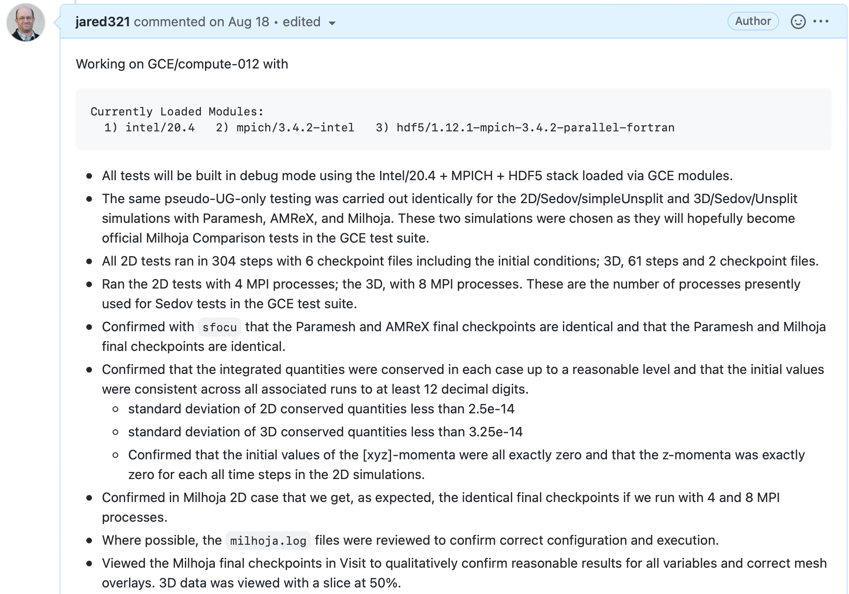
Example: Flash-X
PR #247

Slide 15
No one likes writing lab notes…
We love to consume documentation; write it, not so much.
Optimistic
Lack of experience
Lack of training
Lack of appreciation
Lack of incentives
Cynical
We want and appreciate when others share knowledge with us.
We don’t want to take the time to capture, preserve, and communicate knowledge we generate.
One aspect of productivity
One person decreases their short-term efficiency so that many (and the team) achieve long-term efficiency and quality.
Notes:
Procedures – someone with understanding writes down a recipe so that someone with knowledge can execute it.
How about, "I went into science because I hated English. Now you're telling me my English teacher was right?"

Slide 16
Nothing beats good ol’ pen and paper
“Since at least the 1990s, articles on technology have predicted the imminent, widespread adoption of electronic laboratory notebooks (ELNs) by researchers. It has yet to happen — but more and more scientists are taking the plunge.”
- Roberta Kwok, How to pick an electronic laboratory notebook, Nature
Pen & Paper Pros
Electronic Woes
Most can use paper and pen in any situation
Open format can allow for creativity and easier annotation
Concentrate on the work rather than tooling
Good if notetaking slows down progress
Notebook is stored publicly next to where it is used
Tied to technology that could fail
Overwhelming variety of possible solutions with different pros and cons
Uncertainty about future of tool, increased costs, inability to export
Does funding restrict where and how digital notes can be stored?
Notes:
Don’t say so much about paper & pen since it won’t work. This will save time. Still worthwhile saying why paper & pen is good.
Emphasize how difficult it is to choose the solutions and that clearly, then, each team will need to figure out what they need to use.
Need to find a solution that, among other things, makes it as easy as possible to write notes. Especially important since no one likes writing lab notes…

Slide 17
Criteria for lab notebooks for computing?
Paper won’t work. We work anywhere and sometimes in distributed way.
Should notebooks be public and how to do that?
How many different types of notebooks do we need?
Do we use a single ELN or distribute notes across a suite of tools?
How can we use automation appropriately to overcome difficulties and increase productivity?
We likely need many streams of lab notes

Slide 18
Different streams of lab notes
Lab notebook for changes to scientific instrument
Changes in code repo necessary for study
Changes to SW environments
Changes to build/job files and build systems
Lab notebook for data analysis tools
Lab notebook to detail how experiment was designed and executed
Right tool for the job
We don’t want a single 10,000-line README

Slide 19
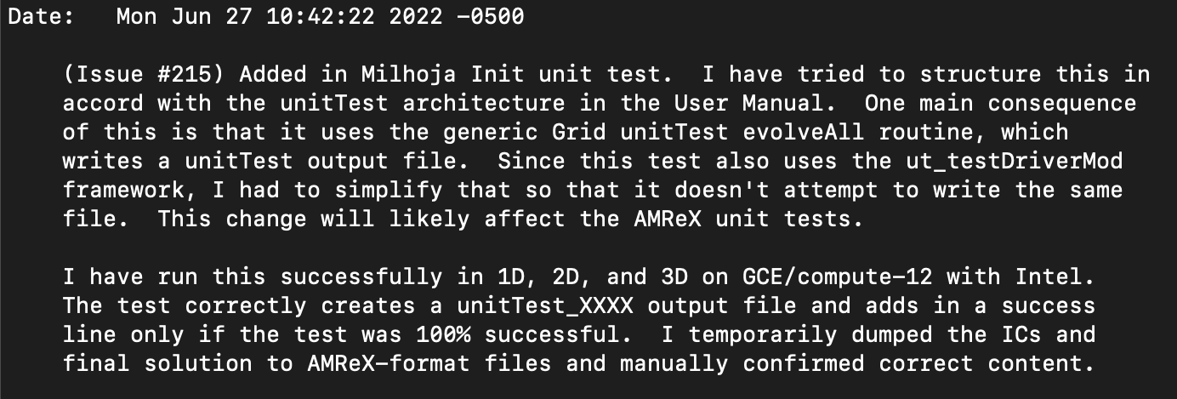
Git lab notes stream
Keep lab notes for your software as close to the “instrument” as possible
Details not obvious from commit diff:
Motivation, reasoning, consequences
Testing notes
*This message is missing a title as the first line.
Use Pull Request to capture final verification streams

Slide 20
README lab notes streams
High-level road maps with motivation, documented decisions, and conclusions
Concise living docs that function as executive summaries
Higher up in documentation hierarchy
Low-level notes such as managing software stack
Traceability of SW environment & therefore verification
Can be turned into procedures

Slide 21
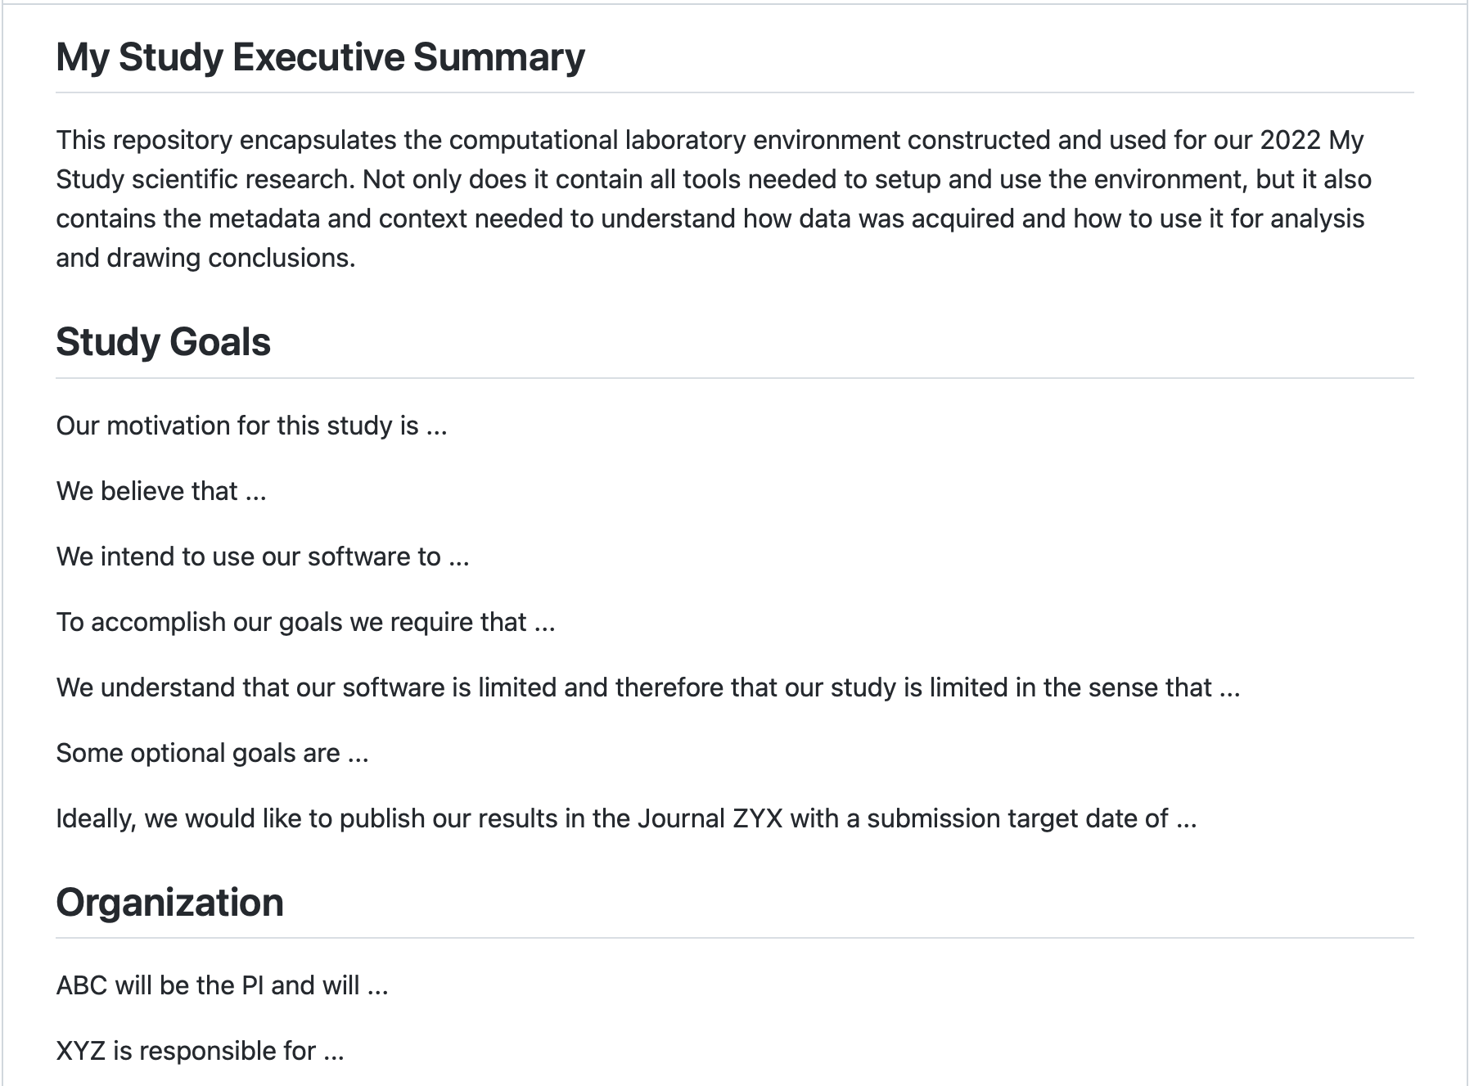
High-level README

Slide 22
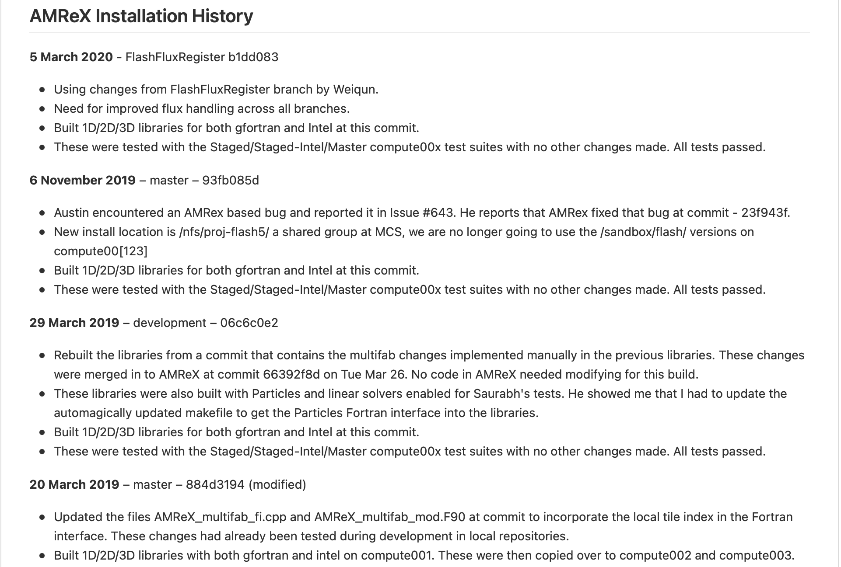
Low-level README

Slide 23
Capturing data context & metadata
Automate as much as possible
Build dates, user, system name, git hashes, configuration data in file headers
Self-documenting files
Build & job logs
Software environment info (e.g., modules, ldd output)
git diffs
Environment variables

Slide 24
Jupyter notebooks
The exception to the rule?
Jupyter notebook can put context & metadata next to data
High-level design & motivation up top
Low-level lab notes for acquiring data
Load & use data
Generate visualizations in place
Comment on results
Where do notebooks fit into the documentation hierarchy?
Repetitive use of notebook?
Limit amount of code in notebook

Slide 25
How to organize your “virtual” (multi-stream) lab notebook?
It should be
Easy to create and maintain lab notes
Easy to concentrate more on executing work & less on documenting it
Easy to find what you need
Each stream should
Have a clear identity for what it records
Not contain notes contained in other streams
Be recorded by using the right tool for the job
This implies the need for a documentation scheme.
I design my lab notebooks into a larger execution environment.

Slide 26
Experimental laboratory environment
In an experimental lab,
Have all my tools at hand, clean, and ready for use,
Know how to use my tools,
Fully characterized and configured instrument,
Understand broken or underperforming instrument performance, and
I want to take comprehensive lab notes quickly and easily.
The Goal
Concentrate on acquiring data, analyzing the data, drawing conclusions, designing next steps, and recording the work for reproducibility.

Slide 27
Computational laboratory environments
Use many simple, minimal lab environments
Tailor formality, complexity, and automation to each use case
Store context & metadata next to data
Each code repository has dedicated test environment
One environment per scientific study
Each developer can have dedicated development environment (optional)
Environments are encapsulated
Dedicated documentation
Dedicated software environments
Can be updated and managed independently
“Store on a shelf” for later

Slide 28
Know your tools / Right tool for the job
Experimental World
What is the tool’s intended use?
How does the tool work?
Will this damage the tool?
Will this damage the work piece?
Will I get a better result if I use a different tool?
Will a different tool be more efficient?
Computational World
If a function has 10 optional variables, you should know what each does and set each one.
If you design a library, make sure that users can learn how to use your tool.
Is it OK to use high-level productivity tools blindly?
Notes:
I have heard of cases where documentation refer to an article to help explain role of ”optional” arguments, but that article doesn’t help.
If designing a library, shoot for making interface as mature as possible as quickly as possible so that users don’t have to keep updating their knowledge of how to use the tool or worse aren’t aware that they need to relearn how to use the tool.
Mention Spack/containers last as this leads into next slide. Should you only be able to use a container or Spack once you have understood all pitfalls associated with setting up a SW environment? Should you only be able to use a container built and maintained by another person after you have learned to build and maintain a container yourself? This is analogous to the idea of an apprenticeship. When someone wants to work with metal, they might be given a chunk of metal and metal file. Their job is to work until they turn it into a cube with just the file. After that, they can use more sophisticated tools.
Would such an experience help you learn about pitfalls as well as what tools to use to sanity check an env/container?

Slide 29
Measure twice, cut once
Experimental World
Some actions are not reversible
Slow down!
Think before you act
Don’t waste materials
Don’t waste time & effort
Computational World
Do appropriate level of planning
Don’t waste energy
Don’t waste core hours
Don’t produce bad data
Long-term efficiency
Maximize scientific impact
Notes:
Anshu works off of this later. Don’t enter into too much detail here so that she can expand upon it in a more appropriate portion of the talk.
Motivation is using telescopes at night for technical study. People let me know before hand that it costs 50 kEuros/hour to run telescope. Not so subtle hint to make sure that I not only knew that I could use the telescope/instrument to gather data but that I could maximize the use of the telescope and data to get maximal impact. After using the telescopes a few times, I started to figure out what was “appropriate” level of planning. For example, I would do dress rehearsals during day. This should sound like using ALCF or OLCF.
Bronson informed me that using Summit costs ~$90k/hour.

Slide 30
Clean your workspace Last 15 minutes of workday is for cleaning
Experimental World
Leave a safe and clean area
Don’t lose tools or equipment
Prevent damage to tools & equipment by others
Respect your tools & clean them
Leave equipment in obvious state
Computational World
Write good commit messages
Maintain issues, PRs, & docs up-to-date as you work
Don’t leave clones in undocumented intermediate state
Communicate bugs & errors explicitly and obviously
Notes:
When I am switching from one project to the next, I dump the state of my brain in an Issue or PR and make/update a checklist of next steps to be done so that when I come back to the project, I can hit the ground running.

Slide 31
Experimental laboratory environment
In an experimental lab,
have all my tools at hand, clean, and ready for use,
know how to use my tools,
fully characterized and configured instrument,
understand broken or underperforming instrument performance, and
I want to take comprehensive lab notes quickly and easily.
The Goal
Concentrate on acquiring data, analyzing the data, drawing conclusions, designing next steps, and recording the work for reproducibility.
Notes:
Instrument characterized and configured so that I know that I am collecting the correct data and so that I know how to use the data appropriately
Again, easier to do when I am in the same environment every day and it is under my control.
This is where we can talk about observatory environment in which we just want to EXECUTE a study. It is an operational environment. Everything is ready to go and we only concentrate on the task at hand. If you are making big, decisions that require thought, something has gone deeply wrong. From here forward, try to enforce that we are creating an operational environment for executing science.
Use Carlo’s quote “in-flight airplane repair.”
Also, if something is broken or underperforming, we need to communicate this to others explicitly and clearly.

Slide 32
Computational laboratory environments
Use many simple, minimal lab environments
Tailor formality, complexity, and automation to each use case
Store context & metadata next to data
Each code repository has dedicated test environment
One environment per scientific study
Each developer can have dedicated development environment (optional)
Environments are encapsulated
Dedicated documentation
Dedicated software environments
Can be updated and managed independently
Notes:
Let’s say that I want to execute a study on the same system on which I have built up testing. Can the study just use the external dependencies built up for testing? Bad idea if the people who manage the tests aren’t involved in the study. They might update the libraries without my knowledge in the middle of my study. More work, but cleaner with obvious ownership and less communication/coordination needed.
As an example, we want the test environment to be well-structured and setup, with good documentation, clearly defined processes for managing the environment. This cannot fail and its management is part of scientific rigor.
A similar statement can be made for studies, but these can be simpler because each study will eventually end and therefore doesn’t need to be used continuously and be maintained.
Development environment is potentially the least demanding and can be setup in accord with a particular person’s work style and expertise.

Slide 33
A system of repositories
Each environment is encapsulated in an individual repository
Some complexity transferred to interconnecting repositories
Systems of repos exist & seem to be increasingly common
Oval size indicates
environment size/complexity
Notes:
I see this more and more as projects grow and tasks grow more complex.
We are working on complex problems. We cannot make complexity disappear, but we can try to transfer to areas where we are capable of managing the complexity well and with confidence. If people believe that they have made the complexity disappear, then more likely than not, they do not appreciate that they have moved the complexity elsewhere. An example to work up here is Spack. We can move the complexity of constructing and managing SW stacks out to modules and spack. Here we have transferred the complexity to a team of experts that we trust (i.e., the spack development team as well as platform management team that installs modules for us). In this sense, the complexity still exists, but at the larger scope of the HPC community rather than at the level of a research team.

Slide 34
Constructing computational lab environment Start from the bottom
File storage, protection, maintenance, & sharing
Try to avoid deep folder structures & long names
Construct software environments
File management tools
Compilation & libraries (e.g., Spack env)
Data analysis tools (e.g., python virtual env)
Platform-specific build systems
Platform-specific job scripts
Testing, verification, & validation
Analysis tools
Documentation infrastructure, & workflow
Article infrastructure
Build, test, & officially verify.
Don’t alter or update afterward.
Notes:
When mentioning that we do this upfront effort to avoid ”inflight airplane repair”, EMPHASIZE that you’ll never be perfect. That will likely happen every now and then. You just hope that it happens less frequently and is less catastrophic. Also, that it’s likely a bad idea to over design your environment to absolutely avoid this. This is necessary to mesh better with what Anshu said on slide 19.
SW env should prefer platform-specific, expert—built modules, then Spack, then hand-built dependencies.
Motivate folder structure naming convention in terms of observatory. Good tools allow for simple and cleaner file management.
Is the bottom-up approach a variant of data-driven design? My prime goal is to save all data
Is this also a case of slowing me down helps me identify unappreciated difficulties and subtlties?

Slide 35
Documentation
We don’t want a single 10,000 line README
Lab notebook for changes to sci instrument
Changes in code repo necessary for study
Changes to SW environments
Changes to build/job files and build systems
Lab notebook for data analysis tools
Lab notebook to detail how experiment was designed and executed
Right tool for the job
Need flexibility to structure data and documentation in repo

Slide 36
Documentation: READMEs
High-level road maps with motivation, documented decisions, and conclusions
Concise living docs that function as executive summaries
READMEs distributed through folder structure
Each sub-experiment has its own README?

Slide 37
Documentation: Version control tools
Locate lab notes associated with code “next” to the instrument
Commit messages
Issues to capture design discussions & requirements?
Pull requests to document code review, verification/validation, etc.?

Slide 38
Documentation: Data context & metadata
Automate as much as possible
Build dates, user, system name, git hashes, configuration data in file headers
Self-documenting files
A lot of this comes from build & job logs
Software environment info
git diffs
Environment variables

Slide 39
Documentation: Jupyter notebooks
Jupyter notebook can put context & metadata next to data
High-level design & motivation up top
Low-level lab notes for acquiring data
Load & use data
Generate visualizations in place
Comment on results
Figuring how to structure work into notebooks helps structure lab env
Where do notebooks fit into the documentation hierarchy?

Slide 40
Is this working?
Work in progress (and always will be)
Used for different types of studies across different projects
I’m not the only one
2018 BSSW Fellow Ivo Jimenez
Popper tool for implementing scientific exploration pipelines that yield reproducible results
Aaron Lentner – George Washington University
FlashKit a high-level interface for helping users structure and manage research with Flash-X
For your exploration: Computational Lab Environment Example
Notes:
While these creators might not call their tools lab environments, I see them as analogous or trying to manage the same issues – create an environment/tool layer/workflow dedicated to EXECUTING work

Slide 41
So far we have talked about setting up the infrastructure that is needed to collect and analyze results.
We still haven’t talked about how to plan running the study/experiments
This section talks about preparing for a successful simulation campaign

Slide 42
So far we have talked about setting up the infrastructure that is needed to collect and analyze results.
We still haven’t talked about how to plan running the study/experiments
This section talks about preparing for a successful simulation campaign
Running simulations at large scales for science discovery is more of a craft and less of science. More than any other aspect of computational science it relies on experience and acquired wisdom that helps one develop a nose for fruitful possibilities.

Slide 43
Why do you need to plan?
Machines are expensive and rare resources
Operating them is also very expensive
If you made a mistake in your input parameters and got garbage results on a large scale run, you just wasted hundreds of thousands of dollars
Many people are competing for these resources
Your wasted run is likely to be either your or someone else’s opportunity lost
You are likely charting new scientific territory
Some aspect of using your code may not have been important before, but may become critical in the new study
Some solver may run up against the limits of its validity
Inflight correction may be needed to parameters to continue with the study

Slide 44
Why do you need to plan?
Machines are expensive and rare resources
Operating them is also very expensive
If you made a mistake in your input parameters and got garbage results on a large scale run, you just wasted hundreds of thousands of dollars
Many people are competing for these resources
Your wasted run is likely to be either your or someone else’s opportunity lost
You are likely charting new scientific territory
Some aspect of using your code may not have been important before, but may become critical in the new study
Some solver may run up against the limits of its validity
Inflight correction may be needed to parameters to continue with the study
Aim for no surprises, but be prepared for them

Slide 45
Why do you need to plan?
Machines are expensive and rare resources
Operating them is also very expensive
If you made a mistake in your input parameters and got garbage results on a large scale run, you just wasted hundreds of thousands of dollars
Many people are competing for these resources
Your wasted run is likely to be either your or someone else’s opportunity lost
You are likely charting new scientific territory
Some aspect of using your code may not have been important before, but may become critical in the new study
Some solver may run up against the limits of its validity
Inflight correction may be needed to parameters to continue with the study
Aim for no surprises, but be prepared for them
In the 2005 simulation mentioned earlier, out of 5 teams, ours was the only team that had success in getting a good science outcome

Slide 46
How do you plan
Focused verification of the target simulation on the target platform
Over and above regular testing
Emphasis on understanding solver validity regime
Pathfinder runs to get a good estimate of needed resources
Cost benefit analysis of fidelity vs reaching science goals in allocated resources

Slide 47
How do you plan
Develop helpful diagnostics
Low overhead ways of confirming the health of the run
Are conserved quantities conserved?
Has any quantity become unphysical?
Develop hierarchy of analysis
Full analysis of runs is not feasible in flight
Intermediate level analysis can give further insight into health of the simulation
Notes:
Comment about making sure that your diagnostics actually flag errors.

Slide 48
Story of one simulation campaign
Theory of Type Ia supernova explosion – 2006/2007
Evidence from observations:
Light curve powered by Ni56 decay
Evidence of medium weight elements, but in much smaller quantities
Implied transition from deflagration to detonation
A 2D exploratory run had given a tantalizing answer to how?
To confirm a full 3D run was needed at good enough resolution
It would be the largest run of its kind at the time – totally uncharted territory
Until then 3D runs had been octants relying on symmetry
The 2D run had shown that symmetry had to be avoided

Slide 49
Preparation Steps
Step 1 – develop a test that represents the most complex physics interactions
Challenges:
Features take a long time to develop
Want to ensure that at least one refinement step occurs during the test
IO too slow to restart from a large checkpoint at late stage of the run
Also test would need a large chunk of the machine
Use physics understanding to create initial conditions that would quickly develop comparable complexity

Slide 50
Preparation Steps
Step 2 – Use the new test to characterize the performance behavior of the target platform
Motivation:
Standard performance studies could not give crucial information
AMR refinement patterns make each application different
Interoperability and trade-off opportunities needed to explored in a closely resembling simulation behavior
Full fidelity 2D runs, and a set of runs of the new test provided enough information to extrapolate and estimate needed CPU hours

Slide 51
Preparation Steps
Step 3 – Look for trade-offs and optimization opportunities
Motivation:
Initial CPU estimates too high to complete the runs within allocations
Exploration of any parameter space needs to minimize individual run times
Many opportunities were found, documented in reference below.
Identify redundant refinement and get rid of it
Coarsen computations for some physics
Move some computations to post-processing
All optimizations were based on scientific and numerical intuitions
Dubey A, Calder AC, Daley C, et al. Pragmatic optimizations for better scientific utilization of large supercomputers. The International Journal of High Performance Computing Applications. 2013;27(3):360-373. doi:10.1177/1094342012464404

Slide 52
Preparation Steps
Step 4 – Prepare diagnostics and quick analysis mechanism
Examples-- diagnostics
Conservation of mass, momentum energy
Changes in dt recorded in the logfiles
Spikes in variable values
Examples – quick analysis
Quick visualization of random 2D slices
Inspection of critical quantities in 1D

Slide 53
Preparation Steps
Step 4 – Prepare diagnostics and quick analysis mechanism
Examples-- diagnostics
Conservation of mass, momentum energy
Changes in dt recorded in the logfiles
Spikes in variable values
Examples – quick analysis
Quick visualization of random 2D slices
Inspection of critical quantities in 1D
Lab notebook artifacts
every run registers all configurations and runtime parameters in a logfile.
logfiles are cumulative
dedicate space for storing all results in a preconfigured directory structure
scripts to move output from scratch to the dedicated space

Slide 54
Outcome
A successful campaign
But not without hitches
Optimization related runs were not given the same level of care
Data was considered disposable
Code changes were documented

Slide 55
Outcome
A successful campaign
But not without hitches
Optimization related runs were not given the same level of care
Data was considered disposable
Code changes were documented
For the paper the referee asked for details from optimizations
We did not have them
Fortunately the referee was satisfied with reasoning and other supporting evidence we produced

Slide 56
Summary and Takeaways
Good science with computation is a craft -- training is needed in how to do it
Machines are expensive to build and expensive to run
They provide opportunity for great work
Care is needed to ensure that the outcome meets expectations
Reproducible results are a necessity, not a luxury
There is no credible science without provenance
"a parameter combination that induces erroneous results is easily selected“ - https://doi.org/10.1063/1.476021

