Slide 1
Improving Reproducibility Through Better Software Practices
David E. Bernholdt (he/him) Oak Ridge National Laboratory
Software Sustainability track @ Argonne Training Program on Extreme-Scale Computing summer school
Contributors: Akash Dhruv (ANL), David E. Bernholdt (ORNL), Anshu Dubey (ANL), Patricia A. Grubel (LANL), Michael A. Heroux (SNL), Jared O’Neal (ANL), David M. Rogers (ORNL), Gregory R. Watson (ORNL)
Additional thanks to: Juan Pablo Haddad, Steve Fickas, Carlo Graziani, Boyana Norris
Notes:
Originally a 45 minute talk, cut to about 30 by putting the Data Management Plans and Reproducibility after the summary and cutting the Psychology example and the 2 slides at the end, probably covered under testing.
To make this a 15 minute talk go through the initial examples and incentives quickly then cover the How to sections.

Slide 2
License, Citation and Acknowledgements
License and Citation
This work is licensed under a Creative Commons Attribution 4.0 International License (CC BY 4.0).
The requested citation the overall tutorial is: David E. Bernholdt, Software Sustainability track, in Argonne Training Program on Extreme-Scale Computing, St. Charles, Illinois, 2026. DOI: 10.6084/m9.figshare.33139910.
Individual modules may be cited as Speaker, Module Title, in Tutorial Title, …
Acknowledgements
This work was supported by the U.S. Department of Energy, Office of Science, Office of Advanced Scientific Computing Research, Next-Generation Scientific Software Technologies (NGSST) and Scientific Discovery through Advanced Computing (SciDAC) programs.
This work was supported by the U.S. Department of Energy Office of Science, Office of Advanced Scientific Computing Research (ASCR), and by the Exascale Computing Project (17-SC-20-SC), a collaborative effort of the U.S. Department of Energy Office of Science and the National Nuclear Security Administration.
This work was performed in part at the Argonne National Laboratory, which is managed by UChicago Argonne, LLC for the U.S. Department of Energy under Contract No. DE-AC02-06CH11357.
This work was performed in part at the Lawrence Livermore National Laboratory, which is managed by Lawrence Livermore National Security, LLC for the U.S. Department of Energy under Contract No. DE-AC52-07NA27344.
This work was performed in part at the Los Alamos National Laboratory, which is managed by Triad National Security, LLC for the U.S. Department of Energy under Contract No.89233218CNA000001
This work was performed in part at the Oak Ridge National Laboratory, which is managed by UT-Battelle, LLC for the U.S. Department of Energy under Contract No. DE-AC05-00OR22725.
This work was performed in part at Sandia National Laboratories. Sandia National Laboratories is a multi-mission laboratory managed and operated by National Technology and Engineering Solutions of Sandia, LLC., a wholly owned subsidiary of Honeywell International, Inc., for the U.S. Department of Energy’s National Nuclear Security Administration under contract DE-NA0003525.

Slide 3
Terminology
A few of the terms used when talking about this topic…
Reproducibility
Replicability
Reliability
Correctness
Accuracy
Transparency
Credibility
They don’t mean exactly the same thing…
…but for the purposes of this presentation, the differences don’t really matter

Slide 4

Reproducible vs Replicable: A Special Note
Historically different communities have defined these two differently
With the increased focus, there has also been an effort to unify the language
Consensus around the definitions of Claerbout, et al.
Others are in the process of switching their terminology to match, i.e., ACM
Reproducible: Another team is able to obtain the same result using the authors’ experimental environment
Replicable: Another team is able to obtain consistent results using a different experimental environment
doi:10.2172/1481626
doi:10.17226/25303

Slide 5

Why Reproducibility is Important
Notes:
Examples that resulted in disputed results
Additional Incentives
Ensure goals include credible science through better software
Limited resources
Data requirement plans for research
Reproducibility and transparency initiatives for publications

Slide 6
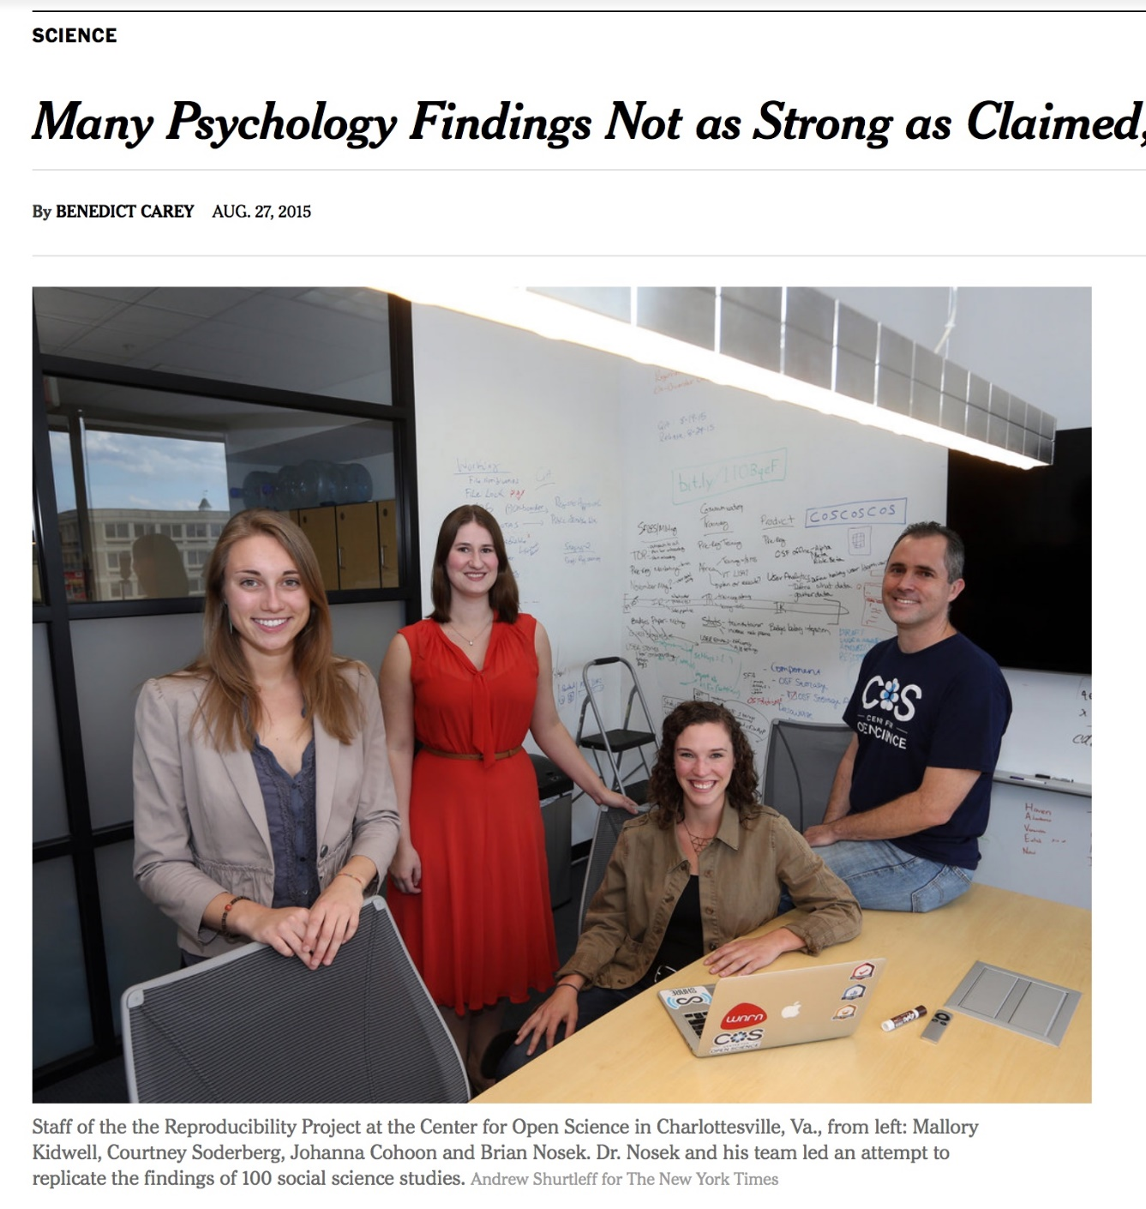
Transparency & Reproducibility
NY Times highlights “problems”.
Only one of many cited examples.
Computational science had been spared this “spotlight”.
http://www.nytimes.com/2015/08/28/science/many-social-science-findings-not-as-strong-as-claimed-study-says.html

Slide 7
Example: Behavior of pure water just above homogeneous nucleation temperature (~ - 40 °C/°F)
Debenedetti/Princeton (2009): 2 possible phases: High or low density
Chandler/Berkeley (2011): Only 1 phase: High density
“LAMMPS codes used in refs 5 and 12 are standard and documented, with scripts freely available upon request.”
Debenedetti tries to reproduce Chandler’s results, unsuccessfully
Debenedetti (with colleague Palmer) to Chandler: “Send us your code”
Chandler responded only after intervention by editor of Nature
Palmer identified a bug/feature in Chandler’s code: a change intended merely to speed up the code gave different results
Code was not actually “standard and documented”; paper was not reproducible
When replaced with a more standard approach, results matched Debenedetti’s
Took seven years to resolve!
Would testing have caught this?
doi:10.1063/PT.6.1.20180822a

Slide 8
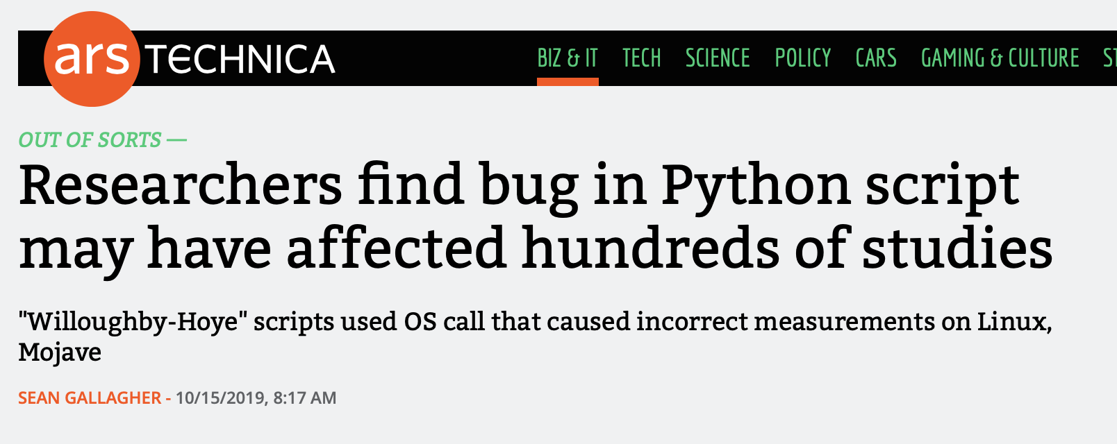
Example: Python Behaves Differently on Different Platforms
Scripts for analyzing experimental nuclear magnetic resonance (NMR) data
Scripts use Python's glob module (listing filenames matching a pattern)
Module ordered results differently in Linux and Mac Mojave
Results depended on the order in which files were processed
Casts doubt on results in 150 papers
Would testing have caught this?
https://arstechnica.com/information-technology/2019/10/chemists-discover-cross-platform-python-scripts-not-so-cross-platform/

Slide 9
Science through computing is, at best, as credible as the software that produces it!

Slide 10
Incentives for Paying Attention to Reproducibility
Common statement: “I would love to do a better job on my software, but I need to:
Get this paper submitted
Complete this project task
Do something my employer values more
Goal: Change incentives to include valuing of better software, better science
This is a long-term goal, requiring a culture change in (computational) science which is in the early stages

Slide 11
Funders and the Community Setting Expectations for Your Data (Including Your Software)
Data Management Plans
FAIR Principles for Research Software
Most research sponsors require data management plans as part of proposals
“Data” includes software (increasingly called out explicitly)
Example: NSF policy on Dissemination and Sharing of Research Results
Investigators can keep their legal rights over their intellectual property, but they still have to make their results, data, and collections available to others
Policies will be implemented via
Proposal review
Award negotiations and conditions
Support/incentives
How to make all research outcomes, including software, optimally reusable by humans and machines?
Findability
Software is described with rich metadata and a unique and assigned a persistent identifier
Accessibility
Metadata are retrievable by their identifier, even when the software is no longer available
Interoperability
Software exchanges data in a way that meets domain-relevant community standards
Reusability
Software has a clear license, detailed provenance, and meets domain-relevant community standards
Also FAIR Principles for Data

Slide 12
Increasing Attention on Reproducibility from Publishers
More publication venues are adding reproducibility recognition or requirements
ACM Replicated Reproducible Computational Results (RCR)
ACM TOMS, TOMACS
http://toms.acm.org/replicated-computational-results.cfm
ACM Badging
Functional, reusable, available, replicated, reproduced
https://www.acm.org/publications/policies/artifact-review-and-badging-current
These conferences have artifact evaluation appendices:
CGO, PPoPP, PACT, RTSS and SC
http://fursin.net/reproducibility.html
NISO Committee on Reproducibility and Badging
https://www.niso.org/niso-io/2019/01/new-niso-project-badging-scheme-reproducibility-computational-and-computing
Publishers: ACM, IEEE, figshare, STM, Reed Elsevier, Springer Nature

Slide 13


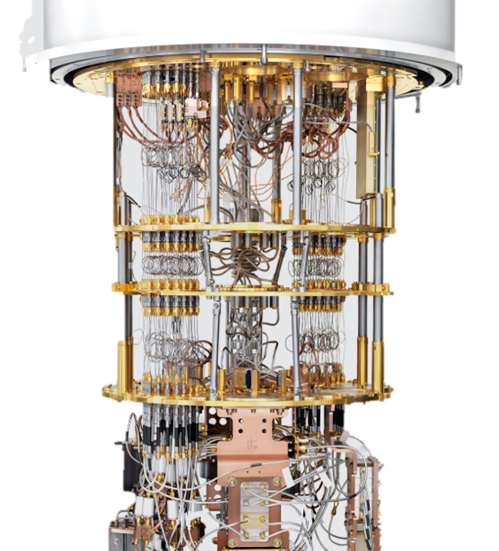
Increasing Attention on Reproducibility for Your Own Sake
Supercomputer cycles are scarce resources
No one wants to spend their precious allocation running simulations two or three times to be confident of the results
Though this ends up happening more than most people admit
And it could still be wrong!
But lots of people need to have confidence in your results
You
Your project lead or boss
Your sponsor
Your reviewers or referees
Your readers
Need to think about how to build credibility without repeating runs

Slide 14

How to Improve Reproducibility

Slide 15
Strategies for Improving Reproducibility During Development (1/3)
Solid versioning practices are fundamental to reproducibility
Version control of code, documentation, and other artifacts
Frequent commits (perhaps to a separate development branch)
Provide versioning information in key output(s)
Version numbers (i.e., semantic versioning) are useful, but when do you increment them?
Automatic identifiers (i.e., git commit hash) are less ambiguous, but may not be as meaningful
Is the code you’re building modified from the version in the repository? (Not often done in practice)
Maintaining documentation (and other artifacts) in sync with code
You’ll forget
Or you won’t have (make) time to go back to it

Slide 16
Strategies for Improving Reproducibility During Development (2/3)
Build in quality from the start
Define and follow coding standards
Not just code style
Expectations for kinds and extent of documentation, types and rigor of tests
Develop tests as you code
Write tests while the code is fresh in your mind
Test Driven Development (TDD) means write tests before code, then code to pass the tests
Require increasingly rigorous testing as the code becomes more “public”
Testing has costs, need to balance level of risk against cost of creating and executing tests
Also think about frequency of tests at different levels of cost (c.f. continuous integration)
Practice peer code review
Per commit – should meet standards, and be understood and judged correct by reviewer
Pair experienced reviewers with less experienced coders to help ensure quality
Retrospective if you have a lot of existing unreviewed code

Slide 17
Strategies for Improving Reproducibility During Development (3/3)
Understand the numerics of your code
Floating point numbers are just approximations to real numbers
Many numerical methods have “quirks” too
If you’re using reduced- or mixed-precision computations, carefully compare with full-precision versions
On paper during development of the algorithms
Maybe provide an alternative full-precision computational path
Consider the possible effects of non-determinism due to concurrency
Floating point calculations done in different order may yield different results
Maybe useful to have an option to force deterministic computation
Look for testing/verification methods that don’t depend on bitwise reproducibility
Know your error bounds and develop tests against them
E.g., conservation rules apply to many physical quantities
Consider consulting subject matter experts for help

Slide 18
Strategies for Improving Reproducibility After Development
Testing, testing, and more testing!
Add “regression tests”
If you fix a bug, add a test to make sure that bug doesn’t creep back in
Add more tests
Be creative
Think about common cases, then corner cases
Think about misuse (unintentional or intentional)
Think about synthetic tests with synthetic data
Think about low-cost tests that can be “always on” (even if they’re not so stringent)
Can you detect silent data corruption?
Test your third-party dependencies
Are your tools doing what you think they’re doing?
What if you’re using a new version?
How do you decide if it is okay to upgrade to a new version?
Test your tests!
Make sure tests fail when they’re supposed to!
Thoroughly verify the code
Does the code do what you intended it to do?
On all relevant platforms (compilers, hardware, etc.)
Test regularly
To identify and document where changes to the underlying platform change code behavior/results

Slide 19
Digression – “Physics” (or Math)-Based Testing Strategies
Use what you know (or can construct) about the model you’re studying to test its implementation
Synthetic operators with known properties
Spectrum (huge diagonals)
Rank (by construction)
Invariance principles
Translational, rotational, etc.
Physical symmetries
Mathematical symmetries
Conservation rules
Fluxes, energy, mass, etc.
…

Slide 20
Digression – Design by Contract Programming
Building testing into your routines
To complement, not replace, other testing
The interface to a routine can be thought of as a contract between caller and the callee (the routine)
What does the routine expect on input? preconditions
What does the routine guarantee at completion? postconditions
What does the routine leave unchanged? invariants
Given valid inputs (preconditions satisfied) a routine should guarantee valid outputs (postconditions satisfied, invariants maintained)
If the preconditions are not satisfied, the routine should return an error
Emphasize low-costs tests that can be always-on
May need to be able to switch enforcement of expensive tests on/off (but try not to!)
Making the contract explicit facilitates correct use of routines
Especially when routine is reused in another context
Especially by those not intimately familiar with them

Slide 21
Strategies for Improving Reproducibility by Planning Experiments
Develop hierarchy of analysis
Full analysis of runs is often not feasible while simulations are running
Intermediate level analysis can give further insight into health of the simulation
Perform pilot/test runs to build confidence in correctness, performance, scaling
Often useful to pursue an incremental/layered strategy
Ensure that you have the resources to store and/or analyze the outputs
What can you afford to archive?
What will you need to process and delete?
What will you need to process during execution or stream?
Plan your experiments thoroughly
If you’re in a team, designate one person to coordinate the experimental campaign
Know what you need (in the code, as inputs, as outputs to capture/analyze, etc.)
Know what to expect (in results, performance/cost, etc.)
How will you convince yourself that your results are trustworthy?
Develop helpful diagnostics
Low overhead ways of confirming the health of the run
Are conserved quantities conserved?
Has any quantity become unphysical?
Consider: use a lab notebook to keep track of all this planning: motivation, reasoning and decisions, consequences (more to follow)

Slide 22
Strategies for Improving Reproducibility During Experiments
Can you reproduce the code used for each and every experiment?
Three years later?
Use only well-defined versions of code (i.e., official “releases”, tags, etc.)
Separate ongoing development from science campaigns using separate branches
Main or development branches are often moving targets
Capture the exact version of the code used for each experiment
Is the code you’re building exactly what’s in the version control repo?
Don’t change versions during a related series of experiments (unless you have to)
Make changes only to the science branch
Reconcile the science branch changes with the development branch only after the science is done
If you have to change versions, know exactly what changed
Capture the exact version of the code used for each experiment
Use only versions of code that have been thoroughly verified
Continue to use regular testing to identify changes due to the underlying platform
E.g., compiler release introduces a new optimization that changes numerical results
Consider capturing version information of key libraries, compilers, and other dependencies used to build code
Not often done, in practice
Put this info into your lab notebook too!

Slide 23
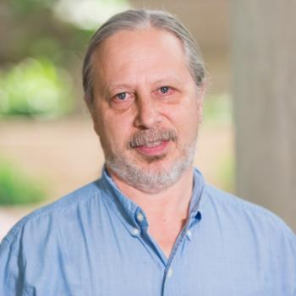
Conversations with Carlo
Carlo Graziani is a Computational Scientist at ANL
BSSw blog article HPC and the Lab Manager
As researchers’ careers progress
The problems become more complex and larger
Previous informal techniques for executing a study start to fail
The researchers sense that something is missing
They invent processes and tools to compensate
This happened to Carlo and at some point, he realized that
“I had re-invented the lab notebook!”

Slide 24
A minimal definition of a lab notebook
A goal of keeping a lab notebook is "...to write with enough detail and clarity that another scientist could pick up the notebook at some time in the future, repeat the work based on the written descriptions, and make the same observations that were originally recorded. If this guideline is followed, even the original author will be able to understand the notes when looking back on them after considerable time has passed!”
- Howard Kanare, Writing the Laboratory Notebook (emphasis added)
Notes:
Module designed with the expectation that attendees have a basic idea of what a lab notebook is as well as some experience (e.g., in university lab classes).
This is just a moment to confirm this and understand the bare minimum of what a lab notebook should do. Put this up front so that people can relate slides to what they understand of lab notes.
Emphasize that this is mostly likely the base minimum. In this sense, the notebook is like a cookbook with a collection of recipes we want others to execute.

Slide 25
Lab notebooks are…
A fundamental part of communication as well as rigorous, reproducible science in a lab,
A common-place or required part of an experimental laboratory,
Populating a scientific “lab notebook” was an “automated” process at the observatory,
A tool for preventing scientific fraud, and
Record of invention and defending against allegations of fraud.
Lab notebooks
Should be used regularly,
Should be comprehensive and never filtered,
Don’t need perfect grammar and full sentences,
Content is frozen at creation, and
Hopefully contains more than just data (e.g., motivation, reasoning, conclusions).
They focus on data and information more than knowledge and understanding, but
people interact, evolve, and grow by collaborating through the notebook.
Notes:
Automated is in quotes because the TIOs and astronomers still needed to input information into a system. But there was a process for them to input such data into tools that aggregated their input with other notes.
Relate back to minimal lab notebook definition. We want more that just a cookbook.
Notebooks serve as implicit communication

Slide 26
Example notebook entries
A better example
Monday July 25, 2022 (Jared)
9:05 am - Continuing work for study ABC. (See July 7)
- I presently believe that if A happens, then B must also happen.
- To verify this, I intend to
…
***
9:30 am - Started executing this experiment on Bebop.
Built debug version of binary with Intel 20.4
Based on clean commit 5a43b21c
Build log saved to my_test_2022.log
No errors or warnings emitted
Used job script run_my_test with configuration 24 (Job ID 123456)
Stdout/err & results saved in folder ABC
10:07 am - Analysis run with script analyze_my_test.py and results saved in same folder.
- Since no peak seen around 1.5 MeV, I was wrong. But based on this, I now believe that if A happens, then C must also happen.
A bad example
Monday July 25, 2022
9:05 am - Do study ABC
8:47 pm - Lot’s of interesting data!
- Results are in GCE
Notes:
Bad example is not at all comprehensive. Imagine if we have three different researchers acquiring data and taking no notes or just these notes. How can you stitch the whole data set together at the time much less at a later time?
Doesn’t need to be exhaustive. I can just leave myself some bread crumbs with the expectation that writing notes is easier, but recreating notes could be time consuming should I ever need to do so.
Are the bread crumbs enough? Can they determine what flags are implied by debug version? What about the full SW stack? What about the SW stack for the analysis? Is such detail needed for this stage of work and if not, is that filtering?
Note that the build logs are acting as lab notes.
Note also, that we could have included git information in the build logs to make things simpler.
We likely should have included a graphic that points out missing peak. Annotating the graphic with what was expected would be nice.
The better example is also not great.

Slide 27
No one likes writing lab notes
“Lab notes are a waste of time. I write notes but never use them.”
- Almost all newcomers to lab notebooks
This attitude comes from lack of experience & awareness
Good notes are implicit communication & sharing
Good notes can be turned into procedures
Lab notes become more useful as time passes
Our memory fades
It can take years before we see the benefit
The beneficiary is often our “future self”
Writing but not reading lab notes is a good thing
Lab notes are most useful when something has gone wrong
Notes:
Procedures – someone with understanding writes down a recipe so that someone with knowledge can execute it.
How about, "I went into science because I hated English. Now you're telling me my English teacher was right?"

Slide 28
Criteria for lab notebooks for computing?
Paper won’t work. We work anywhere and sometimes in distributed way.
Should notebooks be public and how to do that?
How many different types of notebooks do we need?
Do we use a single electronic lab notebook (ELN) or distribute notes across a suite of tools?
How can we use automation appropriately to overcome difficulties and increase productivity?
We likely need multiple streams of lab notes

Slide 29
Different streams of lab notes
Lab notebook for changes to scientific instrument
Changes in code repo necessary for study
Changes to SW environments
Changes to build/job files and build systems
Lab notebook to detail how experiment was designed and executed
Lab notebook for data analysis tools
Right tool for the job
We don’t want a single 10,000-line README

Slide 30
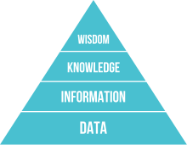
Which leads us to documentation
Documentation is knowledge communication & can build understanding
DIKW pyramid (unaltered) – Wikipedia/Longlivetheux
Data at the bottom. Knowledge as we move up?
Some documents frozen at creation. Others are living.
Does this capture how hard it is to do documentation in a distributed, digital world?
Notes:
Documentation is capture, preserve, & communicate
Not all documents are alike.

Slide 31
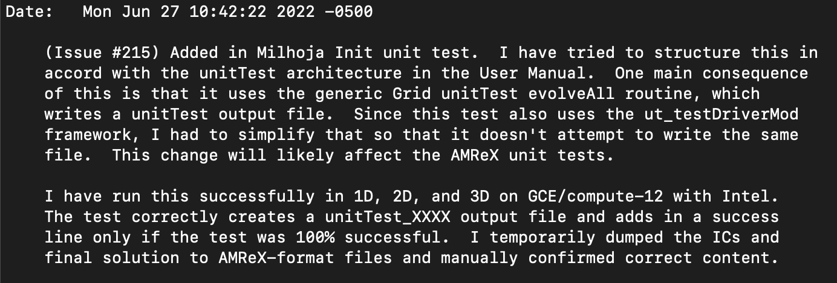
Git lab notes stream
Keep lab notes for your software as close to the “instrument” as possible
Details not obvious from commit diff:
Motivation, reasoning, consequences
Testing notes
*This message is missing a title as the first line.
This is only one component of the lab notebook for software – combine with pull requests

Slide 32
Pull request as a “filtered” notebook entry
A pull request is an aggregation of commits to a git repo
Individual commits are linked to the pull request
The PR allows for additional content that’s distinct from the individual commits
Use PR description to record process to verify correctness of changes
2-2.5 days effort carried out over a week
Copy/pasted from previous PR and adapted first (designed process)
Improved as carried out process – converging on a quasi-procedure
Filtered so that reviewers aren’t overwhelmed
Helped organize effort & design good tests
Additional benefits
Senior reviewers provide feedback & suggest improvements
Junior reviewers exposed to work habits of other people
Example: Flash-X PR #247 on next slide

Slide 33
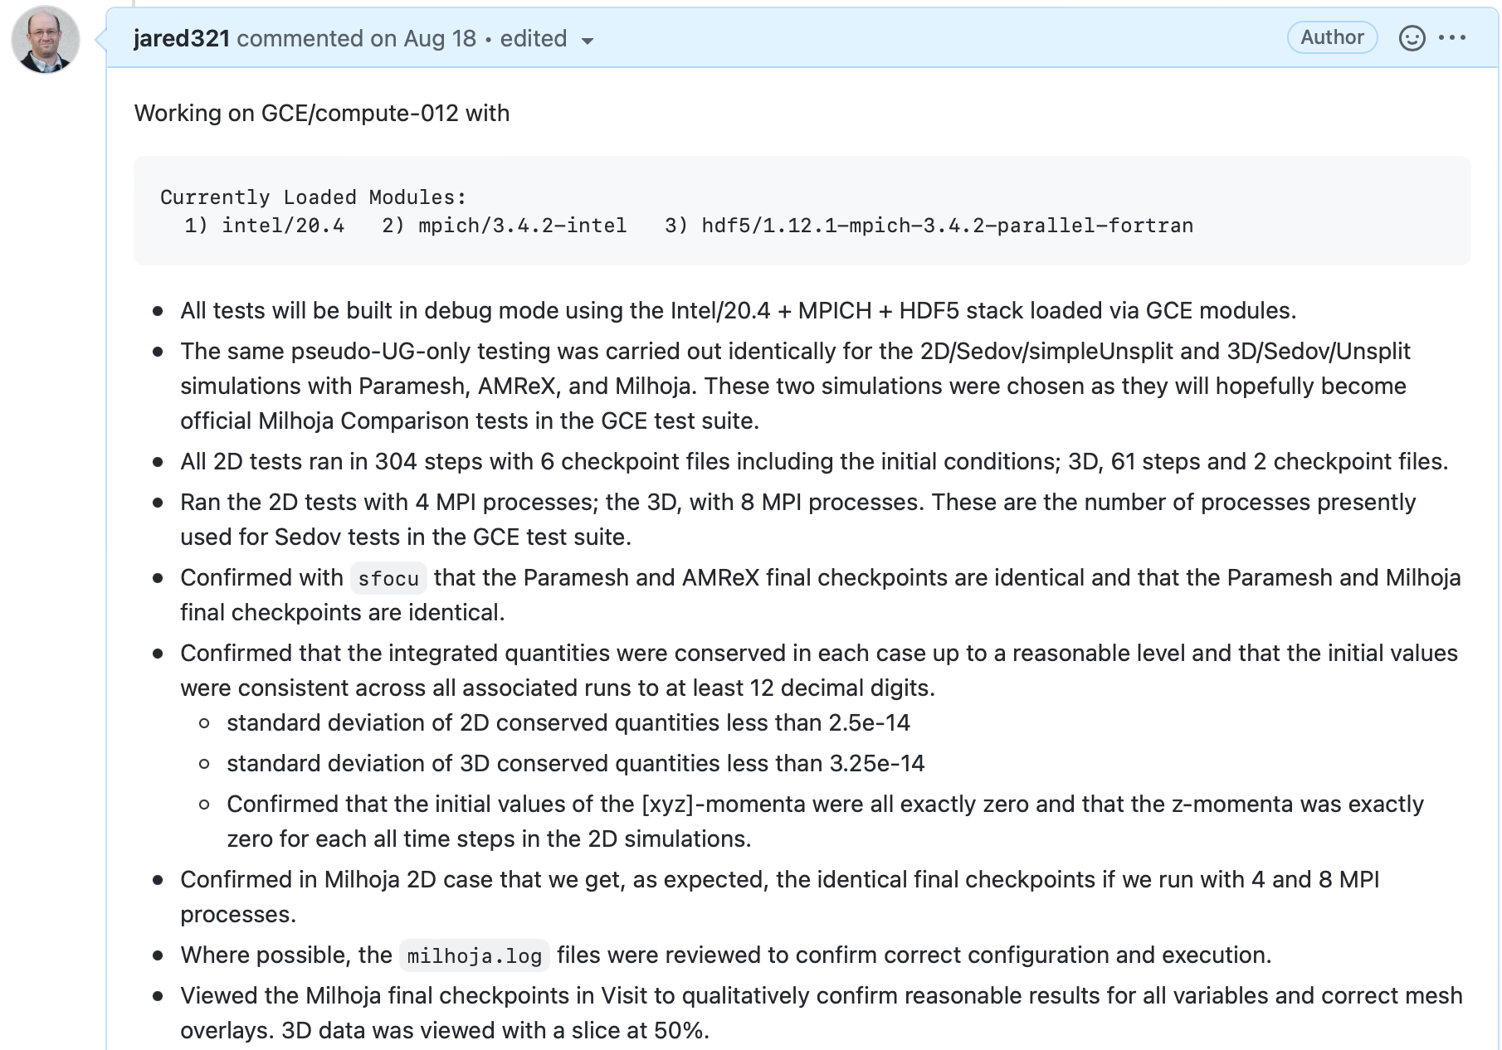
Example: Flash-X
PR #247

Slide 34
README lab notes streams
High-level road maps with motivation, documented decisions, and conclusions
Concise living docs that function as executive summaries
Higher up in documentation hierarchy
Low-level notes such as managing software stack
Traceability of SW environment & therefore verification
Can be turned into procedures

Slide 35
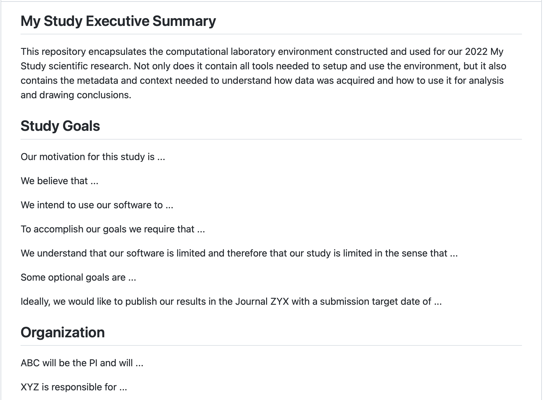
High-level README

Slide 36
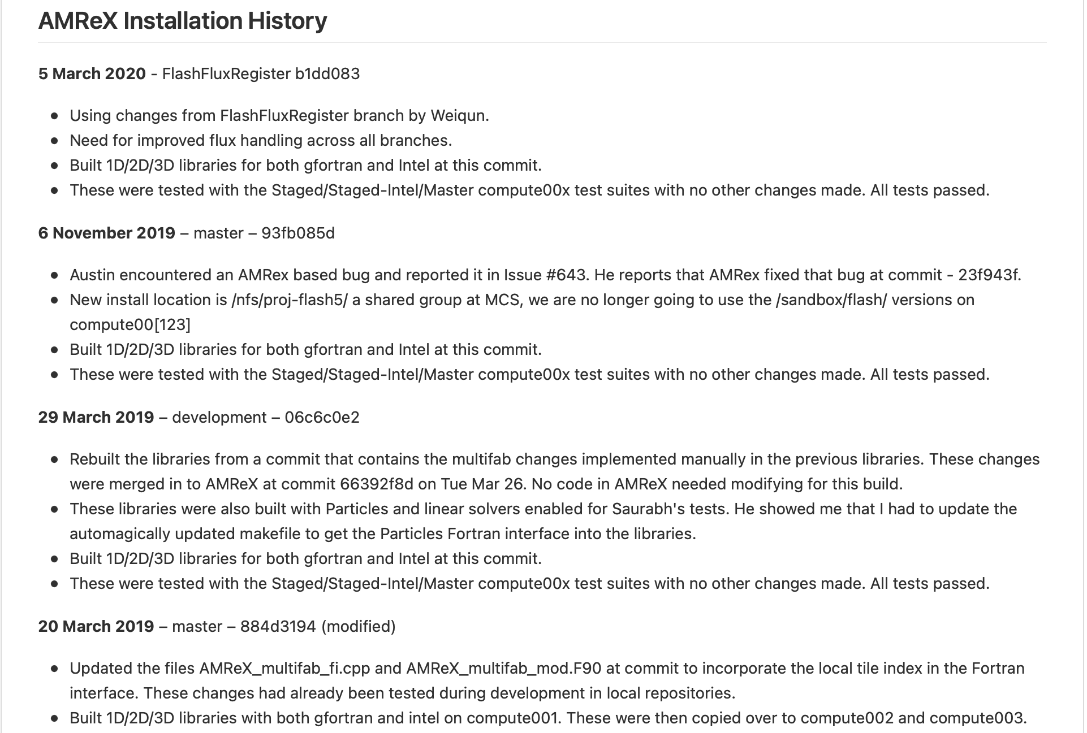
Low-level README

Slide 37
Capturing data context & metadata (distinct from the data)
Build dates, user, system name, git hashes, configuration data in file headers
Self-documenting files
Build & job logs
Software environment info (e.g., modules, ldd output)
git diffs
Environment variables
Automate as much as possible

Slide 38
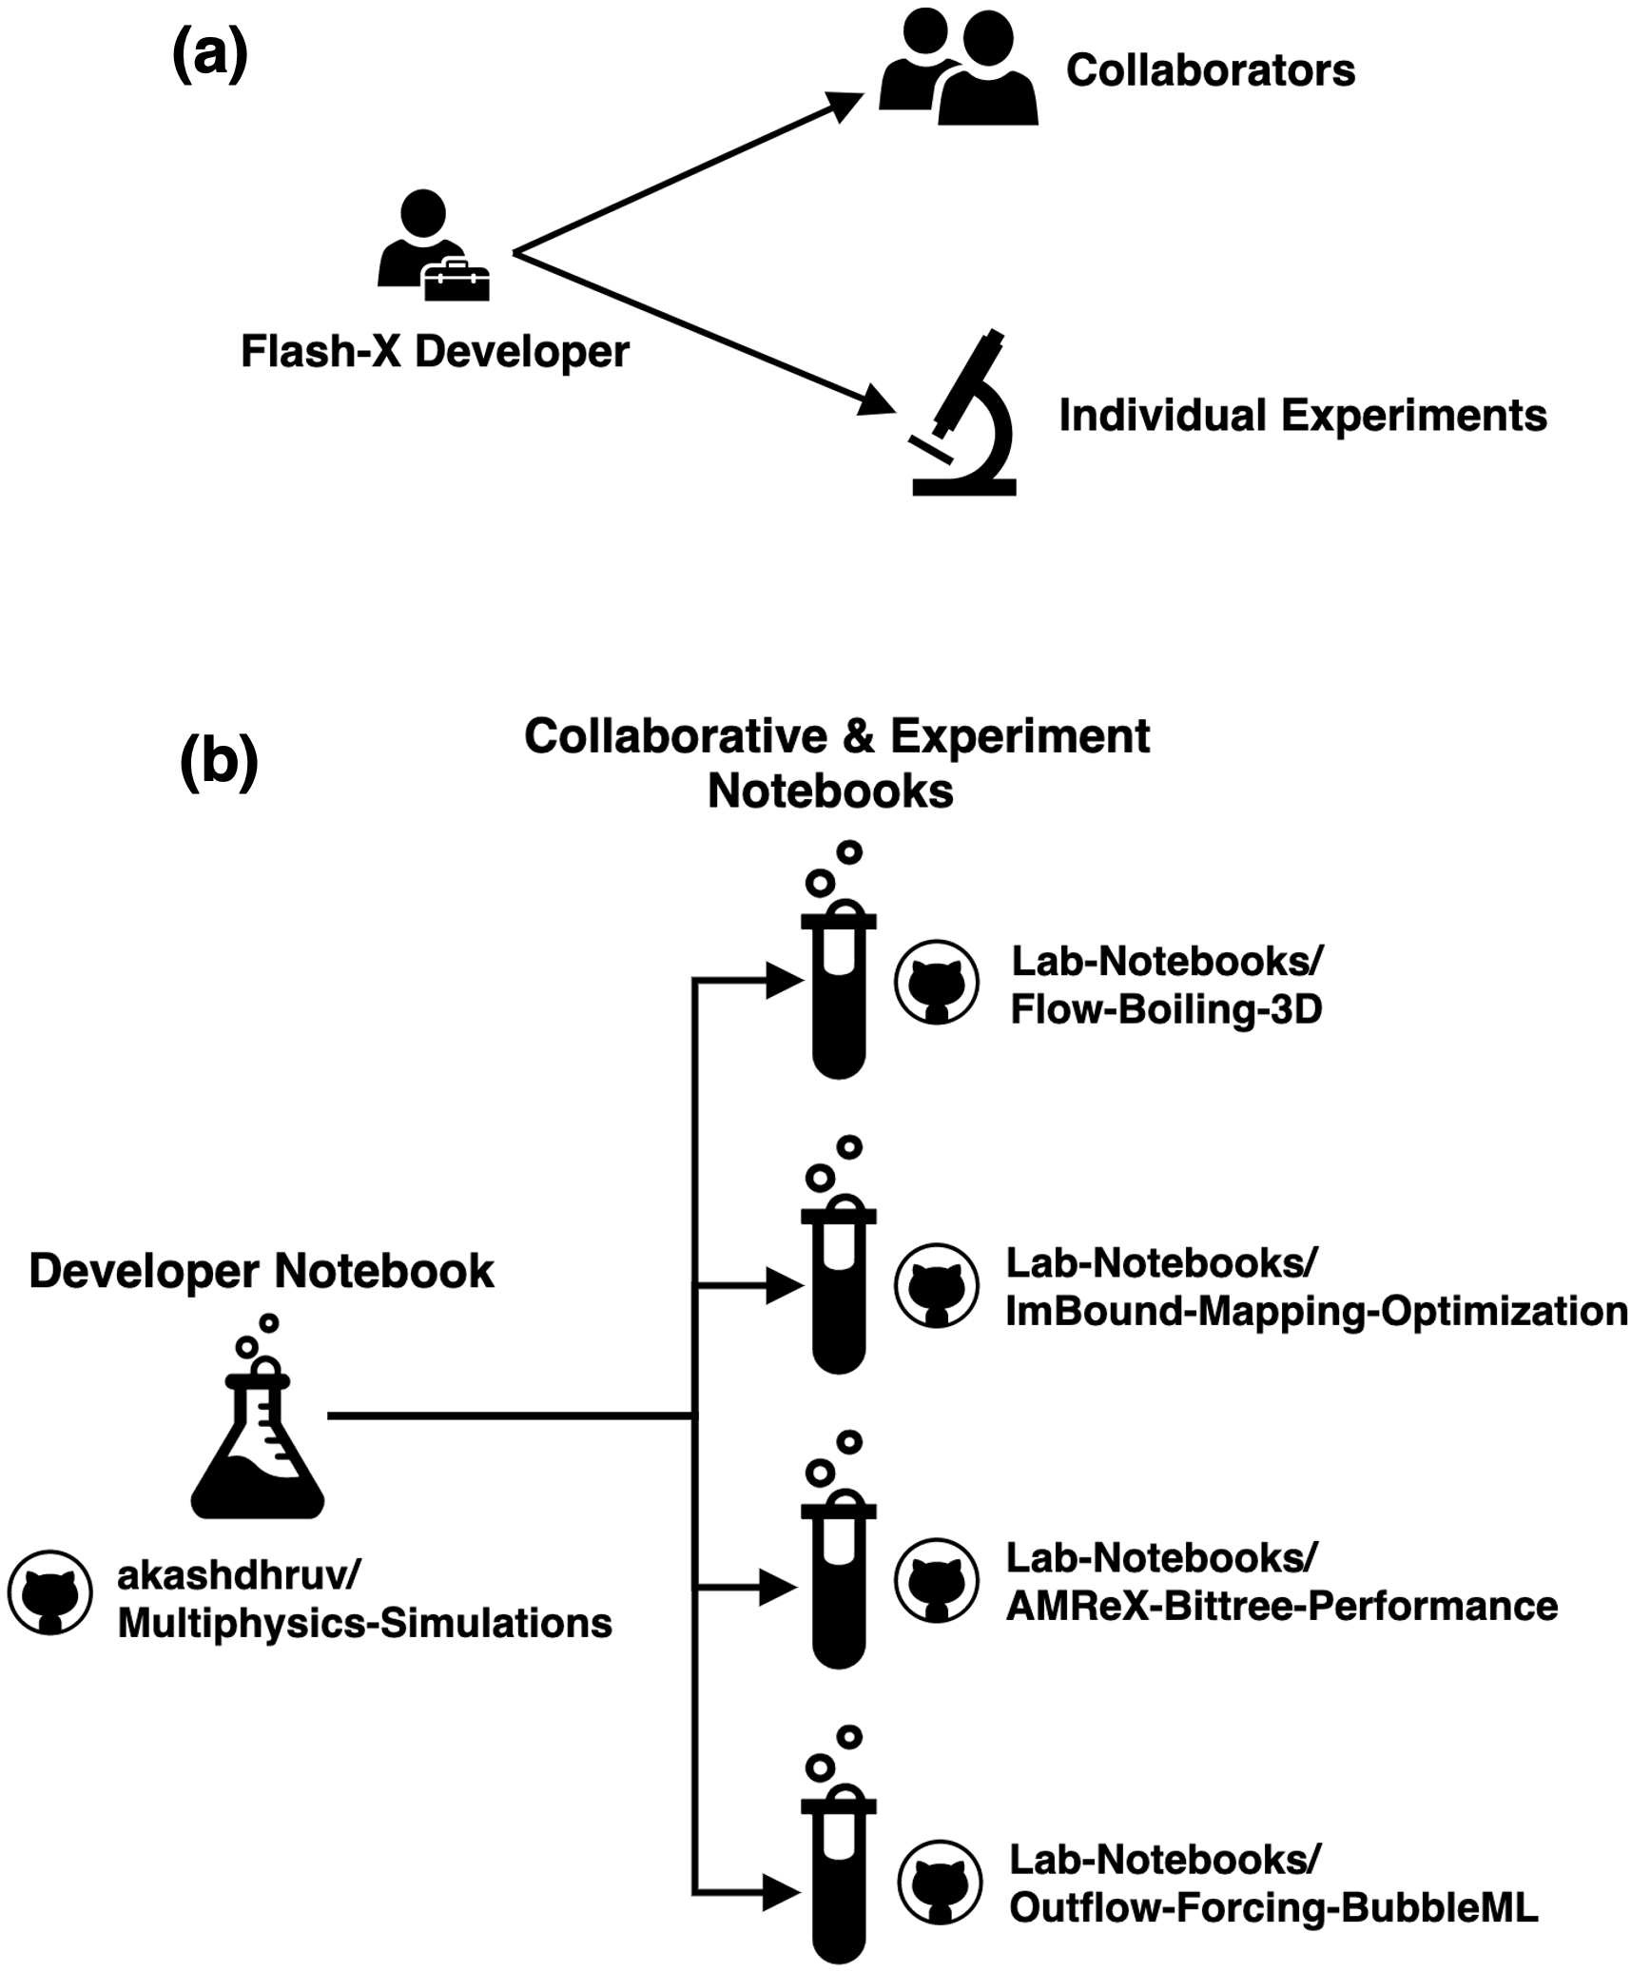
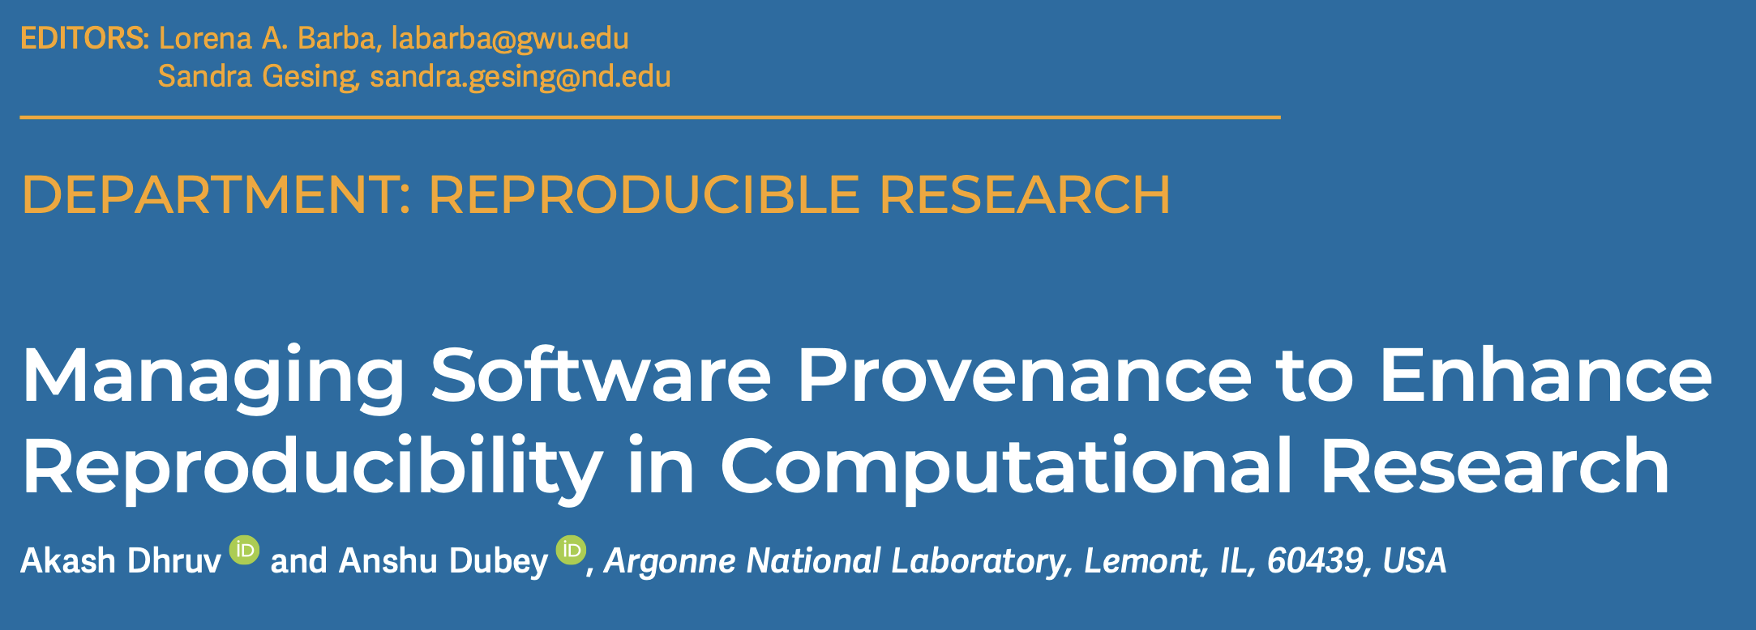




Jobrunner: A command line tool for managing computational lab notebooks
Data Clone
rsync
Execution Environment
Data Clone

Slide 39
How to organize your Jobrunner lab notebook?
It should be
Easy to create and maintain lab notes
Easy to concentrate more on executing work & less on documenting it
Easy to find what you need
Each stream should
Have a clear identity for what it records
Not contain notes contained in other streams

Slide 40
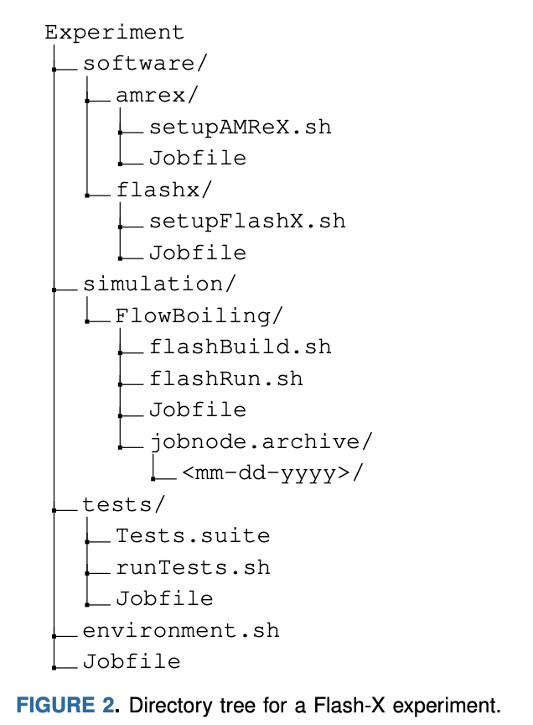
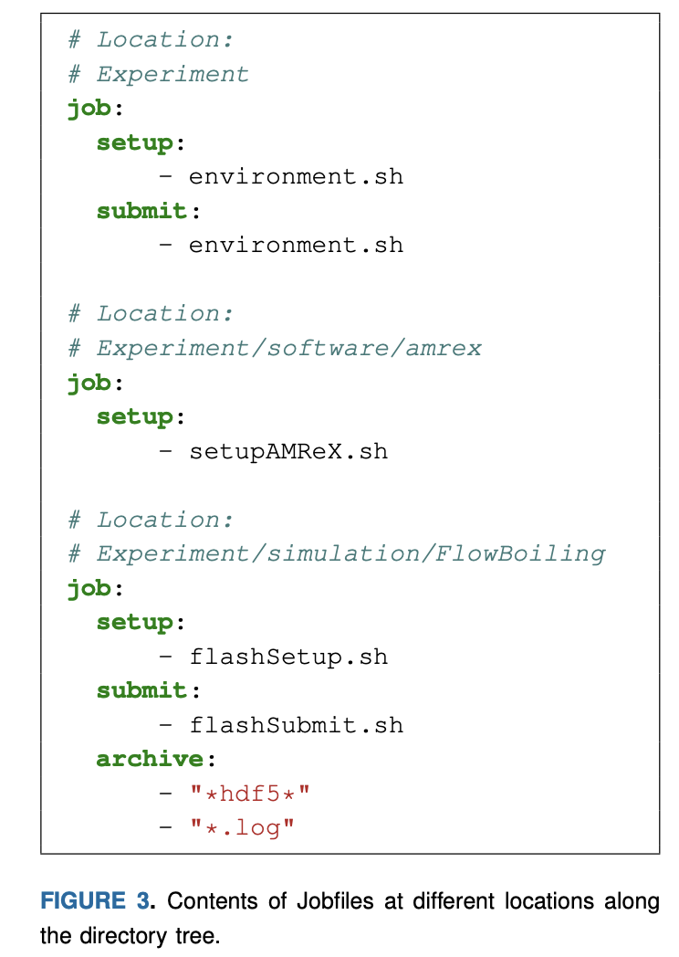
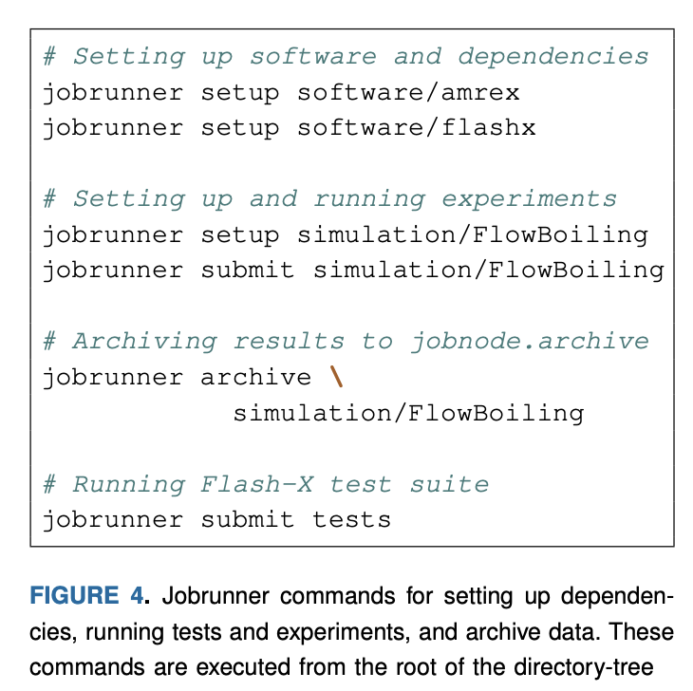
How to organize your Jobrunner lab notebook?

Slide 41
Jupyter notebooks
Jupyter notebook can put context & metadata next to data
High-level design & motivation up top
Low-level lab notes for acquiring data
Load & use data
Generate visualizations in place
Comment on results
Where do notebooks fit into the documentation hierarchy?
Repetitive use of notebook?
Limit amount of code in notebook

Slide 42
How to organize your “virtual” (multi-stream) lab notebook?
It should be
Easy to create and maintain lab notes
Easy to concentrate more on executing work & less on documenting it
Easy to find what you need
Each stream should
Have a clear identity for what it records
Not contain notes contained in other streams
Be recorded by using the right tool for the job

Slide 43
Strategies for Improving Reproducibility with Lab Notebooks
Be thorough in capturing provenance
Agents (codes), entities (inputs, outputs, etc.), activities (the transformation)
Capture code version
Capture all inputs/configuration information for each experiment
Use multiple systems to ensure that you can correctly associate inputs, outputs, and code versions
Systematic directory and file naming conventions (document them!)
Separate written notes (paper notebook, electronic notebook)
Lab notebooks aren’t just for people who literally work in a laboratory!
Scripts to orchestrate experiments (versioned and captured)
Version control (if data is not too large)
Capture important outputs (as feasible)

Slide 44
Strategies for Improving Reproducibility After Experiments
Continue provenance capture through data analysis/reduction process
Agents (codes), entities (inputs, outputs, etc.), activities (the transformation)
Script as much of your analysis/reduction as possible
Prefer scriptable tools over those requiring human interaction
Keep the scripts under version control
Document your process thoroughly
Separately from scripts, etc.
E.g., in your lab notebook
Especially where human interaction is required
Capture key intermediates in the reduction process
The longer the processing pipelines, the more likely problems will creep in
The more you capture, the more you will have for verification (and to find problems) later
Capture the data (in machine-readable form) used to produce graphs and tables
Expected by basic data management plans
And an increasing number of publishers

Slide 45
Tools May Help with Reproducibility
Just a small sampling…
Containers to capture the software
Resources for finding, understanding, and debugging floating point math problems: http://fpanalysistools.org/
Cloud platforms to publish and reproduce research code and data
E.g., https://CodeOcean.com
DOIs and hosting of data, code, documents, etc.
E.g., https://zenodo.org/, https://FigShare.com
Make sure to test and understand your tools thoroughly before using them for something important!

Slide 46
Summary
The credibility of your science derives from the credibility of your code (and process)
Science stakeholders are ratcheting up expectations for reproducibility
Reproducible results are a necessity, not a luxury
There is no credible science without full provenance
Computational science campaigns can be expensive in time and resources
Care and planning is vital to ensure that outcomes meet expectations
There are strategies to improve reproducibility in all phases of the scientific process
During development
After development
During experiments
After experiments
They amount to better software development practices
The same kinds of practices advocated for reasons of productivity, sustainability, maintainability, etc.

Slide 47
Other resources
The FAIR Guiding Principles for Scientific Data Management and Stewardship. Mark D. Wilkinson, et al. https://doi.org/10.1038/sdata.2016.18
FAIR for Research Software (FAIR4RS) Working Group: https://www.rd-alliance.org/groups/fair-for-research-software-fair4rs-wg/forum/
Editorial: ACM TOMS Replicated Computational Results Initiative. Michael A. Heroux. 2015. ACM Trans. Math. Softw. 41, 3, Article 13 (June 2015), 5 pages. DOI: http://dx.doi.org/10.1145/2743015
Enhancing Reproducibility for Computational Methods. Victoria Stodden, Marcia McNutt, David H. Bailey, Ewa Deelman, Yolanda Gil, Brooks Hanson, Michael A. Heroux, John P.A. Ioannidis, Michela Taufer Science (09 Dec 2016), pp. 1240-1241. DOI: 10.1126/science.aah6168
Simple experiments in reproducibility and technical trust by Mike Heroux and students (work in progress), https://betterscientificsoftware.github.io/Trust-Tools/
What every scientist should know about floating-point arithmetic. David Goldberg. https://doi.org/10.1145/103162.103163
Carlo Graziani, HPC and the Lab Manager. Better Scientific Software. https://bssw.io/blog_posts/hpc-and-the-lab-manager. Nov 17, 2021.
Howard M. Kanare, Writing the Laboratory Notebook. American Chemical Society, Washington, D.C., 1985.
Nicole Brewer, Jupyter4Science: Better Practices for Using Jupyter Notebooks for Science. Better Scientific Software. https://bssw.io/items/jupyter4science-better-practices-for-using-jupyter-notebooks-for-science. March 17, 2024.

