Slide 1
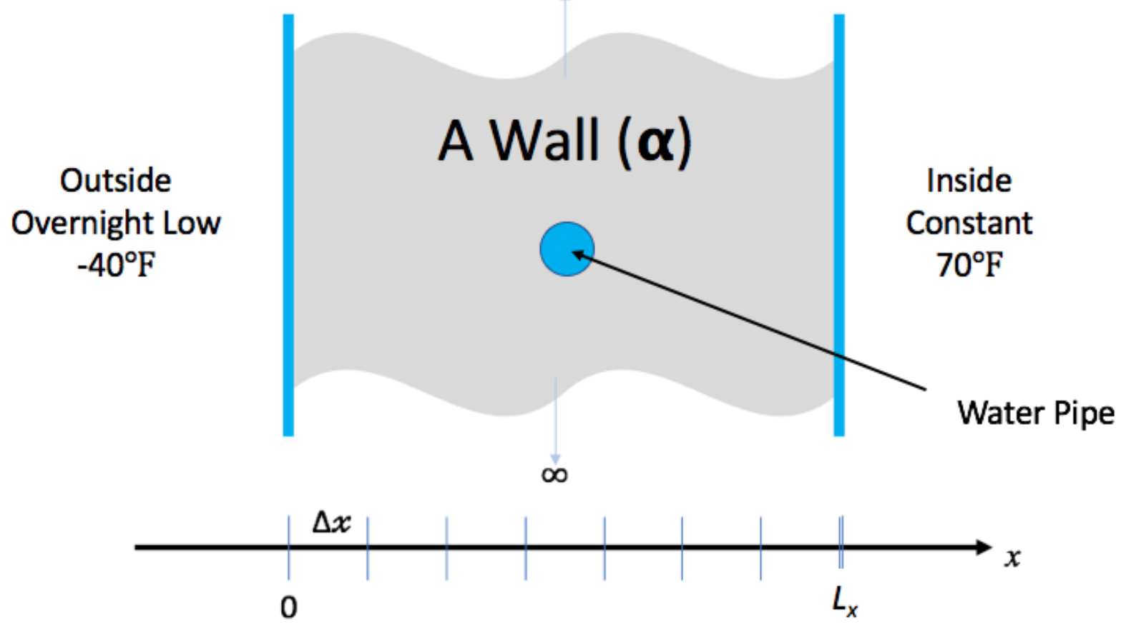
Hands-On Activities
We have created a simple example to give you some (optional) hands-on experience with some of the concepts in this tutorial
You don’t need to understand the math/physics to do the exercises, or find them useful
We have some time in the agenda for the hands-on activities, but feel free to continue to work on them outside of the tutorial. We’ll give feedback on pull requests and issues filed (or email us, see next slide).
Instructions on the tutorial web site: https://bssw-tutorial.github.io/ and click the link for today’s tutorial
Notes:
Variant for hands-on being part of the agenda.

Slide 2
Hands-On Activities
We have created a simple example to give you some (optional) hands-on experience with some of the concepts in this tutorial
You don’t need to understand the math/physics to do the exercises, or find them useful
We do not have time in the agenda for the hands-on activities, but feel free to work on them outside of the tutorial. We’ll give feedback on pull requests and issues filed (or email us, see next slide).
Instructions on the tutorial web site: https://bssw-tutorial.github.io/ and click the link for today’s tutorial
Notes:
Variant for hands-on not being part of the agenda.

Slide 3
Hands-On Activities
We have created a simple example to give you some (optional) hands-on experience with some of the concepts in this tutorial
You don’t need to understand the math/physics to do the exercises, or to find them useful
We have some time in the agenda for the hands-on activities
But feel free to start early (i.e. during breaks) and continue after the tutorial
We’ll give feedback on pull requests and issues filed (or email us, see next slide).
Instructions on the tutorial web site: https://bssw-tutorial.github.io/ and click the link for today’s tutorial

Slide 4
Hands-On Activities
We have created a simple example to give you some (optional) hands-on experience with some of the concepts in this tutorial
You don’t need to understand the math/physics to do the exercises, or to find them useful
We have time this afternoon which we can use for hands-on activities (optional)
You can also work the hands-on activities on your own and email us if you have questions
Instructions on the tutorial web site: https://bssw-tutorial.github.io/ and click the link for today’s tutorial

Slide 5
We Want to Interact with You!
We find these tutorials most interesting and informative (for everyone) if you ask questions and share experiences!
We learn too!
Please raise your hand at any time to ask a question
After the tutorial email us at bssw-tutorial@lists.mcs.anl.gov
With questions or feedback
The list moderator will allow your messages to be posted
Refer to bssw-tutorial.github.io page for all tutorial materials
In-person presentation

Slide 6
We Want to Interact with You!
We find these tutorials most interesting and informative (for everyone) if you ask questions and share experiences!
We learn too!
If you’re in the room with us, please raise your hand to ask a question
If you’re online, please use the raise hand feature to ask a question or put it into the chat if you prefer
We’ll respond verbally or in chat as opportunities permit
After the tutorial email us at bssw-tutorial@lists.mcs.anl.gov
With questions or feedback
The list moderator will allow your messages to be posted
Refer to bssw-tutorial.github.io page for all tutorial materials
Hybrid presentation

Slide 7
We Want to Interact with You!
We find these tutorials most interesting and informative (for everyone) if you ask questions and share experiences!
We learn too!
Please use the raise hand feature to ask a question or put it into the chat if you prefer
We’ll respond verbally or in chat as opportunities permit
After the tutorial email us at bssw-tutorial@lists.mcs.anl.gov
With questions or feedback
The list moderator will allow your messages to be posted
Refer to bssw-tutorial.github.io page for all tutorial materials
Online presentation

