Slide 1
Refactoring Scientific Software
Anshu Dubey
(she/her)
Argonne National Laboratory
Software Productivity and Sustainability track @ Argonne Training Program on Extreme-Scale Computing summer school
Contributors: Anshu Dubey (ANL), Mark C. Miller (LLNL), Jared O’Neal

Slide 2
License, Citation and Acknowledgements
License and Citation
This work is licensed under a Creative Commons Attribution 4.0 International License (CC BY 4.0).
The requested citation the overall tutorial is: Anshu Dubey, David E. Bernholdt, Todd Gamblin, and Jared O’Neal, Software Productivity and Sustainability track, in Argonne Training Program on Extreme-Scale Computing, St. Charles, Illinois, 2024. DOI: 10.6084/m9.figshare.26384188.
Individual modules may be cited as Speaker, Module Title, in Tutorial Title, …
Acknowledgements
This work was supported by the U.S. Department of Energy Office of Science, Office of Advanced Scientific Computing Research (ASCR), and by the Exascale Computing Project (17-SC-20-SC), a collaborative effort of the U.S. Department of Energy Office of Science and the National Nuclear Security Administration.
This work was supported by the U.S. Department of Energy, Office of Science, Office of Advanced Scientific Computing Research, Next-Generation Scientific Software Technologies (NGSST) program.
This work was performed in part at the Argonne National Laboratory, which is managed by UChicago Argonne, LLC for the U.S. Department of Energy under Contract No. DE-AC02-06CH11357.
This work was performed in part at the Lawrence Livermore National Laboratory, which is managed by Lawrence Livermore National Security, LLC for the U.S. Department of Energy under Contract No. DE-AC52-07NA27344.
This work was performed in part at the Los Alamos National Laboratory, which is managed by Triad National Security, LLC for the U.S. Department of Energy under Contract No.89233218CNA000001
This work was performed in part at the Oak Ridge National Laboratory, which is managed by UT-Battelle, LLC for the U.S. Department of Energy under Contract No. DE-AC05-00OR22725.
This work was performed in part at Sandia National Laboratories. Sandia National Laboratories is a multi-mission laboratory managed and operated by National Technology and Engineering Solutions of Sandia, LLC., a wholly owned subsidiary of Honeywell International, Inc., for the U.S. Department of Energy’s National Nuclear Security Administration under contract DE-NA0003525.

Slide 3
What is Refactoring
Definition: Refactoring is a disciplined technique for restructuring an existing body of code, altering its internal structure without changing its external behavior.
Different from development
You have a working code
You know and understand the behavior
You have a baseline that you can use for comparison

Slide 4
What is Refactoring
General motivations
Modularity enhancement
Improve sustainability
Release to outside users
Easier to use and understand
Port to new platforms
Performance portability
Expand capabilities
Structural flexibility
Definition: Refactoring is a disciplined technique for restructuring an existing body of code, altering its internal structure without changing its external behavior.
Different from development
You have a working code
You know and understand the behavior
You have a baseline that you can use for comparison

Slide 5
An Example Workflow
START
FIX
NO
REFACTOR
REGRESSION/UNIT TEST
PASS
YES
Notes:
Tests written before refactoring encapsulate and enforce a contract made at design time. Having them available easily allows us to maintain that any small change does not alter behavior of code being refactored.
Fowler (1999) via Code Complete:
Refactoring is “a change made to the internal structure of the software to make it easier to understand and cheaper to modify without changing its behavior”.

Slide 6
An Example Workflow
START
FIX
NO
YES
REFACTOR
REGRESSION/UNIT TEST
PASS
DONE
YES
NO
Notes:
Tests written before refactoring encapsulate and enforce a contract made at design time. Having them available easily allows us to maintain that any small change does not alter behavior of code being refactored.
Fowler (1999) via Code Complete:
Refactoring is “a change made to the internal structure of the software to make it easier to understand and cheaper to modify without changing its behavior”.

Slide 7
An Example Workflow
NO
START
FIX
INTEGRATION TEST
PASS
NO
YES
YES
REFACTOR
REGRESSION/UNIT TEST
PASS
DONE
YES
NO
Notes:
Tests written before refactoring encapsulate and enforce a contract made at design time. Having them available easily allows us to maintain that any small change does not alter behavior of code being refactored.
Fowler (1999) via Code Complete:
Refactoring is “a change made to the internal structure of the software to make it easier to understand and cheaper to modify without changing its behavior”.

Slide 8
An Example Workflow
NO
START
FIX
INTEGRATION TEST
PASS
NO
YES
YES
REFACTOR
REGRESSION/UNIT TEST
PASS
DONE
SUCCESS
YES
NO
Notes:
Tests written before refactoring encapsulate and enforce a contract made at design time. Having them available easily allows us to maintain that any small change does not alter behavior of code being refactored.
Fowler (1999) via Code Complete:
Refactoring is “a change made to the internal structure of the software to make it easier to understand and cheaper to modify without changing its behavior”.

Slide 9
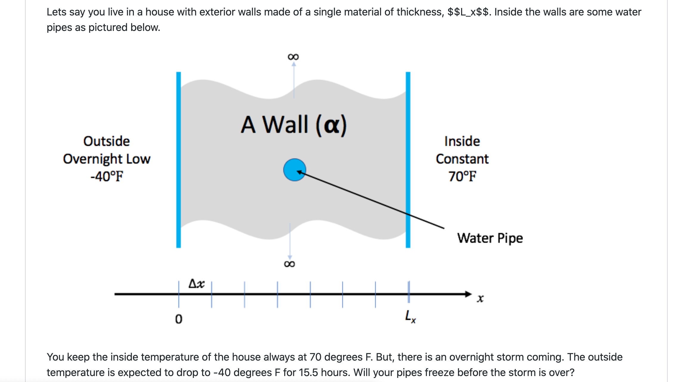
Look at the Running Example
Consider two versions of this code…
One is a single file with monolithic code
The other is modularized reusable maintainable code
If we had only the first version, we would be refactoring to get to the second

Slide 10
Considerations for Refactoring
Know why you are refactoring
Is it necessary
Where should the code be after refactoring
In heat example version 1
It is necessary because
It is a monolithic code
No reusability of any part of the code
Devising tests is hard
Limited extensibility
Where do we want to be after refactoring
Closer to the second version
More modular, maintainable and extensible

Slide 11
Considerations for Refactoring
To modularize the monolithic code…
Separate out utilities, generalize interfaces
Put global definitions in a header file
Create a general build function
No new code or intrusive changes
Know the scope of refactoring
How deep a change
How much code will be affected
In heat example
No capability extension
No performance consideration
Cleaner, more maintainable code

Slide 12
Before Starting
Know your cost estimates
Verification
Check for coverage provided by existing tests
Develop new tests where there are gaps
Make sure tests exist at different granularities
There should be demanding integration and system level tests

Slide 13
Before Starting
Know your cost estimates
Verification
Check for coverage provided by existing tests
Develop new tests where there are gaps
Make sure tests exist at different granularities
There should be demanding integration and system level tests
Know your bounds
on acceptable behavior change
error bounds
bitwise reproduction of results unlikely after transition
Map from here to there

Slide 14
Before Starting
Know your cost estimates
Verification
Check for coverage provided by existing tests
Develop new tests where there are gaps
Make sure tests exist at different granularities
There should be demanding integration and system level tests
Know your bounds
on acceptable behavior change
error bounds
bitwise reproduction of results unlikely after transition
Map from here to there
Incorporate testing overheads into refactoring cost estimates

Slide 15
Exercise: Refactoring bssw-tutorial/hello-numerical-world
I am taking the clean solution and generalizing the update_solution interface
Motivation: Do not want to change heat.C for adding another method
For this exercise we will use “ftcs” and “upwind15” as alternative options

Slide 16
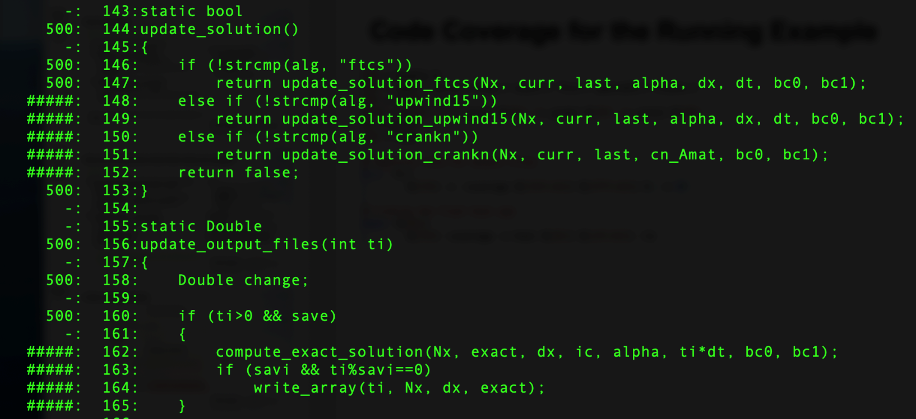
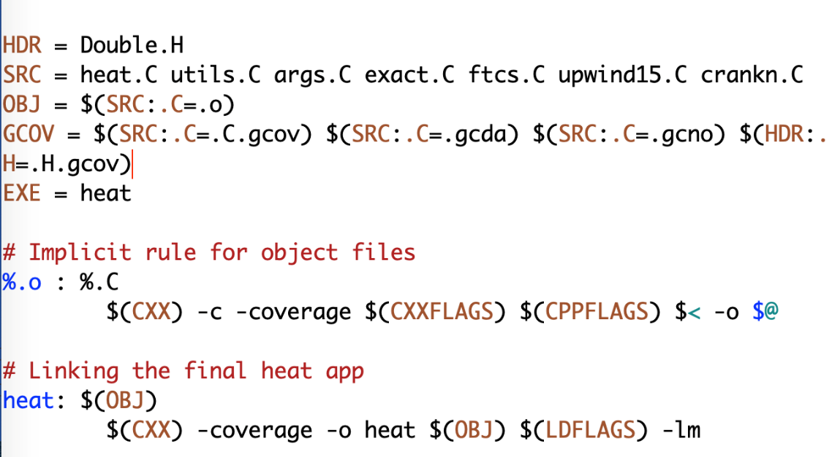
Preparing for Refactoring – check coverage
Run ./heat runame=“ftcs_results”
Run gcov heat.C
Examine heat.C.gcov
A dash indicates non-executable line
A number indicated the times the line was called
##### indicates line wasn’t exercised

Slide 17
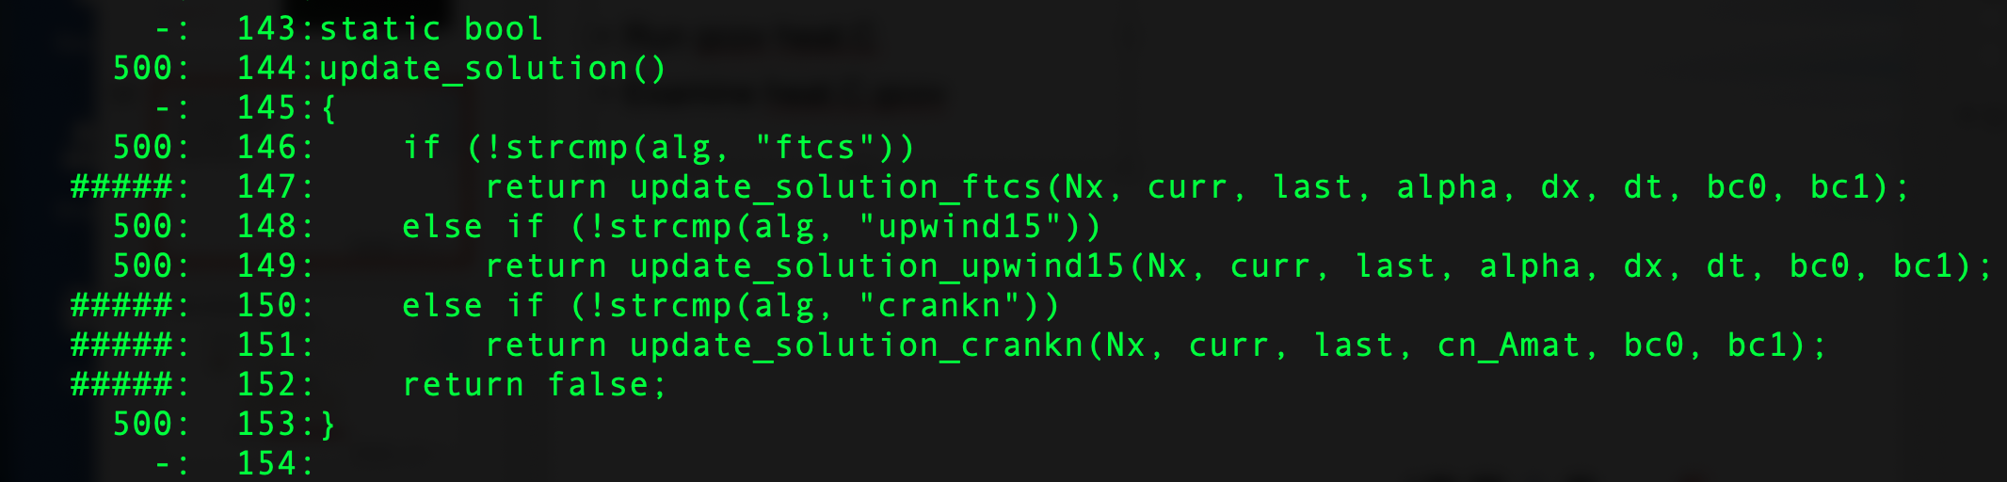
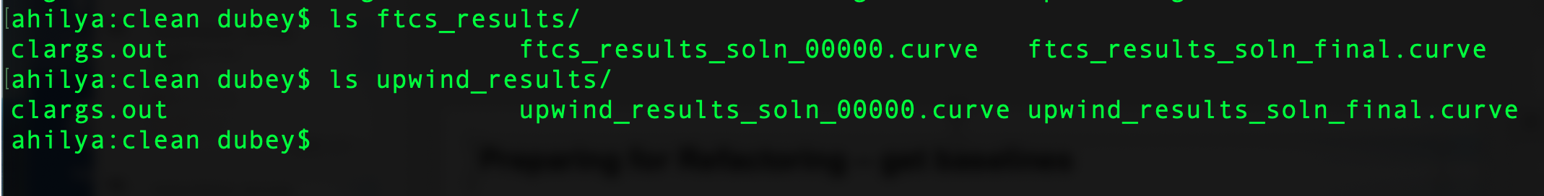
Preparing for Refactoring – get baselines
Call to upwind15 not exercised
Run ./heat alg=“upwind15” runame=“upwind_results
We have baselines for ftcs and upwind

Slide 18
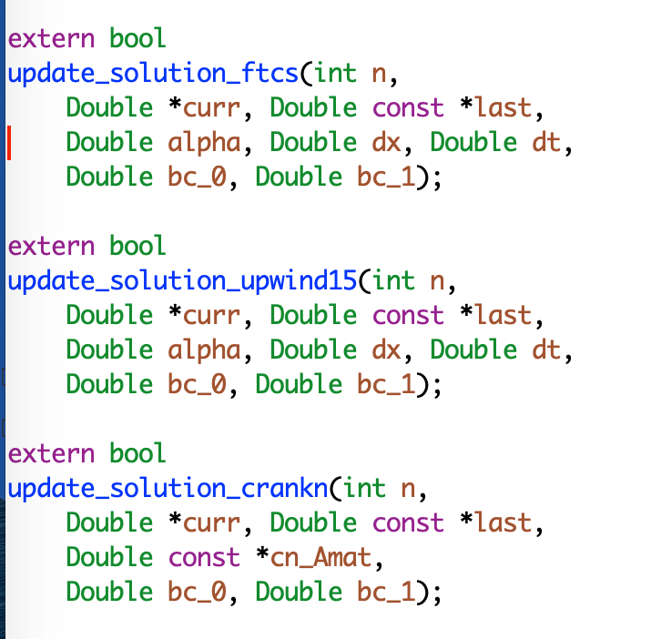
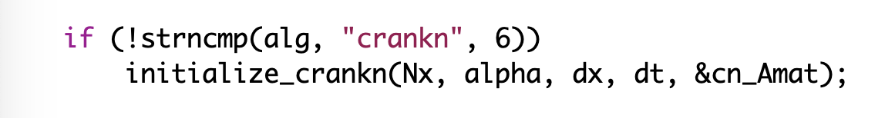
Refactoring – The starting code
Interfaces are not identical
crankn has an extra argument
It also has an extra step in initialization

Slide 19
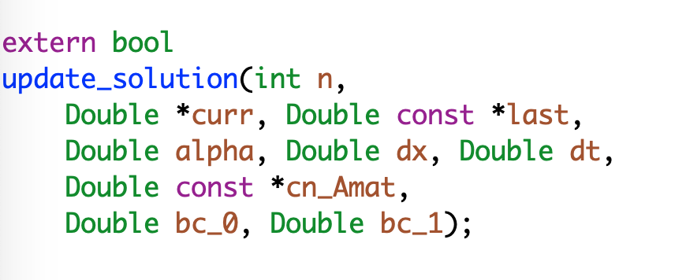
Refactoring
Generalize the interface
Modify the makefile

Slide 20
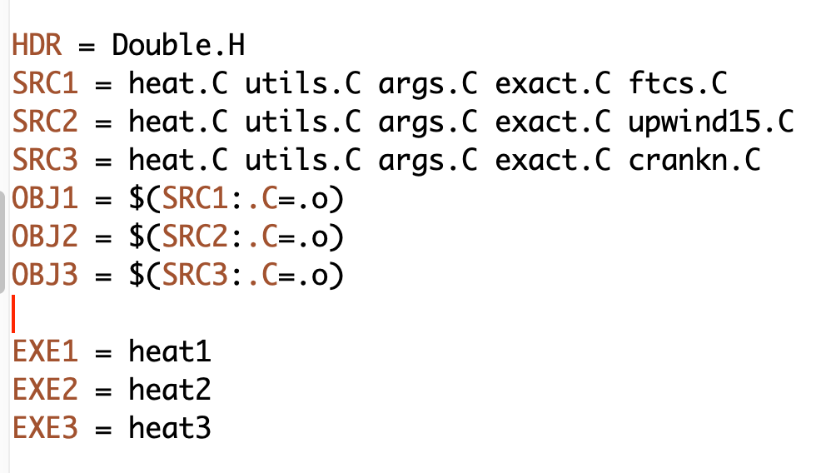
Refactoring
Generalize the interface
Modify the makefile

Slide 21
Refactoring
Generalize the interface
Modify the makefile
Add null implementations of initialize_crank in ftcs and upwind15

Slide 22
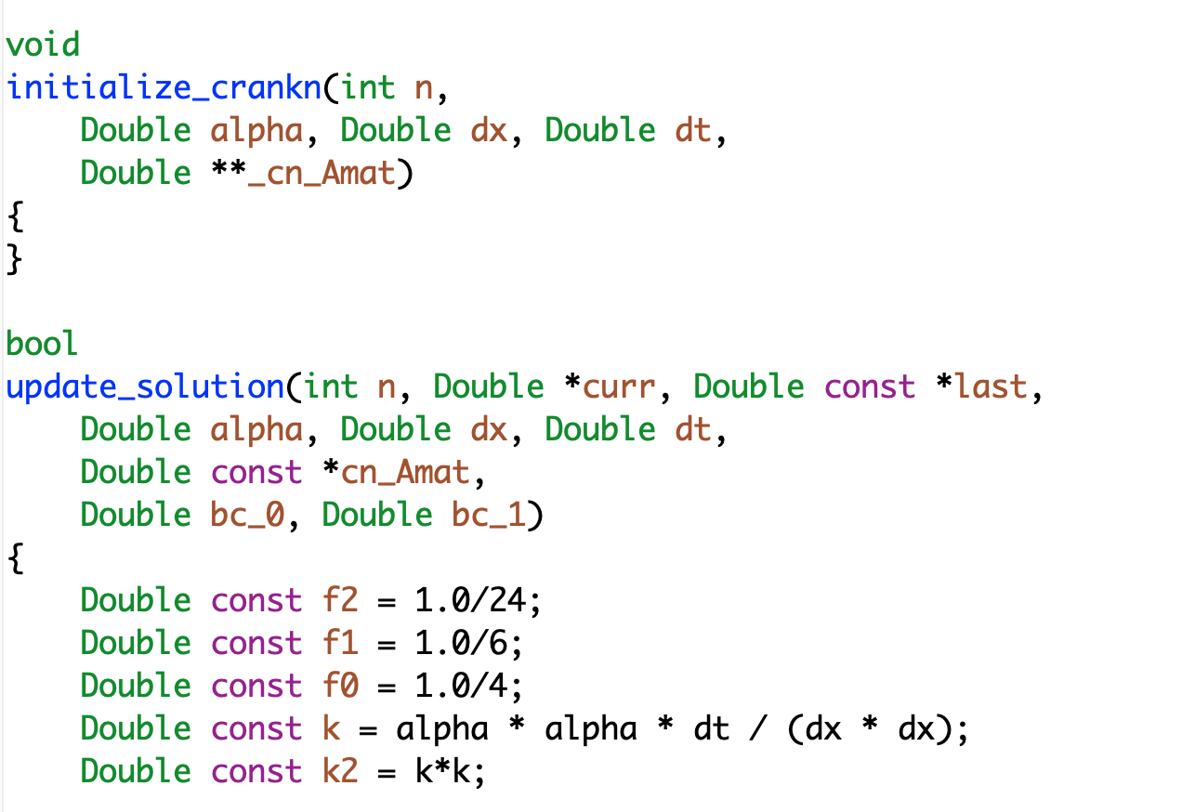
Refactoring
make heat1
Run ./heat runame=“ftcs_results”
Make heat2
Run ./heat runame=“upwind_results”
Verify against baselines

Slide 23
Map from Here to There: On ramp plan
Proportionate to the scope
Scattered independent changes - May be OK
All at once
Invasive large-scale change in the code - Bad idea
All at once

Slide 24
Map from Here to There: On ramp plan1
Turn off all modules except for the one being refactored.
Have a way of testing in intermediate stages
Do this for all modules that need refactoring independently

Slide 25
Map from Here to There: On ramp plan1
Turn off all modules except for the one being refactored.
Have a way of testing in intermediate stages
Do this for all modules that need refactoring independently
One by one turn on more than one refactored module

Slide 26
Map from Here to There: On ramp plan2

Slide 27
Map from Here to There: On ramp plan2
Build a separate environment for testing refactored module

Slide 28
Map from Here to There: On ramp plan2
Build a separate environment for testing refactored module
Copy over the module in this isolated environment

Slide 29
Map from Here to There: On ramp plan2
Build a separate environment for testing refactored module
Copy over the module in this isolated environment
Put back refactored module

Slide 30
Map from Here to There: On ramp plan2
Build a separate environment for testing refactored module
Copy over the module in this isolated environment
Put back refactored module

Slide 31
Map from Here to There: On ramp plan2
Build a separate environment for testing refactored module
Copy over the module in this isolated environment
Put back refactored module

Slide 32
A Real-World Example: FLASH to Flash-X
Refactoring to supporting a different AMR library
Goal: Replace Paramesh with AMReX
Plan: Getting there from here
On ramping
Design
Intermediate steps
Realizing the goal
Notes:
Can point out that this graphic show the need to update the tree - two AMR implementations required a new AMR subfolder.

Slide 33
A Real-World Example: FLASH to Flash-X
Refactoring to supporting a different AMR library
Goal: Replace Paramesh with AMReX
Plan: Getting there from here
On ramping
Design
Intermediate steps
Realizing the goal
Cost estimation
Expected developer time
Extent of disruption in production schedules
Get a buy-in from the stakeholders
That includes the users
For both development time and disruption
Notes:
Can point out that this graphic show the need to update the tree - two AMR implementations required a new AMR subfolder.

Slide 34
Steps in the Flash-X Refactoring : a mix of strategies

Slide 35
Steps in the Flash-X Refactoring : a mix of strategies
Part of a simpler environment for refactoring and testing

Slide 36
Steps in the Process
built to resemble behavior expected by AMReX

Slide 37
Steps in the Process
Refactored Grid interface made compatible with AMReX

Slide 38
Steps in the Process
Bring back the real environment but turn off some features related to AMR

Slide 39
Steps in the Process
Turn on all AMR features needed in the final stage

Slide 40
Steps in the Process

Slide 41
To Have a Good Outcome from Refactoring
Know why
Know how much
Know the cost
Plan
Have strong testing and verification
Get buy-in from stakeholders

