Slide 1
Responsible Software Development with LLMs
Anshu Dubey
(she/her)
Argonne National Laboratory
Better Software for Reproducible Science tutorial @ The International Conference for High-Performance Computing, Networking, Storage, and Analysis (SC25) conference
Contributors: Anshu Dubey (ANL), David E. Bernholdt (ORNL)

Slide 2
License, Citation and Acknowledgements
License and Citation
This work is licensed under a Creative Commons Attribution 4.0 International License (CC BY 4.0).
The requested citation the overall tutorial is: David E. Bernholdt and Anshu Dubey, Better Software for Reproducible Science tutorial, in The International Conference for High-Performance Computing, Networking, Storage, and Analysis (SC25), St. Louis, Missouri, 2025. DOI: 10.6084/m9.figshare.30394186.
Individual modules may be cited as Speaker, Module Title, in Tutorial Title, …
Acknowledgements
This work was supported by the U.S. Department of Energy, Office of Science, Office of Advanced Scientific Computing Research, Next-Generation Scientific Software Technologies (NGSST) and Scientific Discovery through Advanced Computing (SciDAC) programs.
This work was supported by the U.S. Department of Energy Office of Science, Office of Advanced Scientific Computing Research (ASCR), and by the Exascale Computing Project (17-SC-20-SC), a collaborative effort of the U.S. Department of Energy Office of Science and the National Nuclear Security Administration.
This work was performed in part at the Argonne National Laboratory, which is managed by UChicago Argonne, LLC for the U.S. Department of Energy under Contract No. DE-AC02-06CH11357.
This work was performed in part at the Lawrence Livermore National Laboratory, which is managed by Lawrence Livermore National Security, LLC for the U.S. Department of Energy under Contract No. DE-AC52-07NA27344.
This work was performed in part at the Los Alamos National Laboratory, which is managed by Triad National Security, LLC for the U.S. Department of Energy under Contract No.89233218CNA000001
This work was performed in part at the Oak Ridge National Laboratory, which is managed by UT-Battelle, LLC for the U.S. Department of Energy under Contract No. DE-AC05-00OR22725.
This work was performed in part at Sandia National Laboratories. Sandia National Laboratories is a multi-mission laboratory managed and operated by National Technology and Engineering Solutions of Sandia, LLC., a wholly owned subsidiary of Honeywell International, Inc., for the U.S. Department of Energy’s National Nuclear Security Administration under contract DE-NA0003525.

Slide 3
Introduction
Investing some thought in design of software makes it possible to maintain, reuse and extend it
Even if some research software begins its life as a one-off use case, it often gets reused
Without proper design it is likely to accrete features haphazardly and become a monstrosity
Acquires a lot of technical debt in the process
Many projects have had this happen
Most end up with a hard reset and start over again
Arrival of LLMs and their usefulness in increasing productivity has made this topic even more relevant
Rigorous verification is absolutely essential for using LLMs in any coding task.
In this module we will cover general design principles with test-driven development, and verification, and apply them to coding with LLM

Slide 4
Designing Software – High Level Phases
Requirements
gathering
Decomposition
Connectivity
Features and capabilities
Constraints
Limitations
Target users
Other …..
Understand design space
Decompose into high level components
Bin components into types
Understand component hierarchy
Figure out connectivity among components
Articulate dependencies

Slide 5
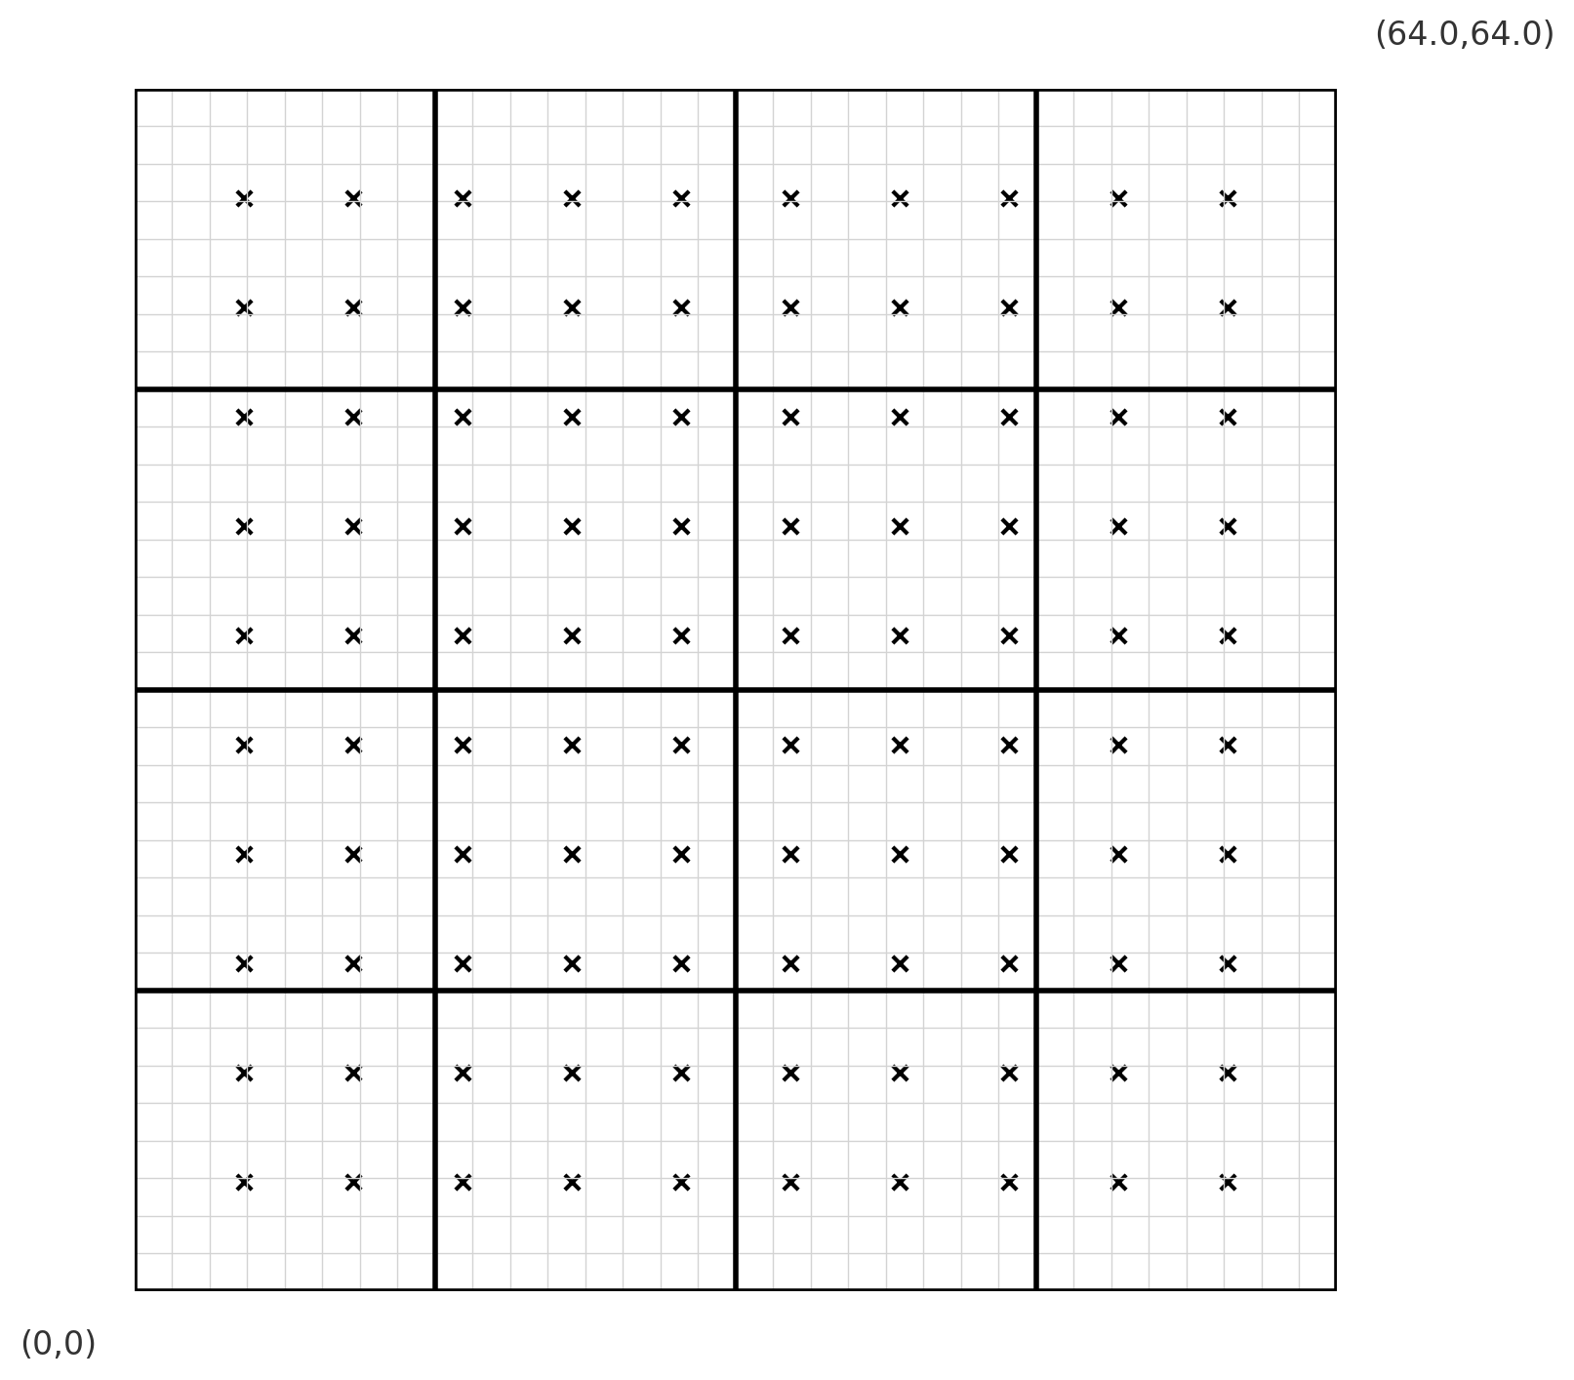
Example
Many applications combine mesh and particles
Particles have positions associated with them
They interchange physical quantities with the mesh
They change positions based on interactions
We will build a uniformly discretized 2D cartesian mesh and initialize with a lattice of particles
We will divide the mesh into blocks
We will associate each particle with a single block
We will move particles to different locations which may change the block they are associated with
We will need to handle particles that leave the domain

Slide 6
Requirements Gathering
Components we need
Mesh generator – with mesh divided into blocks
Particles generator – in a 2D lattice
For each particle ability to locate the block on which the particle resides
Making the particles change position
To verify that we are doing it correctly we need to make sure that
The mesh is generated correctly
The particles are initialized in a lattice and associated with blocks correctly
After moving the particles change their associations correctly

Slide 7
Decomposition
This is a small design space
Several requirements can directly map to components
Driver
Mesh initialization
Data structure
Division into blocks
Particle initialization
Position
Association with a mesh block
Particle mover
Tests
Binning components
Infrastructure Components
Driver
Initialization
Mesh with division into blocks
Particles position
Association with a mesh block
Components that are specific to one instance
Boundary conditions
Particle mover
Components for verification

Slide 8
Connectivity
Mesh generation
Mesh decomposition
Boundary conditions
Driver
Initialization of
Particle positions
Block association
Particle mover

Slide 9
Connectivity
Mesh generation
Mesh decomposition
Boundary conditions
Driver
Tests
Initialization of
Particle positions
Block association
Particle mover

Slide 10
Connectivity
Mesh generation
Mesh decomposition
Boundary conditions
Driver
Initialization of
Particle positions
Block association
Particle mover

Slide 11
Connectivity
Mesh generation
Mesh decomposition
Boundary conditions
Driver
Tests
Initialization of
Particle positions
Block association
Particle mover
This is where we start using LLM

Slide 12
Connectivity
Mesh generation
Mesh decomposition
Boundary conditions
Driver
Tests
Initialization of
Particle positions
Block association
Particle mover
This is where we start using LLM
But first, we figure out verification

Slide 13
What is Testing
Whenever you write a code you are doing it
When you compile it, you are testing for defects in syntax
When you run it for the first time you are testing for correctness
When you add any code and run it again, you are testing it again
When you break down your development into smaller chunks you test each chunk, then you combine the chunks, and you test again.

Slide 14
What is Testing
Whenever you write a code you are doing it
When you compile it, you are testing for defects in syntax
When you run it for the first time you are testing for correctness
When you add any code and run it again, you are testing it again
When you break down your development into smaller chunks you test each chunk, then you combine the chunks, and you test again.
Testing is an integral part of code development

Slide 15
What is Testing
Whenever you write a code you are doing it
When you compile it, you are testing for defects in syntax
When you run it for the first time you are testing for correctness
When you add any code and run it again, you are testing it again
When you break down your development into smaller chunks you test each chunk, then you combine the chunks, and you test again.
Testing is an integral part of code development
So, what is the whole fuss about testing?

Slide 16
What is Testing
Whenever you write a code you are doing it
When you compile it, you are testing for defects in syntax
When you run it for the first time you are testing for correctness
When you add any code and run it again, you are testing it again
When you break down your development into smaller chunks you test each chunk, then you combine the chunks, and you test again.
Testing is an integral part of code development
So, what is the whole fuss about testing?
Formalization of the process has been intimidating to people
because they think of writing tests as an overhead

Slide 17
How to Think About Building Tests
You start by thinking about what is the correct behavior
Next you think about how you are going to be able to tell whether the code is exhibiting correct behavior

Slide 18
How to Think About Building Tests
You start by thinking about what is the correct behavior
Next you think about how you are going to be able to tell whether the code is exhibiting correct behavior
You also think about what would be wrong behavior
Next you think about how you are going to be able to tell whether the code is exhibiting correct behavior

Slide 19
How to Think About Building Tests
Let us work through an example …
You want a large prime number for encryption
As a part of the development, you first write a function that checks if a given number is prime
Correct behavior: input 13 returns true, input 15 returns false
Incorrect behavior: input 15 returns true
You start by thinking about what is the correct behavior
Next you think about how you are going to be able to tell whether the code is exhibiting correct behavior
You also think about what would be wrong behavior
Next you think about how you are going to be able to tell whether the code is exhibiting correct behavior

Slide 20
How to Think About Building Tests
Let us work through an example …
You want a large prime number for encryption
As a part of the development, you first write a function that checks if a given number is prime
Correct behavior: input 13 returns true, input 15 returns false
Incorrect behavior: input 15 returns true
You start by thinking about what is the correct behavior
Next you think about how you are going to be able to tell whether the code is exhibiting correct behavior
You also think about what would be wrong behavior
Next you think about how you are going to be able to tell whether the code is exhibiting correct behavior
Here are all the ingredients
for building a test !!

Slide 21
How to Think About Building Tests
Let us work through an example …
You want a large prime number for encryption
As a part of the development, you first write a function that checks if a given number is prime
Correct behavior: input 13 returns true, input 15 returns false
Incorrect behavior: input 15 returns true
You start by thinking about what is the correct behavior
Next you think about how you are going to be able to tell whether the code is exhibiting correct behavior
You also think about what would be wrong behavior
Next you think about how you are going to be able to tell whether the code is exhibiting correct behavior
Here are all the ingredients
for building a test !!
You write a “main” that reads in a number, calls the functions and prints true or false
You can automate it by including a series of known primes and non-primes and their corresponding true or false values
This is your “unit test” for the function

Slide 22
How to Think About Building Tests
Next you write a function to get to a large prime for encryption
Then you wish to confirm that it is a large enough prime
So, you write another unit test that counts the number of digits in the prime

Slide 23
How to Think About Building Tests
Next you write a function to get to a large prime for encryption
Then you wish to confirm that it is a large enough prime
So, you write another unit test that counts the number of digits in the prime
Finally, you want to verify that it meets your encryption needs
You integrate your new function with your encryption software
The encryption software is likely to have a way to verify that the cipher can only be translated with the right key

Slide 24
How to Think About Building Tests
Next you write a function to get to a large prime for encryption
Then you wish to confirm that it is a large enough prime
So, you write another unit test that counts the number of digits in the prime
Finally, you want to verify that it meets your encryption needs
You integrate your new function with your encryption software
The encryption software is likely to have a way to verify that the cipher can only be translated with the right key
Now you have a more complex test that involves several correctly working components
This is your “integration test”

Slide 25
Types of Tests
Well known tests for enterprise software
Unit tests – verify a single function, extremely quick to run
Integration tests – verify functions working together
System tests – verify functionality of the entire software
Acceptance tests – verify that the client needs are met
Regression tests – verify that there is no degradation in code capabilities

Slide 26
Types of Tests
Additional types of tests needed for research software
Composite unit tests – are tests for specific functionalities and/or capabilities
Granular tests – are integration tests at various granularities verifying correct behavior of interoperating functional units
Restart tests – verify that a run can restart transparently from a checkpointed state
Performance tests – apply to high-performance computing codes, verify that there is no performance loss

Slide 27
Test Driven Development
Documented specifications and requirements of the code
Ensures that thought is given to what it means for the program to be correct, rather than just what the program should do
More efficient development cycle
Much less debugging
Requires:
Care in writing tests
Frequent running of tests
Wide adoption by development team
Consider new code
Test and modify code
Write/
modify tests
Implement/modify code
We will do TDD for our mesh/particle problem

Slide 28
Test Driven Development
Documented specifications and requirements of the code
Ensures that thought is given to what it means for the program to be correct, rather than just what the program should do
More efficient development cycle
Much less debugging
Requires:
Care in writing tests
Frequent running of tests
Wide adoption by development team
Consider new code
Test and modify code
Write/
modify tests
Implement/modify code
We will do TDD for our mesh/particle problem
Now we are really ready to use LLM

Slide 29
Using LLM
In the hands-on info, we had provided a tutorial for CodeScribe– getting and using it
If you don’t have CodeScribe you can still use web-interface
For this example CodeScribe is not really needed.
In every step of the development we will explain the requirement in the prompt, ensure that the model has not misinterpreted any of the requirements, and then ask it to code.
For every function generated we will also ask for a test – in this case our tests are going to rely upon visual inspection by the human-in-the-loop – you.
We will provide a set of prompts as reference, but you should use your own.
For CodeScribe the prompts are appended in the toml file, in direct interaction you have to provide them one after another.

Slide 30
Code Generation Steps
If you wish to use your own methodology, feel free to do so
Step 1 – Generate the mesh
Bounds <0,0> to <64,64>
Divided into 16 blocks, numbered in lexicographic order
Keep track of bounds for each block
Test needs
Function to print all the meta information about the mesh – domain bounds, blocks, bounds for each block and block identity
Human-in-the-loop checks the printed values against the figure on the right.

Slide 31
Code Generation Steps
Step 2 – Place particles on the mesh
In this figure the lattice is 10x10
Each particle has 3 values connected to it. <x,y> position coordinates, and the block that it is associated with
Needs a function to find the block that overlaps with the particle position
Test needs
To test the function to find the right block user is prompted to give a position coordinate, the tester prints the block number, and the user verifies that it is correct
To test that particles are initialized correctly process the entire list of particles and confirm that they are associated with the right block

Slide 32
My Steps
Defined some constants
LOW =1 1 lower end
HIGH = 2 upper end
INTERIOR = 3
MDIM = 3 the maximum possible dimensionality
IAXIS =1 x axis
JAXIS =2 y axis
KAXIS =3 z axis
BLOCK = 4 identity of the block
PERIODIC =10 -- periodic boundary condition
REFLECTIVE = 11 -- reflective boundary condition
OUTFLOW = 12 outflow boundary condition
Code for mesh generation
I opted to prompt user for mesh specs
Test for mesh generation
Manual inspection
You can automate, I have a sample test, you can use my output and use it as baseline
I can give you the reader for baseline
Helper function to get BlockID from coordinates
Code for creating particles lattice
Test for lattice verification
You can use the same sample and reader
Code for making particles move
Testing for verifying correct block association after the move

Slide 33
Advanced Topic – Research Software Challenges in Design and Verification
More Scientific Understanding
Many parts of the model and software system can be under research
Requirements change throughout the lifecycle as knowledge grows
Verification complicated by floating point representation
Real world is messy
More Hardware
Resources
Higher Fidelity
Model
More Diverse
Solvers

Slide 34
SOLID Principles Pose Some Difficulties
Single responsibility
Class/method/function should do only one thing
Open/closed
Open for extension, close for modification
Liskov substitution
Implementations of an interface should give same result
Interface segregation
Client should not have to use methods it does not need
Dependency inversion
High level modules should not depend on low level modules, only on abstractions
Function calls have overheads
Performance matters – quick turnaround of results desirable
New insights may cause modification
May lead to unmaintainable code duplication
It is not always possible to eliminate lateral interactions
Not always possible

Slide 35
Additional Considerations for Research Software
Considerations
Multidisciplinary
Many facets of knowledge
To know everything is not feasible
Two types of code components
Infrastructure (mesh/IO/runtime …)
Science models (numerical methods)
Codes grow
New ideas => new features
Code reuse by others
Design Implications
Separation of Concerns
Shield developers from unnecessary complexities
Work with different lifecycles
Long-lasting vs quick changing
Logically vs mathematically complex
Extensibility built in
Ease of adding new capabilities
Customizing existing capabilities

Slide 36
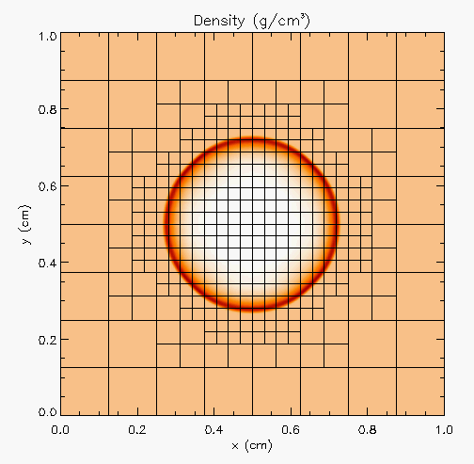
More Complex Application Design – Sedov Blast Wave
Description
High pressure at the center cause a shock to moves out in a circle. High resolution is needed only at and near the shock
Requirements
Adaptive mesh refinement
Easiest with finite volume methods
Driver
I/O
Initial condition
Boundary condition
Shock Hydrodynamics
Ideal gas equation of state
Method of verification

Slide 37
Deeper Dive into Requirements
Adaptive mesh refinement → divide domain into blocks
Blocks need halos to be filled with values from neighbors or boundary conditions
At fine-coarse boundaries there is interpolation and restriction
Blocks are dynamic, go in and out of existence
Conservation needs reconciliation at fine-coarse boundaries
Shock hydrodynamics
Solver for Euler’s equations at discontinuities
EOS provides closure
Riemann solver
Halo cells at fine-coarse boundaries need EOS after interpolation
Method of verification
An indirect way of checking – shock distance traveled can be computed analytically

Slide 38
Components
Deeper Dive into some Components
Driver
Iterate over blocks
Implement connectivity
Mesh
Data containers
Halo cell fill, including application of boundary conditions
Reconciliation of quantities at fine-coarse block boundaries
Remesh when refinement patterns change
I/O
Getting runtime parameters and possibly initial conditions
Writing checkpoint and analysis data
Binned Components
Unchanging or slow changing infrastructure
Mesh
I/O
Driver
Comparison utility
Components evolving with research – physics solvers
Initial and boundary conditions
Hydrodynamics
EOS

Slide 39
Connectivity
Initial conditions
Compare results
Mesh
Driver
I/O
Boundary conditions
Hydrodyn-amics
EOS

Slide 40
Connectivity
Initial conditions
Compare results
Mesh
Driver
I/O
Boundary conditions
Hydrodyn-amics
EOS

Slide 41
Connectivity
Initial conditions
Compare results
Mesh
Driver
I/O
Boundary conditions
Hydrodyn-amics
EOS

Slide 42
Connectivity
Initial conditions
Compare results
Mesh
Driver
I/O
Boundary conditions
Hydrodyn-amics
EOS

Slide 43
Connectivity
Initial conditions
Compare results
Mesh
Driver
I/O
Boundary conditions
Hydrodyn-amics
EOS

Slide 44
A Design Model for Separation of Concerns
Infrastructure
Capabilities
Requirements
Model
Software Architecture API Design
API
Implement
Design
Develop
Test
Validate
Maintain
Augment
Integrate

Slide 45
Exploring Design Space – Abstractions
Constraints
Only infrastructure components have global view
All physics solvers have block view only
Other Design Considerations
Data scoping
Interfaces in the API
Spatial
decomposition
domain sections
as stand-alone
computation unit
Real view : A
whole domain
with many
operators
base
abstraction
Functional
decomposition
collection of
components
Minimal Mesh API
Initialize_mesh
Halo_fill
Access_to_data_containers
Reconcile_fluxes
Regrid
Notes:
Example of changing the block size to adjust to the cache memory
And point-to-point Vs collectives depending upon the scale of the problem

Slide 46
Separation of Concerns Applied
Spatial
decomposition
domain sections
as stand-alone
computation unit
Parallelization
and scaling
optimization
Implemented by
domain experts
and applied
mathematicians
Implemented by
software and
performance
engineers
Real view : A
whole domain
with many
operators
Functional
decomposition
collection of
components
Memory
access and
compute
optimization
Notes:
Example of changing the block size to adjust to the cache memory
And point-to-point Vs collectives depending upon the scale of the problem

Slide 47
Takeaways so Far
Differentiate between slow changing and fast changing components of your code
Understand the requirements of your infrastructure
Implement separation of concerns
Design with portability, extensibility, reproducibility and maintainability in mind

Slide 48
Building a Test-suite
Elements of test development
For some tests assertions will suffice
For others you will need to compare the output against baselines
Building a comparison utility is extremely useful
Also useful to develop diagnostics – indirect ways of verifying behavior
Conservation of physical quantities
No non-physical values

Slide 49
Building a Test-suite
Elements of test development
For some tests assertions will suffice
For others you will need to compare the output against baselines
Building a comparison utility is extremely useful
Also useful to develop diagnostics – indirect ways of verifying behavior
Conservation of physical quantities
No non-physical values
Building baselines for comparison
From a known analytical solution
Manufacture a solution
Visualize and inspect output and anoint as baseline
Run a test case up to point A and drop a checkpoint. Run another test case up to a later point B.
Use point A to restart and B as the anointed baseline

Slide 50
Building a Test-suite
Elements of test development
For some tests assertions will suffice
For others you will need to compare the output against baselines
Building a comparison utility is extremely useful
Also useful to develop diagnostics – indirect ways of verifying behavior
Conservation of physical quantities
No non-physical values
Building baselines for comparison
From a known analytical solution
Manufacture a solution
Visualize and inspect output and anoint as baseline
Run a test case up to point A and drop a checkpoint. Run another test case up to a later point B.
Use point A to restart and B as the anointed baseline
Apply scaffolding for selection of tests … explained next

Slide 51
Example – Back to Sedov Blast
Components needed
Mesh
Hydrodynamics solver
Equation of state
Parallelization
Strategy for development
Think of an application with analytical solution
Notes:
Once those basic unit tests are done, we can create a unit test at the next level. Here, the Sedov blast wave is simulated using the cell grid and equation of state previously tested. The Sedov wave has a known analytical solution, which provides an error estimate for the implementation. Out-of-tolerance errors at this stage indicate a problem specific to hydrodynamics, since the cells and equation of state are already tested. In addition, plotting errors vs. space and time helps to train graduate students.

Slide 52
Example – Shock Hydrodynamics with Adaptive Mesh Refinement
Components needed
Mesh
Hydrodynamics solver
Equation of state
Parallelization
Sedov blast wave
High pressure at the center
Shock moves out in a circle
Analytical solution for how far the shock has travelled
Strategy for development
Think of an application with analytical solution

Slide 53
Step 1 – Equation of State
Initialize density and internal energy with known values
Compute pressure and temperature using EOS
Next use density and computed pressure as input and compute internal energy and temperature using EOS
Compare computed values against initialized values
Notes:
.

Slide 54
Step 1 – Equation of State
Initialize density and internal energy with known values
Compute pressure and temperature using EOS
Next use density and computed pressure as input and compute internal energy and temperature using EOS
Compare computed values against initialized values
We have a unit test
Notes:
.

Slide 55
Step 2 – Mesh
Start with uniform grid
Domain decomposition for parallelization
Halo fill operation
Initialize the interior (red) with a known function
Apply halo fill
Compute values for the halo using the known function
Compare against filled values
rank 1
rank 2
halo cells
Notes:
.

Slide 56
Step 2 – Mesh
Start with uniform grid
Domain decomposition for parallelization
Halo fill operation
Initialize the interior (red) with a known function
Apply halo fill
Compute values for the halo using the known function
Compare against filled values
rank 1
rank 2
halo cells
We have another unit test
Notes:
.

Slide 57
Step 3 – Hydrodynamics
Apply initial conditions to the mesh
zeroes everywhere except at the center
Write code for the analytical expression of the distance traveled by the shock
Do time integration
At time T compare evolved solution against analytical solution
If both mesh and EOS unit test pass, then any failure is in Hydrodynamics
This is a composite unit test
This is also the idea behind scaffolding
Notes:
.

Slide 58
Step 4 – AMR
The same halo fill unit test for mesh also works for AMR
Additional functionalities to test are:
Fine-coarse boundary resolution
Regridding
Steps in testing
Run Sedov with UG
Run Sedov with AMR, but no dynamic refinement
If failed fault is in flux correction
Run Sedov with AMR and dynamic refinement
If failed fault is in regridding

Slide 59
Step 4 – AMR
The same halo fill unit test for mesh also works for AMR
Additional functionalities to test are:
Fine-coarse boundary resolution
Regridding
Steps in testing
Run Sedov with UG
Run Sedov with AMR, but no dynamic refinement
If failed fault is in flux correction
Run Sedov with AMR and dynamic refinement
If failed fault is in regridding
We have continued to build scaffolding and are using granular testing to pinpoint the cause of error
Notes:
.

Slide 60
Step 4 – AMR
The same halo fill unit test for mesh also works for AMR
Additional functionalities to test are:
Fine-coarse boundary resolution
Regridding
Steps in testing
Run Sedov with UG
Run Sedov with AMR, but no dynamic refinement
If failed fault is in flux correction
Run Sedov with AMR and dynamic refinement
If failed fault is in regridding
We have continued to build scaffolding and are using granular testing to pinpoint the cause of error
All of these are examples of clear box testing
Notes:
.

Slide 61
Mixed Clear/Opaque Box Testing For a Legacy Code
There may not be existing tests
Isolate a small area of the code
Dump a useful state snapshot
Build a test driver
Start with only the files in the area
Link in dependencies
Copy if any customizations needed
Read in the state snapshot
Restart from the saved state
Verify correctness
Always inject errors to verify that the test is working
state
driver
Notes:
Here's an example from the E3SM code, the Exascale Earth System Model. Although advanced now, it originated in a combination of Fortran codes dealing with various aspects of climate modeling. The project came together from a collection of independent projects and development practices. They imposed structure on the code through the use of Fortran modules. However, the focus was on running whole models, so their architecture and testing strategies evolved to work with that goal. That led to an unforeseen difficulty. For several sections of the code, even the simplest modification would take running the entire model to test. This meant enqueuing the job in a batch queue that would take non-trivial amount of time to run. What was missing was granular testing. And it wasn’t easy to separate out code sections for testing independently because one Fortran module gets data from another, that in turn gets data from yet another and so on … This is an example of a methodology used to generate an independent test for a code section.
Review the dependencies. Here the model needs to be at a certain ”state” to invoke the target code.
Look for dependencies on Fortran data modules that are outside the sub-tree containing the source code for this section
For each of the data modules determine where the dependencies can be pruned.
d) Run the full model and capture the “state” just before the invocation of the target section.
e) Create a separate working directory for the test
f) In this working area create soft links to the files that have dependencies
g) Where the dependence is to be pruned create a copy of the corresponding file in the working area and modify it as needed.
e) Create a test driver to load the state and exercise the unit.
d) If extra functions from the code were accessed, these were sym-linked into the test directory. Here, the branch at the right represents some helper functions that can be imported easily.
e) That doesn't always work. The red dot represents a module with lots of dependencies - not needed for this test. In these cases, the module was modified to remove unnecessary dependencies.
f) With all the code dependencies sorted out, the test driver itself becomes an isolated unit. For this example, the original test took hours to run through the batch queue of a cluster. The new unit test ran in 20 seconds on a developer's laptop.

Slide 62
New Paradigm in Design Because of Platform Heterogeneity
More Scientific Understanding
Heterogeneous
models
More Hardware
Resources
Higher Fidelity
Model
Software complexity
Distributed
memory
model
More Diverse
Solvers
Platform complexity

Slide 63
State of Practice – Abstractions and Runtimes
Still very focused on GPU
Majority of ECP applications park their data on the GPU and just work there
Abstractions -- data structures and parallelization of loops
Limitations
No way to handle algorithmic variants in a unified way
No way to transfer domain knowledge based possible optimizations to the tools
None of the prevalent languages allow a good way to define data locality
Boutique HPC languages like chapel do – but chicken and egg problem with adoption

Slide 64
State of Practice – Abstractions and Runtimes
Still very focused on GPU
Majority of ECP applications park their data on the GPU and just work there
Abstractions -- data structures and parallelization of loops
Limitations
No way to handle algorithmic variants in a unified way
No way to transfer domain knowledge based possible optimizations to the tools
None of the prevalent languages allow a good way to define data locality
Boutique HPC languages like chapel do – but chicken and egg problem with adoption
The holy grail for scientists – write equation and generate code
Very limited success in some domains
Is there another way?

Slide 65
Mechanisms Needed by the Code
Mechanisms to unify expression of computation
Minimize maintained variants of source suitable for all computational devices
Reconcile differences in data structures
Notes:
Various forms :: CUDE, HIP, OpenACC, OpenMP, OneAPI, SYCL etc etc

Slide 66
Mechanisms Needed by the Code
Mechanisms to unify expression of computation
Minimize maintained variants of source suitable for all computational devices
Reconcile differences in data structures
Mechanisms to move work and data to computational targets
Moving between devices
Launching work at the destination
Hiding latency of movement
Moving data off node

Slide 67
Mechanisms Needed by the Code
Mechanisms to unify expression of computation
Minimize maintained variants of source suitable for all computational devices
Reconcile differences in data structures
Mechanisms to move work and data to computational targets
Moving between devices
Launching work at the destination
Hiding latency of movement
Moving data off node
Mechanisms to map work to computational targets
Figuring out the map
Expression of dependencies
Cost models
Expressing the map

Slide 68
Mechanisms Needed by the Code
Mechanisms to unify expression of computation
Minimize maintained variants of source suitable for all computational devices
Reconcile differences in data structures
Mechanisms to move work and data to computational targets
Moving between devices
Launching work at the destination
Hiding latency of movement
Moving data off node
So, what do we need?
Abstractions layers
Code transformation tools
Data movement orchestrators
Mechanisms to map work to computational targets
Figuring out the map
Expression of dependencies
Cost models
Expressing the map

Slide 69
Underlying Ideas: Unification of Computational Expressions
Make the same code work on different devices
Same algorithm different data layouts or operation sequence:
A way to let compiler know that ”this” expression can be specialized in many ways
Definition of specializations
Often done with template meta-programming
More challenging if algorithms need to be fundamentally different
Support for alternatives

Slide 70
Underlying Ideas: Moving Work and Data to the Target
Parallelization Models
Hierarchy in domain decomposition
Distributed memory model at node level – still very prevalent, likely to remain so for a while
Also done with PGAS models – shared with locality being important
Assigning work within the node
“Parallel For” or directives with unified memory
Directives or specific programming model for explicit data movement
More complex data orchestration system for asynchronous computation
Task based work distribution
Notes:
most accelerator systems these days have mechanisms for sharing (reading/writing) memory between host and device. Easy, but generally not the most performant approach
confounding differences between systems with regard to how well that sharing is supported.
Task based examples – Legion, PaRSEC, HPX, StarPU, Charm++

Slide 71
Underlying Ideas: Mapping Work to Targets
This is how many abstraction layers work
Infer the structure of the code
Infer the map between algorithms and devices
Infer the data movements
Map computations to devices
These are specified either through constructs or pragmas
It can also be the end user who figures out the mapping
In either case performance depends upon how well the mapping is done
.

Slide 72
State of Practice – Abstractions and Runtimes
Still very focused on GPU
Majority of ECP applications park their data on the GPU and just work there
Abstractions -- data structures and parallelization of loops
Limitations
No way to handle algorithmic variants in a unified way
No way to transfer domain knowledge based possible optimizations to the tools
None of the prevalent languages allow a good way to define data locality
Boutique HPC languages like chapel do – but chicken and egg problem with adoption
We have been developing one for Flash-X – started under ECP and TEAMS, continuing with RAPIDS and ENAF
The holy grail for scientists – write equation and generate code
Very limited success in some domains
Is there another way?

Slide 73
Mechanisms Needed by the Code: Example Flash-X
Mechanisms to unify expression of computation
Macros with inheritance
Mechanisms to move work and data to computational targets
Domain specific runtime
Mechanisms to map work to computational targets
DSL for recipes with code generator
Composability in the source
A toolset of each mechanism
Independent tool sets

Slide 74
Mechanisms Needed by the Code
Mechanisms to unify expression of computation
Minimize maintained variants of source suitable for all computational devices
Reconcile differences in data structures
Express code with embedded macros
Let macros have multiple alternative definitions
Implement mechanism to select specific macro definition
Implement mechanism to safely include more than one definition
Allow inline, recursion and arguments in macros

Slide 75
Code Expressed with macros
@M declare
@M directive1
@M loop_2d
…. computation 1
…. computation 2
@M endloop_2d_spl
@M directive2
@M loop_2d_spl
…. computation 3
@M endloop_2d
Common definitions
[loop_2d] [endloop_2d]
definition= definition=
do j=1,n end do
do i=1,m end do
cpu-specific declaration
!!omp directive for CPU
do j=1,n
do i=1,m
…. computation 1
…. computation 2
…. computation 3
end do
end do
CPU specific definitions
Macro-processor
Definitions for GPU
[declare]
definition=
gpu-specific declarations
[directive1]
definition=
!!omp directive1 for gpu
[endloop_2d_spl]
definition=
@M endloop_2d
[directive2]
definition=
!!omp directive2 for gpu
[loop_2d_spl]
definition=
@M loop_2d
Common definitions
gpu-specific declarations
!!omp directive1 for GPU
do j=1,n
do i=1,m
…. computation 1
…. computation 2
end do
end do
!!omp directive2 for GPU
do j=1,n
do i=1,m
…. computation 3
end do
end do
Definitions for CPU
[declare]
definition=
cpu-specific declarations
[directive1]
definition=
!!omp directive for cpu
[endloop_2d_spl]
definition=
[directive2]
definition=
[loop_2d_spl]
definition=
GPU specific definitions
Macro-processor

Slide 76
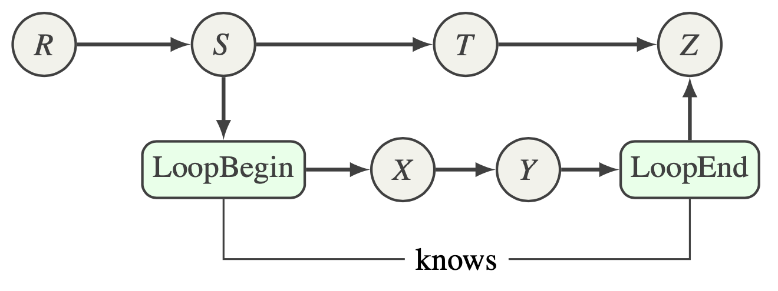
Mechanisms Needed by the Code
Mechanisms to map work to computational targets
Figuring out the map
Expression of dependencies
Cost models
Expressing the map
CG-Kit generates Control Flow Graph by reading user input (recipe).
Represented as a directed acyclic graph (DAG)
Each node represents user-defined code generation operations.
PST
Each edge describes dependencies between nodes.

Slide 77
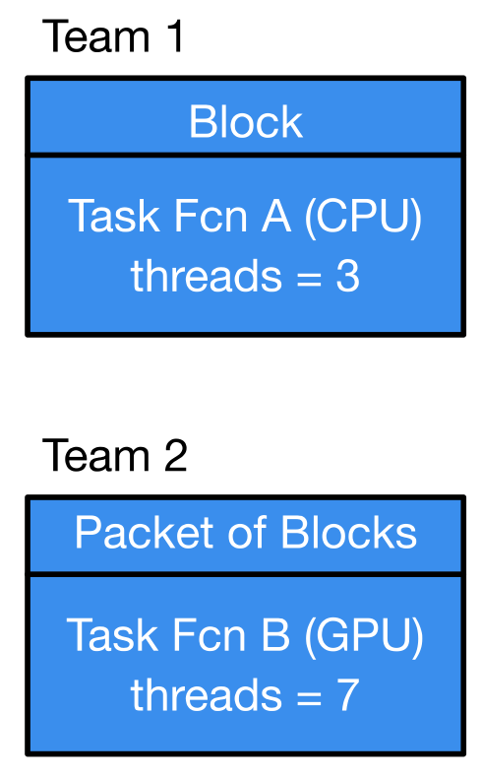
Mechanisms Needed by the Code
Mechanisms to move work and data to computational targets
Moving between devices
Launching work at the destination
Hiding latency of movement
Moving data off-node
Milhoja: A Domain Specific Runtime
Capitalizes on the control flow remaining the same from one timestep to next – static analysis during application configuration
Distributors
Use block iterator
Aggregate blocks if necessary
Initiate asynchronous transfers if necessary
Push blocks to other elements
Computation to apply to each data item
Data type
Number of threads in team activated to apply action to data items

Slide 78
Orchestration of Data and Computation
ConcurrentDataBegin
ConcurrentDataEnd
Task Fcn A (CPU)
Task Fcn C (CPU)
R
S
Distributor
CPU
CPU
T
Z
Task Fcn B (GPU)
Data Packet
DM/Unpack
X
Y

Slide 79
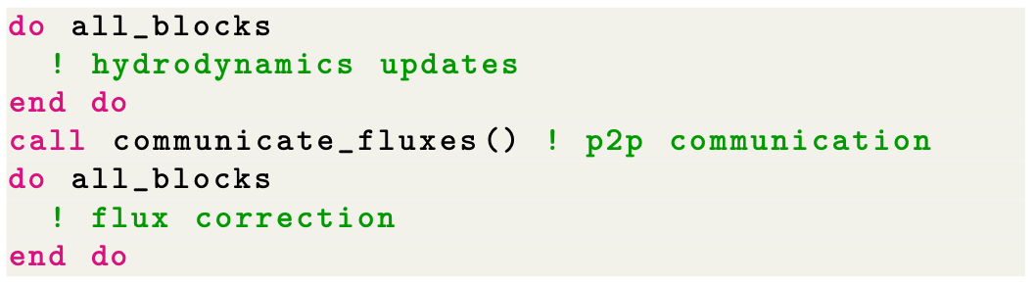
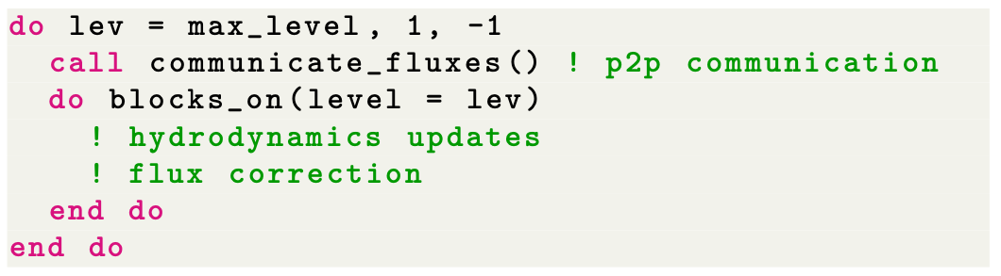
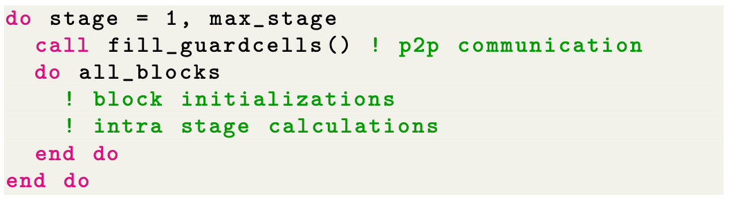
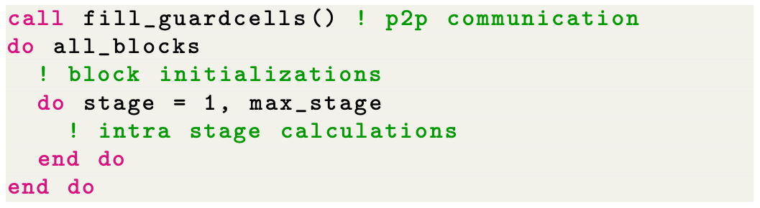
Orthogonal Axes of Challenges and Optimization
Have a method for expressing algorithmic variants
Without delving into the details of the arithmetic
Example -- Flash-X supports two block-structured AMR grid backends
Paramesh: Octree-based, AMReX: Level-based
Each has different preferences for flux correction at fine-coarse boundaries
For higher order RK integration Communication avoidance – telescoping mode

Slide 80
Final Takeaways
Requirements gathering and intentional design are indispensable for sustainable software development
Many books and online resources available for good design principles
Research software poses additional constraints on design and verification because of its exploratory nature
Scientific research software has further challenges
High performance computing research software has even more challenges
That are further exacerbated by the ubiquity of accelerators in platforms
Separation of concerns at various granularities, and abstractions enable sustainable software design and enable verification
Using good software engineering enables relying on LLM for automating aspects of coding.

