Slide 1
Motivation and Overview of Best Practices in HPC Software Development
David E. Bernholdt
(he/him)
Oak Ridge National Laboratory
Software Sustainability track @ Argonne Training Program on Extreme-Scale Computing summer school
Contributors: David E. Bernholdt (ORNL), Anshu Dubey (ANL), Patricia A. Grubel (LANL), Rinku K. Gupta (ANL), Katherine M. Riley (ANL), David M. Rogers (ORNL), Gregory R. Watson (ORNL)

Slide 2
License, Citation and Acknowledgements
License and Citation
This work is licensed under a Creative Commons Attribution 4.0 International License (CC BY 4.0).
The requested citation the overall tutorial is: David E. Bernholdt, Software Sustainability track, in Argonne Training Program on Extreme-Scale Computing, St. Charles, Illinois, 2026. DOI: 10.6084/m9.figshare.33139910.
Individual modules may be cited as Speaker, Module Title, in Tutorial Title, …
Acknowledgements
This work was supported by the U.S. Department of Energy, Office of Science, Office of Advanced Scientific Computing Research, Next-Generation Scientific Software Technologies (NGSST) and Scientific Discovery through Advanced Computing (SciDAC) programs.
This work was supported by the U.S. Department of Energy Office of Science, Office of Advanced Scientific Computing Research (ASCR), and by the Exascale Computing Project (17-SC-20-SC), a collaborative effort of the U.S. Department of Energy Office of Science and the National Nuclear Security Administration.
This work was performed in part at the Argonne National Laboratory, which is managed by UChicago Argonne, LLC for the U.S. Department of Energy under Contract No. DE-AC02-06CH11357.
This work was performed in part at the Lawrence Livermore National Laboratory, which is managed by Lawrence Livermore National Security, LLC for the U.S. Department of Energy under Contract No. DE-AC52-07NA27344.
This work was performed in part at the Los Alamos National Laboratory, which is managed by Triad National Security, LLC for the U.S. Department of Energy under Contract No.89233218CNA000001
This work was performed in part at the Oak Ridge National Laboratory, which is managed by UT-Battelle, LLC for the U.S. Department of Energy under Contract No. DE-AC05-00OR22725.
This work was performed in part at Sandia National Laboratories. Sandia National Laboratories is a multi-mission laboratory managed and operated by National Technology and Engineering Solutions of Sandia, LLC., a wholly owned subsidiary of Honeywell International, Inc., for the U.S. Department of Energy’s National Nuclear Security Administration under contract DE-NA0003525.

Slide 3
Science through computing is, at best, as credible as the software that produces it!
Notes:
Fundamental message

Slide 4
The Success of Computational Science Creates the Challenges of Computational Science
Better Scientific Understanding
Positive feedback loop
More complex codes, simulations and analysis
More moving parts that need to interoperate
Variety of expertise needed – the only tractable development model is through separation of concerns
It is more difficult to work on the same software in different roles without a software engineering process
Onset of higher platform heterogeneity
Requirements are unfolding, not known a priori
The only safeguard is investing in flexible design and robust software engineering process
More Hardware
Resources
Higher Fidelity
Model
More Diverse
Solvers
Supercomputers change fast
Especially now!
Notes:
Numerical models

Slide 5
Challenges Developing Scientific Applications Today
Technical
Sociological
All parts of the model and software system can be under research
Requirements change throughout the lifecycle as knowledge grows
Verification complicated by floating point representation
Real world is messy, so is the software
Increasing architectural diversity
Competing priorities and incentives
Sponsors often care more about scientific publications than software per se
Balancing development and maintenance with research
Limited resources
Need for interdisciplinary interactions
Many different kinds of expertise required to be successful

Slide 6
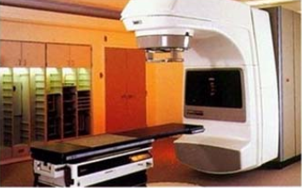
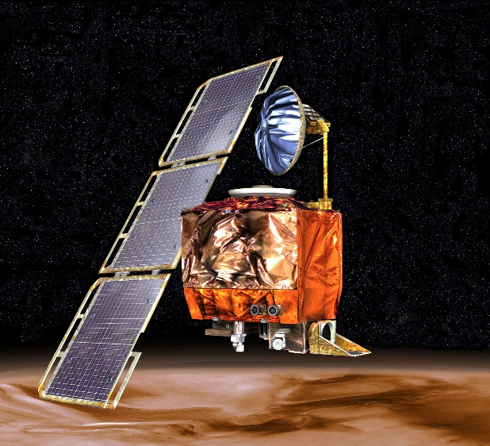
High-Consequence Software-Related Scientific Failures
Therac-25 (1985-1987)
Mars Climate Orbiter (1999)
Computer-controlled radiation therapy system
Poor software design, development and testing practices allowed flaws that let to at least six cases of substantial radiation overdoses, three fatal
Incorrect trajectory adjustment caused loss of the orbiter as it was supposed to enter Martian orbit
Discrepancy in the units used in two different software components
One component didn’t follow specifications
Inadequate testing at the interface
Concerns raised earlier in the mission were ignored because they weren’t properly documented
Just two of many examples

Slide 7
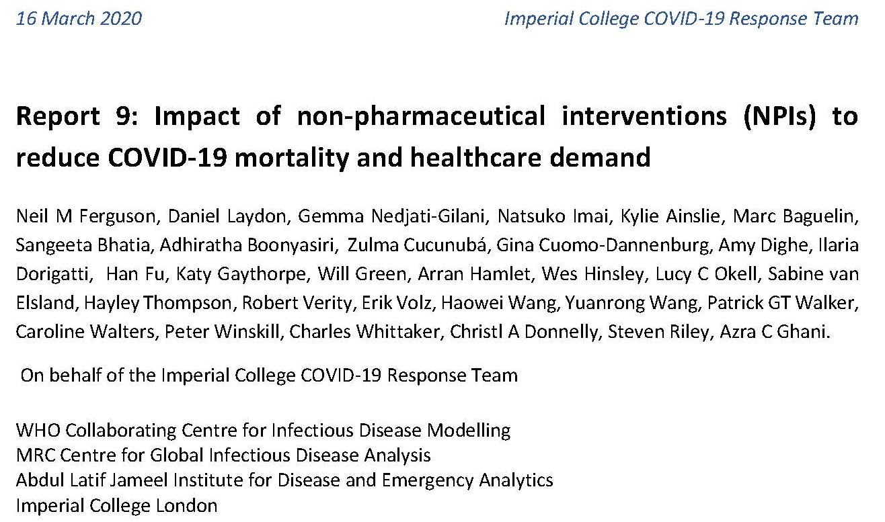
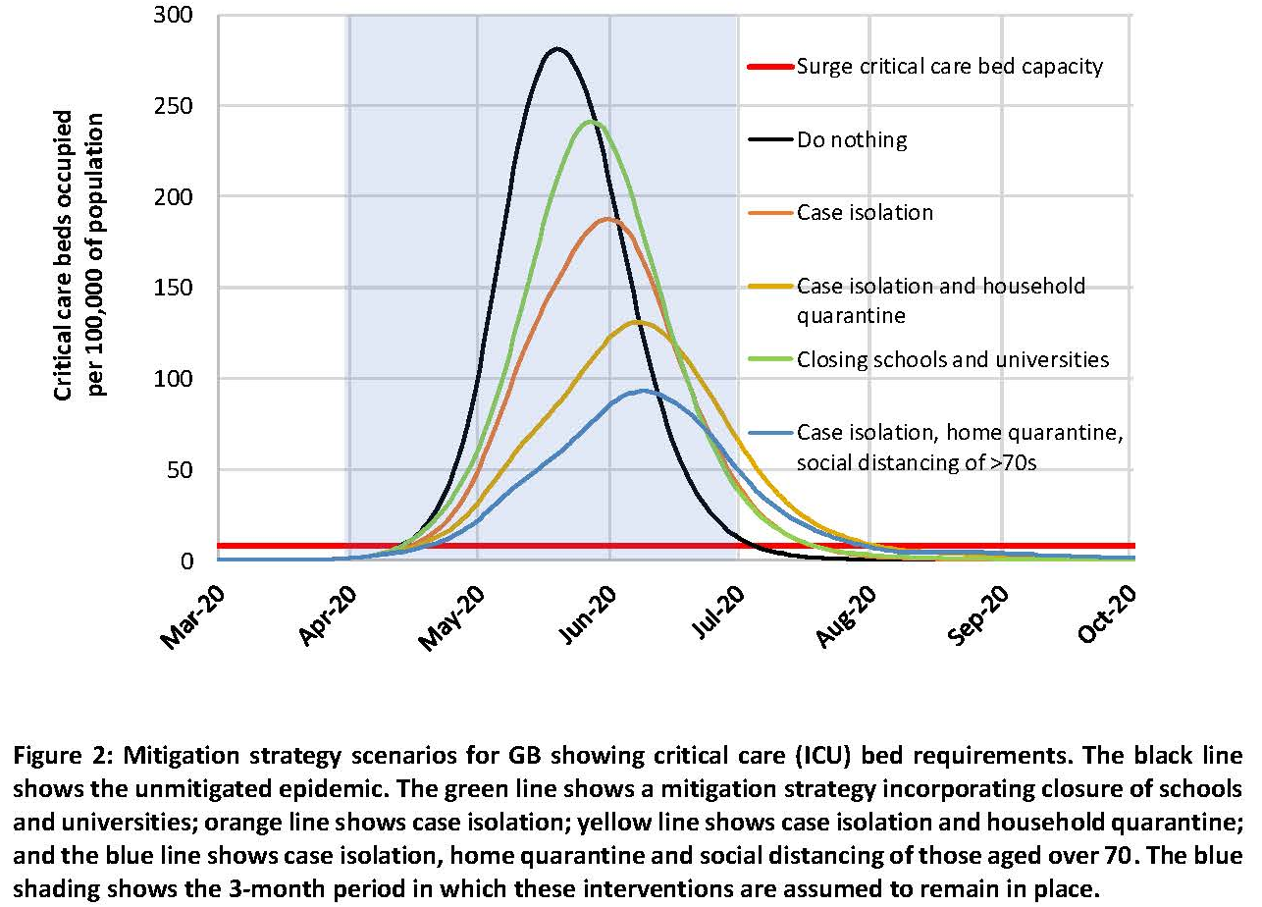
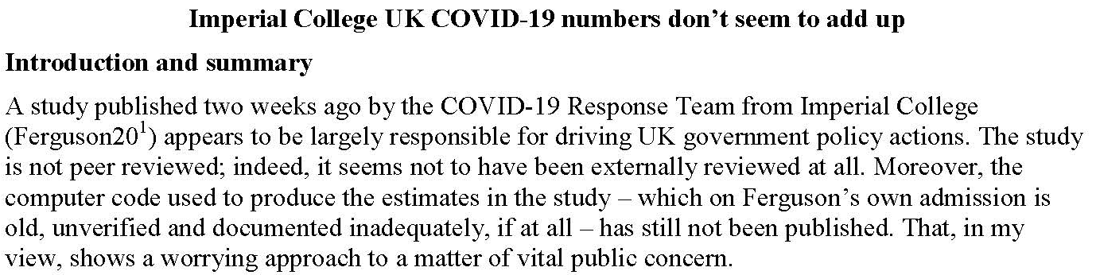
Software Under the Microscope
Mar. 16 2020: Epidemiologist Neil Ferguson (Imperial College) briefed UK Parliament on computational modeling of COVID-19 pandemic
Epidemiological models like this helped prompt government action, but have lots of assumptions
April 1 2020: Nicholas Lewis (independent climate science researcher in UK) can’t easily see where some of the assumptions come from – publishes a blog article
“Moreover, the computer code… is old, unverified, and documented inadequately, if at all…”
https://doi.org/10.25561/77482
https://www.nicholaslewis.org/imperial-college-uk-covid-19-numbers-dont-seem-to-add-up/
https://www.nature.com/articles/d41586-020-01003-6

Slide 8
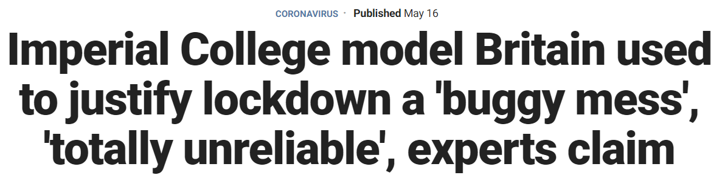
The Press Picks Up the Story
Headline and quotes from the Fox News article
“In our commercial reality, we would fire anyone for developing code like this and any business that relied on it to produce software for sale would likely go bust,” David Richards, co-founder of British data technology company WANdisco, told the Daily Telegraph.
Scientists from the University of Edinburgh have further claimed that it is impossible to reproduce the same results from the same data using the model. The team got different results when they used different machines, and even different results from the same machines.
“There appears to be a bug in either the creation or re-use of the network file. If we attempt two completely identical runs, only varying in that the second should use the network file produced by the first, the results are quite different,” the Edinburgh researchers wrote on the Github file.
A fix was provided, but it was the first of many bugs found within the program.
“Models must be capable of passing the basic scientific test of producing the same results given the same initial set of parameters…otherwise, there is simply no way of knowing whether they will be reliable,” said Michael Bonsall, Professor of Mathematical Biology at Oxford University.
https://www.foxnews.com/world/imperial-college-britain-coronavirus-lockdown-buggy-mess-unreliable
https://www.telegraph.co.uk/technology/2020/05/16/coding-led-lockdown-totally-unreliable-buggy-mess-say-experts/

Slide 9
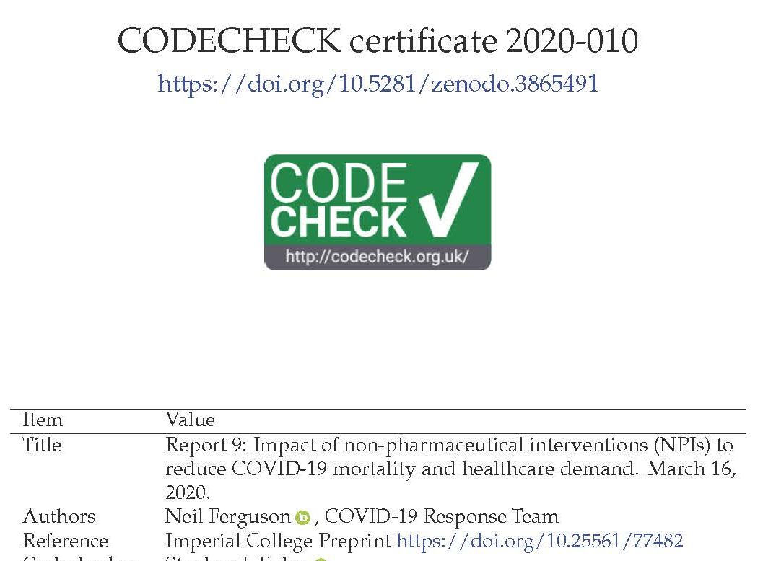
What you May Not Have Heard
Many scientists write code that is crappy stylistically, but which is nevertheless scientifically correct (following rigorous checking/validation of outputs etc). Professional commercial software developers are well-qualified to review code style, but most don’t have a clue about checking scientific validity or what counts as good scientific practice. Criticisms of the Imperial Covid-Sim model from some of the latter are overstated at best.
April 22 2020: Imperial collaborates with Microsoft to refactor and clean up the code, which is released on GitHub
May 10 2020: Phil Bull rebuts criticisms of the Imperial code
Which spurs further discussions within some groups focused on scientific software
May 29 2020: CODECHECK independently reproduces results of Imperial’s Report 9
https://github.com/mrc-ide/covid-sim/
https://philbull.wordpress.com/2020/05/10/why-you-can-ignore-reviews-of-scientific-code-by-commercial-software-developers/amp/
http://doi.org/10.5281/zenodo.3865491

Slide 10
Some Observations
Your code is likely to live longer than you expect … and may be used in ways you don’t expect … by people you don’t know … Plan for it!
Increasingly, consequential decisions are made based on computational results
The codes generating those results may (justifiably) be subject to greater scrutiny
The scientific credibility of software is strongly connected to good software engineering practices
Documentation
Testing, verification, and (where possible) validation
Code readability and quality metrics
Question: Should we excuse scientific software for being “crappy stylistically”?
Hint: crappy code can hide bugs

Slide 11
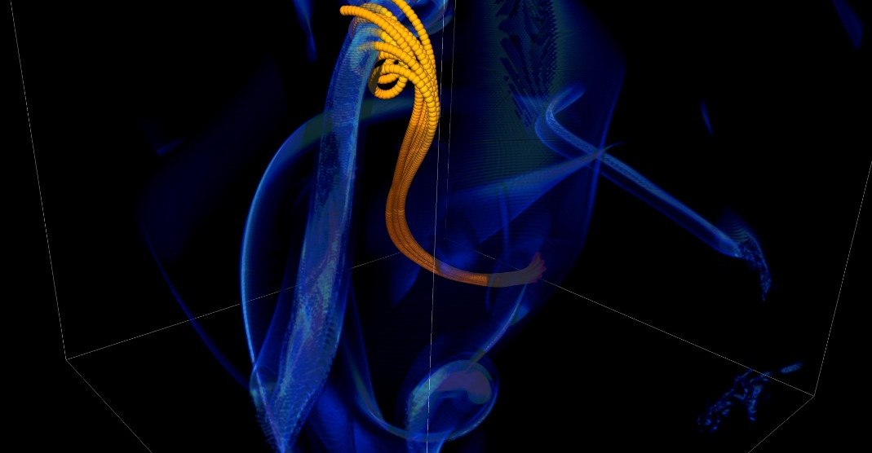
More Subtle Impacts on Scientific Productivity
In 2005, the FLASH astrophysics team was offered a unique opportunity to access one of the biggest machines in the world at that time (BG/L) for a dedicated run
Short notice to prepare
< 1 month to get ready for 1.5 week run
Quick and dirty development of particle capability in code
Error in tracking particles resulted in duplicated tags from round-off
Had to develop post-processing tools to correctly identify trajectories
6 months to process results
FLASH had a software process in place. It was tested regularly. This was one instance when the full process could not be applied because of time constraints.
Notes:
2005, BG/L
This was not even a situation like retracting results

Slide 12
Technical Debt
The implied cost of additional rework caused by choosing an easy (limited) solution now instead of using a better approach that would take longer.
-- Wikipedia
Like monetary debt, the more you accumulate, the harder it is to pay off
Increases cost of maintenance
Parts of software may become unusable over time
Inadequately verified software produces questionable results
Increases ramp-up time for new developers
Overall, reduces software and science productivity

Slide 13
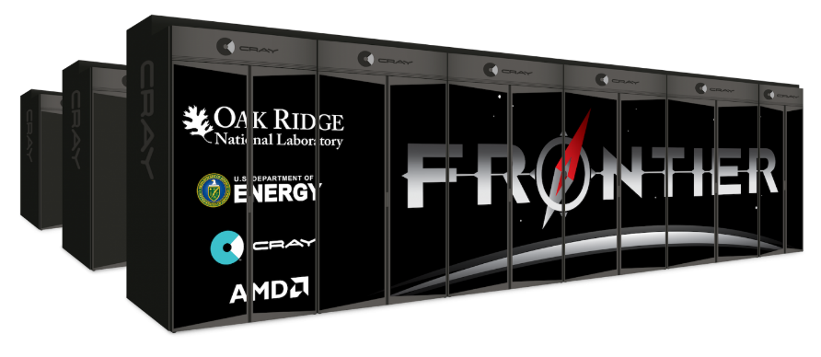
Scientific Facilities Provide Valuable Resources
Major supercomputers often cost O($100M)
All cost millions more to operate, annually
Significant allocations on large supercomputers can be worth millions
Even if you don’t pay the $ you have to spend the time and effort to get the allocation
Alternative scenario: someone else is using an experimental user facility, being guided by your simulations
Sponsors’ concern: Are you being a good steward of the resources?
Your concern: Are you getting the most science possible out of your work (aka scientific productivity)?

Slide 14
Good scientific process requires good software practices
Good software practices increase software sustainability
Good software practices increase scientific productivity
Software sustainability
increases scientific productivity

Slide 15
So, What Are Good Software Practices?
There is no fixed, universally agreed set of best practices for scientific software
Specifics of what’s appropriate will depend on the software, how it is used, and the team
Let’s look at a few recommendations from different perspectives…

Slide 16
Example 1: Best Practices for Scientific Computing (1/2)
Wilson, et al., (2014) https://doi.org/10.1371/journal.pbio.1001745
Write programs for people, not computers.
A program should not require its readers to hold more than a handful of facts in memory at once.
Make names consistent, distinctive, and meaningful.
Make code style and formatting consistent.
Let the computer do the work.
Make the computer repeat tasks.
Save recent commands in a file for re-use.
Use a build tool to automate workflows.
Make incremental changes.
Work in small steps with frequent feedback and course correction.
Use a version control system.
Put everything that has been created manually in version control.
Don't repeat yourself (or others).
Every piece of data must have a single authoritative representation in the system.
Modularize code rather than copying and pasting.
Re-use code instead of rewriting it.
Plan for mistakes.
Add assertions to programs to check their operation.
Use an off-the-shelf unit testing library.
Turn bugs into test cases.
Use a symbolic debugger.

Slide 17
Example 1: Best Practices for Scientific Computing (2/2)
Wilson, et al., (2014) https://doi.org/10.1371/journal.pbio.1001745
Optimize software only after it works correctly.
Use a profiler to identify bottlenecks.
Write code in the highest-level language possible.
Document design and purpose, not mechanics.
Document interfaces and reasons, not implementations.
Refactor code in preference to explaining how it works.
Embed the documentation for a piece of software in that software.
Collaborate.
Use pre-merge code reviews.
Use pair programming when bringing someone new up to speed and when tackling particularly tricky problems.
Use an issue tracking tool.

Slide 18
Example 2: Good Enough Practices in Scientific Computing (1/2)
Wilson, et al., (2017) https://doi.org/10.1371/journal.pcbi.1005510
Data management
Save the raw data.
Ensure that raw data are backed up in more than one location.
Create the data you wish to see in the world.
Create analysis-friendly data.
Record all the steps used to process data.
Anticipate the need to use multiple tables, and use a unique identifier for every record.
Submit data to a reputable DOI-issuing repository so that others can access and cite it.
Manuscripts (out of order to save space)
Write manuscripts using online tools with rich formatting, change tracking, and reference management.
Write the manuscript in a plain text format that permits version control.
Software
Place a brief explanatory comment at the start of every program.
Decompose programs into functions.
Be ruthless about eliminating duplication.
Always search for well-maintained software libraries that do what you need.
Test libraries before relying on them.
Give functions and variables meaningful names.
Make dependencies and requirements explicit.
Do not comment and uncomment sections of code to control a program's behavior.
Provide a simple example or test data set.
Submit code to a reputable DOI-issuing repository.

Slide 19
Example 2: Good Enough Practices in Scientific Computing (2/2)
Wilson, et al., (2017) https://doi.org/10.1371/journal.pcbi.1005510
Collaboration
Create an overview of your project.
Create a shared "to-do" list for the project.
Decide on communication strategies.
Make the license explicit.
Make the project citable.
Project organization
Put each project in its own directory, which is named after the project.
Put text documents associated with the project in the doc directory.
Put raw data and metadata in a data directory and files generated during cleanup and analysis in a results directory.
Put project source code in the src directory.
Put external scripts or compiled programs in the bin directory.
Name all files to reflect their content or function.
Keeping track of changes
Back up (almost) everything created by a human being as soon as it is created.
Keep changes small.
Share changes frequently.
Create, maintain, and use a checklist for saving and sharing changes to the project.
Store each project in a folder that is mirrored off the researcher's working machine.
Add a file called CHANGELOG.txt to the project's docs subfolder.
Copy the entire project whenever a significant change has been made.
Use a version control system.

Slide 20
Example 3: OpenSSF Best Practices Badge Program
https://www.bestpractices.dev/en
Not specifically intended for scientific software
OpenSSF = Open Source Security Foundation
Three levels
Passing focuses on best practices that well-run FLOSS projects typically already follow. Getting the passing badge is an achievement; at any one time only about 10% of projects pursuing a badge achieve the passing level.
Silver is a more stringent set of criteria than passing but is expected to be achievable by small and single-organization projects.
Gold is even more stringent than silver and includes criteria that are not achievable by small or single-organization projects.
Combination of MUST and SHOULD criteria

Slide 21
OpenSSF Best Practices Criteria Summary
Basics
Basic project website content (P, S)
FLOSS license (P)
Documentation (P, S)
Project oversight (S, G)
Accessibility and internationalization (S)
Change control
Public version controlled source repo. (P, G)
Unique version numbering (P)
Release notes (P)
Previous versions (S)
Reporting
Bug-reporting process (P, S)
Vulnerability reporting process (P, S)
Quality
Working build system (P, S, G)
Automated test suite (P, S, G)
New functionality testing (P, S)
Warning flags (P, S)
Coding standards (S, G)
Installation system (S)
Externally-maintained components (S)
Security
Secure development knowledge (P, S)
Use basic good crypto. practices (P, S, G)
Secured delivery against MITM attacks (P, G)
Publicly known vulnerabilities fixed (P)
Secure release (S)
Analysis
Static code analysis (P, S)
Dynamic code analysis (P, S, G)
(P, S, G) denotes additional criteria required at passing, silver, or gold certification levels
Each topic area listed will have one or more specific criteria

Slide 22
Example 4: Good Practices for High-Quality Scientific Computing
Anshu Dubey (2022) https://doi.org/10.1109/MCSE.2023.3259259
Good Practices for Software Development
Good Practices for Using Software
Invest in design
Create the framework into which all of the capabilities you need will fit naturally
Invest in development of tests and automated testing
How can you convince yourself that the code is correct…after every change?
Capture and summarize the thought process
Document the reasoning behind the design and other choices
Use optimal rigor in your software process
Too little can compromise code quality
Too much can reduce developer productivity
Pick and choose from software engineering research
Often requires adaptation for scientific software
Understand the capabilities and limitations
Is your science case breaking assumptions built into the code?
How would you know?
Know the parameters
Are you using the knobs correctly?
Practice rigorous verification and validation for each new science use
New science cases push your code in new ways
Develop a methodology for capturing, analyzing, and archiving results
Fork code for science use
Separate new development from supporting the science runs
We’ll expand on some of these points in the coming slides…
We’ll return to some of these points in the module on reproducibility…

Slide 23
Software Engineering Advice Often Needs Adaptation for Scientific Software
The OpenSSF Best Practices are a good example of software engineering advice “in the wild”
Experiences reported in the wild often don’t consider the special nature of scientific software
But that doesn’t mean we should ignore software engineering research experience
Many useful concepts, approaches, and tools we can just adopt
Some approaches may need to be adapted to work for scientific software
Find out how colleagues have addressed the challenges you’re facing
Probably you will find multiple ways
In the end, some approaches may not work well
Don’t be afraid to experiment with adaptations
Consider using the PSIP process (coming up)

Slide 24
How Much (Time, Effort) Should I Spend on Software Engineering?
Your project should include “just enough” software engineering so that you can meet your short-term and longer-term scientific goals effectively
Take a graduated approach
Early on, maybe your project is exploratory and you’re the only user (and developer), basic practices may suffice
As the project gains developers and/or users, give more thought to software engineering and adjust practices
As the science being done with the code gains greater visibility, give more thought to software engineering and adjust practices
If you anticipate the software being used to make consequential decisions, probably better to consider “more” software engineering from the start
Make a practice of re-evaluating your software engineering needs on a regular basis
Changes may creep up on you without you noticing
Consider putting an annual reminder on your calendar (seriously!)
Plus, whenever significant changes take place

Slide 25

Continual, Incremental Software Process Improvement
Target: your project should include “just enough” software engineering so that you can meet your short-term and longer-term scientific goals effectively
Identify your team’s “pain points” in your software development processes
Help: RateYourProject assessment tool: https://rateyourproject.org/
Set a goal for something to improve
Target processes and behaviors, not just tasks
Pick something that you can address in a few months that will give you a noticeable benefit
Agree on a plan to address it, identify markers of progress and what is “done”
Write them down
Help: Progress tracking card examples: https://bssw-psip.github.io/ptc-catalog/catalog
Work your plan, track your progress
When you are done, celebrate…
…then pick a new pain point to address
Old Process
New Process
Cost
Start
Progress
Finish
The new process costs something to implement, but it pays off over time
Productivity and Sustainability Improvement Planning https://bssw.io/psip
A goal of BSSw.io is to provide resources for improving your software processes. If you find useful resources that aren’t on BSSw.io, consider contributing. Its easy and quick.

Slide 26
About Today’s Tutorial
There are many useful topics that could help you improve your scientific software development process
We’re going to focus on a few topics where the software engineering advice in the wild typically doesn’t address scientific software
Designing software for flexibility and extensibility
Testing strategies for complex high-performance computing software
Refactoring scientific software
Reproducibility
Use of LLMs in scientific software coding tasks

