Slide 1
Refactoring Scientific Software
David E. Bernholdt
(he/him)
Oak Ridge National Laboratory
Software Sustainability track @ Argonne Training Program on Extreme-Scale Computing summer school
Contributors: David E. Bernholdt (ORNL), Anshu Dubey (ANL), Jared O’Neal

Slide 2
License, Citation and Acknowledgements
License and Citation
This work is licensed under a Creative Commons Attribution 4.0 International License (CC BY 4.0).
The requested citation the overall tutorial is: David E. Bernholdt, Software Sustainability track, in Argonne Training Program on Extreme-Scale Computing, St. Charles, Illinois, 2026. DOI: 10.6084/m9.figshare.33139910.
Individual modules may be cited as Speaker, Module Title, in Tutorial Title, …
Acknowledgements
This work was supported by the U.S. Department of Energy, Office of Science, Office of Advanced Scientific Computing Research, Next-Generation Scientific Software Technologies (NGSST) and Scientific Discovery through Advanced Computing (SciDAC) programs.
This work was supported by the U.S. Department of Energy Office of Science, Office of Advanced Scientific Computing Research (ASCR), and by the Exascale Computing Project (17-SC-20-SC), a collaborative effort of the U.S. Department of Energy Office of Science and the National Nuclear Security Administration.
This work was performed in part at the Argonne National Laboratory, which is managed by UChicago Argonne, LLC for the U.S. Department of Energy under Contract No. DE-AC02-06CH11357.
This work was performed in part at the Lawrence Livermore National Laboratory, which is managed by Lawrence Livermore National Security, LLC for the U.S. Department of Energy under Contract No. DE-AC52-07NA27344.
This work was performed in part at the Los Alamos National Laboratory, which is managed by Triad National Security, LLC for the U.S. Department of Energy under Contract No.89233218CNA000001
This work was performed in part at the Oak Ridge National Laboratory, which is managed by UT-Battelle, LLC for the U.S. Department of Energy under Contract No. DE-AC05-00OR22725.
This work was performed in part at Sandia National Laboratories. Sandia National Laboratories is a multi-mission laboratory managed and operated by National Technology and Engineering Solutions of Sandia, LLC., a wholly owned subsidiary of Honeywell International, Inc., for the U.S. Department of Energy’s National Nuclear Security Administration under contract DE-NA0003525.

Slide 3
What is Refactoring
Definition: Refactoring is a disciplined technique for restructuring an existing body of code, altering its internal structure without changing its external behavior.
Different from development
You have a working code
You know and understand the behavior
You have a baseline that you can use for comparison

Slide 4
What is Refactoring
General motivations
Modularity enhancement
Improve sustainability
Release to outside users
Easier to use and understand
Port to new platforms
Performance portability
Expand capabilities
Structural flexibility
Definition: Refactoring is a disciplined technique for restructuring an existing body of code, altering its internal structure without changing its external behavior.
Different from development
You have a working code
You know and understand the behavior
You have a baseline that you can use for comparison

Slide 5
An Example Workflow
START
FIX
NO
REFACTOR
REGRESSION/UNIT TEST
PASS
YES
Notes:
Tests written before refactoring encapsulate and enforce a contract made at design time. Having them available easily allows us to maintain that any small change does not alter behavior of code being refactored.
Fowler (1999) via Code Complete:
Refactoring is “a change made to the internal structure of the software to make it easier to understand and cheaper to modify without changing its behavior”.

Slide 6
An Example Workflow
START
FIX
NO
YES
REFACTOR
REGRESSION/UNIT TEST
PASS
DONE
YES
NO
Notes:
Tests written before refactoring encapsulate and enforce a contract made at design time. Having them available easily allows us to maintain that any small change does not alter behavior of code being refactored.
Fowler (1999) via Code Complete:
Refactoring is “a change made to the internal structure of the software to make it easier to understand and cheaper to modify without changing its behavior”.

Slide 7
An Example Workflow
NO
START
FIX
INTEGRATION TEST
PASS
NO
YES
YES
REFACTOR
REGRESSION/UNIT TEST
PASS
DONE
YES
NO
Notes:
Tests written before refactoring encapsulate and enforce a contract made at design time. Having them available easily allows us to maintain that any small change does not alter behavior of code being refactored.
Fowler (1999) via Code Complete:
Refactoring is “a change made to the internal structure of the software to make it easier to understand and cheaper to modify without changing its behavior”.

Slide 8
An Example Workflow
NO
START
FIX
INTEGRATION TEST
PASS
NO
YES
YES
REFACTOR
REGRESSION/UNIT TEST
PASS
DONE
SUCCESS
YES
NO
Notes:
Tests written before refactoring encapsulate and enforce a contract made at design time. Having them available easily allows us to maintain that any small change does not alter behavior of code being refactored.
Fowler (1999) via Code Complete:
Refactoring is “a change made to the internal structure of the software to make it easier to understand and cheaper to modify without changing its behavior”.

Slide 9
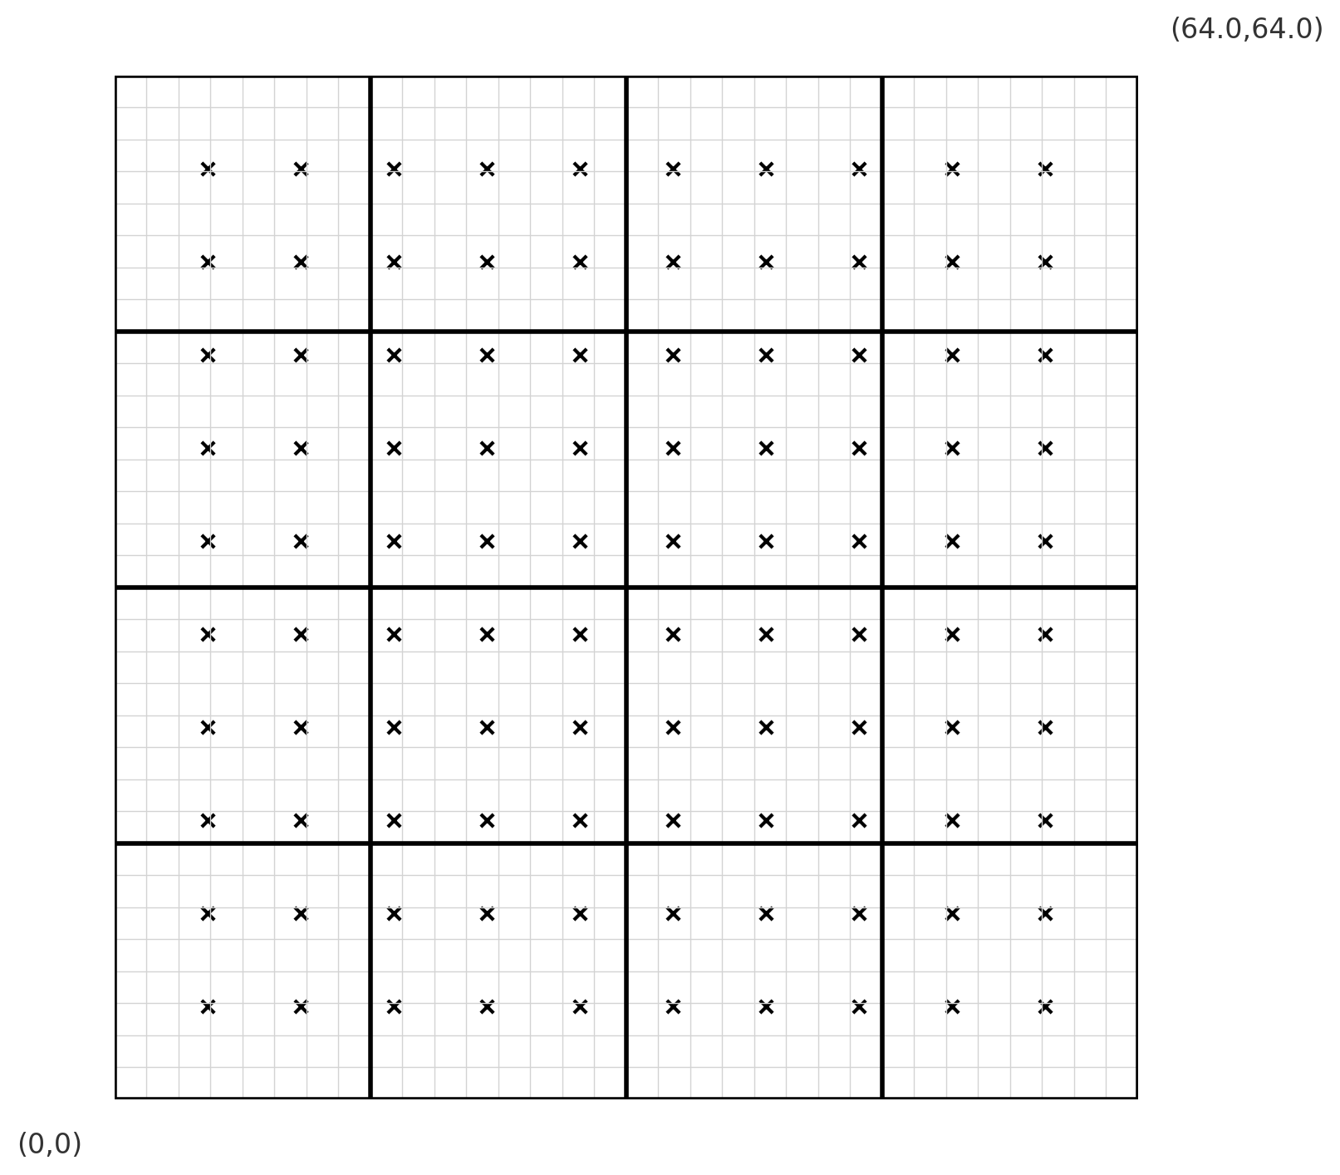
Look at the Running Example
We created a code that moves particles in a prescribed fashion and only handles periodic boundaries
If we want to use other methods, we need to break that out into a function
If we want to also handle outflow boundary condition, we need to allow for particles getting lost

Slide 10
Considerations for Refactoring
Know why you are refactoring
Is it necessary?
Where should the code be after refactoring.
Here we have two reasons
One is enhancing flexibility
The other is adding capability
Know your cost estimates
Know your bounds
on acceptable behavior change
error bounds
bitwise reproduction of results unlikely after transition
Verification
Check for coverage provided by existing tests
Develop new tests where there are gaps
Here we need two new tests.
One to ensure that behavior does not change when we put the method for moving particles into a new function
Another one to ensure that boundary conditions are applied correctly
Make sure tests exist at different granularities
There should be demanding integration and system level tests

Slide 11
Considerations for Refactoring
Know why you are refactoring
Is it necessary?
Where should the code be after refactoring.
Here we have two reasons
One is enhancing flexibility
The other is adding capability
Know your cost estimates
Know your bounds
on acceptable behavior change
error bounds
bitwise reproduction of results unlikely after transition
Verification
Check for coverage provided by existing tests
Develop new tests where there are gaps
Here we need two new tests.
One to ensure that behavior does not change when we put the method for moving particles into a new function
Another one to ensure that boundary conditions are applied correctly
Make sure tests exist at different granularities
There should be demanding integration and system level tests
Incorporate verification overheads into refactoring cost estimates

Slide 12
Considerations for Refactoring
Know why you are refactoring
Is it necessary?
Where should the code be after refactoring.
Here we have two reasons
One is enhancing flexibility
The other is adding capability
Know your cost estimates
Know your bounds
on acceptable behavior change
error bounds
bitwise reproduction of results unlikely after transition
Verification
Check for coverage provided by existing tests
Develop new tests where there are gaps
Here we need two new tests.
One to ensure that behavior does not change when we put the method for moving particles into a new function
Another one to ensure that boundary conditions are applied correctly
Make sure tests exist at different granularities
There should be demanding integration and system level tests
Incorporate verification overheads into refactoring cost estimates
We go back to AI and look at the next set of prompts
https://tinyurl.com/yfxtf89t

Slide 13
Map from Here to There: On ramp plan
Proportionate to the scope
Scattered independent changes - May be OK
All at once
Invasive large-scale change in the code - Bad idea
All at once

Slide 14
Map from Here to There: On ramp plan1
Turn off all modules except for the one being refactored.
Have a way of testing in intermediate stages
Do this for all modules that need refactoring independently

Slide 15
Map from Here to There: On ramp plan1
Turn off all modules except for the one being refactored.
Have a way of testing in intermediate stages
Do this for all modules that need refactoring independently
One by one turn on more than one refactored module

Slide 16
Map from Here to There: On ramp plan2

Slide 17
Map from Here to There: On ramp plan2
Build a separate environment for testing refactored module

Slide 18
Map from Here to There: On ramp plan2
Build a separate environment for testing refactored module
Copy over the module in this isolated environment

Slide 19
Map from Here to There: On ramp plan2
Build a separate environment for testing refactored module
Copy over the module in this isolated environment
Put back refactored module

Slide 20
Map from Here to There: On ramp plan2
Build a separate environment for testing refactored module
Copy over the module in this isolated environment
Put back refactored module

Slide 21
Map from Here to There: On ramp plan2
Build a separate environment for testing refactored module
Copy over the module in this isolated environment
Put back refactored module

Slide 22
A Real-World Example: FLASH to Flash-X
Refactoring to supporting a different AMR library
Goal: Replace Paramesh with AMReX
Plan: Getting there from here
On ramping
Design
Intermediate steps
Realizing the goal
Notes:
Can point out that this graphic show the need to update the tree - two AMR implementations required a new AMR subfolder.

Slide 23
A Real-World Example: FLASH to Flash-X
Refactoring to supporting a different AMR library
Goal: Replace Paramesh with AMReX
Plan: Getting there from here
On ramping
Design
Intermediate steps
Realizing the goal
Cost estimation
Expected developer time
Extent of disruption in production schedules
Get a buy-in from the stakeholders
That includes the users
For both development time and disruption
Notes:
Can point out that this graphic show the need to update the tree - two AMR implementations required a new AMR subfolder.

Slide 24
Steps in the Flash-X Refactoring : a mix of strategies

Slide 25
Steps in the Flash-X Refactoring : a mix of strategies
Part of a simpler environment for refactoring and testing

Slide 26
Steps in the Process
built to resemble behavior expected by AMReX

Slide 27
Steps in the Process
Refactored Grid interface made compatible with AMReX

Slide 28
Steps in the Process
Bring back the real environment but turn off some features related to AMR

Slide 29
Steps in the Process
Turn on all AMR features needed in the final stage

Slide 30
Steps in the Process

Slide 31
To Have a Good Outcome from Refactoring
Know why
Know how much
Know the cost
Plan
Have strong testing and verification
Get buy-in from stakeholders

