Slide 1
Reproducible Workflows
Gregory R. Watson
he/him
Oak Ridge National Laboratory
SC23
David E. Bernholdt (ORNL), Patricia A. Grubel (LANL), David M. Rogers (ORNL), Greg Watson (ORNL)

Slide 2
License, Citation and Acknowledgements
License and Citation
This work is licensed under a Creative Commons Attribution 4.0 International License (CC BY 4.0).
The requested citation the overall tutorial is: Anshu Dubey, David E. Bernholdt, Greg Becker, and Jared O’Neal, Software Productivity and Sustainability track, in Argonne Training Program on Extreme-Scale Computing, St. Charles, Illinois, 2023. DOI: 10.6084/m9.figshare.23823822.
Individual modules may be cited as Speaker, Module Title, in Tutorial Title, …
Acknowledgements
This work was supported by the U.S. Department of Energy Office of Science, Office of Advanced Scientific Computing Research (ASCR), and by the Exascale Computing Project (17-SC-20-SC), a collaborative effort of the U.S. Department of Energy Office of Science and the National Nuclear Security Administration.
This work was performed in part at the Argonne National Laboratory, which is managed by UChicago Argonne, LLC for the U.S. Department of Energy under Contract No. DE-AC02-06CH11357.
This work was performed in part at the Lawrence Livermore National Laboratory, which is managed by Lawrence Livermore National Security, LLC for the U.S. Department of Energy under Contract No. DE-AC52-07NA27344.
This work was performed in part at the Los Alamos National Laboratory, which is managed by Triad National Security, LLC for the U.S. Department of Energy under Contract No.89233218CNA000001
This work was performed in part at the Oak Ridge National Laboratory, which is managed by UT-Battelle, LLC for the U.S. Department of Energy under Contract No. DE-AC05-00OR22725.
This work was performed in part at Sandia National Laboratories. Sandia National Laboratories is a multi-mission laboratory managed and operated by National Technology and Engineering Solutions of Sandia, LLC., a wholly owned subsidiary of Honeywell International, Inc., for the U.S. Department of Energy’s National Nuclear Security Administration under contract DE-NA0003525.

Slide 3
What are HPC workflows?
HPC applications often consist of a series of steps
Each step may be written in different languages
May use different programming models, numeric methods and libraries
Steps often have complex dependencies between them
Steps must be run in a specific sequence to produce correct output
Steps may produce/consume large amounts of data
Data may need to be available from one step to another
Steps may require interaction from the user

Slide 4
Common HPC workflow patterns
High-performance simulation and modeling: setup; simulate; down-sample; post-process; visualize
High-performance AI: training; inference; hyperparameter optimization
Uncertainty quantification/high throughput: generate/gather input data; parallel simulations; combine datasets/analysis
Scientific data lifecycle : interactive, data-analytics; visualization; creation of summary datasets; workflow replication/modification
Hybrid: combinations of the above
In situ: workflow steps integrated into a single application (usually MPI)

Slide 5
Workflow components
Resource provisioning
Each step of the workflow needs to execute on compute resources
These may be preconfigured (e.g. a supercomputer) or dynamically allocated (e.g. cloud)
The execution environment needs to be established (e.g. libraries, runtimes, hardware drivers, etc.
Data management
Steps may consume data – must be available before execution commences
Steps may produce data – how much, where will it be stored?
What to do with the data from the workflow?
Job submission
Access to HPC systems is typically through a batch system
These require scripts that determine what resources are required for the job to run
Workflow management
Orchestrates the flow of activities needed to carry out the computation
Can be driven by data or by tasks
Workflow description
Domain specific language describing workflow
Many workflow systems employ Common Workflow Language (CWL)

Slide 6

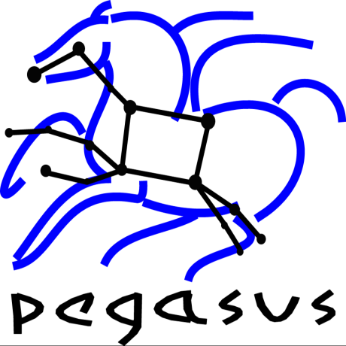


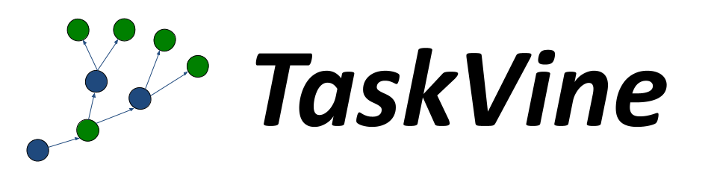



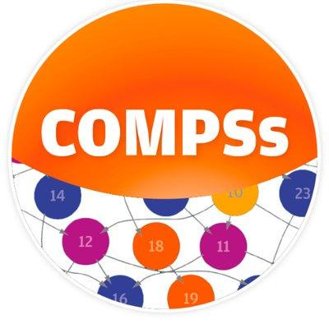






Example workflow systems
Distributed In situ
cromwell
Galaxy
Covalent

Slide 7
How to choose a workflow system
workflow tools: fit-for-purpose, suitability of examples/docs, site
support, longevity of “workflow DSL” code, FAIR data artifacts

Slide 8
Reproducibility challenges for HPC systems
Library and software versions are changing constantly so it is difficult to know what versions were used at build time vs run time
Can be changed by the user (e.g. modules) or by system admins
Hotfixes for system libraries
Kernel hardware drivers can change and affect behavior
Files on the high-performance filesystems are "purged" using a time-based algorithm. So, as data ages, it disappears unless moved to a stable location.
Hardware may experience rare, but random system failures, terminating an otherwise correct run early or, in the worst case, silently corrupting data.
Other jobs running on the system may interfere with the network or I/O performance, leading to unpredictable amounts of latency.

Slide 9
Containers
Containers are one way to reduce reproducibility issues
Used to package up all code and dependencies necessary to execute single process or task
Encapsulates the entire software ecosystem (minus the kernel)
Uses a host operating system virtualization mechanism (not virtual machine)
Common container systems:
Docker (the first) | Shifter (NERSC)
Apptainer (originally Singularity) | Charliecloud (LANL)
Podman (RedHat) | Sarus (CSCS)

Slide 10
Containers (cont…)
Originally designed for Cloud
Docker/Podman not a good fit for HPC
Requires root-level access
Architecture does not suit most HPC installations
Other container technologies are more tailored to HPC
Utilized by GitHub actions/GitLab pipelines
Growing HPC center support (apptainer/singularity, charliecloud, shifter, sarus)
May actually decrease run-time for python apps (via reduced dependency load time)

Slide 11
Examples
Some examples of different workflow systems and workflows
Running HPC job in a container

Slide 12
Summit
Create a Dockerfile
We need to create a Dockerfile so that we can build it on Summit
The best way is to start from the mpiimage-centos-cuda base image
# Start with MPI base image
FROM code.ornl.gov:4567/olcfcontainers/olcfbaseimages/mpiimage-centos-cuda
# Install some useful libraries (may not be needed) RUN fakeroot dnf install -y cmake \ python3 blas-devel lapack-devel fftw3-devel hdf5-devel python3-numpy
# Build the application RUN mkdir /app
COPY <app source files> /app
RUN cd /app && <app build command>

Slide 13
Summit
Build Podman image
Cannot build a Singularity container directly from a Dockerfile
An intermediate step using Podman is required
Log in to a node - it is better to specify a login node so that you always use the same one to make use of Podman cache
ssh <username>@login3.summit.olcf.ornl.gov

Slide 14
Summit
Set up a file in your home directory /ccs/home/<username>/.config/containers/storage.conf with the following content:
[storage]
driver = "overlay"
graphroot = "/tmp/containers/<user>"
[storage.options]
additionalimagestores = [
]
[storage.options.overlay]
ignore_chown_errors = "true"
mount_program = "/usr/bin/fuse-overlayfs"
mountopt = "nodev,metacopy=on"
[storage.options.thinpool]

Slide 15
Summit
Build an image using the Dockerfile you created previously
The build can take quite a while on Summit, so you might want to run it as a background process.
Save Podman image to a tar file in a gpfs folder, e.g. in the project one
module purge
module load DefApps
module load gcc/9.1.0
podman build -v $MPI_ROOT:$MPI_ROOT -f Dockerfile -t app .
podman save -o /gpfs/alpine/proj-shared/xxx/app.tar localhost/app

Slide 16
Summit
Build Singularity image
Create an interactive job on Summit (you cannot build a large Singularity image on login node due to resource restrictions)
Change to the gpfs folder with the Podman tar file and build a Singularity file
bsub -Is -W 0:50 -nnodes 1 -P <your project> $SHELL
cd /gpfs/alpine/proj-shared/xxx
singularity build --disable-cache app.sif docker-archive://app.tar

Slide 17
Summit
Run Singularity image
Create a submit script submit.lsf
Schedule the job to run
#BSUB -P <your project>
#BSUB -W 0:30
#BSUB -nnodes 2
#BSUB -J singularity
#BSUB -o singularity.%J
#BSUB -e singularity.%J
module purge
module load DefApps gcc/9.1.0
source /gpfs/alpine/stf007/world-shared/containers/utils/requiredmpilibs.source
jsrun -n 8 -r4 singularity exec --bind $MPI_ROOT:$MPI_ROOT,/autofs/nccs-svm1_home1,/autofs/nccs-svm1_home1:/ccs/home app.sif /app/app
bsub submit.lsf

Slide 18
Other resources
https://github.com/lanl/BEE
https://hpc.github.io/charliecloud/
https://computing.llnl.gov/projects/maestro-workflow-conductor

