Slide 1

Software Testing – Part 2
David M. Rogers Oak Ridge National Laboratory
Rinku Gupta Sandia National Laboratories
Anshu Dubey Argonne National Laboratory
See slide 2 for license details
NCAR ISS Tutorial, March 2021

Slide 2
License, Citation and Acknowledgements
License and Citation
This work is licensed under a Creative Commons Attribution 4.0 International License (CC BY 4.0).
Requested citation for the overall tutorial: David E. Bernholdt, Anshu Dubey, David M. Rogers, Rinku K. Gupta, Better Scientific Software tutorial, in ISS ‘21: 2021. DOI: (tbd)
Individual modules may be cited as Speaker, Module Title, in Better Scientific Software tutorial…
Acknowledgements
Additional contributors include: Mike Heroux, Alicia Klinvex, Mark Miller, Jared O’Neal, Katherine Riley, Patricia A. Grubel, Deborah Stevens, James Willenbring
This work was supported by the U.S. Department of Energy Office of Science, Office of Advanced Scientific Computing Research (ASCR), and by the Exascale Computing Project (17-SC-20-SC), a collaborative effort of the U.S. Department of Energy Office of Science and the National Nuclear Security Administration.
This work was performed in part at the Argonne National Laboratory, which is managed by UChicago Argonne, LLC for the U.S. Department of Energy under Contract No. DE-AC02-06CH11357.
This work was performed in part at the Oak Ridge National Laboratory, which is managed by UT-Battelle, LLC for the U.S. Department of Energy under Contract No. DE-AC05-00OR22725.
This work was performed in part at the Lawrence Livermore National Laboratory, which is managed by Lawrence Livermore National Security, LLC for the U.S. Department of Energy under Contract No. DE-AC52-07NA27344.
This work was performed in part at the Los Alamos National Laboratory, which is managed by Triad National Security, LLC for the U.S. Department of Energy under Contract No.89233218CNA000001
This work was performed in part at Sandia National Laboratories. Sandia National Laboratories is a multi-mission laboratory managed and operated by National Technology and Engineering Solutions of Sandia, LLC., a wholly owned subsidiary of Honeywell International, Inc., for the U.S. Department of Energy’s National Nuclear Security Administration under contract DE-NA0003525.

Slide 3
How to build your test suite ?
Two purposes
Regression testing
May be long running
Provide comprehensive coverage
Continuous integration
Quick diagnosis of error
A mix of different granularities works well
Unit tests for isolating component or sub-component level faults
Integration tests with simple to complex configuration and system level
Restart tests
Rules of thumb
Simple
Enable quick pin-pointing
Useful resources https://ideas-productivity.org/resources/howtos/

Slide 4
Why not always use the most stringent testing?
Effort spent in devising running and maintaining test suite is a tax on team resources
When the tax is too high…
Team cannot meet code-use objectives
When is the tax is too low…
Necessary oversight not provided
Defects in code sneak through
Evaluate project needs
Objectives: expected use of the code
Team: size and degree of heterogeneity
Lifecycle stage: new or production or refactoring
Lifetime: one off or ongoing production
Complexity: modules and their interactions
Balance is critical

Slide 5
Additional Notes: Good Testing Practices
Verify Code coverage
Must have consistent policy on dealing with failed tests
Issue tracking
How quickly does it need to be fixed?
Who is responsible for fixing it?
Someone should be watching the test suite
When refactoring or adding new features, run a regression suite before check in
Add new regression tests or modify existing ones for the new features
Code review before releasing test suite is useful
Another person may spot issues you didn’t
Incredibly cost-effective

Slide 6
Example 1: Test Development For a New Code
Development of tests and diagnostics goes hand-in-hand with code development
Non-trivial to devise good tests, but extremely important
Compare against simpler analytical or semi-analytical solutions
Build granularity into testing
Use scaffolding ideas to build confidence
Always inject errors to verify that the test is working

Slide 7
Example 2:
Test Development For a Legacy Code
There may not be existing tests
Isolate a small area of the code
Dump a useful state snapshot
Build a test driver
Start with only the files in the area
Link in dependencies
Copy if any customizations needed
Read in the state snapshot
Restart from the saved state
Verify correctness
Always inject errors to verify that the test is working
state
driver

Slide 8
Example 3: Structuring Tests to pinpoint bugs
Real dependency
Mocked up
dependency
Bottom-up picture (shim if needed)
Components can be exercised against known simpler applications
Same applies to combination of components
Build a scaffolding of verification tests to gain confidence
Unit test
Unit test
Unit test

Slide 9
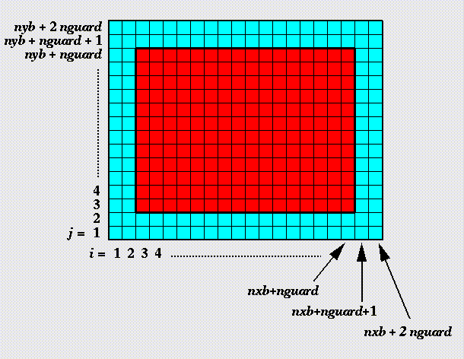
Example 3: Structured Testing
Unit test for Grid halo cell fill
Verification of guard/ghost/halo cell fill
Initialize field on interior cells (red)
Apply guard cell fill
Check for equivalence with known fill pattern
gc test
Eos test
Next, build an EOS Test – is E(V,T) consistent with P(V,T)?

Slide 10
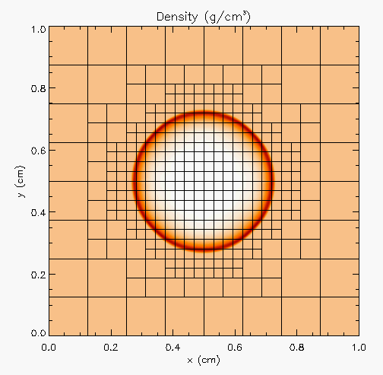
Example 3: Structured Testing
Hydro test
Unit test for Hydrodynamics
Sedov blast wave
High pressure at the center
Shock moves out spherically
FLASH with AMR and hydro
Known analytical solution
gc test
Eos test
Though it exercises mesh, hydro and eos, if mesh and eos are verified first, then this test verifies hydro
More testing needed for Grid using AMR
Flux correction and regridding

Slide 11
Example 3: Structured Testing
For AMR, correct behavior of flux conservation and regridding should also be verified.
Reason about correctness for testing Flux correction and regridding
IF Guardcell fill and EOS unit tests passed
Run Hydro without AMR
If failed fault is in Hydro
Run Hydro with AMR, but no dynamic refinement
If failed fault is in flux correction
Run Hydro with AMR and dynamic refinement
If failed fault is in regridding

Slide 12
Example 4: Coverage Matrix (physics vs. functionalities)
First line of defense – code coverage tools
Code coverage tools necessary but not sufficient
Do not give any information about interoperability
Map your tests and examples – what do they do?
Follow the order
All unit tests – including full module tests (e.g. CL)
Tests sensitive to perturbations (e.g. SV)
Most stringent tests for solvers (e.g. WD, PT)
Least complex test to cover remaining spots (Aha!)

Slide 13
Takeaways
Context: understand testing needs and costs
Devise tests to enable quick pinpointing of errors through reasoning about their behavior
test at various granularities – bottom-up (UNIT/verification) through top-down (integration/validation)
Tests at various difficulties – CI vs. regression
Maintain a holistic validation strategy: think globally, act locally
…….Questions ?

