Slide 1
Scientific Software Design
David E. Bernholdt
(he/him)
Oak Ridge National Laboratory
Software Sustainability track @ Argonne Training Program on Extreme-Scale Computing summer school
Contributors: Anshu Dubey (ANL), David E. Bernholdt (ORNL)

Slide 2
License, Citation and Acknowledgements
License and Citation
This work is licensed under a Creative Commons Attribution 4.0 International License (CC BY 4.0).
The requested citation the overall tutorial is: David E. Bernholdt, Software Sustainability track, in Argonne Training Program on Extreme-Scale Computing, St. Charles, Illinois, 2026. DOI: 10.6084/m9.figshare.33139910.
Individual modules may be cited as Speaker, Module Title, in Tutorial Title, …
Acknowledgements
This work was supported by the U.S. Department of Energy, Office of Science, Office of Advanced Scientific Computing Research, Next-Generation Scientific Software Technologies (NGSST) and Scientific Discovery through Advanced Computing (SciDAC) programs.
This work was supported by the U.S. Department of Energy Office of Science, Office of Advanced Scientific Computing Research (ASCR), and by the Exascale Computing Project (17-SC-20-SC), a collaborative effort of the U.S. Department of Energy Office of Science and the National Nuclear Security Administration.
This work was performed in part at the Argonne National Laboratory, which is managed by UChicago Argonne, LLC for the U.S. Department of Energy under Contract No. DE-AC02-06CH11357.
This work was performed in part at the Lawrence Livermore National Laboratory, which is managed by Lawrence Livermore National Security, LLC for the U.S. Department of Energy under Contract No. DE-AC52-07NA27344.
This work was performed in part at the Los Alamos National Laboratory, which is managed by Triad National Security, LLC for the U.S. Department of Energy under Contract No.89233218CNA000001
This work was performed in part at the Oak Ridge National Laboratory, which is managed by UT-Battelle, LLC for the U.S. Department of Energy under Contract No. DE-AC05-00OR22725.
This work was performed in part at Sandia National Laboratories. Sandia National Laboratories is a multi-mission laboratory managed and operated by National Technology and Engineering Solutions of Sandia, LLC., a wholly owned subsidiary of Honeywell International, Inc., for the U.S. Department of Energy’s National Nuclear Security Administration under contract DE-NA0003525.

Slide 3
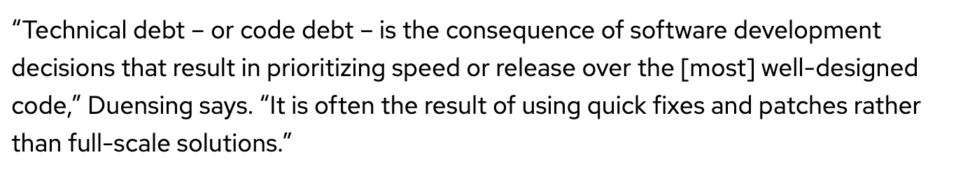
Introduction
Investing some thought in design of software makes it possible to maintain, reuse and extend it
Even if some research software begins its life as a one-off use case, it often gets reused
Without proper design it is likely to accrete features haphazardly and become a monstrosity
Acquires a lot of technical debt in the process
Many projects have had this happen
Most end up with a hard reset and start over again
In this module we will cover general design principles and those that are tailored for scientific software
We will also work through two use cases
definition from https://enterprisersproject.com/article/2020/6/technical-debt-explained-plain-english

Slide 4
Designing Software – High Level Phases
Requirements
gathering
Decomposition
Connectivity
Features and capabilities
Constraints
Limitations
Target users
Other …..
Understand design space
Decompose into high level components
Bin components into types
Understand component hierarchy
Figure out connectivity among components
Articulate dependencies

Slide 5
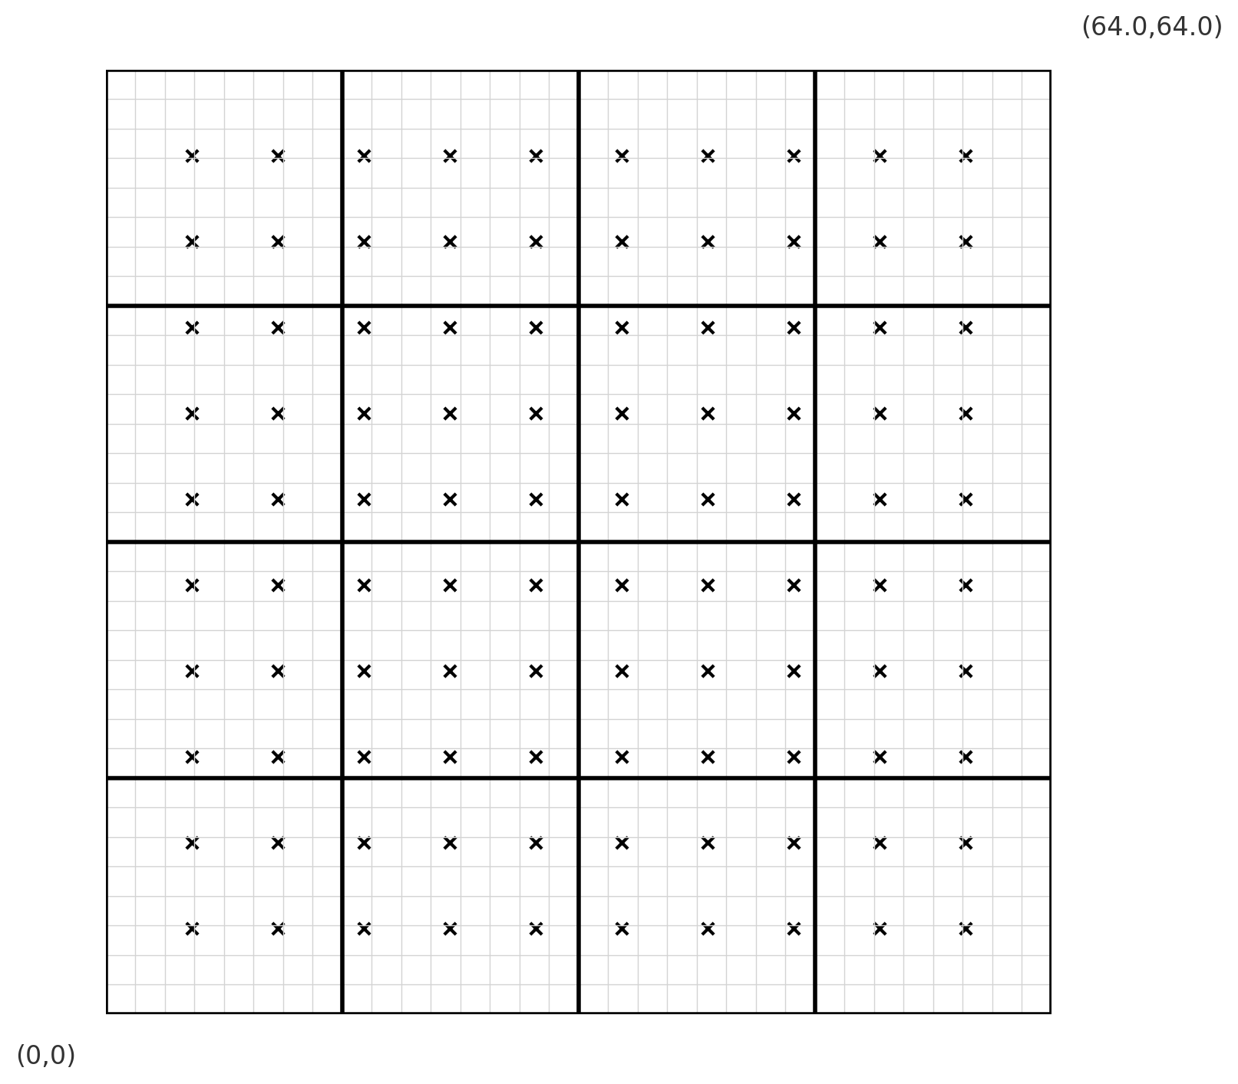
Simple Use Case
Many applications combine mesh and particles
Particles have positions associated with them
They interchange physical quantities with the mesh
They change positions based on interactions
We will build a uniformly discretized 2D cartesian mesh and initialize with a lattice of particles
We will divide the mesh into blocks
We will associate each particle with a single block
We will move particles to different locations which may change the block they are associated with
We will need to handle particles that leave the domain
To make sure that we are doing it correctly we need
Ways of verifying that particle is associated with the right block

Slide 6
Requirements gathering
Components we need
Mesh generator – with mesh divided into blocks
Particles generator – in a 2D lattice
For each particle ability to locate the block on which the particle resides
Making the particles change position
To verify that we are doing it correctly we need to make sure that
The mesh is generated correctly
The particles are initialized in a lattice and associated with blocks correctly
After moving the particles change their associations correctly

Slide 7
Decomposition
This is a small design space
Several requirements can directly map to components
Driver
Mesh initialization
Data structure
Division into blocks
Particle initialization
Position
Association with a mesh block
Particle mover
Tests
Binning components
Infrastructure Components
Driver
Initialization
Mesh with division into blocks
Particles position
Association with a mesh block
Components that are specific to one instance
Boundary conditions
Particle mover
Components for verification
Tests

Slide 8
Connectivity
Mesh generation
Mesh decomposition
Boundary conditions
Driver
Initialization of
Particle positions
Block association
Particle mover

Slide 9
Connectivity
Mesh generation
Mesh decomposition
Boundary conditions
Driver
Tests
Initialization of
Particle positions
Block association
Particle mover

Slide 10
Connectivity
Mesh generation
Mesh decomposition
Boundary conditions
Driver
Initialization of
Particle positions
Block association
Particle mover

Slide 11
Connectivity
Mesh generation
Mesh decomposition
Boundary conditions
Driver
Tests
Initialization of
Particle positions
Block association
Particle mover

Slide 12
Research Software Challenges
More Scientific Understanding
Many parts of the model and software system can be under research
Requirements change throughout the lifecycle as knowledge grows
Verification complicated by floating point representation
Real world is messy
More Hardware
Resources
Higher Fidelity
Model
More Diverse
Solvers

Slide 13
Additional Considerations for Research Software
Considerations
Multidisciplinary
Many facets of knowledge
To know everything is not feasible
Two types of code components
Infrastructure (mesh/IO/runtime …)
Science models (numerical methods)
Codes grow
New ideas => new features
Code reuse by others
Design Implications
Separation of Concerns
Shield developers from unnecessary complexities
Work with different lifecycles
Long-lasting vs quick changing
Logically vs mathematically complex
Extensibility built in
Ease of adding new capabilities
Customizing existing capabilities

Slide 14
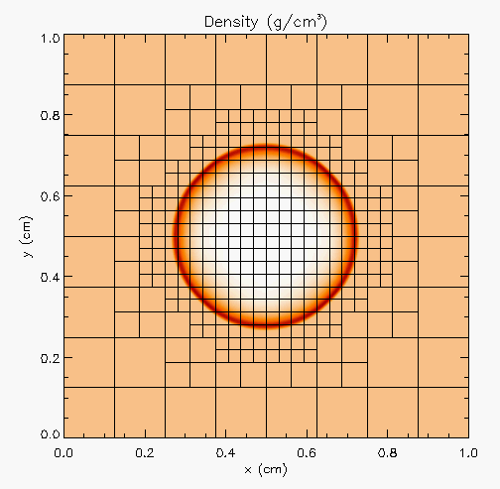
More Complex Application Design – Sedov Blast Wave
Description
High pressure at the center cause a shock to moves out in a circle. High resolution is needed only at and near the shock
Requirements
Adaptive mesh refinement
Easiest with finite volume methods
Driver
I/O
Initial condition
Boundary condition
Shock Hydrodynamics
Ideal gas equation of state
Method of verification

Slide 15
Deeper Dive into Requirements
Adaptive mesh refinement → divide domain into blocks
Blocks need halos to be filled with values from neighbors or boundary conditions
At fine-coarse boundaries there is interpolation and restriction
Blocks are dynamic, go in and out of existence
Conservation needs reconciliation at fine-coarse boundaries
Shock hydrodynamics
Solver for Euler’s equations at discontinuities
EOS provides closure
Riemann solver
Halo cells are fine-coarse boundaries need EOS after interpolation
Method of verification
An indirect way of checking – shock distance traveled can be computed analytically

Slide 16
Components
Deeper Dive into some Components
Driver
Iterate over blocks
Implement connectivity
Mesh
Data containers
Halo cell fill, including application of boundary conditions
Reconciliation of quantities at fine-coarse block boundaries
Re-mesh when refinement patterns change
I/O
Getting runtime parameters and possibly initial conditions
Writing checkpoint and analysis data
Binned Components
Unchanging or slow changing infrastructure
Mesh
I/O
Driver
Comparison utility -- testing
Components evolving with research – physics solvers
Initial and boundary conditions
Hydrodynamics
EOS

Slide 17
Connectivity
Mesh
Initial conditions
Boundary conditions
Driver
Tests
I/O
Hydrodynamics
EOS

Slide 18
A Design Model for Separation of Concerns
Infrastructure
Capabilities
Requirements
Model
Software Architecture API Design
API
Implement
Design
Develop
Test
Validate
Maintain
Augment
Integrate

Slide 19
Exploring design space – Abstractions
Constraints
Only infrastructure components have global view
All physics solvers have block view only
Other Design Considerations
Data scoping
Interfaces in the API
Spatial
decomposition
domain sections
as stand-alone
computation unit
Real view : A
whole domain
with many
operators
base
abstraction
Functional
decomposition
collection of
components
Minimal Mesh API
Initialize_mesh
Halo_fill
Access_to_data_containers
Reconcile_fluxes
Regrid
Notes:
Example of changing the block size to adjust to the cache memory
And point-to-point Vs collectives depending upon the scale of the problem

Slide 20
Separation of Concerns Applied
Spatial
decomposition
domain sections
as stand-alone
computation unit
Parallelization
and scaling
optimization
Implemented by
domain experts
and applied
mathematicians
Implemented by
software and
performance
engineers
Real view : A
whole domain
with many
operators
Functional
decomposition
collection of
components
Memory
access and
compute
optimization
Notes:
Example of changing the block size to adjust to the cache memory
And point-to-point Vs collectives depending upon the scale of the problem

Slide 21
Takeaways so far
Differentiate between slow changing and fast changing components of your code
Understand the requirements of your infrastructure
Implement separation of concerns
Design with portability, extensibility, reproducibility and maintainability in mind

Slide 22
New Paradigm Because of Platform Heterogeneity
More Scientific Understanding
Heterogeneous
models
More Hardware
Resources
Higher Fidelity
Model
Software complexity
Distributed
memory
model
More Diverse
Solvers
Platform complexity

Slide 23
Mechanisms Needed by the Code
Mechanisms to unify expression of computation
Minimize maintained variants of source suitable for all computational devices
Reconcile differences in data structures
Mechanisms to move work and data to computational targets
Moving between devices
Launching work at the destination
Hiding latency of movement
Moving data off node
So, what do we need?
Abstractions layers
Code transformation tools
Data movement orchestrators
Mechanisms to map work to computational targets
Figuring out the map
Expression of dependencies
Cost models
Expressing the map

Slide 24
Mechanisms Needed by the Code: Example of Flash-X
Mechanisms to unify expression of computation
Macros with inheritance
Mechanisms to move work and data to computational targets
Domain specific runtime
Mechanisms to map work to computational targets
DSL for recipes with code generator
Composability in the source
A toolset of each mechanism
Independent tool sets

Slide 25
State of Practice – Abstractions and Runtimes
Still very focused on GPU
Majority of ECP applications park their data on the GPU and just work there
Abstractions -- data structures and parallelization of loops
Limitations
No way to handle algorithmic variants in a unified way
No way to transfer domain knowledge based possible optimizations to the tools
None of the prevalent languages allow a good way to define data locality
Boutique HPC languages like chapel do – but chicken and egg problem with adoption

Slide 26
State of Practice – Abstractions and Runtimes
Still very focused on GPU
Majority of ECP applications park their data on the GPU and just work there
Abstractions -- data structures and parallelization of loops
Limitations
No way to handle algorithmic variants in a unified way
No way to transfer domain knowledge based possible optimizations to the tools
None of the prevalent languages allow a good way to define data locality
Boutique HPC languages like chapel do – but chicken and egg problem with adoption
The holy grail for scientists – write equation and generate code
Very limited success in some domains

Slide 27
State of Practice – Abstractions and Runtimes
Still very focused on GPU
Majority of ECP applications park their data on the GPU and just work there
Abstractions -- data structures and parallelization of loops
Limitations
No way to handle algorithmic variants in a unified way
No way to transfer domain knowledge based possible optimizations to the tools
None of the prevalent languages allow a good way to define data locality
Boutique HPC languages like chapel do – but chicken and egg problem with adoption
We have been developing one for Flash-X – started under ECP and TEAMS, continuing with RAPIDS and ENAF
The holy grail for scientists – write equation and generate code
Very limited success in some domains
Is there another way?

Slide 28
ORCHA: Overview
ORCHA consists of three tools: CG-Kit, Macroprocessor, and Milhoja
A user expresses the control flow of the simulation in a “recipe”
CG-Kit reads and parses the given recipe, statically optimizes the control flow graph
Macroprocessor selects the right definition for the target and translates the static physics code (similar to what Kokkos/AMReX do for C++ codes)
Milhoja handles data transfers and kernel launching
The magic component that puts everything together – Flash-X-RecipeTools
These are the application specific parts of ORCHA – need to be developed for each application
They do code generation for application specific task functions and data packets
Key design choice to avoid having to change applications intrusively to become compatible with ORCHA

Slide 29
Orthogonal Axes of Challenges and Optimization
Have a way of rearranging data locality and moving data and computation
Let the human-in-the-loop dictate this
CG-Kit – recipes in python
-- templates for different variants
-- express where to compute what
-- emit code in Fortran/C/C++
Milhoja – flatten/decompose data and move it to the target
-- combine data into one data packet
-- decompose into smaller computational sections if needed
If tools only execute what they are told to, they are simpler
Code generation is our friend – especially when it is simple forward map
And is not entangled with the details of the arithmetic
If N blocks are sent to the device, we need N copies of all block-wise scratch
For all data items we need device pointers
Code internally decorated with directives

Slide 30
Code Generators
Two Classes
Data packet generators
Parse the interface files
Collect all data to be put into a data packet
Generate code that will flatten all data into data packets
Task function generators
Consolidate functions to be invoked
Bookended by internode communication
Unpack data packets
Decorate interface definitions with needed metadata
Example -- this link will work only if you have access to the Flash-X code repository. Please email flash-x@lists.cels.anl.gov with your github username to get access

Slide 31
ORCHA: Workflow
MainDriver (invoke Milhoja Runtime)
User-written Recipe
Flash-X RecipeTools (CG-Kit)
Milhoja Code Generator
TaskFunctions
DataPackets
Flash-X Source Code (with Macros)
Macroprocessor
Compiler
Milhoja Runtime
Executable

Slide 32
ORCHA: Example 1
Sedov explosion test
Hydrodynamics with an ideal-gas EOS
Generated / transformed codes:
Recipe (user input):
ORCHA Begin
Begin
addNode(HydroBegin, GPU), dep(Root)
addNode(HydroCompute, GPU), dep(HydroBegin)
End
DataPacket A
TaskFuncion A
HydroBegin_GPU
HydroCompute_GPU
Hydro exposes 2 interfaces to ORCHA
Every exposed interface is required to be thread-safe for the whole call-stack, and should be compilable for the target
In the file where the interfaces are defined, we annotations as comments provide complete inventory of data that is needed for the computation
Recipetools recursively parse the annotations, cumulate all the data that is part of one taskfunction and generate code for assembling data packets and task functions
ORCHA End
A DataPacket can collect N AMR blocks, where N is a runtime parameter

Slide 33
ORCHA: Example 2
Cellular detonation
Hydrodynamics, nuclear burn, and Helmholtz EOS are needed
Recipe (user input):
Generated / transformed code:
Begin
addNode(HydroBegin, GPU), dep(Root)
addNode(HydroCompute, GPU), dep(HydroBegin)
addNode(BurnCompute, CPU), dep(HydroCompute)
addNode(BurnUpdate, CPU), dep(BurnCompute)
End
ORCHA Begin
DataPacket A
TaskFuncion A
HydroBegin_GPU
HydroCompute_GPU
Burn exposes 2 interfaces to ORCHA
Can only run on CPU – third party library dependence
EOS needs to compiled for both CPU and GPU, both Hydro and Burn call
TaskFunction B
BurnCompute_CPU
BurnUpdate_CPU
TileWrapper B
ORCHA End

Slide 34
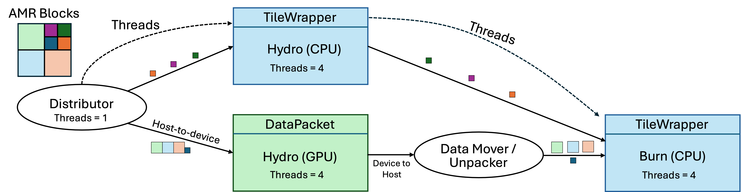
ORCHA: Example 2
Cellular detonation
Hydrodynamics, nuclear burn, and Helmholtz EOS are needed
Generated / transformed code:
Recipe (user input):
ORCHA Begin
Begin
addNode(HydroBegin, [CPU, GPU]), dep(Root)
addNode(HydroCompute, [CPU, GPU]), dep(HydroBegin)
addNode(BurnCompute, CPU), dep(HydroCompute)
addNode(BurnUpdate, CPU), dep(BurnCompute)
End
DataPacket A
TaskFunction B
HydroBegin_CPU
HydroCompute_CPU
TaskFunction A
HydroBegin_GPU
HydroCompute_GPU
TileWrapper B
Runtime: (GPU + CPU)_{Hydro} → (CPU)_{Burn}
TaskFunction C
BurnCompute_CPU
BurnUpdate_CPU
TileWrapper C
ORCHA End

Slide 35
Final takeaways
Requirements gathering and intentional design are indispensable for sustainable software development
Many books and online resources available for good design principles
Research software poses additional constraints on design because of its exploratory nature
Scientific research software has further challenges
High performance computing research software has even more challenges
That are further exacerbated by the ubiquity of accelerators in platforms
Separation of concerns at various granularities, and abstractions enable sustainable software design

Slide 36
References
Dubey Anshu, “Insights from the software design of a multiphysics multicomponent scientific code” Computing in Science & Engineering, 2021. DOI:10.1109/MCSE.2021.3069343
Dubey, Anshu, et al. "Flash-X: A multiphysics simulation software instrument." SoftwareX 19 (2022): 101168. DOI:10.1016/j.softx.2022.101168
Rudi, Johann, et al. "CG-Kit: Code Generation Toolkit for Performant and Maintainable Variants of Source Code Applied to Flash-X Hydrodynamics Simulations." arXiv preprint arXiv:2401.03378 (2024).
O’Neal, Jared, et al. "Domain-specific runtime to orchestrate computation on heterogeneous platforms." European Conference on Parallel Processing. Cham: Springer International Publishing, 2021. DOI:10.1007/978-3-031-06156-1_13
Dubey, Anshu, et al. "A tool and a methodology to use macros for abstracting variations in code for different computational demands." Future Generation Computer Systems (2023). DOI:10.1016/j.future.2023.07.014

