Slide 1
Reproducible Workflows
Gregory R. Watson
(he/him)
Oak Ridge National Laboratory
Software Practices for Reproducible Science tutorial @ ACM-REP 2024
Contributors: Patricia A. Grubel (LANL), David M. Rogers (ORNL), Gregory R. Watson (ORNL)

Slide 2
License, Citation and Acknowledgements
License and Citation
This work is licensed under a Creative Commons Attribution 4.0 International License (CC BY 4.0).
The requested citation the overall tutorial is: Anshu Dubey and Gregory R. Watson, Software Practices for Reproducible Science tutorial, in 2024 ACM Conference on Reproducibility and Replicability (ACM-REP), Rennes, France and online, 2024. DOI: 10.6084/m9.figshare.26019469.
Individual modules may be cited as Speaker, Module Title, in Tutorial Title, …
Acknowledgements
This work was supported by the U.S. Department of Energy Office of Science, Office of Advanced Scientific Computing Research (ASCR), and by the Exascale Computing Project (17-SC-20-SC), a collaborative effort of the U.S. Department of Energy Office of Science and the National Nuclear Security Administration.
This work was supported by the U.S. Department of Energy, Office of Science, Office of Advanced Scientific Computing Research, Next-Generation Scientific Software Technologies (NGSST) program.
This work was performed in part at the Argonne National Laboratory, which is managed by UChicago Argonne, LLC for the U.S. Department of Energy under Contract No. DE-AC02-06CH11357.
This work was performed in part at the Lawrence Livermore National Laboratory, which is managed by Lawrence Livermore National Security, LLC for the U.S. Department of Energy under Contract No. DE-AC52-07NA27344.
This work was performed in part at the Los Alamos National Laboratory, which is managed by Triad National Security, LLC for the U.S. Department of Energy under Contract No.89233218CNA000001
This work was performed in part at the Oak Ridge National Laboratory, which is managed by UT-Battelle, LLC for the U.S. Department of Energy under Contract No. DE-AC05-00OR22725.
This work was performed in part at Sandia National Laboratories. Sandia National Laboratories is a multi-mission laboratory managed and operated by National Technology and Engineering Solutions of Sandia, LLC., a wholly owned subsidiary of Honeywell International, Inc., for the U.S. Department of Energy’s National Nuclear Security Administration under contract DE-NA0003525.

Slide 3
Introduction
A workflow can be any series of activities needed to complete a task
In scientific computing, a workflow can help with reproducibility by
Describing in a formal way how to undertake activities for scientific problem-solving
Might be as simple as using a script, or as complex as using a domain specific workflow description language
A workflow system can help with reproducibility by
Providing the infrastructure required to execute the activities described by a workflow
Tracking the workflow and data provenance
Workflow concepts and tools make this job easier and will be discussed in this module

Slide 4
Outline
Workflow concepts
Example workflow systems
Common workflow patterns
Choosing a workflow system
Reproducibility issues and containers

Slide 5
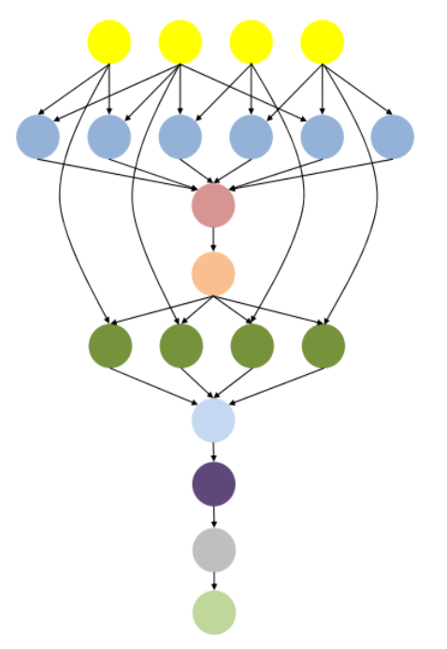
What are scientific workflows?
HPC workflow == one or more steps require HPC
Scientific applications often consist of a series of computational or data manipulation steps
Each step may be written in different languages
May use different programming models, numeric methods and libraries
Steps often have complex dependencies between them
Steps must be done in a specific sequence to produce correct output
Can include cycles
Steps may produce/consume large amounts of data
Data may need to be available from one step to another
Steps may require interaction from the user
Image source: Al-Haboobi, Ali. (2017). Improving Max-Min scheduling Algorithm for Reducing the Makespan of Workflow Execution in the Cloud. International Journal of Computer Applications. 177. 975-8887. DOI:10.5120/ijca2017915684.

Slide 6
Reasons to use a workflow system
I have a large complex problem that can be broken down into a number of distinct steps
I need to scale to a large jobs/systems
I want to document steps / run method
I need to be able to track and restart failed components
I want to be able to reproduce the results or have someone else reproduce them
I need to track provenance of task execution and data movement
My application requires building a complicated environment

Slide 7
Workflow activities and components
Resource provisioning
Each step of the workflow needs to execute on compute resources
These may be preconfigured (e.g. a supercomputer) or dynamically allocated (e.g. cloud)
The execution environment needs to be established (e.g. libraries, runtimes, hardware drivers, etc.
Data management
Steps may consume data – must be available before execution commences
Steps may produce data – how much, where will it be stored?
What to do with the data from the workflow?
Job submission
Access to HPC systems is typically through a batch system
These require scripts that determine what resources are required for the job to run
Workflow management
Orchestrates the flow of activities needed to carry out the computation
Can be driven by data or by tasks
Workflow description
Domain specific language describing workflow
Many workflow systems employ Common Workflow Language (CWL)

Slide 8

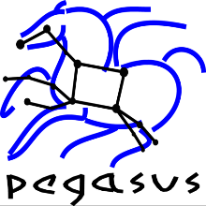


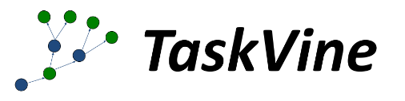



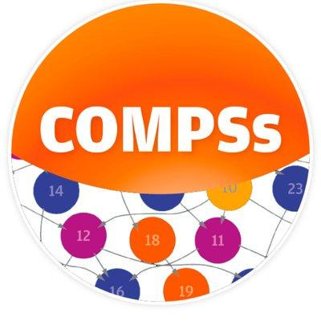






Example workflow systems https://s.apache.org/existing-workflow-systems
Distributed In situ
cromwell
snakemake
Galaxy
Covalent

Slide 9
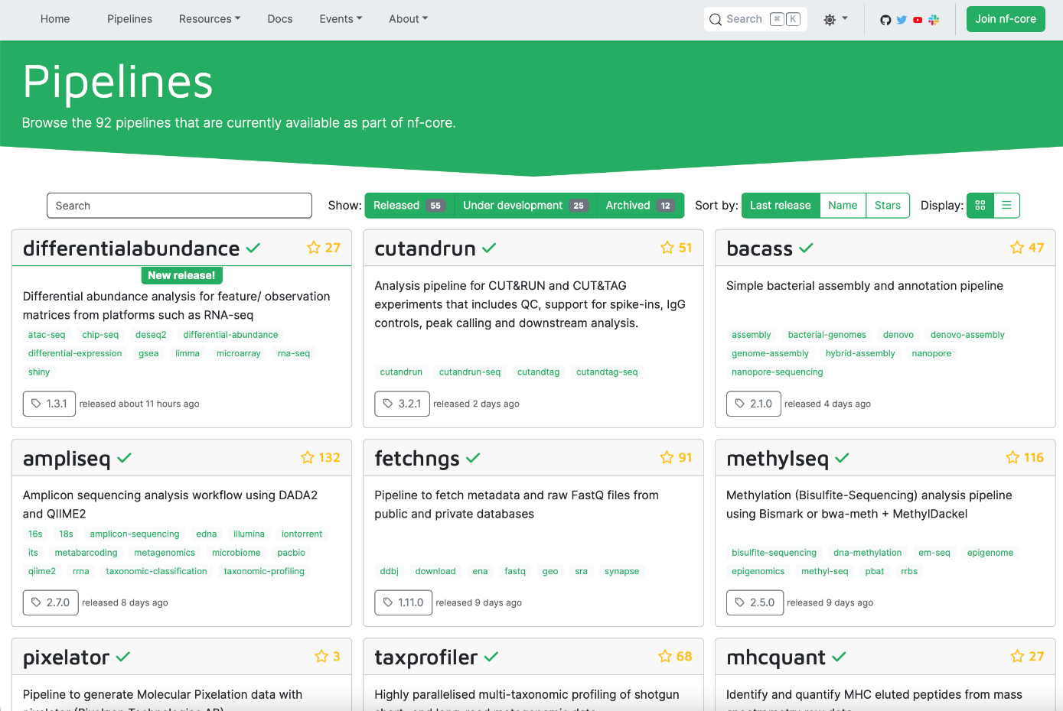
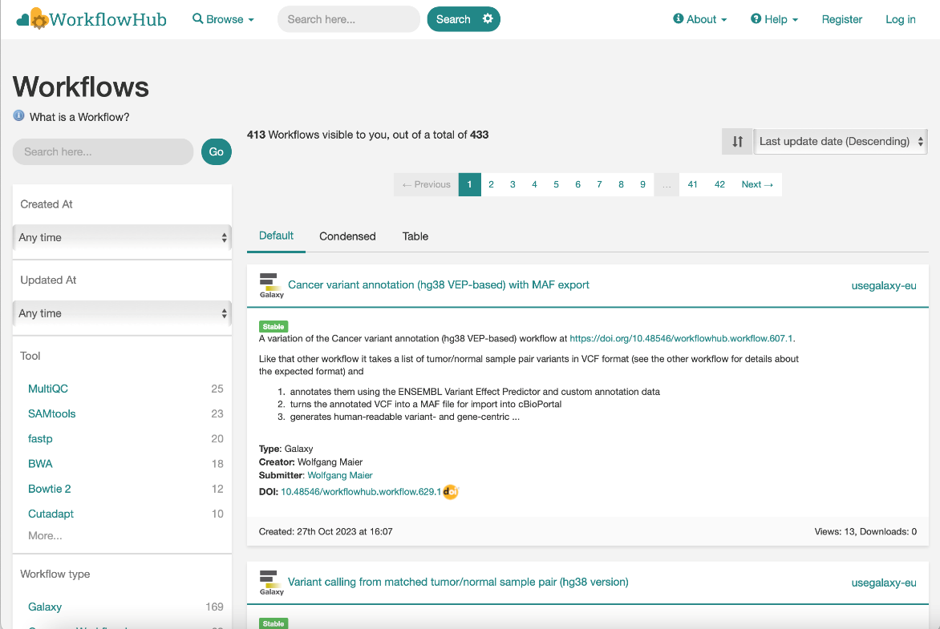
Workflow Repositories and Registries
Registry: indexes or catalogs of workflow metadata
Repository: workflow descriptions and metadata are indexed and stored
Metadata framework: help support reproducibility by managing metadata
Data repository: permanently stores and manages data; provides digital object identifier (DOI)
Implementations:
https://nf-co.re
https://workflowhub.eu
https://zenodo.org
Metadata provides the ability to describe the context of data and entities involved in its production, use and reuse.

Slide 10
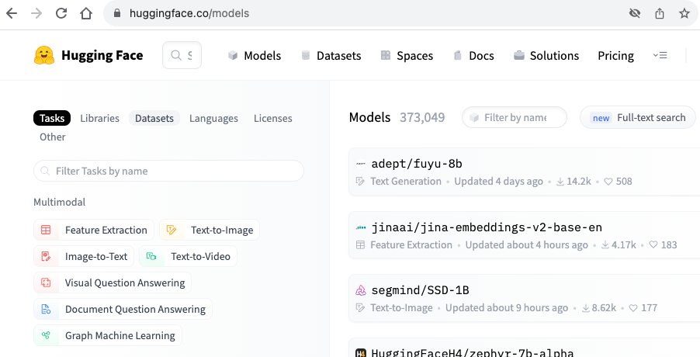
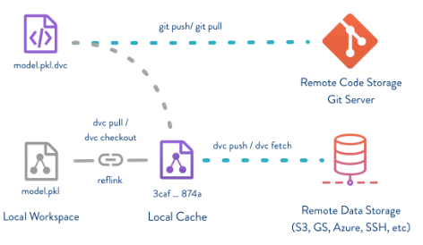
Data / Code Combinator
Publish data and structured code from within your code
Offers tracking functionality for provenance (code / experiment progression)
Popular for AI/ML models, where it facilitates model comparisons
Implementations:
pypi / dvc (DVC.org)
Weights & Biases (wandb.ai)
huggingface.co

Slide 11
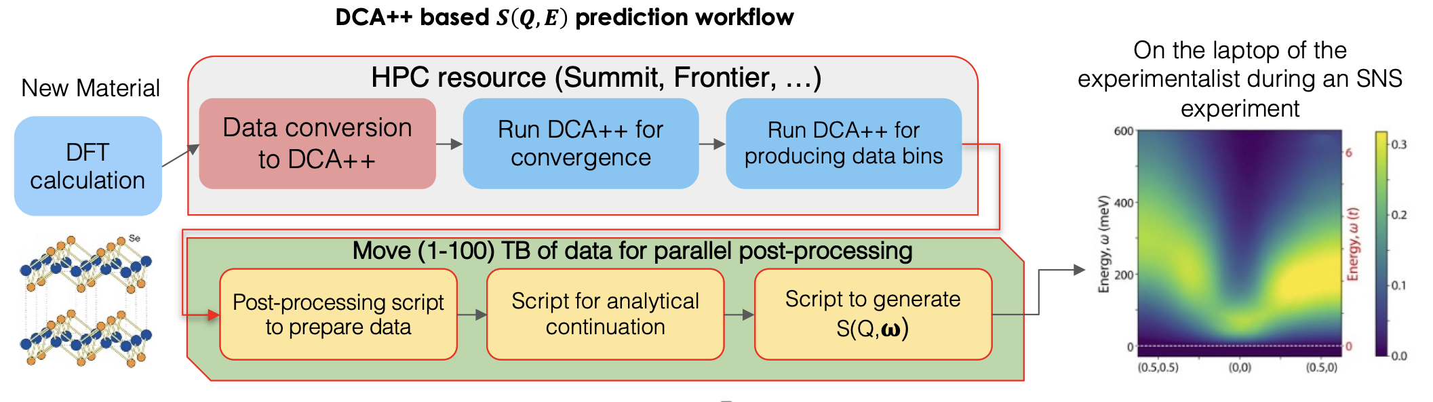

Common scientific workflow patterns High-performance Simulation and Modeling
Figure 4. Diagram of the S(Q,$ω$) prediction workflow. The workflow begins with a DFT calculation based on the new material of interest to build a low-energy effective model. A first DCA++ simulation is performed for convergence to self-consistency. For the problems of interest here, which require O(1000) bins of data for the four-point vertex function, a second DCA++ simulation is run to produce the binned data. The relevant observables are extracted and manipulated into a convenient form using several Python scripts. This includes the extraction of the vertex function $Γ$, the solution of the Bethe-Salpeter equation to generate S(Q,$ω$) on the imaginary frequency axis, and the analytic continuation to perform the rotation to the real frequency axis. The final product of the Python analysis is the prediction for S(Q,$ω$) .
Source: https://doi.org/10.1007/978-3-031-23606-8_9
Setup: mesh generation, pre-computation
Simulate: physics calculations
Down-sample: data reduction
Post-process: format for visualization tools
Visualize: inspect the data

Slide 12
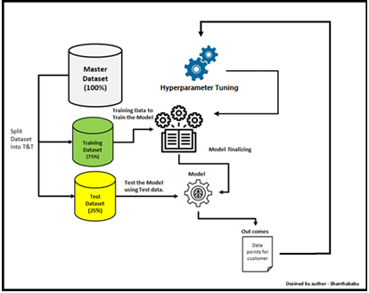
Common scientific workflow patterns High-performance AI
Training: AI model training using scientific data
Inference: Use the model to make predications
Hyperparameter optimization: Find the best combination of hyperparameters for the problem
Source: https://www.analyticsvidhya.com/blog/2022/02/a-comprehensive-guide-on-hyperparameter-tuning-and-its-techniques/

Slide 13
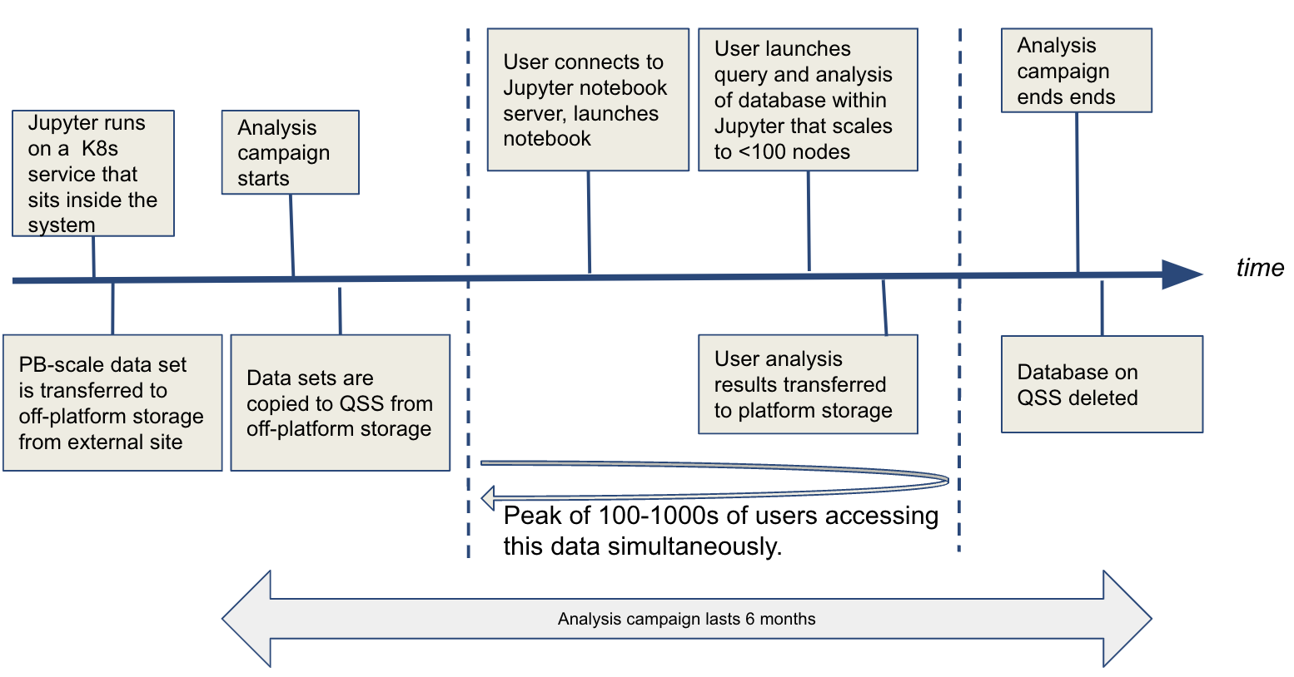
Common scientific workflow patterns Scientific Data Lifecycle
Interactive data-analytics: running data intensive workflows against shared datasets
Visualization: flexible visualizations depending on requirements
Creation of summary datasets
Workflow replication/modification
Source: https://www.nersc.gov/assets/NERSC-10/Workflows-Archetypes-White-Paper-v1.0.pdf

Slide 14
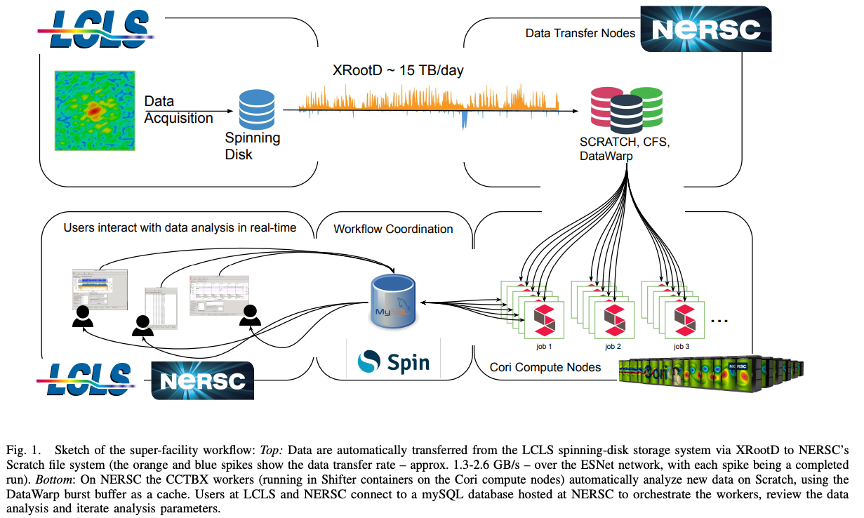
Common scientific workflow patterns Real-Time / Streaming
Data transport
Compression
Visualization
Buffering / final storage
Implementations:
XRootD
pypi / ray
Apache kafka
Globus
custom...
Real-Time XFEL Data Analysis at SLAC and NERSC: a Trial Run of Nascent Exascale Experimental Data Analysis. DOI:10.48550/arXiv.2106.11469
Johannes P. Blaschke, Aaron S. Brewster, Daniel W. Paley, Derek Mendez, Asmit Bhowmick, Nicholas K. Sauter, Wilko Kröger, Murali Shankar, Bjoern Enders, Deborah Bard

Slide 15
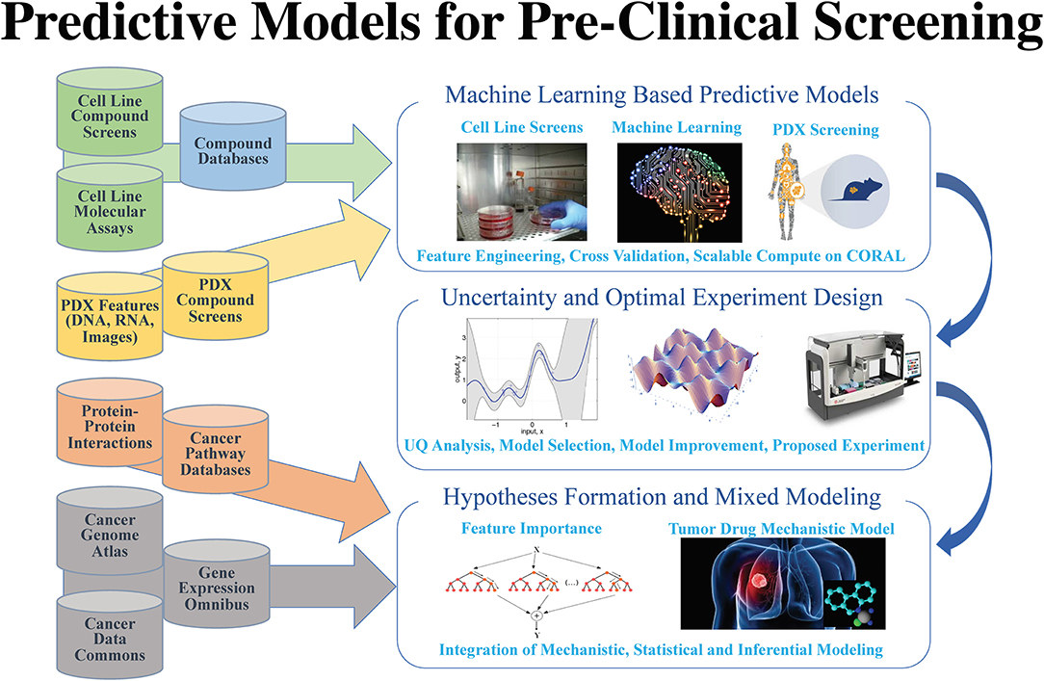
Common scientific workflow patterns Hybrid
Combines elements of multiple workflow patterns
Bhattacharya Tanmoy, Brettin Thomas, Doroshow James H., Evrard Yvonne A., Greenspan Emily J., Gryshuk Amy L., Hoang Thuc T., Lauzon Carolyn B. Vea, Nissley Dwight, Penberthy Lynne, Stahlberg Eric, Stevens Rick, Streitz Fred, Tourassi Georgia, Xia Fangfang, Zaki George, “AI Meets Exascale Computing: Advancing Cancer Research With Large-Scale High Performance Computing”, Frontiers in Oncology, vol 9, 2019, DOI:10.3389/fonc.2019.00984

Slide 16
Make-like (acyclic)
prot_dcd:
resource:
time: 1.0
cpu: 4
nrs: 1
inp:
- Production/remd_{n}/prot.xtc
- Production/remd_{n}/prot.tpr
out:
- Production/remd_{n}/prot.psf
- Production/remd_{n}/prot.dcd
script: |
. /ccs/proj/bif128/setup-env-vmd.sh
{mpirun} vmd -dispdev text \
-e $SRC/vmd/rewrap.tcl \
-args {inp[0]} {inp[1]} \
{out[0]} {out[1]}
Typical characteristics:
List of a -> b conversion rules
File presence = workflow state
Shell-like variable substitution
Can be auto-parallelized
Implementations:
GNU make
plan9 mk
pmake
snakemake
fireworks
swift/T
nextflow.io
DPLASMA

Slide 17
Workflow-like Programming Models: Map-Reduce
rank 0
rank 1
rank 2
Map: run function over all data items
Reduce: aggregate results (sum/etc.)
Scan: calculating running reduce
Collect: gather info. to root rank
Filter: conditionally remove elements
Repartition/regroup: reorder elements
[0,1, 2]
[3, 4, 5]
[6, 7, 8]
rank 3
rank 4
rank 5
Implementations:
module / mpi
GNU parallel
pypi / mpi_list
pypi / pyspark / pysparkling
pypi / mpi4py
[9, 10, 11]
[12, 13]
[14, 15]

Slide 18
Workflow-like Execution Models: Bag of Tasks
Server stores a set of "tasks" and exports an API:
Add task
Fetch task
Mark task complete
May also track DAG state
May be "push" instead of "pull"
Server
Implementations:
pypi / parsl
pypi / celery
pypi / dask
RADICAL/pilot
Apache Airflow
Ruby resque
Hashicorp Nomad
Slurm / LSF / etc.
github.com/frobnitzem/dwork
Client 1
Client 2
Client 3
...
Request task from server
Do work and output
Inform server of completion

Slide 19
Factors to consider
Is it available on my system (discuss with your HPC center)
How does it handle data provenance?
Are there workflows that already do what I want?
What are the computational requirements for each component/step?
Which need HPC?
Could I just use cloud vs. HPC (scale / other constraints)
What data requirements does my problem have?
How much data is consumed/produced by each step?
Where do data transfers need to happen?

Slide 20
Reproducibility challenges for HPC systems
Library and software versions are changing constantly so it is difficult to know what versions were used at build time vs run time
Can be changed by the user (e.g. modules) or by system admins
Hotfixes for system libraries
Kernel hardware drivers can change and affect behavior
Files on the high-performance filesystems are "purged" using a time-based algorithm. So, as data ages, it disappears unless moved to a stable location
Hardware may experience rare, but random system failures, terminating an otherwise correct run early or, in the worst case, silently corrupting data
Other jobs running on the system may interfere with the network or I/O performance, leading to unpredictable amounts of latency

Slide 21






Containers
Containers are one way to reduce portability issues, however can come with a performance penalty
Used to package up all code and dependencies necessary to execute single process or task
Encapsulates the entire software ecosystem (minus the kernel)
Uses a host operating system virtualization mechanism (not virtual machine)
Common container systems: Docker (the first); Apptainer (was singularity); Podman (RedHat); Charliecloud (LANL); Shifter (NERSC); Sarus (CSCS)

Slide 22
Containers (cont…)
Originally designed for Cloud
Docker not a good fit for HPC
Requires root-level access
Architecture does not suit most HPC installations
Other container technologies are more tailored to HPC
Growing HPC center support (Apptainer/Singularity, Charliecloud, Shifter, Sarus)
May actually decrease run-time for python apps (via reduced dependency load time)
Utilized by GitHub actions/GitLab pipelines

Slide 23

Open Container Initiative (OCI) https://opencontainers.org
Industry standard for container formats and runtimes
Allows containers built using one container system to be run with another
E.g. build with Podman and run using Singularity
Containers can be stored in different registries
Three specificiations:
Runtime Specification (runtime-spec)
Image Specification (image-spec)
Distribution Specification (distribution-spec)

Slide 24
Containers supported by HPC systems¹
ALCF
Theta: Singularity
Aurora: Singularity
OLCF
Summit: Singularity
Frontier: Singularity
NERSC
Cori: Shifter
Perlmutter: Shifter, Singularity, Podman
LLNL
Sierra/Lassen: Singularity
El Capitan: Singularity
LANL
Trinity: Charliecloud
Linux clusters: Charliecloud
Crossroads: Charliecloud
SNL
Astra: Singularity, Charliecloud, Podman
Linux clusters: Shifter, Singularity
¹ Source: Containers and the Truth between HPC & Cloud System Software Convergence. 2021. DOI:10.2172/1859696

Slide 25
Issues using containers in HPC
MPI with HPC containers is a mess
Certain vendors don’t support MPI libraries via a container
Users have to match MPI build to host MPI configurations
There are solutions but at the expense of portability and specific to implementation
Build environment does not match run environment
Supporting non-x86 machines (eg: Summit, Astra, ...) requires special build nodes
Even x86 is no guarantee of performance or portability
Many libraries make build-time assumptions which can be bad
Job life is a batch in HPC
Containers & MPI libraries don’t default to playing well with schedulers
Module settings (environment variables) can leach into containers

Slide 26
Issues using containers in HPC (cont…)
Most HPC Container runtimes support GPUs
singularity run --nv ...
shifter --module=cuda-10.1 ...
ch-fromhost --nvidia ...
Variation between GPUs
singularity run --nv ...
singularity run --rocm ...
Relatively little integration to date with Intel GPUs
E4S image with OneAPI is planned for release next year
None of this looks like the Cloud

Slide 27
Summary
Workflow systems provide a powerful tool to undertake scientific discovery
High-performance Simulation and Modeling; High performance AI; Scientific Data Lifecycle; Real-Time/Streaming; Hybrid
There are a large number of systems available
Choosing the right one depends on the needs of the application (computational, data, reproducibility) and what is available locally
Workflows help with reproducibility, there are resources that help with sharing workflow codes and data
HPC has many reproducibility issues
Containers help with portability, and most HPC systems support containers
HPC and containers are not currently a great fit

Slide 28
Other resources
Workflow systems
Containers
AiiDA: https://www.aiida.net
BEE: https://github.com/lanl/BEE
COMPSs: https://compss.bsc.es
Covalent: https://www.covalent.xyz
Cromwell: http://cromwell.readthedocs.io
FireWorks: https://materialsproject.github.io/fireworks
Galaxy: https://galaxyproject.org
Maesto: https://maestrowf.readthedocs.io
Nextflow: https://www.nextflow.io
Pegasus: https://pegasus.isi.edu
Snakemake: https://snakemake.github.io
Swift: http://swift-lang.org/Swift-T
Taskvine: https://ccl.cse.nd.edu/software/taskvine
Apptainer (singularity) https://apptainer.org
Charliecloud: https://hpc.github.io/charliecloud
Docker: https://docker.com
Podman: https://podman.io
Sarus: https://sarus.readthedocs.io/en/stable
Shifter: https://shifter.readthedocs.io/en/latest

Slide 29
Other resources
Workflow repositories
Workflow registries
@nf-core (Nextflow)
https://nf-co.re
Snakemake workflow catalog
https://snakemake.github.io/snakemake-workflow-catalog
WorkflowHub
https://workflowhub.eu
Dockstore
https://dockstore.org
Metadata frameworks
Data repositories
Common workflow language
https://www.commonwl.org
Workflow RO-Crate
https://w3id.org/workflowhub/workflow-ro-crate/1.0
Bioschemas Profiles
https://bioschemas.org/profiles
Zenodo
https://zenodo.org
Dataverse
https://dataverse.org

Slide 30
Other resources
C. Harris, P. O'Leary, M. Grauer, A. Chaudhary, C. Kotfila and R. O'Bara, "Dynamic Provisioning and Execution of HPC Workflows Using Python," 2016 6th Workshop on Python for High-Performance and Scientific Computing (PyHPC), Salt Lake City, UT, USA, 2016, pp. 1-8, doi: 10.1109/PyHPC.2016.005.
S. Bharathi, A. Chervenak, E. Deelman, G. Mehta, M. -H. Su and K. Vahi, "Characterization of scientific workflows," 2008 Third Workshop on Workflows in Support of Large-Scale Science, Austin, TX, USA, 2008, pp. 1-10, doi:10.1109/WORKS.2008.4723958.
Blaschke, Johannes P., Brewster, Aaron S., et. al. 2021. "Real-Time XFEL Data Analysis at SLAC and NERSC: a Trial Run of Nascent Exascale Experimental Data Analysis". doi:10.48550/arXiv.2106.11469.
Younge, Andrew J. 2021. "Containers and the Truth between HPC & Cloud System Software Convergence.". DOI:10.2172/1859696.

Slide 31
Summit: Singularity
Create a Dockerfile
We need to create a Dockerfile so that we can build it on Summit
The best way is to start from the mpiimage-centos-cuda base image
# Start with MPI base image
FROM code.ornl.gov:4567/olcfcontainers/olcfbaseimages/mpiimage-centos-cuda
# Install some useful libraries (may not be needed) RUN fakeroot dnf install -y cmake \ python3 blas-devel lapack-devel fftw3-devel hdf5-devel python3-numpy
# Build the application RUN mkdir /app
COPY <app source files> /app
RUN cd /app && <app build command>

Slide 32
Summit: building container
Build Podman image
Cannot build a Singularity container directly from a Dockerfile
An intermediate step using Podman is required
Must build on a Summit node because it is not x86 architecture
Log in to a node - it is better to specify a login node so that you always use the same one to make use of Podman cache
ssh <username>@login3.summit.olcf.ornl.gov

Slide 33
Summit: building container…
Set up a file in your home directory /ccs/home/<username>/.config/containers/storage.conf with the following content:
[storage]
driver = "overlay"
graphroot = "/tmp/containers/<user>"
[storage.options]
additionalimagestores = [
]
[storage.options.overlay]
ignore_chown_errors = "true"
mount_program = "/usr/bin/fuse-overlayfs"
mountopt = "nodev,metacopy=on"
[storage.options.thinpool]

Slide 34
Summit: building container…
Build an image using the Dockerfile you created previously
The build can take quite a while on Summit, so you might want to run it as a background process.
Save Podman image to a tar file in a gpfs folder, e.g. in the project one
module purge
module load DefApps
module load gcc/9.1.0
podman build -v $MPI_ROOT:$MPI_ROOT -f Dockerfile -t app .
podman save -o /gpfs/alpine/proj-shared/xxx/app.tar localhost/app

Slide 35
Summit: building Singularity image
Build Singularity image
Create an interactive job on Summit (you cannot build a large Singularity image on login node due to resource restrictions)
Change to the gpfs folder with the Podman tar file and build a Singularity file
bsub -Is -W 0:50 -nnodes 1 -P <your project> $SHELL
cd /gpfs/alpine/proj-shared/xxx
singularity build --disable-cache app.sif docker-archive://app.tar

Slide 36
Summit: running container
Run Singularity image
Create a submit script submit.lsf
Schedule the job to run
#BSUB -P <your project>
#BSUB -W 0:30
#BSUB -nnodes 2
#BSUB -J singularity
#BSUB -o singularity.%J
#BSUB -e singularity.%J
module purge
module load DefApps gcc/9.1.0
source /gpfs/alpine/stf007/world-shared/containers/utils/requiredmpilibs.source
jsrun -n 8 -r4 singularity exec --bind $MPI_ROOT:$MPI_ROOT,/autofs/nccs-svm1_home1,/autofs/nccs-svm1_home1:/ccs/home app.sif /app/app
bsub submit.lsf

