Slide 1
Git Workflows
Gregory R. Watson (he/him) Oak Ridge National Laboratory
Better Scientific Software tutorial @ Improving Scientific Software 2022
Contributors: Patricia Grubel (LANL), Rinku K. Gupta (ANL), Jared O’Neal (ANL), James M. Willenbring (SNL)
LA-UR-21-29292

Slide 2
License, Citation and Acknowledgements
License and Citation
This work is licensed under a Creative Commons Attribution 4.0 International License (CC BY 4.0).
The requested citation the overall tutorial is: David E. Bernholdt, Patricia A. Grubel, Rinku K. Gupta, and David M. Rogers, Better Scientific Software tutorial, in Improving Scientific Software conference, online, 2022. DOI: 10.6084/m9.figshare.19416767
Individual modules may be cited as Speaker, Module Title, in Better Scientific Software tutorial…
Acknowledgements
This work was supported by the U.S. Department of Energy Office of Science, Office of Advanced Scientific Computing Research (ASCR), and by the Exascale Computing Project (17-SC-20-SC), a collaborative effort of the U.S. Department of Energy Office of Science and the National Nuclear Security Administration.
This work was performed in part at the Argonne National Laboratory, which is managed by UChicago Argonne, LLC for the U.S. Department of Energy under Contract No. DE-AC02-06CH11357.
This work was performed in part at the Oak Ridge National Laboratory, which is managed by UT-Battelle, LLC for the U.S. Department of Energy under Contract No. DE-AC05-00OR22725.
This work was performed in part at the Lawrence Livermore National Laboratory, which is managed by Lawrence Livermore National Security, LLC for the U.S. Department of Energy under Contract No. DE-AC52-07NA27344.
This work was performed in part at the Los Alamos National Laboratory, which is managed by Triad National Security, LLC for the U.S. Department of Energy under Contract No.89233218CNA000001
This work was performed in part at Sandia National Laboratories. Sandia National Laboratories is a multi-mission laboratory managed and operated by National Technology and Engineering Solutions of Sandia, LLC., a wholly owned subsidiary of Honeywell International, Inc., for the U.S. Department of Energy’s National Nuclear Security Administration under contract DE-NA0003525.

Slide 3
Content
Goal using Version Control with Git
Workflow Mechanisms for Collaboration
Branches
Cloning
Pull Requests
Forks
Code Review
Exposure to workflows of different complexity
Collaboration using Git Workflows for CSE projects
What to think about when evaluating different workflows

Slide 4
Introduction
Version control (or revision control) is a means of tracking changes made to source code
Older style is known as a centralized version control system
One master copy of the repository that everyone accesses
E.g. CVS, Subversion, etc.
Most projects now uses a distributed version control system
Each developer maintains their own copy of the entire repository
E.g. Git, Mercurial, etc.
Various hosting services are available to provide additional functionality, such as collaboration, DevOps, issue tracking, etc.
GitHub, GitLab, Bitbucket, etc.

Slide 5
Goal
Development teams would like to use version control to collaborate productively and ensure correct code.

Slide 6
First Workflow
The simplest way of using Git is to mimic the centralized approach
Called the Centralized Workflow
See Atlassian/BitBucket for more information
Leverages local vs. remote repo dimension
Integration in local repo when local repos interact with remote repo
Working directly on the main branch
Issues
What if you have many team members?
What if developers only push once a month?
Lengthy development efforts without integrating
Occasional contributors
What if team members works on different parts of the code?
Remote repo
clone
clone
Local repo
Alice
Local repo
Bob

Slide 7
Workflow Mechanisms for Collaboration
Branches
Enable separate development for features or fixes on the same repo
Enables different types of Workflows
Clones
Makes a copy of the repository with a pointer back to the original repo
May include all branches, or only some
Changes can be “pushed” back to the original repo
Hosted services provide
Pull/Merge Requests
Enables code review and testing before merge
Forks (GitHub)
Enables contributions from external collaborators that have read access only
Controls on original repo remains with the team

Slide 8
Branches
Branches are independent lines of development
Use branches to protect main branch
Feature branches
Organize a new feature as a sequence of related commits in a branch
Branches are usually combined or merged
Develop on a branch, test on the branch, and merge into main
Integration occurs at merge commits
main
main
main
main

Slide 9
Control Project Branch Complexity
Workflow policy is needed
Project supported branches and workflows should not be unnecessarily complex
Individuals and sub-teams can leverage more complex models when advantageous
Descriptive names or linked to issue tracking system
Where do branches start and end?
main

Slide 10
Feature Branches
Extend Centralized Workflow
Remote repo has commits A & B
Bob pulls remote to synchronize local repo to remote
Bob creates local feature branch based on commit B
Commit C pushed to remote repo
Alice pulls remote to synchronize local repo to remote
Alice creates local feature branch based on commit C
Both develop independently on local feature branches
main
main
main

Slide 11
Feature Branch Divergence
Alice integrates first without issue
Alice does fast-forward merge to local main
Alice deletes local feature branch
Alice pushes main to remote
Meanwhile, Bob pulls main from remote and finds Alice’s changes
Merge conflict between commits D and E
main
main
main

Slide 12
Feature Race Condition
Integration occurs on Bob’s local repo
Bob laments not having fast-forward merge
Bob rebases local feature branch to latest commit on main
E based off of commit B
E’ based off of Alice’s commit I
E’ is E integrated with commits C, D, F, G, I
Merge conflict resolved by Bob & Alice on Bob’s local branch when converting commit E into E’
Can test on feature branch and merge easily and cleanly
See Atlassian/BitBucket for a richer Feature Branch Workflow
main
main
main

Slide 13
More Branches
Branches with infinite lifetime
Base off of main branch
Exist in all copies of a repository
Each provides a distinct environment
Development vs. pre-production
main

Slide 14
Pull/Merge Requests (GitHub/GitLab)
Code review and testing before merge
Alerts team and others about changes in branch before merge
Discussions ensue with possible follow up commits
Can request reviewer
Set policies for merge
Enforce rules such as coding standards
Minimum number of reviewers
Protected braches

Slide 15
GitHub Forks
A “fork” of a repository is a complete copy of another repository, inside a different GitHub account.
Different from a clone
Forking requires read access to the upstream repository
Forks of public repositories are public
External collaborators can be granted write access to your fork
You cannot fork a fork
Does not copy issues or pull requests
Use branches within your fork (do not modify main)
A pull/merge request can be used to suggest changes to the upstream repository
Added benefit: pull requests from forks prevent huge numbers of branches on the upstream repository

Slide 16
Code Review – What Peer Code Review Can Provide
Allows discussion of proposed changes
Iterations for better code
Discussions and reviewing allow more understanding of the code
Ensures requested change/feature met
Evaluates impact of the change
Breakages
Interactions with other parts of code
Ensures coding guidelines are met
Improves practices by learning
About other parts of the code
Helpful coding techniques by others
Blog: How to code review in a Pull Request
Author: Hugo Sousa - March 17, 2021
https://blog.codacy.com/how-to-code-review-in-a-pull-request/

Slide 17
Code Review - Improvement and Practices
Helpful practices for scientific research software
Make code review process formal with structured guidelines
Allocate sufficient time in the development process to perform code review
Try to ensure at least one science review and one technical review
Timely reviews - provide quick feedback to incoming review requests
Train reviewers on how to phrase good feedback
Train developers to accept comments to improve their code
Include automatic code review tool and train reviewers in best use practice of the tool
Testing and Code Review Practices in Research Software Development
Presenter: Nasir Eisty – September 9, 2020
https://ideas-productivity.org/events/hpc-best-practices-webinars/#webinar044

Slide 18
Git Workflow Models of Different complexity
Commonly Known Workflows
Git Flow
GitHub Flow
GitLab Flow

Slide 19
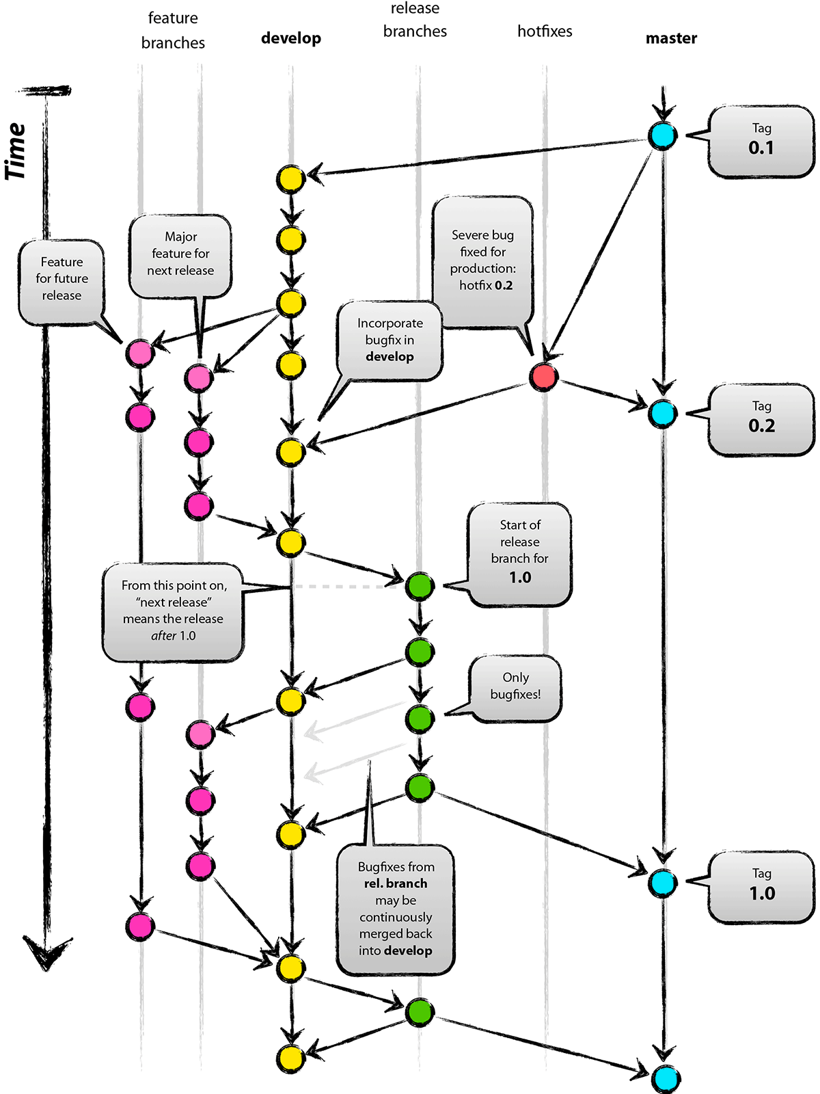

Git Flow
Full-featured workflow
Increased complexity
Designed for SW with official releases
Feature branches based off of develop
Git extensions to enforce policy
How are develop and main synchronized?
Where do merge conflicts occur and how are they resolved?
main
Author: Vincent Driessen
Original Blog: https://nvie.com/posts/a-successful-git-branching-model/
License: Creative Commons

Slide 20
GitHub Flow
http://scottchacon.com/2011/08/31/github-flow.html
Published as viable alternative to Git Flow
No structured release schedule
Continuous deployment & continuous integration allows for simpler workflow
Key Ideas
All commits in the main branch are deployable
Base feature branches off of main
Push local repository to remote constantly
Open Pull Requests early to start dialogue
Merge into main after Pull Request review

Slide 21
GitLab Flow
https://docs.gitlab.com/ee/workflow/gitlab_flow.html
Published as viable alternative to Git Flow & GitHub Flow
Semi-structured release schedule
Workflow that simplifies difficulties and common failures in synchronizing infinite lifetime branches
Key Ideas
main branch is staging area
Mature code in main flows downstream into pre-production & production infinite lifetime branches
Allow for release branches with downstream flow
Fixes made upstream & merged into main.
Fixes cherry picked into release branch

Slide 22
Considerations for Choosing a Git Workflow
Want to establish a clear set of polices that
results in correct code on a particular branch (usually main),
ensures that a team can develop in parallel and communicate well,
minimizes difficulties associated with parallel and distributed work, and
minimizes overhead associated with learning, following, and enforcing policies.
Adopt what is good for your team
Consider team culture and project challenges
Assess what is and isn’t feasible/acceptable
Start with simplest and add complexity where and when necessary

Slide 23
Summary
Distributed version control systems can introduce complexities due to their nature
Git provides a variety of mechanisms to aid collaboration
Hosting services provide additional collaboration mechanisms
Workflows provide a way of enabling collaborating developers to work effectively
There are many different workflows, choosing the best one that suites your team

Slide 24
Collaboration using Git Workflows for CSE projects
Trilinos Workflow
Open MPI Workflow
Flecsi Workflow

Slide 25
Current Trilinos Workflow
https://trilinos.github.io/
Test-driven workflow
Feature branches start and end with develop
All changes to develop must come from GitHub pull requests
Feature branches are merged into develop only after passing pull request test suite
Change sets from develop are tested daily for integration into main
Workflow designed so that
All commits in main are in develop
Merge conflicts exposed when integrating into develop
Merge conflicts never occur when promoting to main
main
develop
develop -> main testing
Pull request testing
Issue 1
Issue 2
Notes:
From the website: The Trilinos Project is a community of developers, users and user-developers focused on collaborative creation of algorithms and enabling technologies within an object-oriented software framework for the solution of large-scale, complex multi-physics engineering and scientific problems on new and emerging high-performance computing (HPC) architectures.
Trilinos is also a collection of reusable scientific software libraries, known in particular for linear solvers, non-linear solvers, transient solvers, optimization solvers, and uncertainty quantification (UQ) solvers.

Slide 26
Current Open MPI Workflow
Workflow designed so that
Support two most recent releases
Issues are addressed on all applicable branches
All PR’s reviewed by at least one core developer
Main and supported branches work at all times
Developers work on main or feature branches depending on complexity of the changes
Testing
CI testing on PR’s for any branch using Jenkins (limited set of compilers, hardware, tests)
Nightly testing on all branches using community-built MTT framework (more complex set of compilers, hardware, tests)
Additional testing for release candidates
https://www.open-mpi.org
Versioning:
Major versions - break compatibility
Minor versions – visible
Releases correct issues
main
Upcoming release (if exists)
Latest supported release
Previous supported release
Issue 1
Issue 2
Notes:
A High Performance Message Passing Library

Slide 27
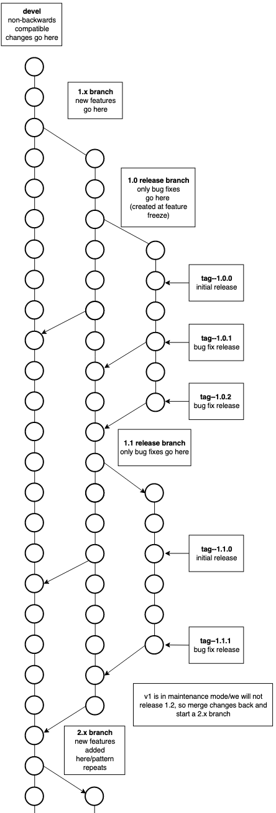
Current FleCSI Workflow
https://flecsi.github.io/flecsi
Versioning:
Incompatible - devel branch breaks compatibility with previous versions
Feature (1, 2 …) named for major version
Release - (1.x, 2.x …) named for major.minor version, correct issues, tags used for bug fixes.
Workflow designed so that
All supported branches work at all times
Merge Requests are tested and reviewed
Testing
Customized unit-testing framework based on Google Test
Special gitlab-ci branch - images and configuration files
Notes:
FleCSI is a compile-time configurable framework designed to support multi-physics application development for current and emerging HPC systems.
In the diagram there is a 1.x branch only for new releases, an initial 1.0 release branch with tag 1.0.0 as the initial release and tags 1.0.1, 1.0.2 for bug fixes, when 1.1 feature is release again an initial tag 1.1.0, then bug fix release tags 1.1.1 & 1.1.2 etc. Once a major version goes into maintenance mode and a new major feature branch begins; in this case 2.x and like branches and tags are created for 2.x

