Slide 1
Scientific Software Design
Anshu Dubey
(she/her)
Argonne National Laboratory
Software Productivity and Sustainability track @ Argonne Training Program on Extreme-Scale Computing summer school
Contributors: Anshu Dubey (ANL), Mark C. Miller (LLNL), David E. Bernholdt (ORNL)

Slide 2
License, Citation and Acknowledgements
License and Citation
This work is licensed under a Creative Commons Attribution 4.0 International License (CC BY 4.0).
The requested citation the overall tutorial is: Anshu Dubey, David E. Bernholdt, Todd Gamblin, and Jared O’Neal, Software Productivity and Sustainability track, in Argonne Training Program on Extreme-Scale Computing, St. Charles, Illinois, 2024. DOI: 10.6084/m9.figshare.26384188.
Individual modules may be cited as Speaker, Module Title, in Tutorial Title, …
Acknowledgements
This work was supported by the U.S. Department of Energy Office of Science, Office of Advanced Scientific Computing Research (ASCR), and by the Exascale Computing Project (17-SC-20-SC), a collaborative effort of the U.S. Department of Energy Office of Science and the National Nuclear Security Administration.
This work was supported by the U.S. Department of Energy, Office of Science, Office of Advanced Scientific Computing Research, Next-Generation Scientific Software Technologies (NGSST) program.
This work was performed in part at the Argonne National Laboratory, which is managed by UChicago Argonne, LLC for the U.S. Department of Energy under Contract No. DE-AC02-06CH11357.
This work was performed in part at the Lawrence Livermore National Laboratory, which is managed by Lawrence Livermore National Security, LLC for the U.S. Department of Energy under Contract No. DE-AC52-07NA27344.
This work was performed in part at the Los Alamos National Laboratory, which is managed by Triad National Security, LLC for the U.S. Department of Energy under Contract No.89233218CNA000001
This work was performed in part at the Oak Ridge National Laboratory, which is managed by UT-Battelle, LLC for the U.S. Department of Energy under Contract No. DE-AC05-00OR22725.
This work was performed in part at Sandia National Laboratories. Sandia National Laboratories is a multi-mission laboratory managed and operated by National Technology and Engineering Solutions of Sandia, LLC., a wholly owned subsidiary of Honeywell International, Inc., for the U.S. Department of Energy’s National Nuclear Security Administration under contract DE-NA0003525.

Slide 3
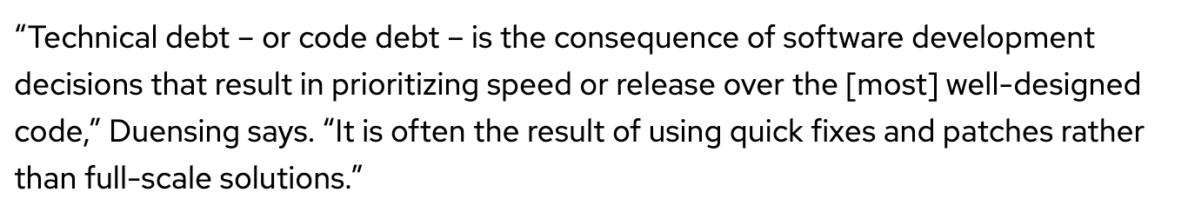
Introduction
Investing some thought in design of software makes it possible to maintain, reuse and extend it
Even if some research software begins its life as a one-off use case, it often gets reused
Without proper design it is likely to accrete features haphazardly and become a monstrosity
Acquires a lot of technical debt in the process
Many projects have had this happen
Most end up with a hard reset and start over again
In this module we will cover general design principles and those that are tailored for scientific software
We will also work through two use cases
definition from https://enterprisersproject.com/article/2020/6/technical-debt-explained-plain-english

Slide 4
Designing Software – High Level Phases
Requirements
gathering
Decomposition
Connectivity
Features and capabilities
Constraints
Limitations
Target users
Other …..
Understand design space
Decompose into high level components
Bin components into types
Understand component hierarchy
Figure out connectivity among components
Articulate dependencies

Slide 5
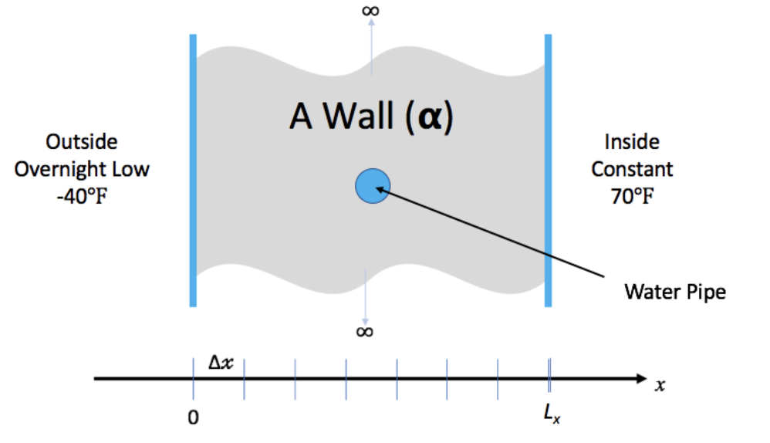
Example 1 – Problem Description
We have a house with exterior walls made of single material of thickness L_{x}
The wall has some water pipes shown in the picture.
The inside temperature is kept at 70 degrees. But outside temperature is expected to be -40 degrees for 15.5 hours.
Will the pipes freeze before the storm is over

Slide 6
Requirements gathering
To solve heat equation we need:
a discretization scheme
a driver for running and book-keeping
an integration method to evolve solution
Initial conditions
Boundary conditions
To make sure that we are doing it correctly we need:
Ways to inspect the results
Ways of verification

Slide 7
Decomposition
This is a small design space
Several requirements can directly map to components – in this instance functions
Driver
Initialization – data containers
Mesh initialization – applying initial conditions
Integrator
I/O
Boundary conditions
Comparison utility
Binning components
Components that will work for any application of heat equation
Driver
Initialization – data containers
I/O
Comparison utility
Components that are
Mesh initialization – applying initial conditions
Integrator
Boundary conditions

Slide 8
Connectivity
Mesh generation
Compare results
Initialize
Data containers
Driver
Write results
Boundary conditions
Integrator
Initial conditions

Slide 9
Connectivity – alternative possibility
Mesh generation
Compare results
Initialize
Data containers
Driver
Write results
Initial conditions
Boundary conditions
Integrator

Slide 10
Resources for Independent Exploration
Code repository in python
https://github.com/abiswas-odu/heateq-design-intersect-2023
A few possibilities of design exploration
Did we need three different interfaces for update solution ?
What would have been needed to make it into one interface
Explore the whole exercise in C++ on your own checkout
https://xsdk-project.github.io/MathPackagesTraining2020/lessons/hand_coded_heat/

Slide 11
Research Software Challenges
More Scientific Understanding
Many parts of the model and software system can be under research
Requirements change throughout the lifecycle as knowledge grows
Verification complicated by floating point representation
Real world is messy
More Hardware
Resources
Higher Fidelity
Model
More Diverse
Solvers

Slide 12
Additional Considerations for Research Software
Considerations
Multidisciplinary
Many facets of knowledge
To know everything is not feasible
Two types of code components
Infrastructure (mesh/IO/runtime …)
Science models (numerical methods)
Codes grow
New ideas => new features
Code reuse by others
Design Implications
Separation of Concerns
Shield developers from unnecessary complexities
Work with different lifecycles
Long-lasting vs quick changing
Logically vs mathematically complex
Extensibility built in
Ease of adding new capabilities
Customizing existing capabilities

Slide 13
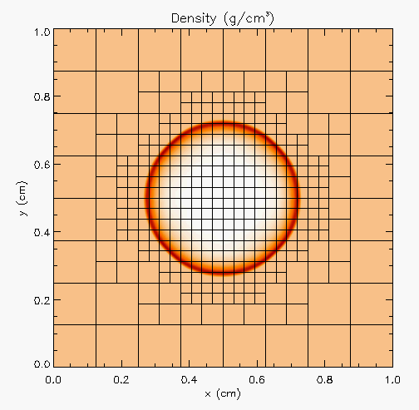
More Complex Application Design – Sedov Blast Wave
Description
High pressure at the center cause a shock to moves out in a circle. High resolution is needed only at and near the shock
Requirements
Adaptive mesh refinement
Easiest with finite volume methods
Driver
I/O
Initial condition
Boundary condition
Shock Hydrodynamics
Ideal gas equation of state
Method of verification

Slide 14
Deeper Dive into Requirements
Adaptive mesh refinement → divide domain into blocks
Blocks need halos to be filled with values from neighbors or boundary conditions
At fine-coarse boundaries there is interpolation and restriction
Blocks are dynamic, go in and out of existence
Conservation needs reconciliation at fine-coarse boundaries
Shock hydrodynamics
Solver for Euler’s equations at discontinuities
EOS provides closure
Riemann solver
Halo cells are fine-coarse boundaries need EOS after interpolation
Method of verification
An indirect way of checking – shock distance traveled can be computed analytically

Slide 15
Components
Deeper Dive into some Components
Driver
Iterate over blocks
Implement connectivity
Mesh
Data containers
Halo cell fill, including application of boundary conditions
Reconciliation of quantities at fine-coarse block boundaries
Remesh when refinement patterns change
I/O
Getting runtime parameters and possibly initial conditions
Writing checkpoint and analysis data
Binned Components
Unchanging or slow changing infrastructure
Mesh
I/O
Driver
Comparison utility
Components evolving with research – physics solvers
Initial and boundary conditions
Hydrodynamics
EOS

Slide 16
Connectivity
Initial conditions
Compare results
Mesh
Driver
I/O
Boundary conditions
Hydrodyn-amics
EOS

Slide 17
Connectivity
Initial conditions
Compare results
Mesh
Driver
I/O
Boundary conditions
Hydrodyn-amics
EOS

Slide 18
Connectivity
Initial conditions
Compare results
Mesh
Driver
I/O
Boundary conditions
Hydrodyn-amics
EOS

Slide 19
Connectivity
Initial conditions
Compare results
Mesh
Driver
I/O
Boundary conditions
Hydrodyn-amics
EOS

Slide 20
Connectivity
Initial conditions
Compare results
Mesh
Driver
I/O
Boundary conditions
Hydrodyn-amics
EOS

Slide 21
A Design Model for Separation of Concerns
Infrastructure
Capabilities
Requirements
Model
Software Architecture API Design
API
Implement
Design
Develop
Test
Validate
Maintain
Augment
Integrate

Slide 22
Exploring design space – Abstractions
Constraints
Only infrastructure components have global view
All physics solvers have block view only
Other Design Considerations
Data scoping
Interfaces in the API
Spatial
decomposition
domain sections
as stand-alone
computation unit
Real view : A
whole domain
with many
operators
base
abstraction
Functional
decomposition
collection of
components
Minimal Mesh API
Initialize_mesh
Halo_fill
Access_to_data_containers
Reconcile_fluxes
Regrid
Notes:
Example of changing the block size to adjust to the cache memory
And point-to-point Vs collectives depending upon the scale of the problem

Slide 23
Separation of Concerns Applied
Spatial
decomposition
domain sections
as stand-alone
computation unit
Parallelization
and scaling
optimization
Implemented by
domain experts
and applied
mathematicians
Implemented by
software and
performance
engineers
Real view : A
whole domain
with many
operators
Functional
decomposition
collection of
components
Memory
access and
compute
optimization
Notes:
Example of changing the block size to adjust to the cache memory
And point-to-point Vs collectives depending upon the scale of the problem

Slide 24
Takeaways so far
Differentiate between slow changing and fast changing components of your code
Understand the requirements of your infrastructure
Implement separation of concerns
Design with portability, extensibility, reproducibility and maintainability in mind

Slide 25
New Paradigm Because of Platform Heterogeneity
More Scientific Understanding
Heterogeneous
models
More Hardware
Resources
Higher Fidelity
Model
Software complexity
Distributed
memory
model
More Diverse
Solvers
Platform complexity

Slide 26
Mechanisms Needed by the Code
Mechanisms to unify expression of computation
Minimize maintained variants of source suitable for all computational devices
Reconcile differences in data structures
Mechanisms to move work and data to computational targets
Moving between devices
Launching work at the destination
Hiding latency of movement
Moving data off node
So, what do we need?
Abstractions layers
Code transformation tools
Data movement orchestrators
Mechanisms to map work to computational targets
Figuring out the map
Expression of dependencies
Cost models
Expressing the map

Slide 27
Mechanisms Needed by the Code: Example of Flash-X
Mechanisms to unify expression of computation
Macros with inheritance
Mechanisms to move work and data to computational targets
Domain specific runtime
Mechanisms to map work to computational targets
DSL for recipes with code generator
Composability in the source
A toolset of each mechanism
Independent tool sets

Slide 28
State of Practice – Abstractions and Runtimes
Still very focused on GPU
Majority of ECP applications park their data on the GPU and just work there
Abstractions -- data structures and parallelization of loops
Limitations
No way to handle algorithmic variants in a unified way
No way to transfer domain knowledge based possible optimizations to the tools
None of the prevalent languages allow a good way to define data locality
Boutique HPC languages like chapel do – but chicken and egg problem with adoption

Slide 29
State of Practice – Abstractions and Runtimes
Still very focused on GPU
Majority of ECP applications park their data on the GPU and just work there
Abstractions -- data structures and parallelization of loops
Limitations
No way to handle algorithmic variants in a unified way
No way to transfer domain knowledge based possible optimizations to the tools
None of the prevalent languages allow a good way to define data locality
Boutique HPC languages like chapel do – but chicken and egg problem with adoption
The holy grail for scientists – write equation and generate code
Very limited success in some domains
Is there another way?

Slide 30
State of Practice – Abstractions and Runtimes
Still very focused on GPU
Majority of ECP applications park their data on the GPU and just work there
Abstractions -- data structures and parallelization of loops
Limitations
No way to handle algorithmic variants in a unified way
No way to transfer domain knowledge based possible optimizations to the tools
None of the prevalent languages allow a good way to define data locality
Boutique HPC languages like chapel do – but chicken and egg problem with adoption
We have been developing one for Flash-X – started under ECP and TEAMS, continuing with RAPIDS and ENAF
The holy grail for scientists – write equation and generate code
Very limited success in some domains
Is there another way?

Slide 31
Orthogonal Axes of Challenges and Optimization
Separate out arithmetic and control flow
Make arithmetic invariant
Turn separate pieces into building blocks using macros
[hy_fluxesSec1]
args= XL, XR,limits
definition =
@M loop_begin(limits)
if (flux(1@M indices) > 0.) then
call doSection1(XL(:@M indices), ……)
else
call doSection1(XR(:@M indices), …….)
end if
@M loop_end
Alternative Definitions
For all spatial points at once For one spatial point at a time. indices] [indices]
definition = definition =
,i,j,k
[loop_begin] [loop_begin]
args = limits args = limits
definition= definition=
do k = limits(LOW,KAXIS),limits(LOW,KAXIS)
do j = limits(LOW,JAXIS),limits(LOW,JAXIS)
do I = limits(LOW,IAXIS),limits(LOW,IAXIS)
[loop_end] [loop_end]
definition = definition =
enddo
enddo
enddo
Permit alternative definitions for all the macros as needed
Build in arbitration mechanism for picking the right definition
This code section can be invoked as
@M hy_fluxesSec1(uLeft,uRight,blkLimits)

Slide 32
Alternatively
[hy_fluxesSec1]
args= XL, XR,limits
definition =
@M loop_begin(limits)
if (flux(1@M indices) > 0.) then
@M doSection1(XL)
else
@M doSection1(XR)
end if
@M loop_end
Alternative Definitions
For all spatial points at once For one spatial point at a time
[indices] [indices]
definition = definition =
,i,j,k
[loop_begin] [loop_begin]
args = limits args = limits
definition= definition=
do k = limits(LOW,KAXIS),limits(LOW,KAXIS)
do j = limits(LOW,JAXIS),limits(LOW,JAXIS)
do I = limits(LOW,IAXIS),limits(LOW,IAXIS)
[loop_end] [loop_end]
definition = definition =
enddo
enddo
enddo
[doSection1]
args=uDir
definition =
… some computation
uDir(:@M indices) = res
With macros it is possible to use any arbitrary code section as a building block

Slide 33
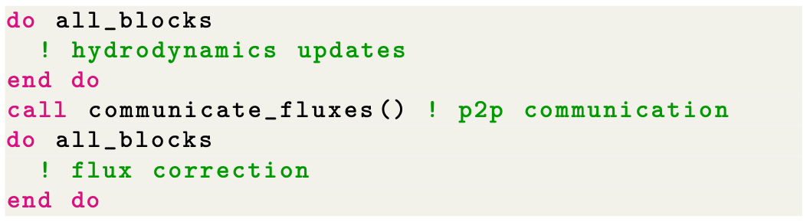
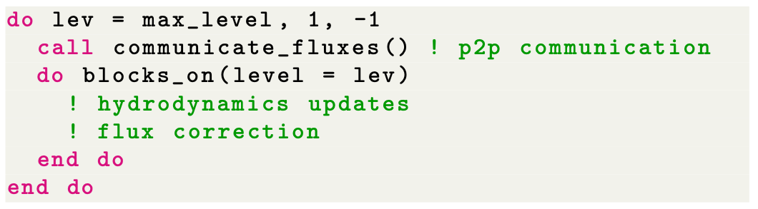
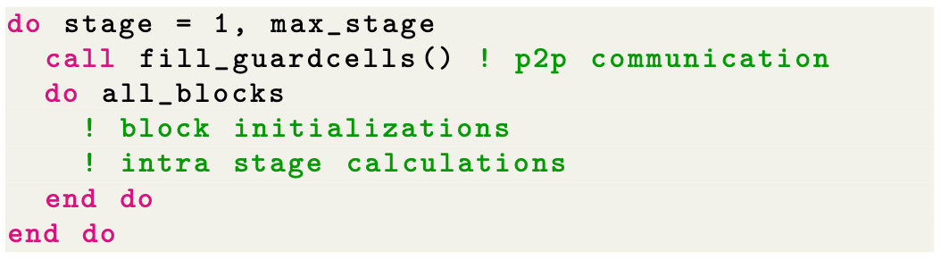
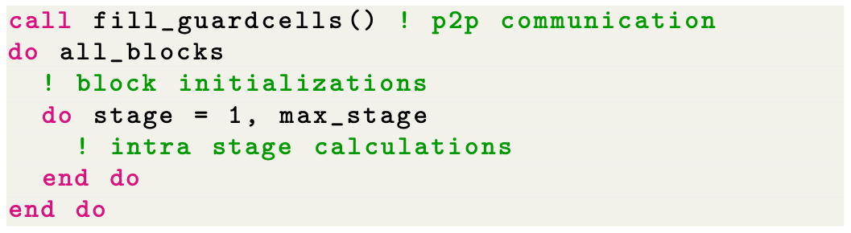
Orthogonal Axes of Challenges and Optimization
Have a method for expressing algorithmic variants
Without delving into the details of the arithmetic
Example -- Flash-X supports two block-structured AMR grid backends
Paramesh: Octree-based, AMReX: Level-based
Each has different preferences for flux correction at fine-coarse boundaries
For higher order RK integration Communication avoidance – telescoping mode

Slide 34
Orthogonal Axes of Challenges and Optimization
Have a way of rearranging data locality and moving data and computation
Let the human-in-the-loop dictate this
CG-Kit – recipes in python
-- templates for different variants
-- express where to compute what
-- emit code in Fortran/C/C++
Milhoja – flatten/decompose data and move it to the target
-- combine data into one data packet
-- decompose into smaller computational sections if needed
If tools only execute what they are told to, they are simpler
Code generation is our friend – especially when it is simple forward map
And is not entangled with the details of the arithmetic
If N blocks are sent to the device we need N copies of all block-wise scratch
For all data items we need device pointers
Code internally decorated with directives

Slide 35
Code Generators
Two Classes
Data packet generators
Parse the interface files
Collect all data to be put into a data packet
Generate code that will flatten all data into data packets
Task function generators
Consolidate functions to be invoked
Bookended by internode communication
Unpack data packets
Decorate interface definitions with needed metadata
Example -- this link will work only if you have access to the Flash-X code repository. Please email flash-x@lists.cels.anl.gov with your github username to get access.

Slide 36
Final takeaways
Requirements gathering and intentional design are indispensable for sustainable software development
Many books and online resources available for good design principles
Research software poses additional constraints on design because of its exploratory nature
Scientific research software has further challenges
High performance computing research software has even more challenges
That are further exacerbated by the ubiquity of accelerators in platforms
Separation of concerns at various granularities, and abstractions enable sustainable software design

