Slide 1
Software Practices for Reproducible Science
David E. Bernholdt, Anshu Dubey, Todd Gamblin, and Jared O’Neal
Software Productivity and Sustainability track @ Argonne Training Program on Extreme-Scale Computing summer school
Slides, late-breaking updates, etc. at: https://bssw-tutorial.github.io/
and click the link for today’s tutorial

Slide 2
License, Citation and Acknowledgements
License and Citation
This work is licensed under a Creative Commons Attribution 4.0 International License (CC BY 4.0).
The requested citation the overall tutorial is: Anshu Dubey, David E. Bernholdt, Todd Gamblin, and Jared O’Neal, Software Productivity and Sustainability track, in Argonne Training Program on Extreme-Scale Computing, St. Charles, Illinois, 2024. DOI: 10.6084/m9.figshare.26384188.
Individual modules may be cited as Speaker, Module Title, in Tutorial Title, …
Acknowledgements
This work was supported by the U.S. Department of Energy Office of Science, Office of Advanced Scientific Computing Research (ASCR), and by the Exascale Computing Project (17-SC-20-SC), a collaborative effort of the U.S. Department of Energy Office of Science and the National Nuclear Security Administration.
This work was supported by the U.S. Department of Energy, Office of Science, Office of Advanced Scientific Computing Research, Next-Generation Scientific Software Technologies (NGSST) program.
This work was performed in part at the Argonne National Laboratory, which is managed by UChicago Argonne, LLC for the U.S. Department of Energy under Contract No. DE-AC02-06CH11357.
This work was performed in part at the Lawrence Livermore National Laboratory, which is managed by Lawrence Livermore National Security, LLC for the U.S. Department of Energy under Contract No. DE-AC52-07NA27344.
This work was performed in part at the Los Alamos National Laboratory, which is managed by Triad National Security, LLC for the U.S. Department of Energy under Contract No.89233218CNA000001
This work was performed in part at the Oak Ridge National Laboratory, which is managed by UT-Battelle, LLC for the U.S. Department of Energy under Contract No. DE-AC05-00OR22725.
This work was performed in part at Sandia National Laboratories. Sandia National Laboratories is a multi-mission laboratory managed and operated by National Technology and Engineering Solutions of Sandia, LLC., a wholly owned subsidiary of Honeywell International, Inc., for the U.S. Department of Energy’s National Nuclear Security Administration under contract DE-NA0003525.

Slide 3
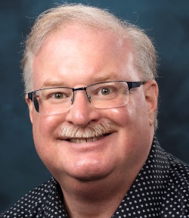
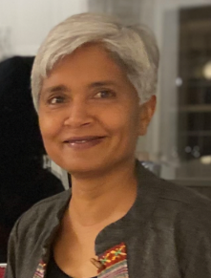
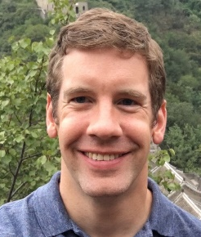
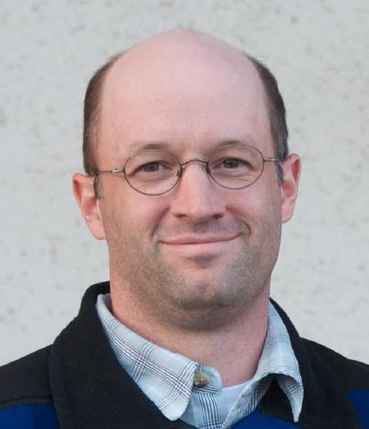
About Us
David E. Bernholdt, ORNL
Anshu Dubey, ANL
Todd Gamblin, LLNL
Jared O’Neal, ANL
David
he/him
Anshu
she/her
Todd
he/him
Jared
he/him
Participants in the Consortium for the Advancement of Scientific Software (CASS) and DOE/ASCR software stewardship projects: https://cass.community/
Members of the IDEAS Productivity family of projects: https://ideas-productivity.org/
Lead for the Spack project: https://spack.io/ (Todd)
Also…
SciDAC: RAPIDS Institute, fusion energy sciences, nuclear physics
NSF Cyberinfrastructure for Sustained Scientific Innovation (CSSI) program
Past: Exascale Computing Project
And more!

Slide 4

Building an Online Community
https://bssw.io
New community-based resource for scientific software improvement
A central hub for sharing information on practices, techniques, experiences, and tools to improve developer productivity and software sustainability for computational science & engineering (CSE)
Goals
Raise awareness of the importance of good software practices to scientific productivity and to the quality and reliability of computationally-based scientific results
Raise awareness of the increasing challenges facing CSE software developers as high-end computing heads to extreme scales
Help CSE researchers increase effectiveness as well as leverage and impact
Facilitate CSE collaboration via software in order to advance scientific discoveries
Site users can…
Find information on scientific software topics
Contribute new resources based on your experiences
Create content tailored to the unique needs and perspectives of a focused scientific domain

Slide 5

Follow BSSw
BSSw Digest: https://bssw.io/pages/receive-our-email-digest
Updates on BSSw content
New blog posts, events, and resources
BSSw Fellowship
Typically 1-2 messages per month
Also: RSS feed: https://bssw.io/items.rss

Slide 6
The Importance of Naming
Computing is rife with terminology that many consider harmful and exclusionary
Examples include: whitelist/blacklist, master/slave, and master (standalone)
We support efforts to replace such language with more inclusive language
In this tutorial, we strive to use inclusive language
Example: we use “main” for the default git branch, even where outside sources we reference may use “master”
We welcome suggestions for further improvements in our tutorial
Additional information:
The Inclusive Naming Initiative
The BSSw.io resource on inclusive naming provides some additional context and links

Slide 7
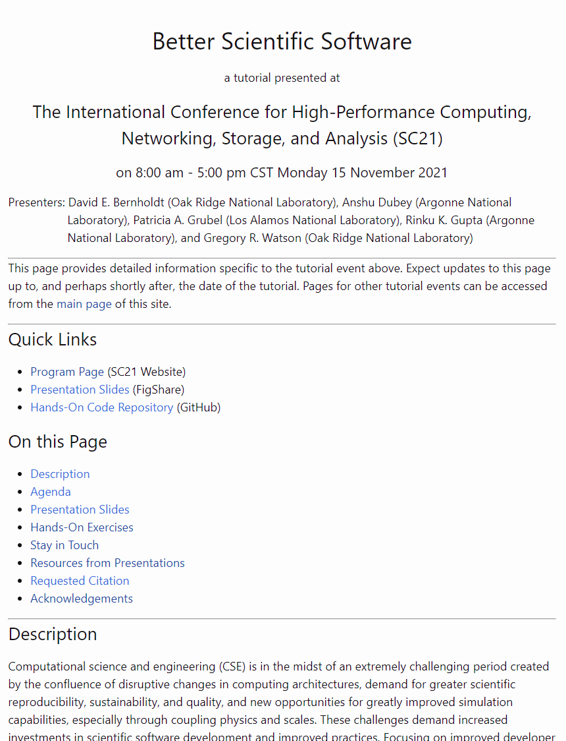
BSSw Tutorial Web Site
https://bssw-tutorial.github.io/ is the one URL you need to find all the resources for this tutorial
Each tutorial event has its own page
Each tutorial page is considered archival
All of the materials used in that tutorial (or links to them)
Materials may be updated if we find mistakes

Slide 8
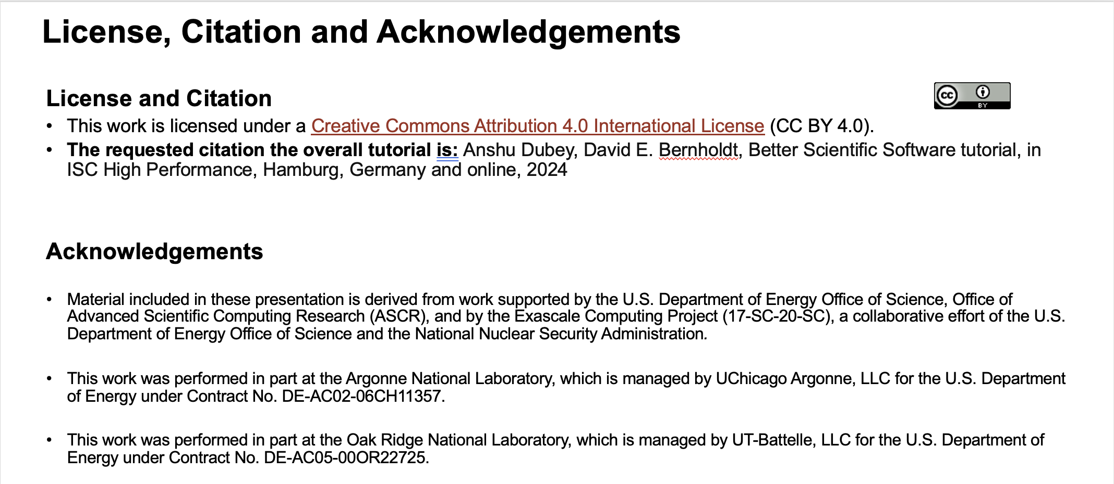
Explaining Slide 2
Slide 2 in all of our presentations contains the license, citation, and acknowledgements for the tutorial
(Software) best practice to make your license and preferred citation(s) easily findable
Sponsor acknowledgements rarely hurt!

Slide 9
We Want to Interact with You!
We find these tutorials most interesting and informative (for everyone) if you ask questions and share experiences!
We learn too!
Please raise your hand at any time to ask a question
After the tutorial email us at bssw-tutorial@lists.mcs.anl.gov
With questions or feedback
The list moderator will allow your messages to be posted
Refer to bssw-tutorial.github.io page for all tutorial materials

Slide 10
Agenda (1/2)
The agenda is also available on the tutorial web page. Visit https://bssw-tutorial.github.io and click on the link for today’s tutorial
Time (CDT) | Title | Presenter
8:30 AM | Introduction | David E. Bernholdt (ORNL)
8:35 AM | Motivation and Overview of Best Practices in HPC Software Development | David E. Bernholdt (ORNL)
9:15 AM | Scientific Software Design | Anshu Dubey (ANL)
10:00 AM | Break
10:30 AM | Spack: Package Management for HPC | Todd Gamblin (LLNL)
11:30 AM | Spack Hands-On | Todd Gamblin (LLNL)
12:30 PM | Lunch

Slide 11
Agenda (2/2)
The agenda is also available on the tutorial web page. Visit https://bssw-tutorial.github.io and click on the link for today’s tutorial
Time (CDT) | Title | Presenter
12:30 PM | Lunch
1:30 PM | Software Testing and Verification | Anshu Dubey (ANL)
2:30 PM | Refactoring Scientific Software | Anshu Dubey (ANL)
3:00 PM | Break
3:30 PM | Software Licensing | David E. Bernholdt (ORNL) and Todd Gamblin (LLNL)
4:30 PM | Improving Reproducibility Through Better Software Practices | David E. Bernholdt (ORNL)
5:30 PM | Lab Notebooks for Computational Mathematics, Sciences, & Engineering | Jared O'Neal (ANL)
6:30 PM | Adjourn

