Slide 1
Ad-hoc On-Demand Distance Vector (AODV)
By Charlie Perkins and Elizabeth Moyer

Slide 2
Ad-hoc Networks
No infrastructure in the network
All nodes capable of movement
Links appear and disappear dynamically
Special constraints:
  limited bandwidth
  limited power
  high error rates
Protocol needed to create and maintain routes
Conventional routing protocols not applicable

Slide 3
Desired Characteristics of an
Ad-hoc Routing Protocol
Ability to find multi-hop paths
Unicast, broadcast, and multicast routing ability
Dynamic topology maintenance
Ability to self-start
Loop-freedom and rapid route convergence
Low consumption of memory, bandwidth
Scalable to large (1000) populations of nodes
Minimal control overhead
No data overhead

Slide 4
Ad-hoc On-Demand Distance Vector Routing (AODV)
Primary Objectives
  Provide unicast, broadcast, and multicast capability
  Initiate forward route discovery only on demand (reactive)
  Disseminate changes in local connectivity to those neighboring nodes likely to need the information
Characteristics
  On-demand route creation, resulting in localized effect of topology changes, and minimized control traffic
  Two dimensional routing metric: <Seq #, HopCount>
  Storage of routes in a Route Table at each node
    i.e. hop-by-hop routing

Slide 5
Loop freedom
Each node:
  has a non-decreasing local sequence number
  keeps track of the largest sequence number it has seen from each other node.
Recall that the metric to reach a destination is
  <seq #, hop count>
To ensure loop freedom, for every node A whose next hop to D is B (i.e., A → B → … → D), we always have the following
  seq # of D at A is ≤ seq # of D at B
  If equal, the hop count at A to reach D is greater than the hop count at B to reach D
You can argue that this ensures loop freedom (why?)
(D’s seq #, hop-count)
(5,5)
A
(7,4)
B
X
(7,3)
Y
(8,1)
D
(8,0)

Slide 6
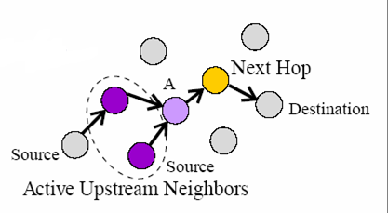
Routing Table
A row in A’s routing table:
  Destination IP Address
  Destination Sequence Number
  Hop Count
  Next Hop IP Address
  Active Upstream Neighbors
  Expiration time
Nodes that recently have sent data to the destination via A
Update the expiration time to at least:
current_time + active_route_timeout
whenever data is sent to the
destination
Route entries may be updated
if a better route is discovered
(i.e. with greater sequence
number or an equal sequence
number with a smaller hop
count)

Slide 7
Route Discovery
Route discovery is performed by broadcasting (flooding) a route-request (RREQ) message looking for the destination
The destination replies with a route-reply (RREP)
Each node maintains a local broadcast_id number
  It is incremented every time a new RREQ is broadcasted
  Used to eliminate redundant broadcasts

Slide 8
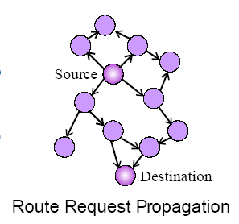
Route Discovery
Source increases its local sequence number and broadcast ID. Then, it broadcasts a Route Request (RREQ)
RREQ contains:
<Source_Addr, Source_Seq#, Broadcast_ID, Dest_Addr, Dest_Seq#(0 if unknown), Hop_Count>
Nodes keep track of <Source_Addr, Broadcast_ID>
and discards redundant broadcasts
A node can reply to the RREQ if
  It is the destination, or
  It has a route to the destination with sequence number at least Dest_Seq#
Otherwise it rebroadcasts the RREQ after increasing the hop count.

Slide 9
RREQ Propagation
S, bid,src s# 5,hc 0
S
Some fields are
omitted, i.e., D
and seq # of D
S, bid, src s# 5,hc 0
D

Slide 10
RREQ Propagation
S (5,1)
S
S, bid,src s# 5,hc 1
S (5,1)
S (5,2)
S, bid,src s# 5,hc 1
S,bid,src s# 5,hc 2
S (5,3)
S,bid,src s# 5,hc 3
D

Slide 11
RREQ Propagation
S (5,1)
S
S (5,1)
S (5,2)
S,bid,src s# 5,hc 4
X
S (5,3)
Y
S (5,4)
S,bid,src s# 5,hc 2
Both X and Y discard each other’s RREQ since the same (source, bcast_id) has been seen before (i.e., Y will not learn of the shorter path to S)
D

Slide 12
Some details on processing a RREQ
Dest_Seq# in the RREQ is the latest # known by the source (perhaps 0)
If the same bcast_id has been seen before, drop the message (even if it has a lower hop count!)
Since the source seq # is incremented before bdcasting the RREQ, it is larger than the source seq # of any earlier RREQ.
  I.e., this will create a new path back to the source that overrides any earlier paths created from a RREQ.
  Why do we want this?

Slide 13
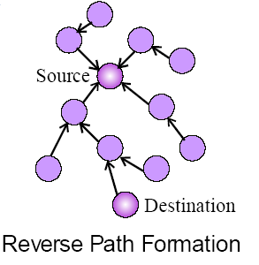
Reverse Route Entry Setup
From the RREQ, nodes update their Route Table with an entry for the source node.
  Destination IP Address = Source_Addr
  Destination Sequence Number = Source_Seq#
  Hop Count = Hop_Count
  Next Hop IP Address = neighbor from whom I received this RREQ
  Active Neighbors = empty
  Expiration time = current time + active_route_timeout
This entry is later used to forward the Route Reply (RREP) back to source if one is received
Expiration time is long enough for a RREP to be received back at the source.

Slide 14
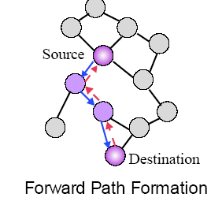
Route Reply
Destination, or intermediate node with current route to destination, unicasts Route Reply (RREP) back to source.
If RREP is sent by the destination:
  The destination increases its sequence number (if necessary) before sending RREP
  New value must be increased to at least the Dest_Seq# of the RREQ.
RREP contains:
<Source_Addr, Dest_Addr, Dest_Seq#, Hop_Count, Lifetime>

Slide 15
Forward Route Entry Setup
From the RREP, nodes along the path to the source add a Routing Table entry for the destination node:
  Destination IP Address = Dest_Addr
  Destination Sequence Number = Dest_Seq#
  Hop Count = Hop_Count
  Next Hop IP Address = neighbor from whom I received this RREP
  Active Neighbors = empty
  Expiration time = current time + max(lifetime, active_route_timeout)
Since routes are bidirectional, lifetime is also applied to the table entry of the source
Source can begin sending data when it receives first RREP.

Slide 16
Optimizations
If a node x receives a control message (RREQ or RREP) from which it learns a better metric (larger seq# or equal seq# but with smaller hop count) regarding some node y, AND x forwards the message to its neighbor(s), then
  x MUST update its routing table entry for y, i.e.,
    Update its metric for y from the metric in the control message
    Choose as next hop to y the node that forwarded the control message to x.
Why? (see next slide ☺ )

Slide 17
Optimizations (continued)
p ---- x --- … --- … -- y
  If x forwards the message to p, and x does not update its routing table, it will violate the loop invariant if p chooses x as its next hop to y
message propagation

Slide 18
Optimizations (continued)
Source --- … --- Intermediate Node --- … --- Destination
If you sent an early RREP (you are the intermediate node) then
  Also send a (unsolicited) RREP to the destination
  This RREP has as a “destination” the source of the RREQ, and as “source” the destination of the RREQ.
  This will prevent the destination from broadcasting a RREQ looking for the source later on (when the destination sends data to the source)

Slide 19
Summary of routing table changes
If you receive a RREP with a better seq# or same seq# but a better hop count from a neighbor, do you update your routing table?
If you receive a RREQ with a better seq# do you update your routing table?
If you receive a RREQ with the same seq # but a better hop count, do you update your routing table?

Slide 20
More details on processing a RREQ
Can a node X receive a new RREQ (broadcast_id never seen before) with a source Y and a seq # smaller than what X has seen before from Y?
  Yes, if Y did a RREP (say, to Z) after doing the RREQ and the RREP arrived to X before the RREQ
  X keeps the information of the larger sequence # in its routing table (no change)
  Do allow the broadcast of the RREQ to continue since you have not seen it before

Slide 21
Path Maintenance – Active Neighbors
A routing table entry for a destination (i.e. a “path” to the destination) is active if within the last active_route_timeout seconds it has received a data message addressed to that destination.
The set of active neighbors of a routing table entry are all those neighbors that have sent data messages addressed to the destination within the last active_route_timeout seconds.
Inactive routing table entries are deleted
Movement of nodes not along active path does not trigger protocol action.

Slide 22
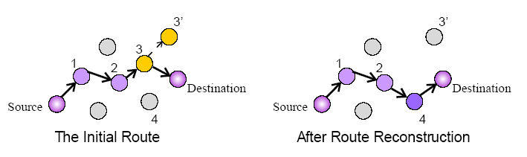
Path Maintenance (continued …)
Node 3 moves to new location 3’
Node 2 notices loss of link, sends link failure to Node 1 (its active neighbor)
Node 1 forwards link failure to Source (its active neighbor)
Source reinitiates route discovery, finds new route through Node 4

Slide 23
Path Maintenance (continued …)
If source node itself moves, it can reinitiate route discovery.
When destination or intermediate node moves along an active path (still have active neighbors),
  Node upstream of break sends unsolicited RREP to all active upstream neighbors
    ∞ hop count, with incremented Dest_Seq#
  RREP is propagated to their active neighbors, and so on back to source (each setting their hop count to ∞)
  Used to flush stale routes (has larger seq# so nodes must update their tables to ∞)
Source can reinitiate route discovery if route is still needed
  RREQs contains destination sequence number at least greater than the RREP that showed ∞ hop count.

Slide 24
Local Connectivity Management
Node must periodically hear from its neighbors to know they are still within range
Eavesdrop on neighbor transmissions
If no other transmissions within hello_interval, broadcast Hello packet
Failure to hear from a neighbor for
(1 + allowed_hello_loss) * hello_interval
indicates loss of link

Slide 25
Simulation Results
If you are interested in these, please see the paper
I will not hold you responsible for the simulations.

Slide 26
Concluding Remarks
On-demand route establishment
Minimum delay for route discovery
Quick response to link breakage in active routes
Maintenance of loop-free routes by use of destination sequence numbers
Scalable to large populations of nodes

