Slide 1
Multi-Protocol Label Switching

Slide 2
Background
It was meant to improve routing performance on the Internet
  Routing is difficult using CIDR (longest prefix matching)
MPLS is similar to virtual circuits
  Only a fixed-sized label is used (like a VCID) with local scope
It is very datagram oriented though
  It uses IP addressing and IP routing protocols

Slide 3
What is it good for?
To enable IP capability on devices that cannot handle IP traffic
Forward packets along “explicit routes” (pre-calculated routes not used in “regular” routing)
To support certain virtual private network services
Note: “performance” is not above
  Router hardware-software have improved so much is not an issue anymore

Slide 4
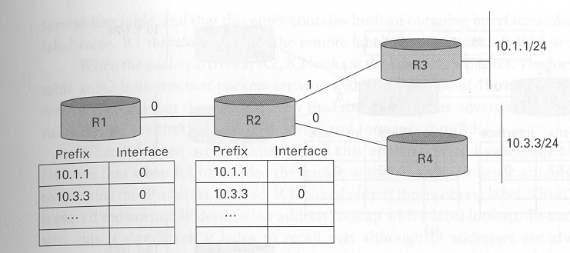
Destination Based Forwarding

Slide 5
Labels for Destination-Based Forwarding
A label is allocated for each prefix in its table
  The label is chosen locally
  Think of them as indices into the routing table
Router advertises this to its neighbors
  “label distribution protocol” (LDP)
Packets addressed to the prefix should, for efficiency, be tagged with the label.
The label of an incoming packet is “swapped” before being forwarded to the next router.

Slide 6
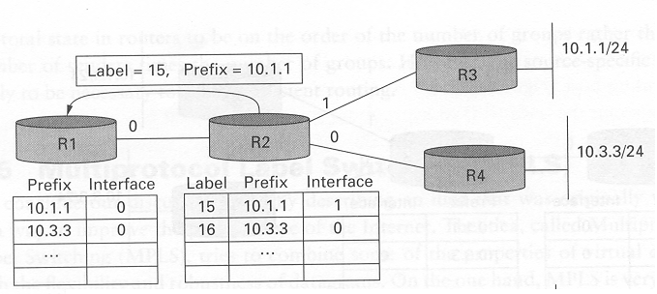

Slide 7
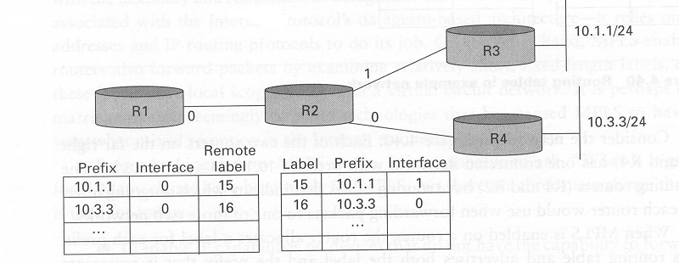

Slide 8
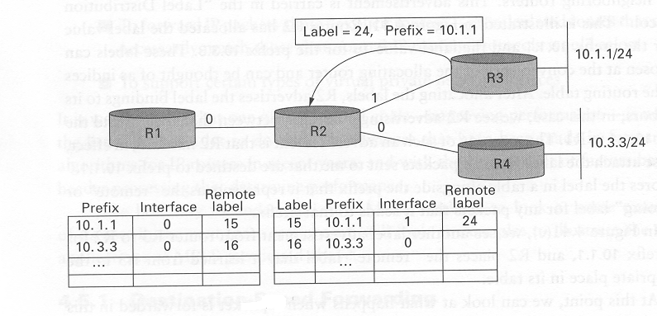
How does a data packet go from R1 to R3?

Slide 9
Remarks
Rather than longest prefix-matching we use label matching
  Labels can be very efficient, simply an index into the routing table
Regular IP routing is still used
  E.g., we could use OSPF to determine the routes
  Then we use labels for efficiency in per-hop routing
Labels are not necessary, they are used just for efficiency (in destination-based forwarding)
Differences with VC’s:
    Note that a “Setup” phase (like in VC’s) is not used !
    Index in VCs was (port #, VID)
    Index in MPLS is just the MPLS label (port # is not used)

Slide 10
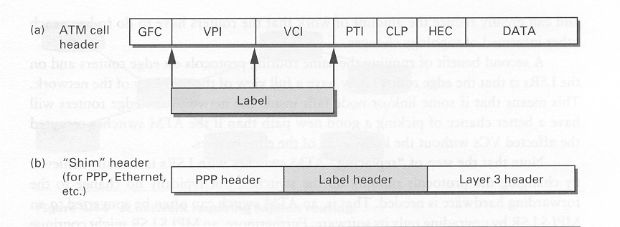
Placement of “labels”
For Ethernet, the “protocol number” in the Ethernet header will be 0x8847 (i.e. MPLS); the “protocol number” of IP is not used.
Thus, IP never sees the message!

Slide 11
MPLS, in general
We saw destination-based forwarding (a specific application of MPLS)
Let us now look at MPLS in general terms

Slide 12
Some Definitions
Forwarding Equivalence Class (FEC): a group of IP packets which are forwarded in the same manner (e.g., over the same path, with the same forwarding treatment)
Labeled Switched Router (LSR): A router capable of supporting MPLS labels.
Labeled Switched Path: a sequence of LSR’s so that data can traverse the entire path using labels.

Slide 13
Label Merging
When multiple input streams corresponding to the same FEC exit using the same MPLS label
InLabel NxtHop Label
Port 3 30
25 Port 3 30
Netw D
Dest NxtHop Label
D Port 1 10
R2
R4
Port 3
R1
Port 1
Port 5
R3
Dest NxtHop Label
D Port 5 25

Slide 14
Non-Label Merging
Each source-destination pair has its own label at each LSR router.
InLabel NxtHop Label
Port 3 5
25 Port 3 8
Netw D
Dest NxtHop Label
D Port 1 10
R2
R4
R1
Port 3
Port 1
Port 5
R3
Dest NxtHop Label
D Port 5 25

Slide 15
Pushing-Requesting Labels
R2 can “push” a label to R1, indicating which label to use to reach D
R1 can “request” a label from R2 to be used to reach D.
If using non-merging, usually R1 requests a label from R2
Netw D
R2
R4
R1

Slide 16
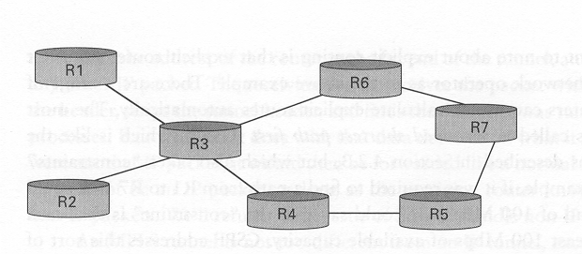
Explicit Routing
Similar to “source routing” but done by a router
“Fish” network due to its shape
R1 -> R7 : R1 R3 R6 R7
R2 -> R7 : R2 R3 R4 R5 R7
  Perhaps we want to balance the load somehow
Cannot be done with regular IP
  IP routing does not look at the source of the message

Slide 17
Resource Reservation Protocol (RSVP)
How to establish a “labeled path” from R1 to R7 and R2 to R7?
  (note: two labels at R3, one for R1 and one for R2)
Use RSVP
  It sets up a “path” from a source to a destination
  It reserves resources (optional)
  It is basically like setup of a VC in ATM

Slide 18
Explicit Route Advantages
Traffic Engineering
  You can control how much traffic travels through some point in the network
  This is done by controlling the paths taken by traffic
Fast-rerouting
  You can bypass broken links quickly with explicit routing.
    No need to wait for a routing protocol (OSPF) to react.
  How?
    Keep track of two paths, regular path and backup path
    If the regular path fails use the backup

Slide 19
MPLS and ATM
Most importantly, we can use ATM switches for IP
We can turn “ATM Cell switches” into “label switching routers” usually only by changing the software and not the hardware of the switch.
  I.e., give the ATM switch a “brain transplant”

Slide 20
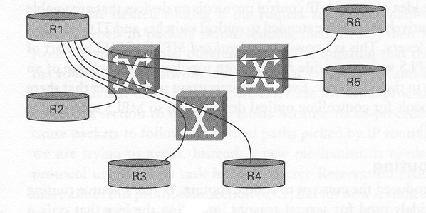
IP over ATM (Before MPLS)
We built a VC over the ATM network from every router to every other router
  Known as an “overlay” network
Whole ATM network looked like a single “subnet” to the IP Routers
  ATM switches are not aware that the payload is an IP packet

Slide 21
IP disassembly into ATM cells
IP becomes an “application” to the ATM layer.
IP packets have to be broken into small 48-byte pieces, and placed into ATM Cells
Cells are sent over the ATM circuit (e.g. from R1 to R6), the switches only see ATM Cells, not IP packet
At R6, the cells are regrouped and the IP packet restored

Slide 22
Why did we used to do this?
Was desirable because ATM switches had higher throughput than IP routers
This no longer the case
However:
  There is though a lot of ATM hardware still out there
  Plus ATM provides other features
    Circuit emulation, virtual circuit services

Slide 23
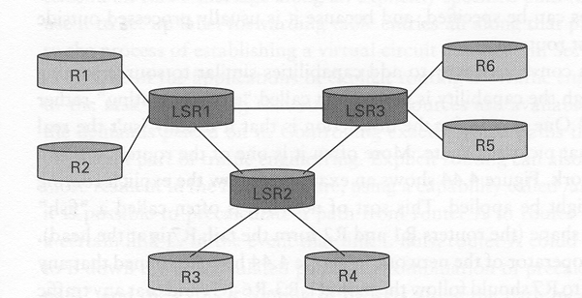
ATM switches as LSRs (using MPLS)
Change the software (not hardware) of ATM switches.
  I.e., ATM cells still have to arrive on the links, and use VC’s
However, ATM switches are now “peers” of MPLS routers (and run IP)
Each link is now an independent subnet

Slide 24
How to route IP packets?
Can we send IP messages to our neighbors?
  We can use a special VCID (hardcoded in software, say 0) to send IP messages to our neighbor.
  Each node has a VCID 0 with each of its neighbors (a “single hop” VCID)
  Thus, to send an IP message to a neighbor
    Disassemble the IP packet into ATM Cells
    Send them on VCID 0 of the link of the desired neighbor
    The neighbor reassembles the IP packet
Since we can send an IP message to any neighbor
  This implies ATM LSR’s can execute ANY Internet protocol based on IP (e.g., OSPF, RIP, etc) and forward IP datagrams

Slide 25
End-to-end VC’s
Disassembly/reassembly at each hop is wasteful
  It is better to establish an e-2-e VC for each source/destination pair, e.g., from R1 to R6
From OSPF (or other mechanism), each router knows which other router is ATM or regular router
  R1 “requests” a label from LSR1 for destination R6
  LSR1 requests a label from LSR3 for destination R6
  LSR3 requests a label from R6
  I.e., a VC is built from R1 to R6
Labels are NOT merged (not destination-based forwarding).
  Why?

Slide 26
Advantages of MPLS vs overlay
Each MPLS router has fewer “adjacencies” (i.e. neighbors)
  This reduces the OSPF traffic to the router significantly
  In OSPF you receive the topology of the entire network via each of your neighbors.
Each router now has a view of the entire topology
  Not possible in overlay networks (ATM network “black box”)
  Routers have better control of paths in case of link failures
    In overlay networks, the ATM switches would do the rerouting
ATM switches may still support native ATM if desired.

Slide 27
GMPLS
“Generalized” MPLS
Used in optical networks
  Turn an optical switch (e.g. SONET) into a LSR
Give the IP routers a better view/control of the optical network

Slide 28
Virtual Private Networks
We can do VPN’s with MPLS.
Let us review VPN’s’ with regular IP first.
Goal
  Controlled connectivity
Virtual Private Network
  A group of connected networks
  Connections may be over multiple networks not belonging to the group (e.g. over the Internet)
  E.g., joining the networks of several branches of a company into a “private internetwork”

Slide 29
Virtual Private Networks
C
A
B
K
L
M
C
K
L
A
B
M

Slide 30
Tunneling
IP Tunnel
  Virtual point-to-point link between an arbitrarily connected pair of nodes
IP Tunnel
Internetwork
Network 1
R1
R2
Network 2
10.0.0.1
IP Dest = 2.x
IP Dest = 10.0.0.1
IP Dest = 2.x
IP Payload
IP Dest = 2.x
IP Payload
IP Payload

Slide 31
Tunneling
Advantages of tunneling
  Transparent transmission of packets over heterogeneous networks
    The data carried may not even be IP messages!
  Only need to change relevant routers (end points)
  Coupled with encryption, gives you a secure private internetwork.
  End-points of tunnels my have features not available in other Internet routers.
    Multicast
    Local Addresses
  Useful for mobile routing.
Disadvantages
  Increases packet size
  Processing time needed to encapsulate and decapsulate packets
  Management at tunnel-aware routers

Slide 32
Virtual Private Networks
We can do similarly with MPLS
We can connect different sites with an MPLS tunnel
We can send regular IP traffic through the tunnel, or any other type of traffic.

Slide 33
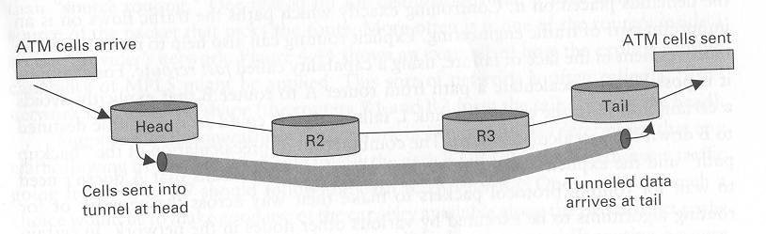
“Layer 2” tunnel
Use MPLS to provide an Internet tunnel between two
  LANs (Ethernet, etc)
  ATM points
Any data can be “wrapped” with a label
  It need not be IP datagrams
  LSRs (R2, R3 in figure) do not look “beyond” the label

Slide 34
Demultiplexing Label
What to do with the packet once it reaches the other side of the tunnel?
  A “demultiplexing” label needs to be added to inform the end-point router what to do with the packet.

Slide 35
E.g., Emulate a VC
ATM cells with a specific VCID come in at the entrance of the tunnel
ATM cells at the end of the tunnel should have the appropriate VCID for the next switch after the router.

Slide 36
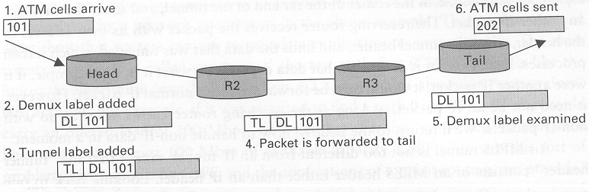

Slide 37
Emulate a VC (steps)
An ATM cell arrives to the input LSR with VCID 101
The head router attaches the demultiplexing label and identifies the emulated circuit
The head router attaches the tunnel label (to reach the tail router)
Routers in the middle forward as usual
The tail router removes the tunnel label, finds the demultiplexing label, and identifies the VC
The tail router modifies the VCID to the next ATM switch value (202) and sends it to the ATM switch.

Slide 38
Label Stacks
The previous example has a stack of two labels
You can have larger stacks of labels in the header.
In the example
  It enables to have a tunnel
  And many types of traffic within the tunnel

Slide 39
“Layer 3” VPN’s
The packet being carried is an IP packet
  Hence the name “layer 3” VPNs
Service provider (see picture next ..)
  Has many customers
  Each customer has many sites
    These sites are linked with tunnels to appear to be one large Internetwork
  Each customer can only reach its own sites
    The customer is isolated from the rest of the Internet and from other customers

Slide 40
