Slide 1
The Performance of Query Control Schemes for the Zone Routing Protocol

Slide 2
Classification of Routing Protocols
Proactive
  Continuously evaluate routes [More control traffic]
  No delay to begin transmission if path unknown
  DV based on DBF, OLSR, WRP
Reactive
  Route Discovery On Demand [Flood n/w with route queries]
  DSR, AODV
Hybrid
  ZRP [Zone Routing Protocol]

Slide 3
ZRP – Motivation
Initiate route determination at limited search cost
Query selected nodes instead of all nodes
Proactive route maintenance is needed only in the node’s local neighbourhood
ZRP uses hybrid proactive/reactive approach

Slide 4
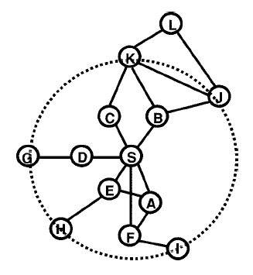
ZRP – Routing Zones
A routing zone is the local neighborhood
within which a node proactively maintains
Routes
The zone radius is a constant
(2 in the figure)
S – node whose zone is depicted
L – outside zone of S
A-F – neighbors of S
G-K – peripheral nodes of the zone
The zone is based on nodal
Connectivity not physical proximity

Slide 5
ZRP – IntrAzone Routing (IARP)
Construction of routing zone requires knowledge of neighbors – provided by MAC / Neighbor Discovery Protocol
IARP can use Link State Routing protocols – OSPF like
Restrict route updates to the scope of node’s routing zone
In this paper, it is a simple timer based Link State Protocol with a TTL field of n for a routing zone radius of n hops

Slide 6
ZRP – IntErzone Routing (IERP) (1)
IERP uses a query-response mechanism to discover routes to nodes outside the routing zone
IERP route query is triggered when destination lies outside routing zone
BorderCast to query selected nodes using BRP [Border Resolution Protocol] – I.e. n/w multicast to border nodes.
Query Packet contains <source, brcast-ID>
Upon Receipt, border node adds its ID to the query
If destination is not in its routing zone, it bordercasts again
Else it sends accumulated path back to the source.

Slide 7
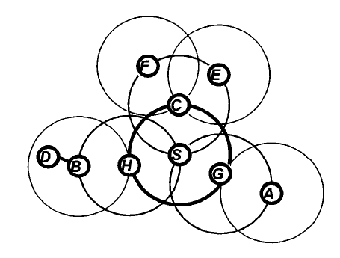
ZRP – IntErzone Routing (2)
S prepares to send
data to D
S checks if D is
in its routing zone
S send Route Query
to its peripheral
nodes G, H, C
H sends to B, B sends
forwarding path S-H-B-D
Best route can be selected from many possible ones

Slide 8
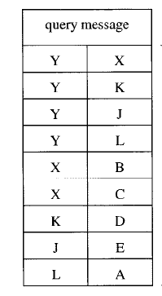
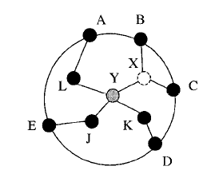
ZRP – Constructing Bordercast tree
Root Directed Bordercast
Adds a per packet
overhead that increases
more than linearly
with zone radius
Works against the
benefits of a hybrid approach

Slide 9
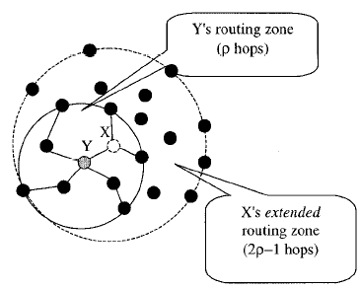
ZRP – Constructing Bordercast tree
Distributed Bordercast
Interior nodes are able to construct bordercast tree (let radius be ρ)
Interior node is ρ-1 hops away from node doing the bdcast.
Interior node has to construct tree of depth ρ of the node doing the bdcast.
I.e., interior node needs to know the topology of an extended routing zone of 2 ρ - 1 hops
Preserves savings of hybrid approach

Slide 10
ZRP – Not Hierarchical
Hierarchical routing relies on strategic assignment of gateways or landmarks in order to break the n/w into subnets
Two nodes in different subnets have to send data up the hierarchy to a subnet common to both
In ZRP, communication outside the routing zone is done in a peer-peer manner
Also results in increase in utilization of the wireless spectrum
ZRP is thus a flat routing protocol

Slide 11
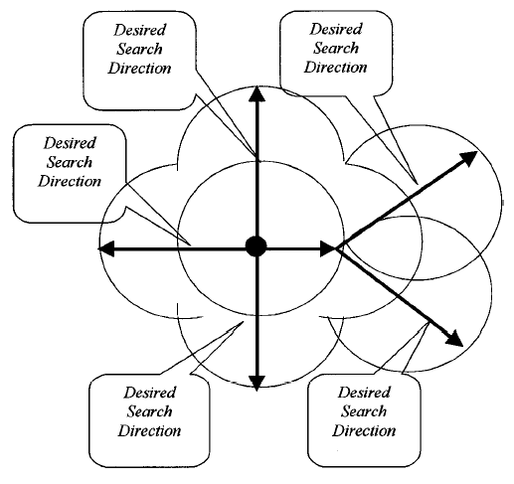
Query Control Mechanisms
Query only selected nodes
Conventional flooding techniques can be modified for ZRP
An entire zone is “covered” by the bordercast of its central node
I.e., a query should not return back to the same zone.
Must direct the search outward.

Slide 12
Query Detection
In order for a node to prevent a query to return into a zone it must first realize that its zone was already queried
We need a “query detection mechanism” for a node to determine if its zone has been queried.
We have two schemes: a direct scheme (QD1), and an indirect scheme (QD2)

Slide 13
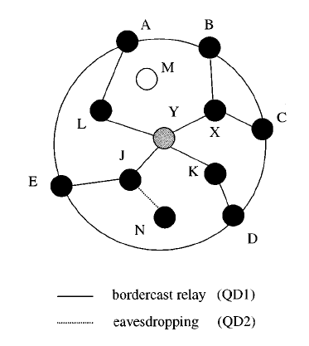
Query Detection (QD1/QD2)

Slide 14
Early Termination (1)
Nodes have information collected from QD1/QD2
They also know the topology of a 2ρ - 1 routing zone.
A node can safely prune any route query messages that stray inward.
Let X be a node that receives the query, (I.e., X is on the bordercast tree), let C and D be the border nodes on the subtree of of X. Then, X does not forward the query if for each of C and D at least one of the following hold:
  X has forwarded the same query to this border node before.
  The border node is an interior node of a zone already covered by the query.

Slide 15
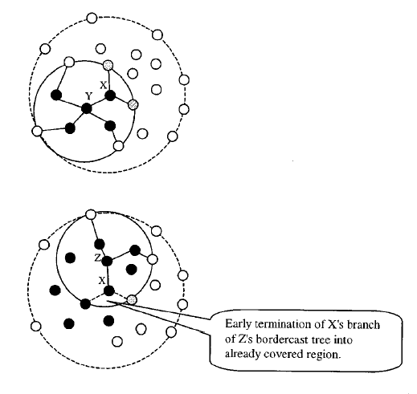
Early Termination (2)

Slide 16
Random Query Processing Delay (RQPD) – (1)
It takes finite time for a query to make its way along the bordercast tree
During this window the routing zone is vulnerable to query overlap from nearby bordercasts
Nearby nodes broadcasting at roughly the same time can cause this problem
Add a random delay for processing route query messages
Does not necessarily introduce delays in query processing

Slide 17
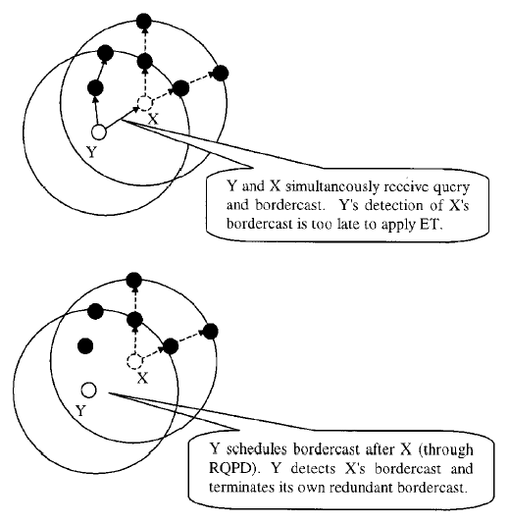
Random Query Processing Delay (RQPD) – (2)

Slide 18
Simulation Results
You are not responsible for them
You can read them in the paper if you are interested.

Slide 19
Results
ZRP Hybrid routing protocol produces much less routing traffic than a pure reactive / proactive scheme
Increasing reactive n/w are suitable for faster n/w & larger routing zones are preferable for slower n/w
Effective query control mechanisms help in reducing both the control traffic and initial setup time for routes
ZRP traffic and Delay are minimized when radius of zone = 3. Traffic is 10% less than and Delay is 60% that of purely reactive routing [@CMR=100query/km]

Slide 20
Comments – (1)
Query methods are useful to reduce control traffic in Interzone routing in the ZRP
In combination with bordercasting, querying selectively covers the n/w without lot of associated control traffic
Scalability is still an issue
CMR is not a sufficient basis for selection of the routing zone radius

Slide 21
Comments – (2)
Query methods improve performance of ZRP
  Bordercasting covers the network with less control messages
  Better utilization of the wireless spectrum
  ZRP - Less scalable than hierarchical/geographical
IERP can choose best route from many routes
QD1: interior nodes access bordercast packets
QD2: requires promiscuous mode of operation
ET: reduces inward flow of packets
RQPD: reduces inward packets due to asynchronous operation

