Slide 1
Stable Internet Routing Without Global Coordination
Lixin Gao, & Jennifer Rexford,

Slide 2
Problem
Too much overhead to maintain path histories (dynamic execution solution)
Difficult to gather all policies and check for cycles in dispute graphs
Can we select some practical guidelines?
  If the guidelines are followed, the system is stable (always reaches a steady state)
Their approach: hierarchies
  You avoid circular conflicts by introducing hierarchies of nodes
  Policies are based on the hierarchy

Slide 3
Background
We need some background before presenting the technique
In particular, the difference between export, import, and route selection policies.

Slide 4
BGP Import, Export, Path Selection
There are three types of policies:
  Import Policy: of the paths offered by my neighbors, which ones will I allow? (i.e. “import” the path)
  Path Selection: given the paths offered by my neighbors which satisfy my import policy, which one do I like the best?
  Export Policy: given my current path, will I tell my neighbor of this path or tell my neighbor that I have no path? (i.e., “export” the path)
Note: in the Griffin paper, import/export policy was not explicit, only “list of allowed paths” was given.
  A path is allowed in an “SPP instance” only if it exists in the export policy of my neighbour and in my import policy

Slide 5
Neighbor Relationships
For each neighbour B of AS A, we have one of the following three relationships:
  B is the service provider of A: in this case, B is the “access point” (or perhaps one of several) over which A accesses the rest of the Internet
  B is a customer of A: in this case, A is the service provider or B
  B is a peer of A: neither is a provider or customer of the other. They are simply “peers” who help each other.

Slide 6
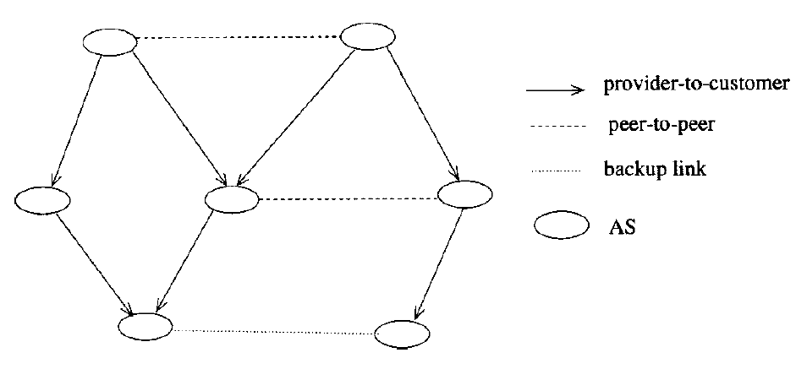
AS relationship graph
Provider-to-customer edges must form a directed acyclic graph (DAG)

Slide 7
Export policy restrictions
Convergence is assured by restricting the export policies
  i.e., you can’t tell everything to everyone

Slide 8
Export policy restrictions - providers
Exporting to a provider: In exchanging routing information with a provider:
  An AS can only export its networks and the routes of its customers.
  However, it can not export routes learned from other providers or peers.
  That is, an AS does not provide transit services for its provider.
Provider-to-customer relationship
Exported path to destination

Slide 9
Export policy restrictions - peers
Exporting to a peer: In exchanging routing information with a peer:
  An AS can only export its networks and the routes of its customers
  However, it can not export the routes learned from other providers or peers.
  That is, an AS does not provide transit services for its peers.
Provider-to-customer relationship
Exported path to destination

Slide 10
In Summary (previous rules)
A node can export to its peer and to its provider only paths that it has learned from its customers
Provider-to-customer relationship
Exported path to destination

Slide 11
Exporting to peers or providers
I say that a route r is a “cust_only” route if for every pair of adjacent nodes (A,B) in the route, A is a service provider of B
Lemma 0 : a node can only export a “cust_only” path to its peers and service providers
g
What can h export to its provider g or its peer x?
  only what it receives from a customer (i.e. i)
What can i export to its provider h?
  only what it receives from its customer (i.e. j)
What can j export to its provider i?
  only what it receives from its customer …
h
x
i
j

Slide 12
Export policy restrictions - customers
Exporting to a customer: In exchanging routing information with a customer:
  An AS can export everything: its customer routes, as well as routes learned from its providers and peers.
  That is, an AS does provide transit services for its customers.
Exported path to destination

Slide 13
Exporting to customers
Lemma 1: A path exported by a provider P to a customer C can only be subsequently exported by providers to their customers (exported via provider → customer edges).
  If g exports the path to h, h cannot export it to y nor to x
    h can export to y or x only a path via a customer
  You can repeat the argument between h and i, etc.
y
g
h
x
i
j

Slide 14
Still not good enough
The following system, even though it satisfies the export policies, is not safe
Every node starts directly to zero
Then choose the neighbour clockwise
Have we seen this one before?
1
(1 3 0)
(1 0)
2
3
(3 2 0)
(3 0)
(2 1 0)
(2 0)
0

Slide 15
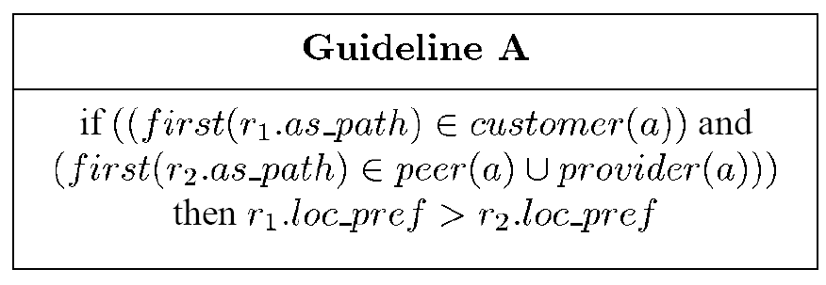
Additional Policy Requirements
Must prefer customer paths over those of peers and providers

Slide 16
The end result
Theorem 1: For a BGP system that has only customer–provider and peer-to-peer relationships (no backup links), if all ASms follow guideline A, then the BGP system is inherently safe (always converges)
We will show that the system cannot have a dispute wheel.

Slide 17
Proof
R_{k}
u₀
R₀
R_{i-1}
u_{i}
u₁
u_{i-1}
e'
u_{k}
R₁
e
Q₀
u₂
Q_{k}
Q₁
Q_{i}
Q₂
0
0
Q_{(i+1)}
Let Q_{i} = eQ’_{i}, and R_{i-1} = R’_{i-1}e’, where e and e’ are edges.
Q_{i}
u_{(i+1)}
R_{i}

Slide 18
Proof (continued)
R_{i-1}
Assume e is provider-customer (u_{i} is provider of w_{i}).
Since u_{i} prefers customer paths, and from the wheel λ(Q_{i}) < λ(R_{i}Q_{i+1})
  This implies the first hop in R_{i} is via a customer x.
  From lemma 0, the entire path R_{i}Q_{i+1} is a cust_only path.
  In particular, first edge in Q_{i+1} is a provider-customer edge
e'
u_{i}
x
R_{i}
u_{i+1}
e
w_{i}
Q_{i}
Q_{i+1}
0
Repeat the argument at u_{i+1}, and you have that all edges on the rim of the wheel are provider-customer edges (actually, all edges in the entire wheel ☺ )
This is not possible (provider-customer graph is acyclic)

Slide 19
Proof (continued, remaining cases)
e CANNOT be provider-customer
Consider e’
  If e’ is peer-to-peer,
    Because w_{i} is not a customer of of u_{i}
    (e is not provider-customer), it is illegal
    for u_{i} to export Q_{i} to its peer v_{i-1}.
  If e’ is provider-customer edge
    Same thing.
  If e’ is a customer-provider edge (This is the only case remaining!)
    v_{i-1} is customer of provider u_{i}.
    From Lemma 1, all of R_{i-1} consists of customer-provider edges
    We can repeat this argument at all nodes, so all R_{i} paths are customer-provider, which violates the acyclic provider graph.
R_{i-1}
u_{i}
u_{i-1}
e'
R_{i}
u_{i+1}
v_{i-1}
e
w_{i}
Q_{i}
Q_{i+1}
0

Slide 20
Remarks
If links and or nodes are added/deleted, or if the policies change, as long as they satisfy the given requirements the system will remain stable.

Slide 21
Multiple BGP speakers
How does a BGP speaker select a route when there are multiple BGP speakers in its AS?
Can the paths be different for BGP speakers in the same AS?

Slide 22
Route fields
Assume an AS A receives a route r from its neighbor B
Route r has several fields
  r.as_path: the list of ASms from B to the destination
  r.MED: if multiple links between A & B, MED determines which one B prefers that A uses (multi-exit discriminator)
  r.community: you can organize ASms into “communities”, and mentioned the community to which this path belongs.
  r.local_pref: how desirable the path is (local preference), and is assigned by A.

Slide 23
Path Selection Policy
  If we have multiple BGP speakers per AS then, path selection is as follows:
    From the paths that satisfy the import policies
      Choose those with the greatest local_pref (I assume local_pref is consistent among all routers in the same AS)
    Then, out of the remaining paths from above choose the ones with least # of AS hops to the destination
    Then, for each neighboring AS B,
      Of the paths chosen above, if multiple paths from B (one per BGP border router), choose the one with lowest MED value (we are left with at most one path per AS neighbor)
    Choose the path whose internal cost to reach the border router is least.

Slide 24
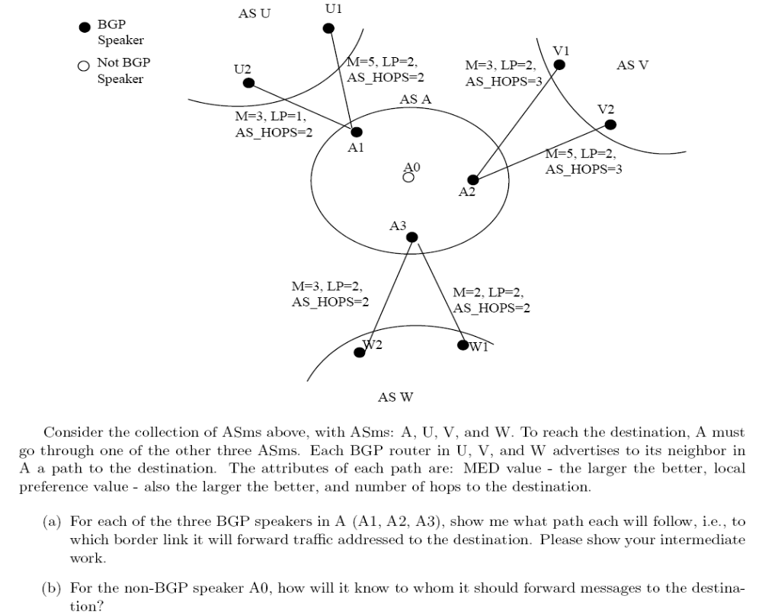
the smaller the better

Slide 25
Answer to previous slide
Path via (A1, U2) is discarded due to its low local preference value of 1 (all other paths have a local pref value of 2)
Next, paths via AS V are also discarded because # AS HOPS is larger than the other ASms
We are left with 3 paths: (A1,U1), (A3,W2) and (A3,W1)
(A3, W2) is discarded since its MED is greater than (A3,W1)
We are left with two paths (A1,U1) and (A3,W1).
Then, A1, A2, and A3 choose their path according to the internal cost to reach the border router
  A1 chooses to go via U1, since reaching the border costs 0 (cost from A1 to A1 is zero, but from A1 to A3 is > 0)
  Similarly, A3 chooses to go via W1
  A2 chooses to go via A1 or A3 depending on which one is closer (in terms of local cost) to A2.

