Slide 1


Machine Learning Model for
Detecting Bug in Inconsistent Code Clones
Chowdhury Ashabul Yeameen Seungtack Baek

Slide 2
The basics
What is Code Clone?

Slide 3
1. Write code
2. Copy and paste
3. Discover error in one copy
4. Fix inconsistently

Slide 4
The Dataset
What input did we use?

Slide 5
Dataset
DejaVu provides a labeled 139 dataset of Firefox source code
BUG: Clear sign of bug
CHECK: Possible bug; requires domain knowledge to verify
SMELL: Code smell. Not good practice and may end up with introducing bug
STYLE: Change of style, say adding braces for single statement if clause
FALSE: Most likely not bug

Slide 6
Dataset
Figured out important features
Manually extracted feature for 130 data points
Automatically fetch distance and cross file data
Map 5-classifications to binary classification
Harmful
Benign

Slide 7
File “A”
nsCOMPtr<nsIPrivateDOMEvent> privateEvent(do_QueryInterface(event));
if (!privateEvent)
return;
privateEvent->SetTrusted(PR_TRUE);
nsRefPtr<nsPLDOMEvent> plevent = new nsPLDOMEvent(content, event);
if (!plevent)
return;
plevent->PostDOMEvent();
Potential Buggy Differences
File “B”
nsCOMPtr<nsIPrivateDOMEvent> privateEvent(do_QueryInterface(event));
if (!privateEvent)
return;
privateEvent->SetTrusted(PR_TRUE);
nsRefPtr<nsPLDOMEvent> plevent = new nsPLDOMEvent(content, event);
if (plevent)
plevent->PostDOMEvent();
Potential Buggy Differences

Slide 8
File “A”
nsTreeBodyFrame::ScrollByLines(PRInt32 aNumLines)
{
if (!mView)
return NS_OK;
PRInt32 newIndex = mTopRowIndex + aNumLines;
if (newIndex < 0)
newIndex = 0;
else {
PRInt32 lastPageTopRow = mRowCount - mPageLength;
if (newIndex > lastPageTopRow)
newIndex = lastPageTopRow;
}
...
Potential Buggy Differences
nsTreeBodyFrame::ScrollByPages(PRInt32 aNumPages)
{
if (!mView)
return NS_OK;
PRInt32 newIndex = mTopRowIndex + aNumPages
* mPageLength;
if (newIndex < 0)
newIndex = 0;
else {
PRInt32 lastPageTopRow = mRowCount - mPageLength;
if (newIndex > lastPageTopRow)
newIndex = lastPageTopRow;
}
...
File “B”
Potential Buggy Differences

Slide 9
Our contribution
So, what did we DO?

Slide 10
Features
For each clone pair, the diff will have certain semantic features, such as…
Introduction of new branch (if, #ifdef, #endif, etc.)
Change in the number of conditions (for same decision)
Change in return statement
Change in branching logic (continue, break, etc)
Introduction of new variable definition
Calling a resource allocation/release function
…

Slide 11
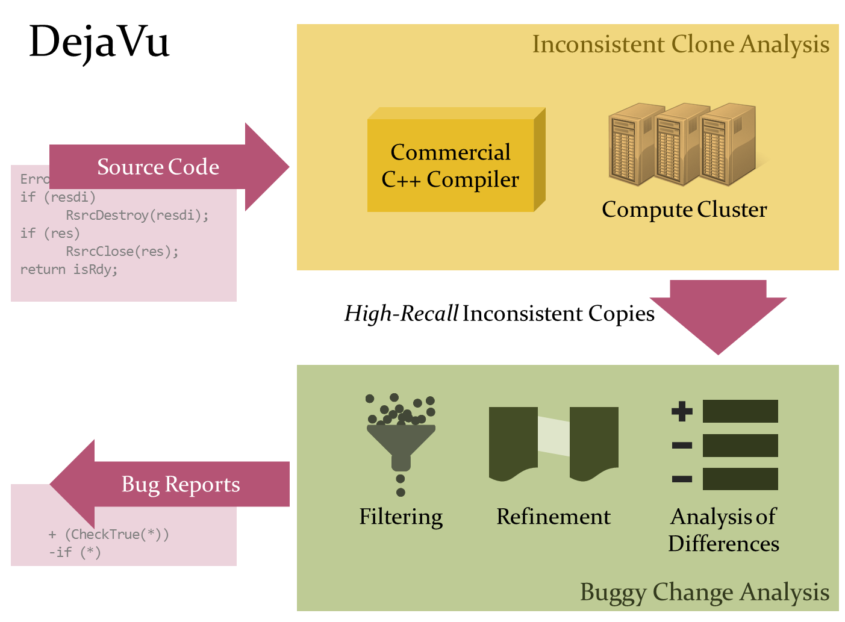
BENIGN
BUGGY
Machine Learning
Reports Contains:
1. Source Code of the candidates
2. Potential buggy difference
3. Other attributes (e.g. TextSim,
Distance, etc.)
ARFF File
1. Source Code of the candidates
2. Potential buggy difference
Extract Features
3. Other attributes (e.g. TextSim,
Distance, etc.)
Extract Attributes

