Slide 1
Chord: A Scalable Peer-to-peer Lookup
Service for Internet Applications
Stoica, Morris, Karger,Kaashoek, Balakrishnan
MIT and Berkeley, SIGCOMM 2001

Slide 2
Motivation
How to find data in a distributed file sharing system?
N₂
N₃
Publisher
N₁
Key=“LetItBe”
Value=MP3 data
Internet
N₅
?
N₄
Client
Lookup(“LetItBe”)
Lookup is the key problem

Slide 3
Centralized Solution (Napster)
N₂
N₃
Publisher
N₁
Key=“LetItBe”
Value=MP3 data
Internet
DB
N₅
N₄
Client
Lookup(“LetItBe”)
Requires O(M) state.
Fast lookup (message exchanges between nodes)
Single point of failure

Slide 4
Centralized: Napster
Simple centralized scheme
How to find a file?
  Use a centralized index database
  Servers contact the index node to upload their list of content at initialization
  To locate a file
    Send a query to central index node
    Get the list of peer locations storing the file
  Fetch the file directly from one of the peers

Slide 5
Distributed Solution (1)
Flooding (Gnutella, Morpheus, etc.)
Worst case O(N) messages per lookup
N₂
N₃
Publisher
N₁
Key=“LetItBe”
Value=MP3 data
Internet
N₅
N₄
Client
Lookup(“LetItBe”)

Slide 6
Flooding: Gnutella
Find a node to get onto the system
How to find a file?
  Broadcast request to all neighbors
  On receiving a request, if don’t have the file
    Re-broadcast to other neighbors
  If have the file, pass the info to the requester

Slide 7
Flooding: Gnutella
Advantages:
  Totally decentralized, highly robust
Disadvantages:
  Not scalable
    Can flood all the network with requests (can use TTL scoping to prevent large scale flooding)

Slide 8
Partial Flooding: FastTrack (aka Kazaa)
Modifies the Gnutella protocol into two-level hierarchy
  Hybrid of Gnutella and Napster
Supernodes
  Nodes that have better connection to Internet
  Act as temporary indexing servers for other nodes
  Help improve the stability of the network
Standard nodes
  Connect to supernodes and report list of files
  Allows slower nodes to participate
Search
  Broadcast (Gnutella-style) search across supernodes
Initially, you register with a centralized server
  You then connect to a supernode from there.

Slide 9
Distributed Solution (2)
Routed messages (Freenet, Tapestry, Chord, CAN, etc.)
Only exact matches
N₂
N₃
Publisher
N₁
Key=“LetItBe”
Value=MP3 data
Internet
N₅
N₄
Client
Lookup(“LetItBe”)

Slide 10
Routing Challenges
Define a useful key nearness metric
Keep the hop count small
Keep the routing tables “right size”
Stay robust despite rapid changes in membership
Chord: emphasizes efficiency and simplicity

Slide 11
Chord Overview
Provides peer-to-peer lookup service:
  Lookup(key) → IP address
  Chord does not store the data
How does Chord locate a node?
How does Chord maintain routing tables?
How does Chord cope with changes in membership?

Slide 12
Chord Properties
Efficient: O(Log N) messages per lookup
  with “high probability”
  N is the total number of servers
Scalable: O(Log N) state per node
Robust: survives massive changes in membership
Proofs are in paper / tech report
  Assuming no malicious participants

Slide 13
Chord ID’s
m bit identifier space for both keys and nodes
Key identifier = SHA-1(key)
Node identifier = SHA-1(IP address)
Both are uniformly distributed
How to map key IDs to node IDs?
Key=“LetItBe”
SHA-1
ID=60
IP=“198.10.10.1”
SHA-1
ID=123

Slide 14
Consistent Hashing [Karger 97]
A key is stored at its successor: node with next higher (or equal) ID
0
K5
IP=“198.10.10.1”
N123
K20
Circular 7-bit
ID space
K101
N32
N90
Key=“LetItBe”
K60

Slide 15
Fast Search, but Big Routing Tables,
Every node knows all other nodes
  requires global information
Routing tables are large O(N)
Lookups are fast O(1)
0
N10
Where is “LetItBe”?
Hash(“LetItBe”) = K60
N123
“Yes”
N32
“have LetItBe?”
K60
N90
N55

Slide 16
Small Routing Tables, but Slow Search
Every node knows its successor in the ring
requires O(N) time
0
N10
Where is “LetItBe”?
Hash(“LetItBe”) = K60
N123
N32
“N90 has K60”
K60
N90
N55

Slide 17
More scalable lookups
Every node knows m other nodes in the ring
  Store them in a “finger table” with m entries or “fingers”
Entry i, 1 ≤ i ≤ m, in finger table of node n points to:
n.finger[i] = successor(n + 2^{i-1})
(i.e. the first node ≥ n + 2^{i-1})
n.finger[i] is reffered to as i^{th} finger of n
N118
N96
N19
N80
80 + 2⁰
80 + 2¹
80 + 2²
80 + 2³
80 + 2⁴
80 + 2⁵
80 + 2⁶

Slide 18
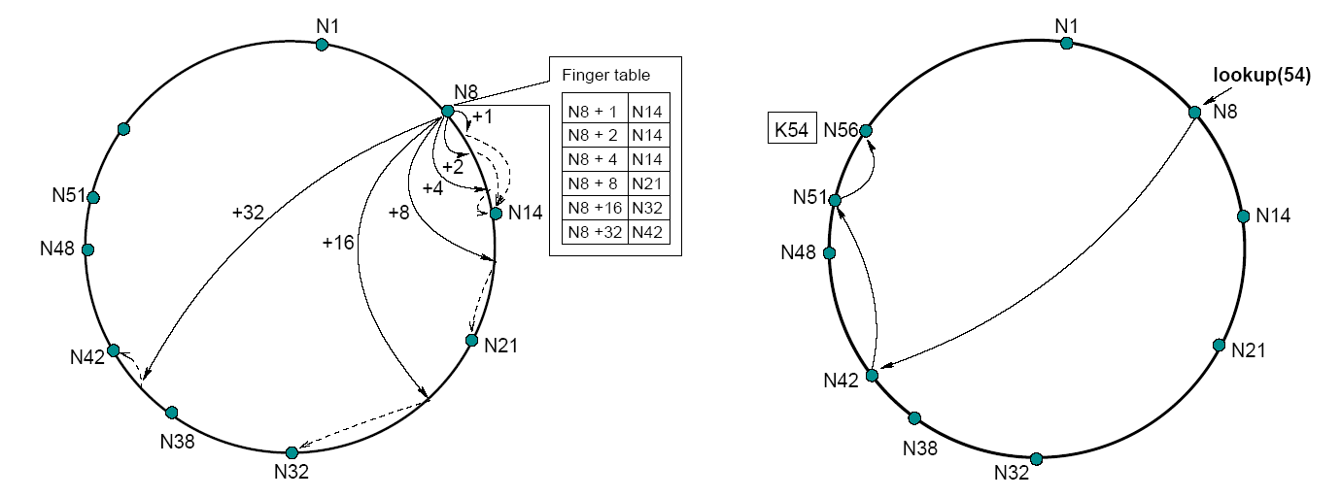
Lookup example
Lookup(15): table says: 12 .. 14 stored in N14, 16 .. 21 stored in N21, so “don’t overshoot”, and forward to N14.
What about looking for 17 (choose N14 or N21)?
  Table says: 16 .. 21 stored in N21
Choose actually N14 (the table may not be accurate!). E.g., node N18 could exist!
Only the successor of each node is assumed to be correct

Slide 19
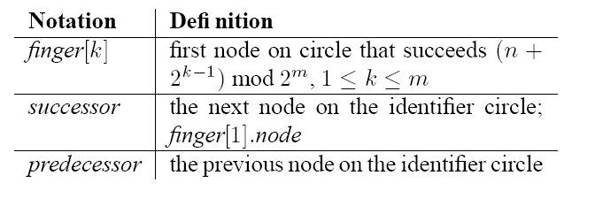
More detail about lookups.
Each node maintains a successor and a predecessor.
Only the successor is assumed to always be valid.
  Well, the predecessor too, but it is not used in searching

Slide 20
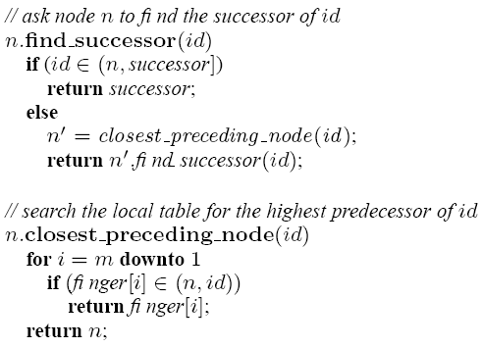
Lookup algorithm
Return finger[3] even if n + 2^(4-1) < id (you cannot assume there are no nodes between n + 2^(4-1) and finger[4])
Note: I am assuming no need to search
for ID = n, finger[1], finger[2], etc
n
id
finger[3]
finger[4]
finger[4] points to where I think key n + 2^(4-1) should be stored (the possible successor of n + 2^(4-1) )
Assume n + 2^(4-1) is here
Never forward query to a node
whose ID is greater than the key ID

Slide 21
Comments on lookup
Two important characteristics of finger tables
  Each node stores info about only a small number of others
  A node does not generally have enough info to directly determine the successor of an arbitrary key k

Slide 22
Lookups are faster
Lookups take O(Log N) hops (with high probability!)
N5
N10
N110
N20
K19
N99
N32
Lookup(K19)
N80
N60

Slide 23
Joining the ring
Three step process: (we discuss detail later)
  Initialize all fingers of new node
  Update successor and predecessor information
    Inform successor and predecessor of new node (so they in turn update their successor and predecessor values)
  Transfer keys from successor to new node
Lazy finger update:
  Periodically verify immediate successor, predecessor
  Periodically refresh finger table entries

Slide 24
Initialize the new node finger table
Locate any node p in the ring
Ask node p to lookup fingers of new node N36
Return results to new node
N5
N20
N36
N99
1. Lookup(37,38,40,…,100,164)
N40
N80
N60

Slide 25
Updating Successor and Predecessor
The successor is identified by finger[1].
Ask the successor about its predecessor.
Tell your new successor you are its predecessor
Tell the predecessor of your successor that you are its successor.
N5
N20
N99
N36
N40
N80
N60

Slide 26
Joining the Ring - Step 3
Transfer keys from successor node to new node
  only keys in the range are transferred
N5
Move keys in range 21..36
from N40 to N36
In the example, move 30
N20
N99
N36
K30
N40
K30
K38
N80
N60

Slide 27
Joining the Ring - Step 3
Failure of nodes might cause incorrect lookup
N80 doesn’t know correct successor, so lookup fails
N120
N113
N10
N102
N85
Lookup(90)
N80

Slide 28
Handling Failures
Only the successor finger is enough for correctness (i.e. must know at all times my successor)
Use successor list
  Each node knows r immediate successors
  After failure, will know first live successor
  Correct successors guarantee correct lookups
Guarantee is with some probability
  Can choose r to make probability of lookup failure arbitrarily small

