Slide 1
Routing in Ad-Hoc Networks
And the DSR Protocol

Slide 2
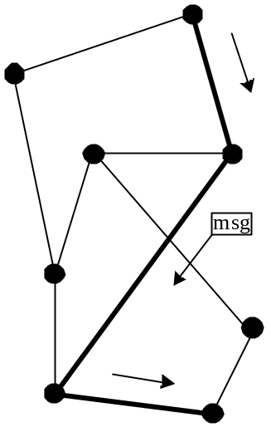
Routing Overview
We have a network with nodes and edges
Goal: how to transfer messages from one node to another
Two orthogonal axis:
  Axis 1: When is the route found? (on-demand or always available)
  Axis 2: Who decides the packet route? (source or intermediate nodes)

Slide 3
Axis 1: When is the route found?
Proactive Protocols
  Continuously evaluate routes
  Table driven
  No latency for data messages (routes are pre-computed)
  Large capacity to keep network information current
    A lot of routing information may never be used!
Reactive Protocols
  On Demand
  Route discovery by some global search
  Bottleneck for first data messages due to latency of route discovery
    May not be appropriate for real-time communication

Slide 4
Axis 2: Who determines route?
Destination (“hop-by-hop”) routing
  Source specifies only destination in message header: D
  Intermediate nodes look at destination in header, consult internal tables to determine appropriate next hop
  Like postal service – specify only the final destination on an envelope, and intermediate post offices select where to forward next…
Source (“path”) routing
  Source specifies entire route: places complete path to destination in message header: A – B – C – D
  Intermediate nodes just forward to specified next hop: B would look at path in header, forward to C
  Like airline travel – get complete set of tickets to final destination before departing…

Slide 5
Comparison
Source routing
  Moderate source storage (entire route for each desired dest.)
  No intermediate node storage (well…, we do need caching for efficiency though)
  Higher data message overhead (entire path in message header)
Destination routing
  No source storage
  Need intermediate node storage (table w/ routing instructions for destinations.)
  Lower data message overhead (just destination in header)

Slide 6
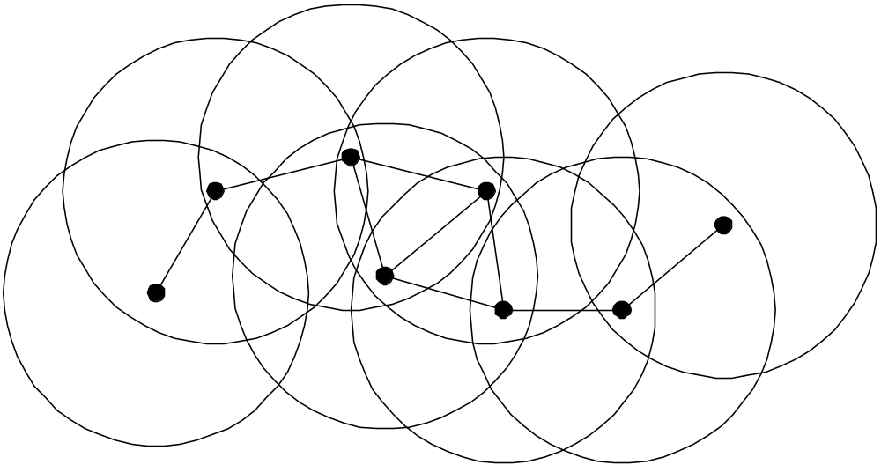
Mobile wireless hosts
  May directly communicate with only the subset within range at given time
  Any pair of nodes can communicate via multiple hops.

Slide 7
Mobile Ad-Hoc Network (MANET)
Collection of mobile nodes forming a network
No centralized administration or standard support services
Highly co-operative, each host is an independent router
Hosts use wireless RF transceivers as network interface
Network topology is dynamic (frequent network changes – links break, nodes come and go)
Possible unidirectional links
Conferences/Meetings
Search and Rescue
Disaster Recovery
Automated Battlefields

Slide 8
Ad Hoc Routing Protocols
Standardization effort led by IETF Mobile Ad-hoc Networks (MANET) task group
  http://www.ietf.org/html.charters/manet-charter.html
  9 routing protocols in draft stage, 4 drafts dealing with broadcast / multicast / flow issues
Other protocols being researched
  utilize geographic / GPS info, ant-based techniques, etc.

Slide 9
Conventional Routing Protocols?
Mostly proactive
Not designed for highly dynamic, low bandwidth networks
“Count-to-infinity” problem and slow convergence
Loop formation during temporary node failures and network partitions
Protocols that use flooding techniques create excessive traffic and control overhead (e.g., link-state routing, where all nodes do a periodic broadcadst)

Slide 10
Leading MANET Contenders
“on demand” (reactive) protocols: route information discovered only as needed
  DSR: Dynamic Source Routing
    Source routing protocol
  AODV: Ad-hoc On-demand Distance Vector Routing
    “Hop-by-hop” protocol
ZRP: Zone routing protocol, a mixture of reactive and proactive.
OLSR: optimized link-state routing

Slide 11
Dynamic Source Routing (DSR)
On demand: No periodic router advertisements
Source routing: to send a packet to another host, the sender constructs a source route in the packet’s header
Caching: each mobile host participating in the ad hoc network maintains a route cache in which it caches source routes (avoid further router discoveries)
If no route found in the cache, the sender may attempt to discover one using the route discovery protocol.
Host monitors the correct operation of a route in use, we call this route maintenance

Slide 12
Two Main Components
route discovery
  the mechanism by which a sending node S obtains a route to destination D
route maintenance
  the mechanism by which a sending node S detects that the network topology has changed and its route to D is no longer valid

Slide 13
Route Discovery in DSR
Y
Z
S
E
F
B
C
M
L
J
A
G
H
D
K
I
N
Represents a node that has received RREQ for D from S

Slide 14
Route Discovery in DSR
Broadcast
Y
[S]
Z
S
E
F
B
C
M
L
J
A
G
H
D
K
I
N
Represents transmission of RREQ
[X,Y] Represents route record stored in RREQ

Slide 15
Route Discovery in DSR
Y
[S,E]
Z
S
E
[S,B]
F
B
C
M
L
J
A
[S,C]
G
H
D
K
I
N
Node H receives packet RREQ from two neighbors:
potential for collision

Slide 16
Route Discovery in DSR
Y
Z
S
E
F
[S,E,F]
B
[S,B,A]
C
M
L
J
A
[S,B,H]
G
H
D
K
[S,C,G]
I
N
C receives RREQ from G and H, but does not forward
it again, because C has already forwarded RREQ once

Slide 17
Route Discovery in DSR
Y
Z
S
E
F
[S,E,F,J]
B
C
M
L
J
A
G
H
[S,B,H,I]
D
K
I
[S,C,G,K]
N
J and K both broadcast RREQ to D
Their transmissions may collide at D

Slide 18
Route Discovery in DSR
Y
Z
S
E
[S,E,F,J,M]
F
B
C
M
L
J
A
G
H
D
K
I
N
D does not forward RREQ, because D is the intended target

Slide 19
Route Reply in DSR
Y
RREP [S,E,F,J,D]
Z
S
E
F
B
C
M
L
J
A
G
H
D
K
I
N
Represents RREP control message
It is “source-routed” towards the source
(path D, J, F, E, S)
The data part contains the path from S to D
(path S, E, F, J, D)

Slide 20
RREP header and data
The header of the RREP includes the nodes the message must traverse (i.e. the path to reach the source)
The data part of the RREP contains the path from the source to the destination
  This tells the source how to reach the destination
These two often the same path (but backwards)
  However, this is not always the case!

Slide 21
DSR route discovery – basic idea
S broadcasts route-request to D
  route request contains:
    route record (path followed),
    request id (sequence number)
each node forwards request by adding own address and re-broadcasting
requests propagate outward until:
  target is found, or
  a node that has a route to D is found

Slide 22
Forwarding Route Requests
A request is forwarded if all below hold:
  Receiving node is not the destination
  Receiving node is not already listed in recorded source route
    Avoid routing loops (however, a node will not add an entry to its cache if it has a loop anyway, so this is useful but not crucial)
  Receiving node has not seen request with same sequence number
    Forward each request only once (for efficiency)
  IP TTL field may be used to limit scope
Destination D copies route into a Route-reply packet and sends it back to S

Slide 23
Route Cache
All routes learned by a node are kept in Route Cache
  Reduces cost of route discovery
What to cache?
  Cache the route record of each route-request
  Cache the path in each route-reply
  Cache the path in each data packet.
When to remove cache entries
  Entries have limited lifetime – it is not specified how to determine this.

Slide 24
Early Route-Replies
If intermediate node receives RReq for D and has entry for D in route cache, it responds to RReq and does not propagate RReq further
  Reduces the overhead of route requests
  Encourages “expanding ring” search for route

Slide 25
Unidirectional Links
With unidirectional links, path from S to D is not the same as from D to S
Destination may need to discover a route to the source to deliver RREP
  If a route exists in its cache, use it
  O.W. piggyback Route Reply onto new Route Request
    This is flooded towards the source !!
    This should not be terminated by an early route reply, i.e., it should broadcast all the way to the source.

Slide 26
Unidirectional Links - Caching
If your network allows unidirectional links, it limits caching
Assume we have a path A --> B --> C --> D --> E
“A” sends data packets to “E”
What will “C” cache?
  If the network allows unidirectional links, you only cache the path C --> D --> E
  If the network only allows bidirectional links, you also cache the path C --> B --> A

Slide 27
Route Discovery Summary
On demand discovery of source routes
Route requests sent to local neighbors and if no reply, via controlled flooding
Cache as much as you can

Slide 28
Sending Data
Check cache for route to D
If route exists then
  if reachable in one hop
    send packet
  else
    insert routing header to D and send
If route does not exist, buffer packet and initiate route discovery

Slide 29
Route Maintenance
Used when link breakage occurs
Link status/breakage may be detected using:
  link-layer ACKs (MACAW RTS/CTS/ACK),
  “passive ACKs”
    overhearing the xmission of your packet at the next hop
  DSR ACK request
    Send a DSR packet asking for an ACK
    If A->B unidirectional, the ACK from B to A may arrive via a different path.

Slide 30
Router Error Messages
Route Error message sent to source of message being forwarded when the break is detected
Intermediate nodes “eavesdrop”, adjust cached routes (remove routes with link B – C )
Source deletes route; tries another if one cached, or issues new Route Request
  Source piggybacks Route Error on the new Route Request to clear intermediate nodes’ route caches
  This prevents return of invalid route via early reply
X
S
A
B
C
D

Slide 31
How to send Route Error Messages?
If MAC protocol is bidirectional, use reverse path as data
O.W. if have an entry in the cache use it
O.W. piggyback it on a RREQ towards the source

Slide 32
The Optimization in DSR
Full use of the Route Cache
Piggybacking on Route Discoveries
Reflecting Shorter Routes
Improved Handling of Errors

Slide 33
Full Use of Route Cache
We described already that you cache all you can
You can keep the cache at node A in the form of a tree rooted at A
For new route A → E, only <C,E> is enough
Less information, but we use less memory
A
B
C
D
E

Slide 34
Piggybacking on Route Discoveries
Recall that if sender doesn’t have a route cached to the destination host, it initiates a route discovery
  This delays the transmission of the first packet
The delay for route discovery, and total number of packets transmitted, is reduced by allowing data to be piggybacked on route request packet
Use piggyback also when sending route reply

Slide 35
Reflecting Shorter Routes
Assume two hosts communicate using cached routes
We can use shorter routes if nodes move sufficiently closer together
Improvement
  Let host operate in promiscuous receive mode
  D hears the transmission from B to C, ( )
  and sends an unsolicited route-reply ( )to the source
S
B
C
D
Mobile host D notices that the route can be shortened

Slide 36
Improved Error Handling
If a destination is not reachable, a Route Reply is not received.
  If the application wants to send a lot of data to this destination, then we will generate many failed RREQ, consuming lots of bandwidth.
  Use exponential backoff, if a RREQ, then wait twice as long before sending another one.
Operate in promiscuous mode
  Learn as much as possible from Route-Error messages.

