Slide 1
CS 414 - Object-Oriented Design Fall 2020
P3

Slide 2
P2 Objectives (for reference only - remove before presenting)
User stories and tasks /1.5
Kanban board /0.5
Design artifacts /2.0
Source code /3.0
Development manual /0.5
Traceability link matrix /1.5
Output of scrum ceremonies /1.0
Presentation /3.0
Peer evaluation /2.0
Total /15.0

Slide 3
Meet the Team!
Unspecified Behavior
Adam Anderson
Brent Staab
Keabeth Gonzales
Kai Griem
Maddie Mihevc (Scrum Master)

Slide 4
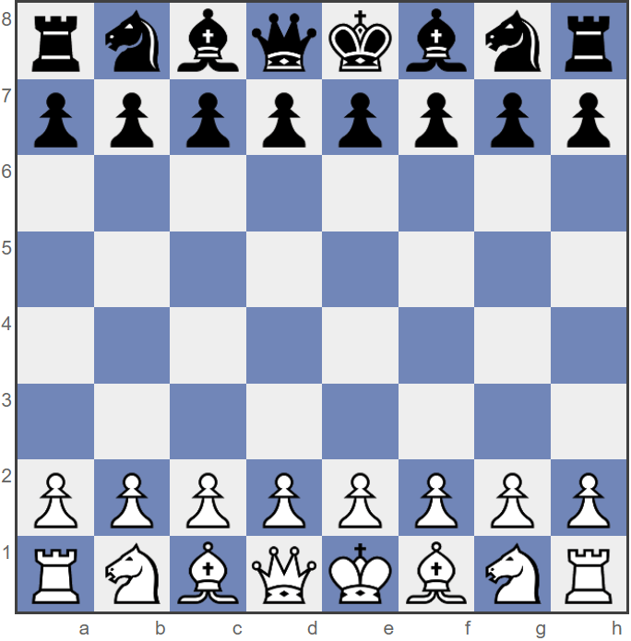
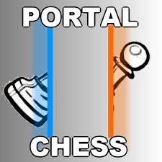
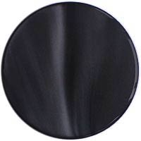



Description of Portal Chess
Portal chess is a derivative of the classical chess game. The main difference is the introduction of two new ‘fairy pieces’ called portals which allow the pieces to move in new and exciting ways.
Image from: https://images.app.goo.gl/dHWwR21iMgRP1wJz5

Slide 5
Rules
There are several types of Portal chess, but we are planning on implementing the version described by wika57 on his YouTube video. https://www.youtube.com/watch?v=Zq4pJw_nk_0
Setup
The basic rules of classical chess apply
Pieces have the same restrictions, and the overall objective is the same (checkmate the King)
Players place their portals before the game starts
White pieces can only go in row 4
Black pieces can only go in row 5
You can only control your own-colored portal

Slide 6
Rules - continued
Game Play
A piece passes through a portal unless the portal is blocked
A piece can be blocked from entering a portal if a piece of the same color is on the other side.
A piece can take another piece by using the portal
Both portals cannot be occupied at the same time
A piece can check/checkmate people using the portal
A piece must exit the portal in the direction it traveled into the portal
A portal can be moved onto a piece causing it to teleport. *Unless the other portal is occupied*
A player has a choice to move a chess piece or the portal piece in one turn, not both.
If your own chess piece is occupying a portal, you cannot pass another one of your own pieces through the unoccupied portal
A piece can enter either portal regardless of color
Portals can not occupy the same square
A portal can be moved regardless of whether it is occupied or not, the occupying piece does not move with the portal
If a piece occupies one portal and a whole turn phase end without the piece moving from the teleporter it does not teleport.
A Knight can jump over a portal piece
A pawn can become a queen by using a portal

Slide 7
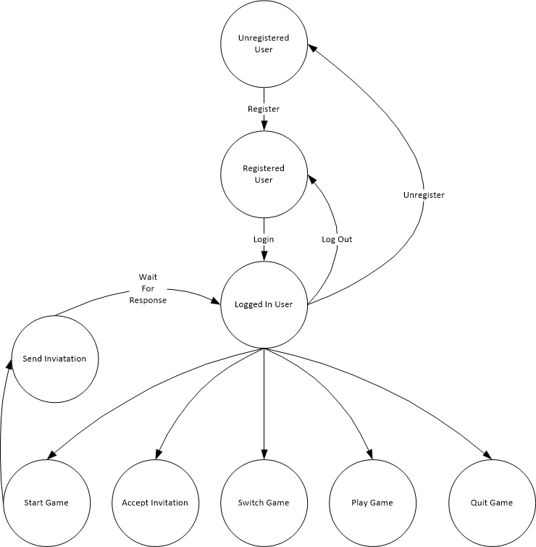
Actors and Stakeholders
Unregistered Users
No user information stored
Not allowed to play a game
Registered Users
Full user profile stored
Includes Name, e-mail, active game(s), game history and results
Logged in user
View profiles
Can play one or more games
Can invite players to a game
Can accept invitations to a game
Play/Quit a game
Unregister

Slide 8
Product Choices - Game
Will not support ‘En passant’ https://en.wikipedia.org/wiki/En_passant
Person who starts the game will make the first move
First person to respond to a game request will be the 2nd player
A game will terminate if a player does not make a move within a given amount of time
Any player who quits will be given a loss and their opponent will will get a win

Slide 9
Retrospective
TODO

Slide 10
Traceability Link Matrix
File is located in https://github.com/bstaab/cs414-f20-UnspecifiedBehavior/blob/master/Documents/TraceabilityLinkMatrix.xlsx
The backend has been updated
Needs front end updated – someone on front end should due this

Slide 11
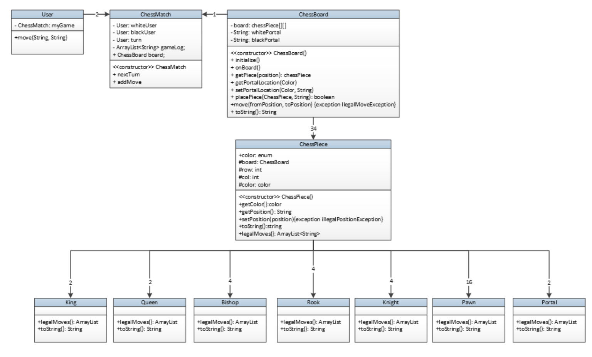
Class Diagram

Slide 12
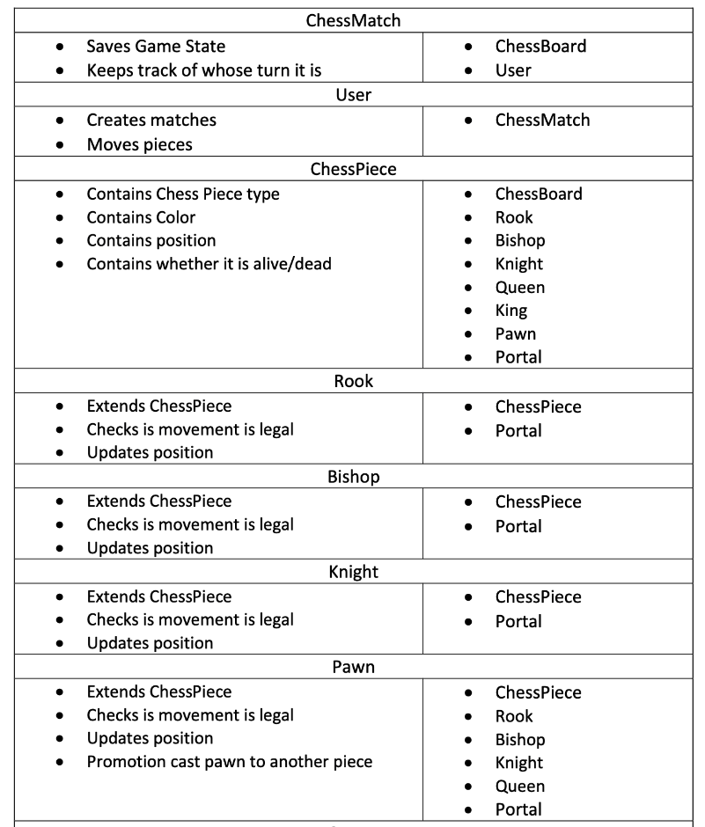
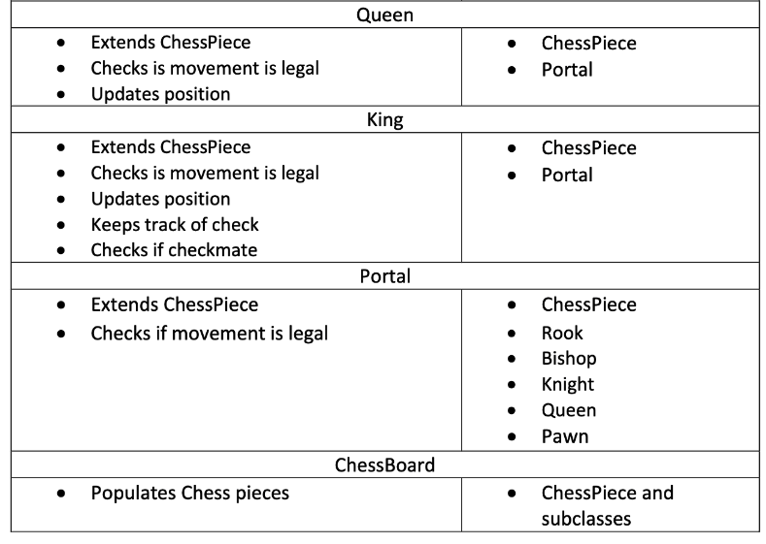
CRC Cards

Slide 13
User Stories and Tasks

Slide 14
Acceptance Criteria

Slide 15
Kanban Board
Need a snapshot of our last board with updated tasks

Slide 16
Output of Scrum Ceremonies

Slide 18
Rules
There are several types of Portal chess, but we are planning on implementing the version described by wika57 on his YouTube video. https://www.youtube.com/watch?v=Zq4pJw_nk_0
Setup
The basic rules of classical chess apply
Pieces have the same restrictions, and the overall objective is the same (checkmate the King)
Players place their portals before the game starts
White pieces can only go in row 4
Black pieces can only go in row 5
You can only control your own colored portal

Slide 19
Description of Portal Chess
Portal chess is a derivative of the classical chess game. The main difference is the introduction of two new ‘fairy pieces’ called portals which allow the pieces to move in new and exciting ways.
Image from: https://images.app.goo.gl/dHWwR21iMgRP1wJz5

Slide 20
Rules - continued
Game Play
A piece passes through a portal unless the portal is blocked
A piece can be blocked from entering a portal if a piece of the same color is on the other side.
A piece can take another piece by using the portal
Both portals cannot be occupied at the same time
A piece can check/checkmate people using the portal
A piece must exit the portal in the direction it traveled into the portal
A portal can be moved onto a piece causing it to teleport. *Unless the other portal is occupied*
A player has a choice to move a chess piece or the portal piece in one turn, not both.
If your own chess piece is occupying a portal, you cannot pass another one of your own pieces through the unoccupied portal
A piece can enter either portal regardless of color
Portals can not occupy the same square
A portal can be moved regardless of whether it is occupied or not, the occupying piece does not move with the portal
If a piece occupies one portal and a whole turn phase end without the piece moving from the teleporter it does not teleport.
A Knight can jump over a portal piece
A pawn can become a queen by using a portal

