Slide 1
Operation Systems
Inter/Intra-process communication

Slide 2
Summary
We are going to cover:
Difference between a thread and a process
Different thread types (main/background)
Inter-process communication
Client\Server
Sync\Async
Publish and subscribe
Buses\Brokers

Slide 3
Process vs Thread
Process
Is an executing instance of an application. For example, when you double-click the Microsoft Word icon, you start a process that runs Word
Thread
Is a path of execution within a process. Also, a process can contain multiple threads. When you start Word, the operating system creates a process and begins executing the primary thread of that process.
A thread is often referred to as a “lightweight process”

Slide 4
Process vs Thread
Threads are usually used for small tasks, processes are usually used for more heavyweight tasks i.e. the execution of applications
Threads within the same process share the same memory whereas different processes do not!
This enables the sharing of data structures
Allows inter-thread communication

Slide 5
Multi-threading
Having threads within a process allow for multi-threading
Hence you can have multiple things go on in the process at the one time
Best demonstrated by the following examples:
Single threaded
Multi-threaded

Slide 6
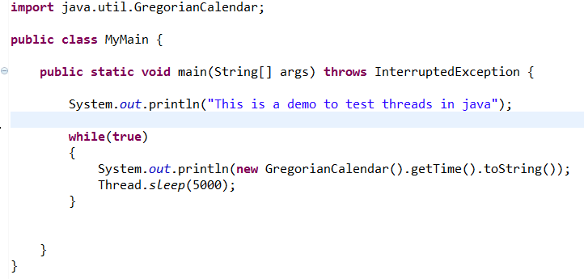
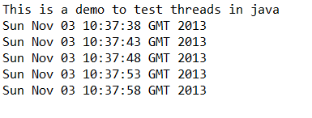
Single-threaded example
Note stalling of main thread
While loop
Use of InterruptedException

Slide 7
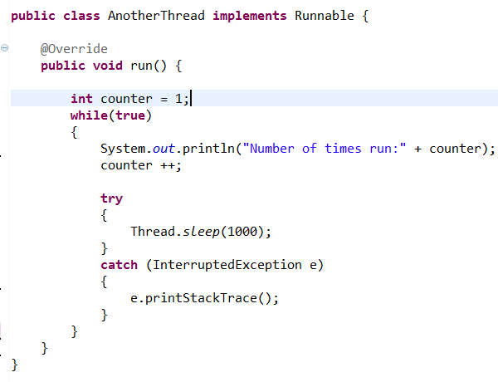
Runnable class – i.e. separate thread
Use of Runnable interface
Run method
While loop
Incremental counter
Standalone – no output
Try/Catch this time

Slide 8
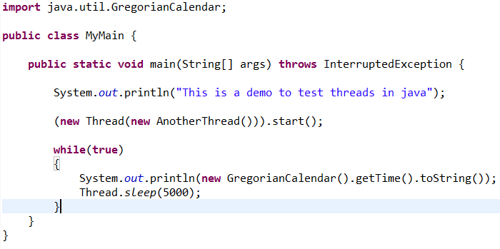
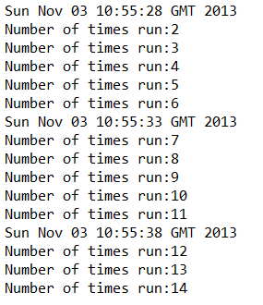
Multi-threaded application
Spawning off a new thread called AnotherThread and starting it
This automatically calls the new threads run method
Known as a background thread
Main thread known as a foreground thread

Slide 9
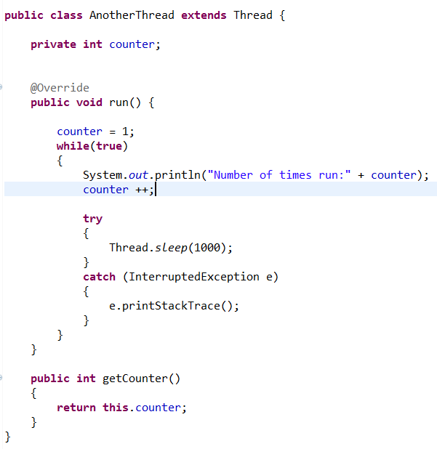
Sharing state across multiple threads
Extends Thread instead of implementing Runnable
New public get counter method
This AnotherThread class can be instantiated now by another class

Slide 10
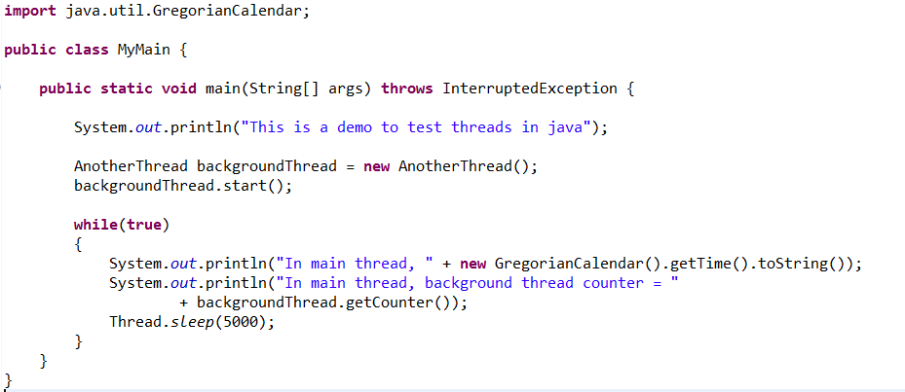
Sharing state across multiple threads
We can now instantiate the thread and then start it
We can get access to the counter value via the getCounter() method
This demonstrates sharing across multiple threads

Slide 11
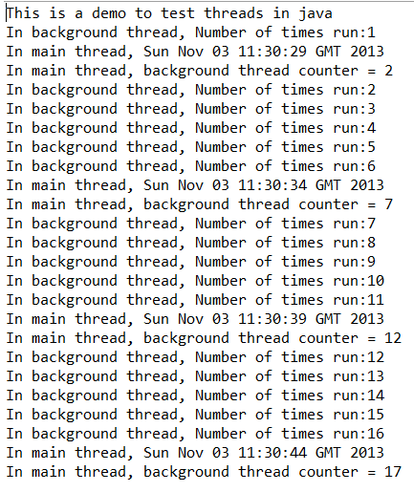
Output from multi-threaded app sharing state

Slide 12
Communicating across processes
Processes within a system can be independent or co-operating
Co-operating processes can affect or be affected by other processes
Reasons to co-operate:
Information sharing
Computation speedup
Modularity
Convenience

Slide 13
Co-operating processes need inter-process communication (IPC)
Different types of IPC
Shared memory
Signals
Pipes
Shared resource
Sockets
Message Passing

Slide 14
Shared memory
Shared memory is memory that may be simultaneously accessed by multiple programs with an intent to provide communication among them or avoid redundant copies
Shared memory is an efficient means of passing data between programs
Depending on context, programs may run on a single processor or on multiple separate processors.
Using memory for communication inside a single program, for example among its multiple threads, is also referred to as shared memory.

Slide 15
IPC - Signals
Signals are one of the oldest inter-process communication methods used by operating systems.
They are used to signal asynchronous events to one or more processes.
A signal could be generated by a keyboard interrupt or an error condition such as the process attempting to access a non-existent location in its virtual memory.
Processes can choose to ignore most of the signals that are generated
Sample signal in UNIX:
SIGFPE A Signal for a floating point exception
Default action for process that receives this is to dump memory and exit

Slide 16
IPC - Pipes
Can vary per operating system but are unidirectional byte streams which connect the standard output from one process into the standard input of another process
E.g. ls | pr | lpr
Pipes the output from the ls command listing the directory's files into the standard input of the pr command which paginates them. Finally the standard output from the pr command is piped into the standard input of the lpr command which prints the results on the default printer
Would have already seen this concept in powershell also

Slide 17
Shared resource
A resource accessible to both processes is used to communicate:
File
A process can store data in a file which can be accessed by another process. Note that changes can be listened for
Memory
Multiple processes given access to the same memory allowing all to change it and read changes made by other processes
Database
A process can store data in a database which can be accessed by another process. Note that changes can be listened for
Queue
A process can store data in a queue which can be accessed by another process. Note that changes can be listened for

Slide 18
IPC - Sockets
IPC over the network
Best demonstrated by an example. Will use the client-server paradigm, which is roughly
One program, called the server blocks waiting for a client to connect to it
A client connects
The server and the client exchange information until they're done
The client and the server both close their connection

Slide 19
IPC - Sockets
The only pieces of background information you need are:
Hosts have ports, numbered from 0-65535. Servers listen on a port. Some port numbers are reserved so you can't use them when you write your own server.
Multiple clients can be communicating with a server on a given port. Each client connection is assigned a separate socket on that port.
Client applications get a port and a socket on the client machine when they connect successfully with a server.

Slide 20
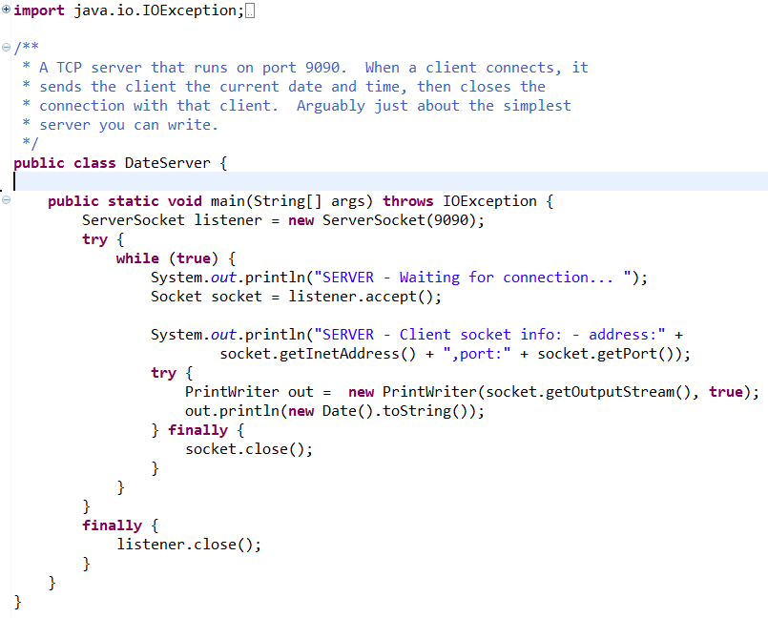
IPC – Socket Example (Server)

Slide 21
IPC – Socket Example (Server)
Note the following:
Use of ServerSocket on port 9090
Call to the ServerSocket accept method – thread pauses here
If connection received, will printlient Sockets IP address and port
Via a PrintWriter, sends a generated date back to the client
Closes Socket connection and awaits the next client
When program exists, closes ServerSocket connection

Slide 22
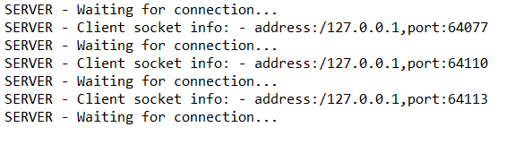
IPC – Socket Example (Server)
Sample output

Slide 23
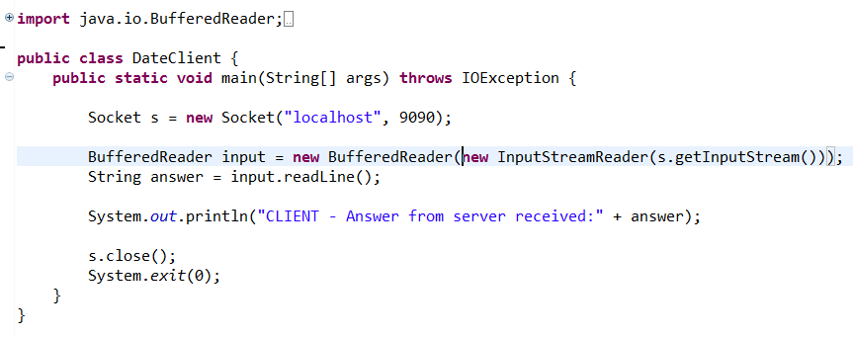
IPC – Socket Example (Client)
Uses a single socket connection, on localhost over port 9090
Reads in the servers response via BufferedReader and prints result
Closes Socket and exits

Slide 24
Message Passing
Message passing is the paradigm of communication where messages are sent from a sender to one or more recipient
When designing a message passing system several choices are made:
Whether messages are transferred reliably
Whether messages are guaranteed to be delivered in order
Whether messages are passed
one-to-one (unicast),
one-to-many (multicast or broadcast),
many-to-one (client–server),
many-to-many (All-to-All).
Whether communication is synchronous or asynchronous

Slide 25
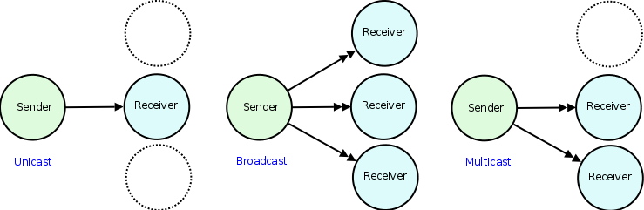
Uni\Multi\Broadcast
Unicast sends to a single destination only
Broadcast sends to everyone
Multicast sends to a selection of multiple defined destinations

Slide 26

Client\Server and Many-to-many
Client\Server
1 server servicing many clients
DateTime socket client server
Many-to-many
All nodes can communicate with all other nodes
Very complex to maintain

Slide 27
Broker\Bus hybrids
A broker or a bus enable you to have a hybrid of message paradigms
E.g. I want node A to broadcast message X to everybody
E.g I want node B to only send message Y to node Q

Slide 28
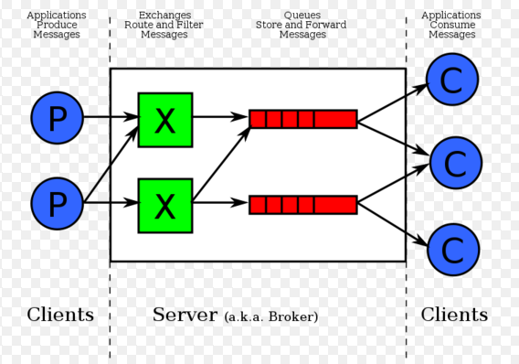
Broker (RabbitMQ example)
Producer processes
Consumer processes
Exchanges are used for routing producer messages
Queues are used to service consumers

Slide 29
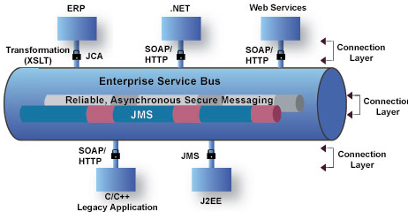
Bus (ESB example)
Bus responsible for routing messages to their destination
Note the different types of platforms/languages etc that can communicate with each other

Slide 30
Publish/Subscribe
Note that with both bus and broker, the common message paradigm of publish and subscribe is used
Publisher (Also known as the producer) publishes a message to the bus/broker
Subscriber (Also knoen as consumer) subscribes interest to that type of message.
The bus/broker will route the all appropriate messages to their associated subscribers
Note: There may be no subscribers, in which case the message is just dropped on the floor!

Slide 31
Sync/Async Messaging
Sync (Synchronous messaging)
A thread that sends a sync message is paused until it gets a sync response message back
Sync messages are reliable
Use for critical messaging
Async (Asynchronous messaging)
A thread that sends an async message is free continue on processing once sent
Async messages are not reliable
Async message responses are handled be a callback function that is in a completely separate thread
Use for metric values, logging etc (non-critical messaging)

